Slide 1
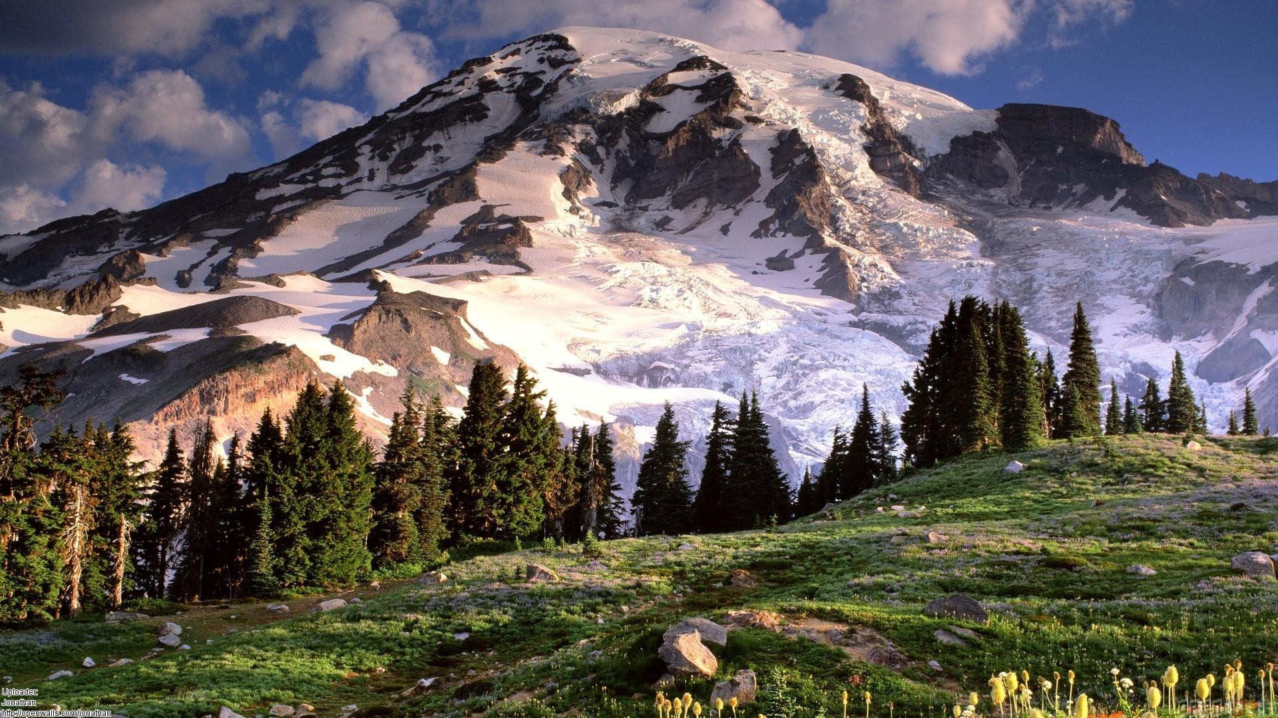
Click and drag the circle to uncover the message beneath

Slide 2
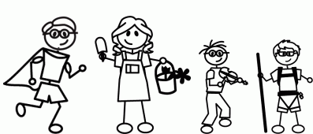
Happy Fathers Day!
Hi Dad,
I miss you very much. You have been a superhero to many of us in the family, and we love you for that. Thank you so much for everything you have done for us.
I think about you and the family daily. Rest assured that I am very happy being here in the northwest. I have taken this trip to the northwest to advance my career, discover more about myself, learn how to manage life, and I certainly have accomplished them to quite an extent. But, I will never forget to be there to take care of you and mom in the future, just as you guys have for me. You, Mom, and my brother are all extremely important people to me, and I will always remember that.
You are and will always be the father that I love so very much. Happy Fathers Day, Dad.
Love,
Frank
PS – the mountain at the front is Mt. Rainier. I hope to take you guys there when you come. It’s a beautiful sight. Also, I learned React.js by making this gift. :D. I hope you like it! Love you, Dad. I cant wait to see you soon!

