Slide 1
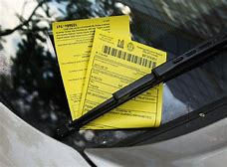
Toronto Parking Infraction
Tickets
Chao Zhao
Damir Galiullin
Hao Chu
Mugu Thangarasa
2019-Nov-13

Slide 2
Motivation
Motivation: Vehicle is now a daly need, especially for people living in areas with inconvenient public transit. With the amount of private cars increasing, we believe the tendency of violations related with parking increases due to a lack of parking area provided and increasing parking fees.
Under this situation, our team is interested in the parking infractions in Toronto area.
We believe the amount of infractions is related to the seasonal weather, i.e. winter, more tickets issued than in summer due to the cold weather.
We also believe downtown area has a higher infraction rate than uptown and other suburb areas with the fact that traffic in downtown is heavier, roads are more complicated and you need to pay wherever you park.
Also, income has some relationship with the parking tickets amount
Notes:
Around 2 million tickets are issued per annum, which brings considerable revenue to the City (avg $50*2mln=$100mln approx)

Slide 3
Questions & Data
How the weather conditions impact on the number of issuing ticket fines?
If number of parking tickets depends on household income distribution by area?
In order to answer the two questions, we need the parking violation data by geographic data of Toronto.
The parking violation data can be found in the Open Data-City of Toronto, refer the link: https://open.toronto.ca/dataset/parking-tickets/
The income data can be found in the Open Data-City of Toronto, refer the link: https://open.toronto.ca/dataset/ward-profiles-2018-25-ward-model/
The geographic data is used to plot the parking violation “heat map”, and we basically use mapbox API to get the data. And overlapping all the addresses where violations occurred with the map.

Slide 4
Data Cleanup & Exploration
Three Year’s parking data for year 2016 to 2018
Fill NaN values with blank for addresses with no unit number
Grouped by dates and calculated tickets amount by seasons and months
Extract all the addresses base on dates for year 2018
Collected data from three weather stations
Combined all data sets and got mean weather data for this project
Mapbox API calls and data transfers
Toronto Open Data API
Toronto Income source data is based on 2016 census and show income by average or median of 25 wards/areas

Slide 5
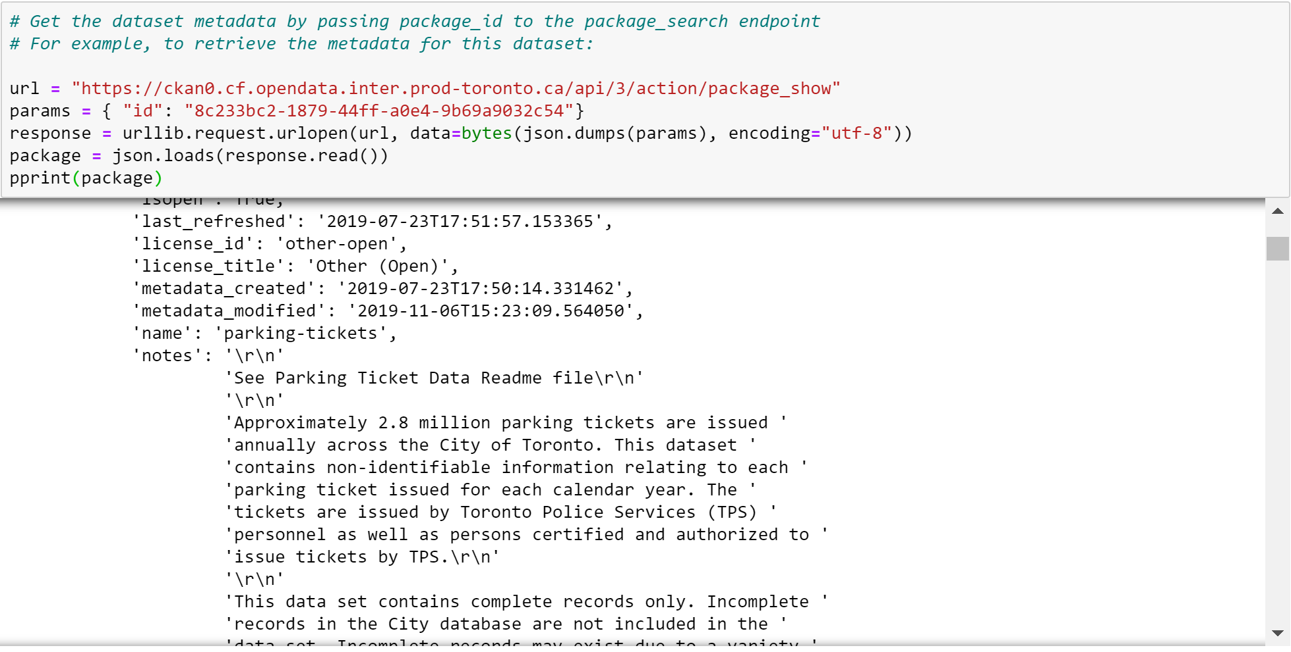
Get the parking data from Toronto open data

Slide 6
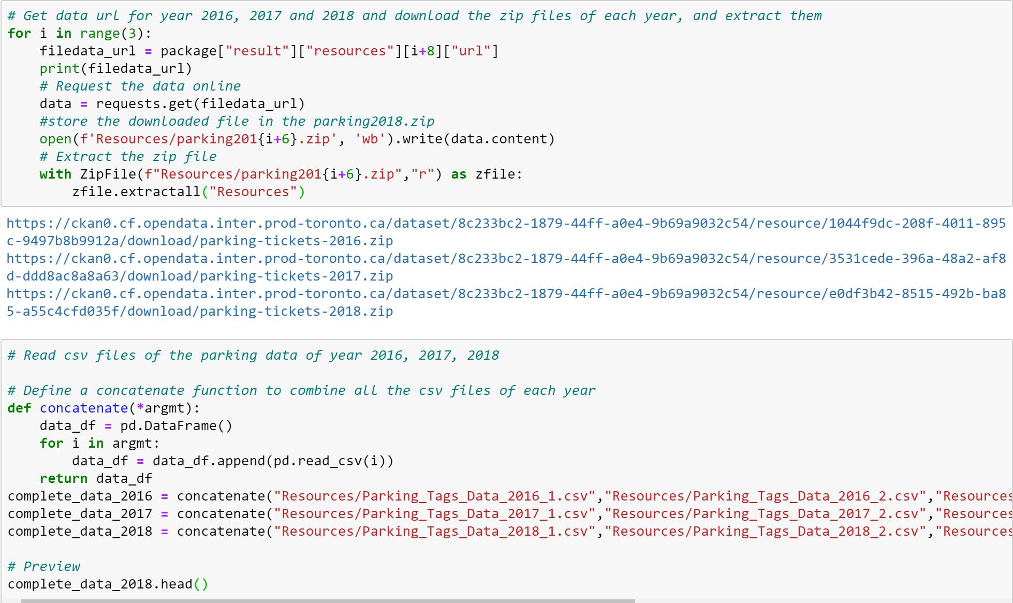
Download and unzip the parking data files and combine them together

Slide 7
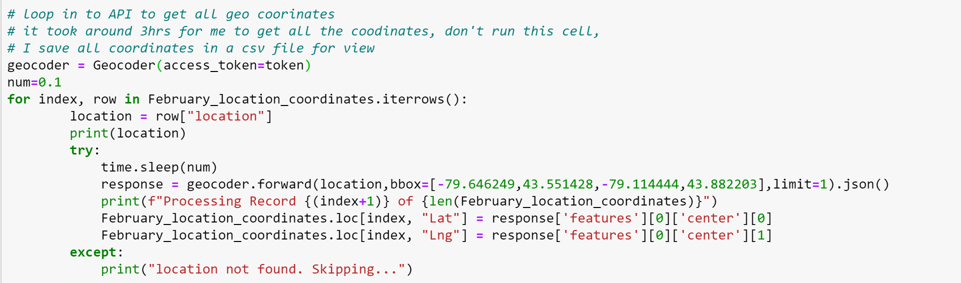
API calls from Mapbox and convert addresses into geo-coordinates

Slide 8
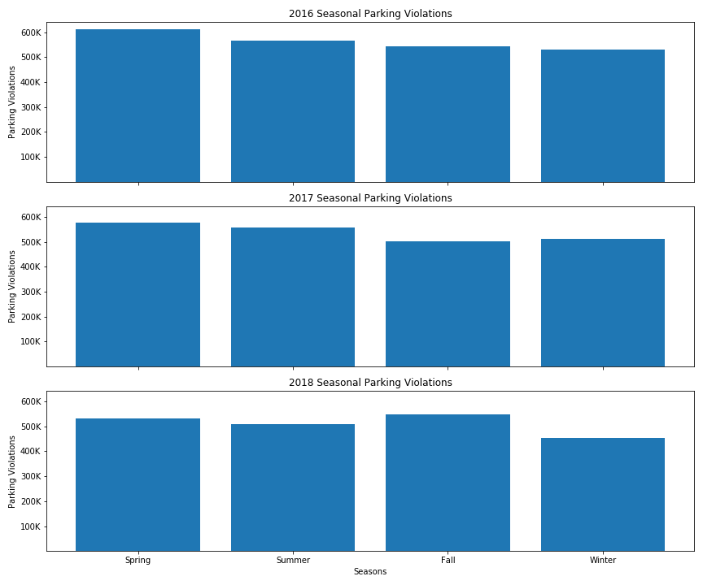
Data Analysis(seasons vs parking tickets)
Horizontal comparison
Almost evenly distributed for all three years
Usually spring has the most violations
Vertical comparison
The distributions are kind of stable through the three years, parking violations decrease from spring to winter
A slight fluctuation in year 2018
Conclusion: we don’t see a much difference among seasons that affect the parking violations

Slide 9
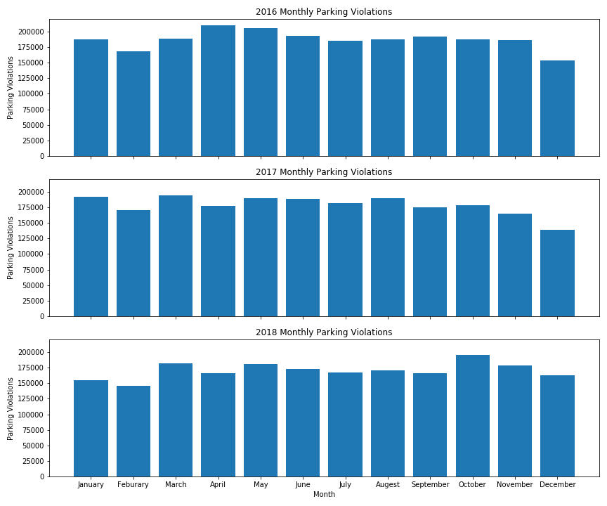
Data Analysis(months vs parking tickets)
Similarly, there is not much relationships between months and parking violations, as you can see.
For all three years, the tickets amount fluctuates but stable through the entire year

Slide 10
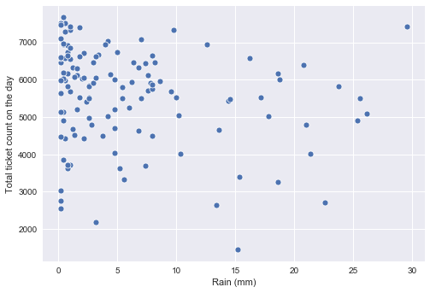
Data Analysis(rainy days vs parking tickets)
With very little rain or sunny days, violations are about 6000 per day.
With heavier rains(>5mm), most violations also around 6000
Conclusion: rainy days don’t affect the amount of parking violations very much

Slide 11
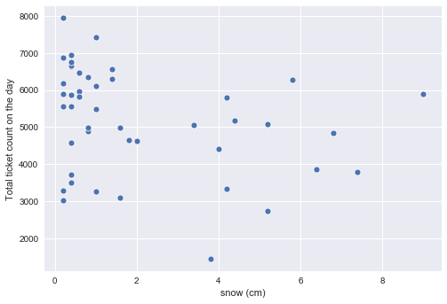
Data Analysis(snow days vs parking tickets)
Heavier snow days tend to have fewer parking violations
With small amount of snows(<2cm), we can see violations still are very high
Conclusion: heavier snow tends to decrease the violations granted

Slide 12
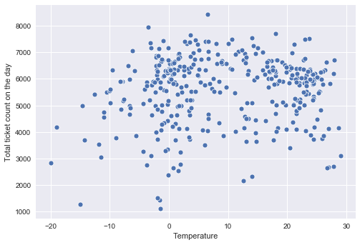
Data Analysis(weather vs parking tickets)
Extreme cold temperature (below -10 degree C)
shows trend that less parking tickets issued.
At the same time there are not significant
difference between mild cold (-5 to 15 C) and
hot summer (above 20 C).

Slide 13
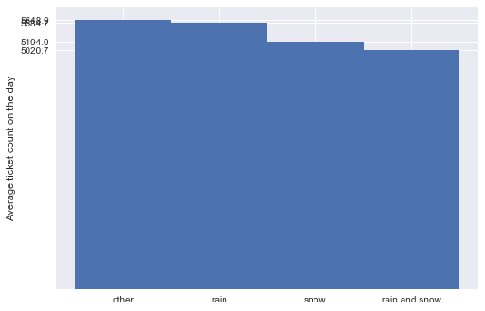
Bad weather Day vs Parking Ticket
Rain has no effect on trend,
But same time snow days approx.
9% less tickets issued
Rain/snow days 13% less tickets
Issued.
Notes:
We can see that bad weathers affect the trend , even though,l more than 5000 tickets/per day.

Slide 14
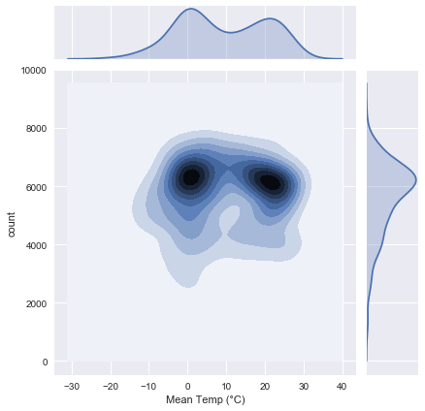
KDE Plot

Slide 15
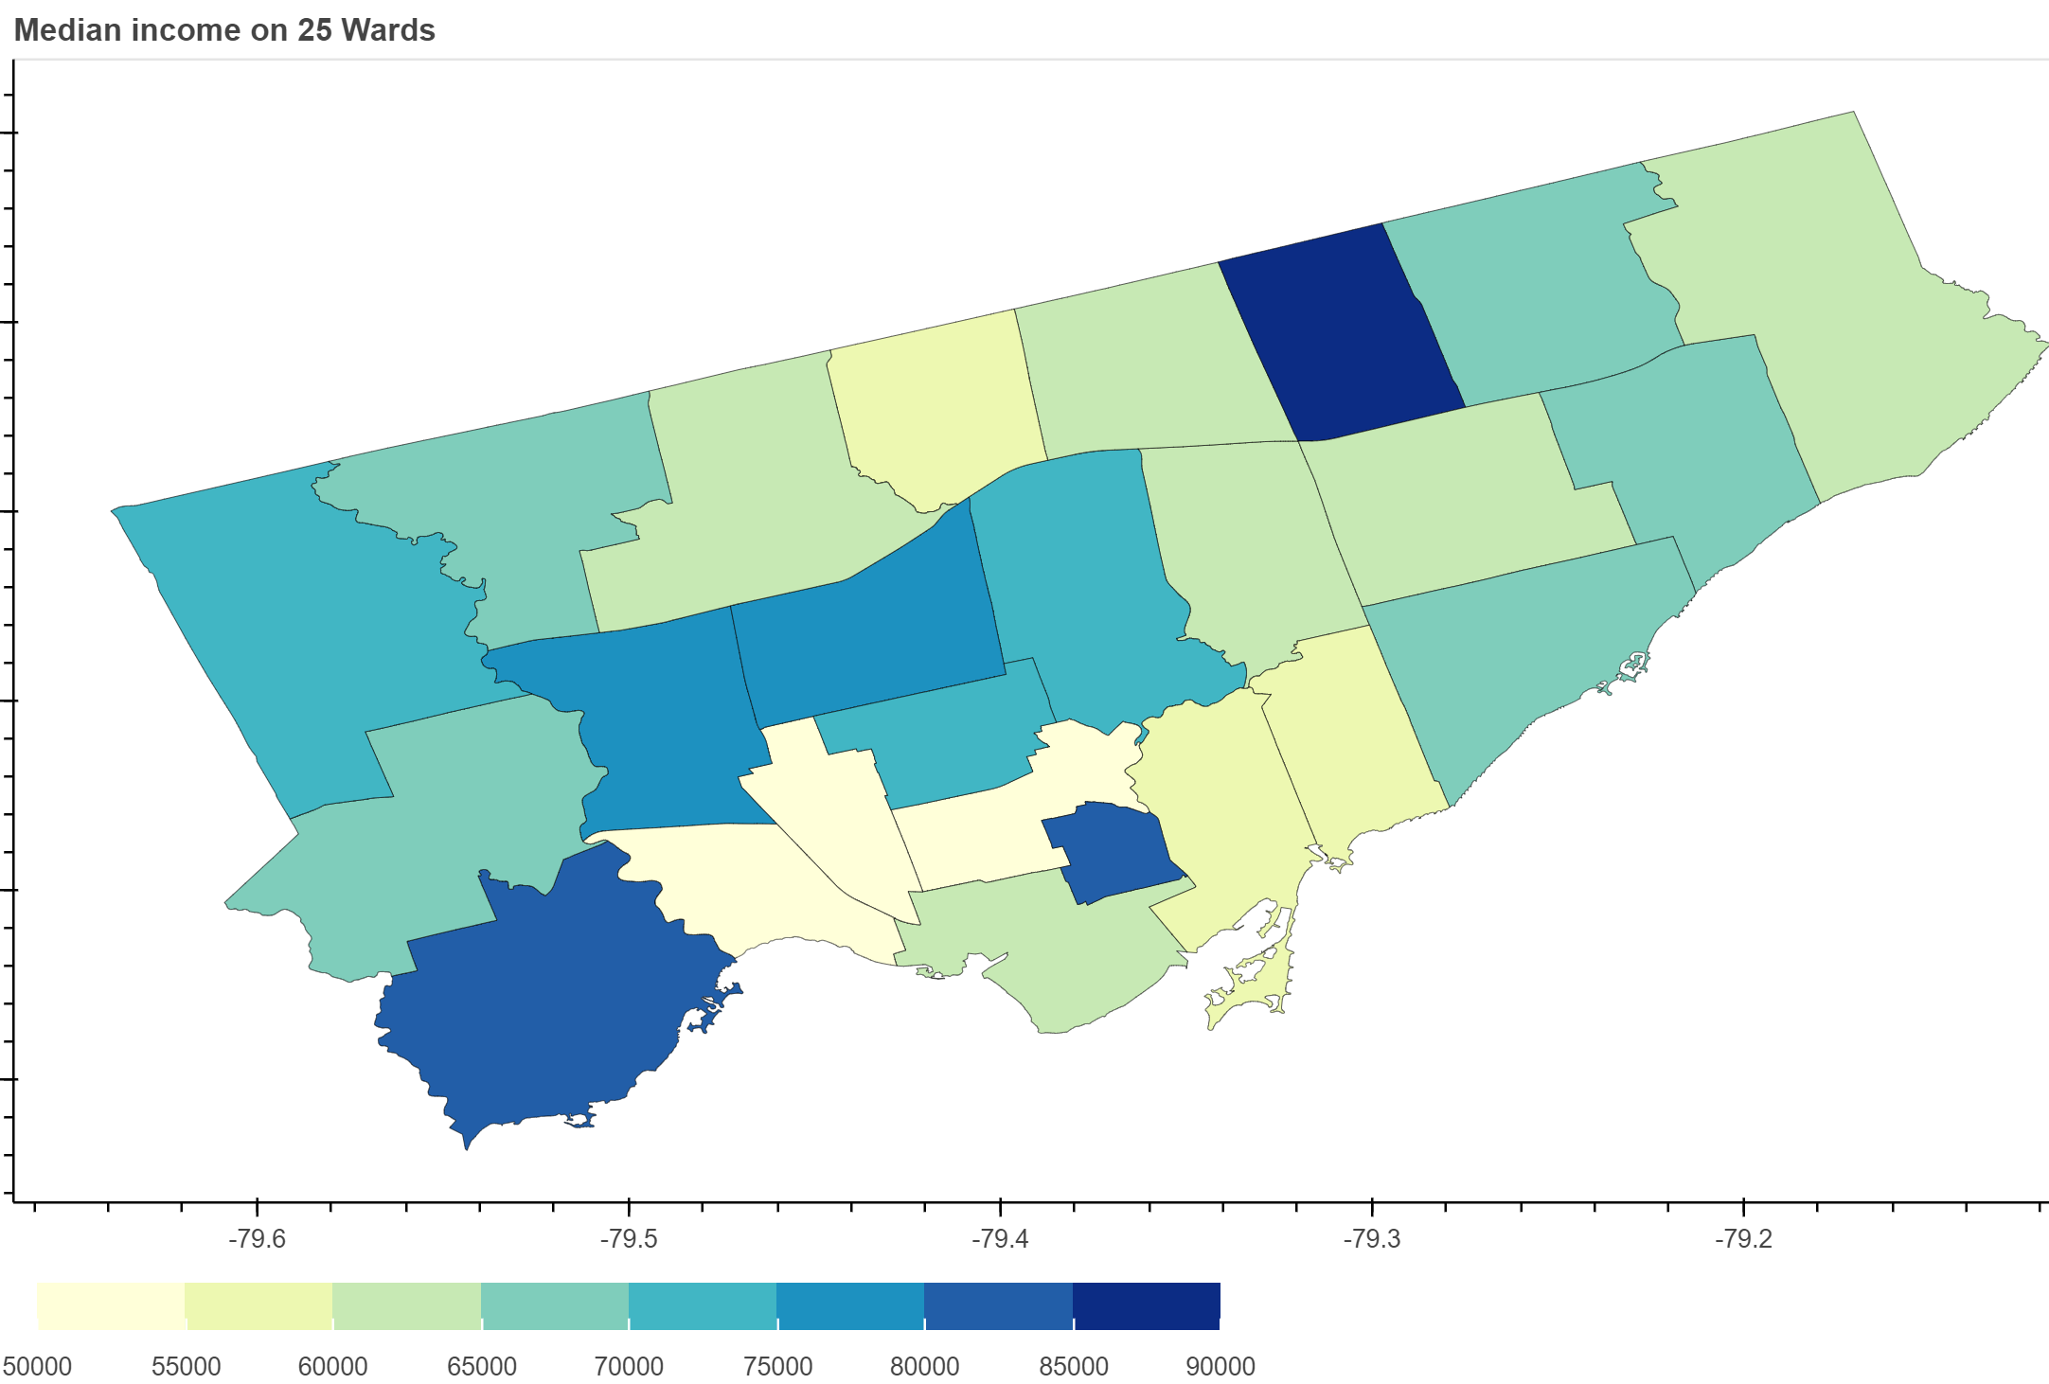
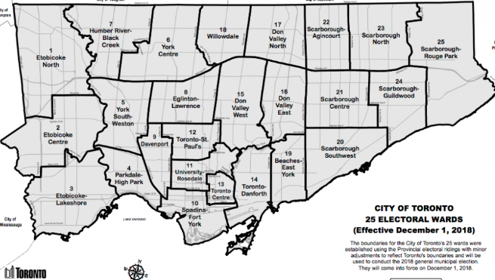
Static choropleth map for income

Slide 16
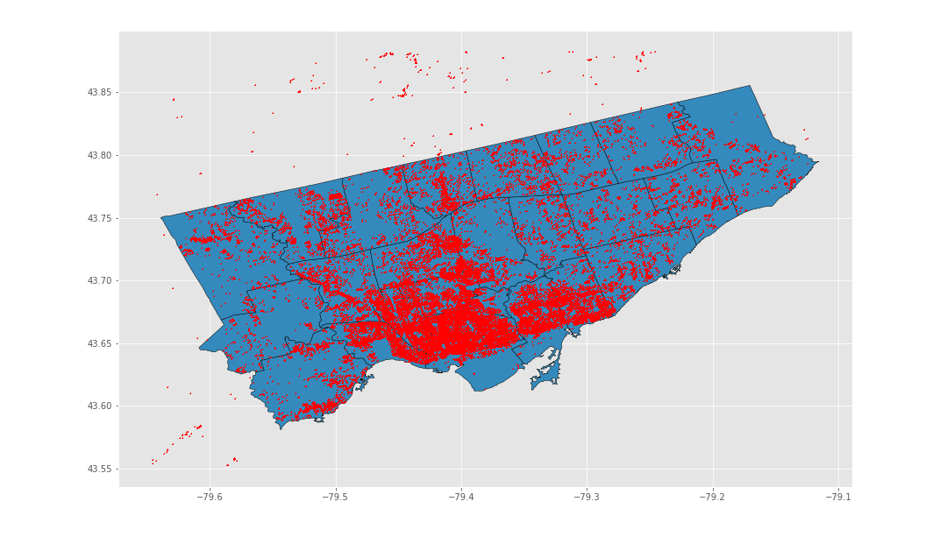

Slide 17
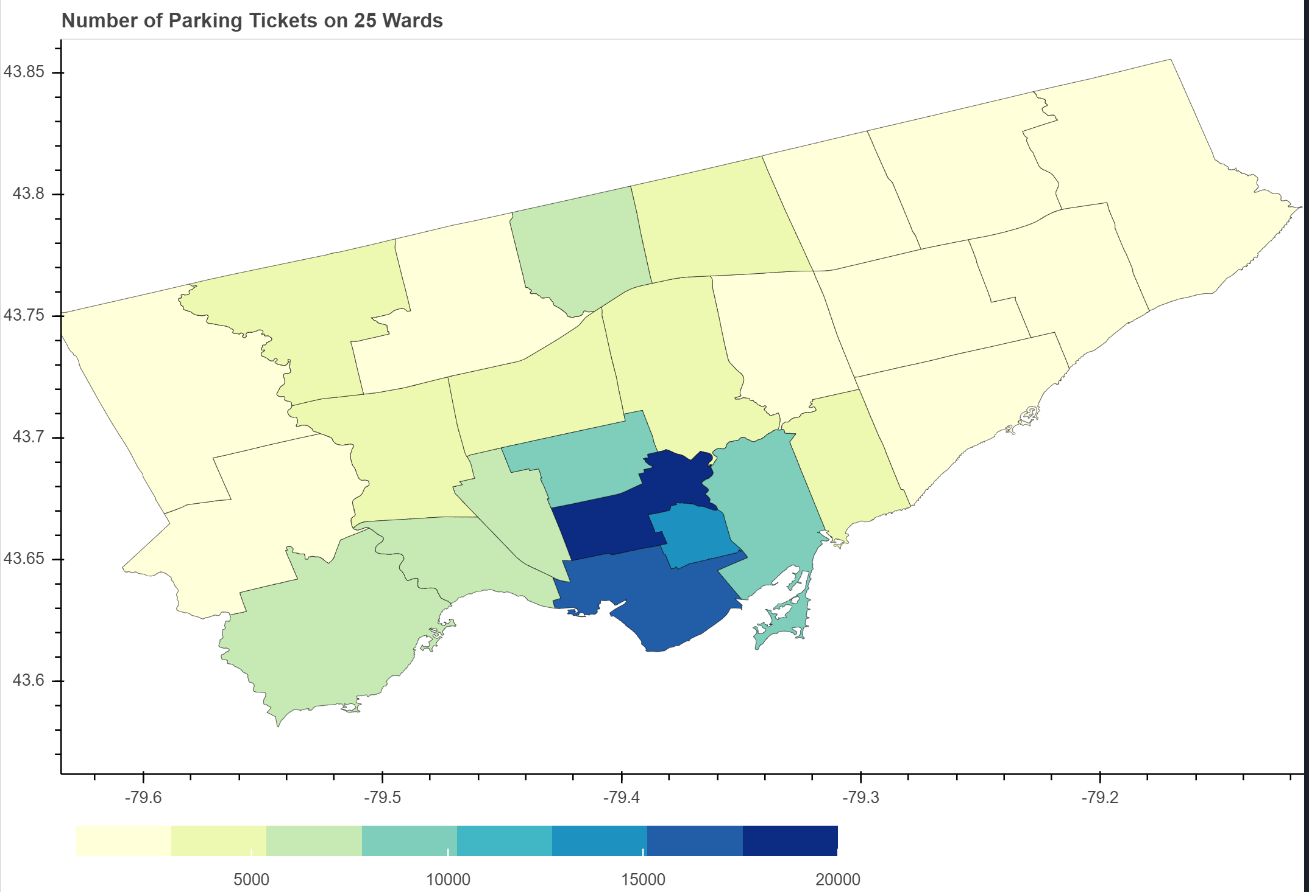
Static choropleth map for parking tickets
University
-Rosedale ward has highest
ticket issued followed by
Spadiana-Ford York, Toronto
Center (core downtown wards).
Scarborough and Etobicoke
wards has less ticket issued

Slide 18
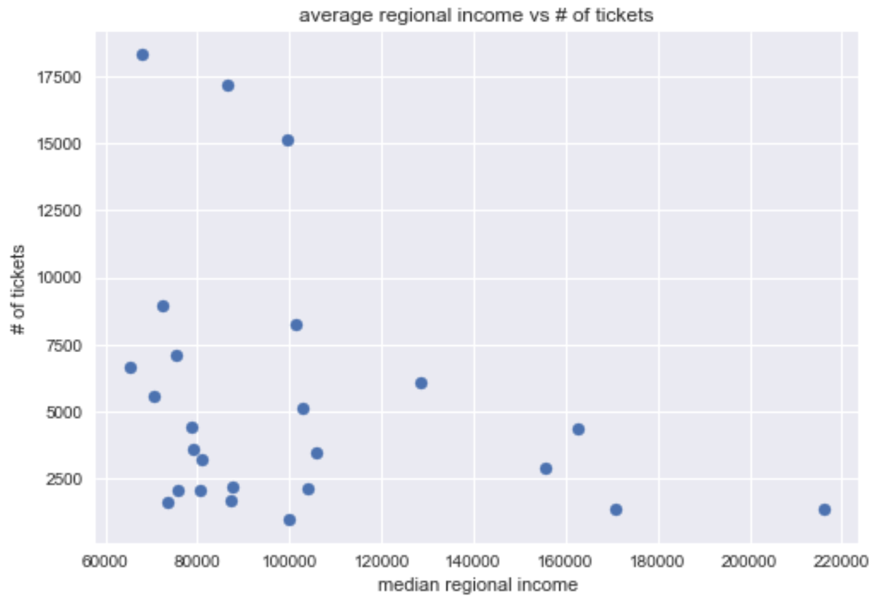
Data Analysis(regional income vs parking tickets)
Based on the plot below we can see the trend that high-income area has less parking tickets.
Note:-
In order to draw the solid conclusions,
we need additional data like
Number of car vs real estate,
street parking permit availability and etc.
Notes:
Toronto income is based on 25 regional wards/areas

Slide 19
Some Fun Facts

Slide 20
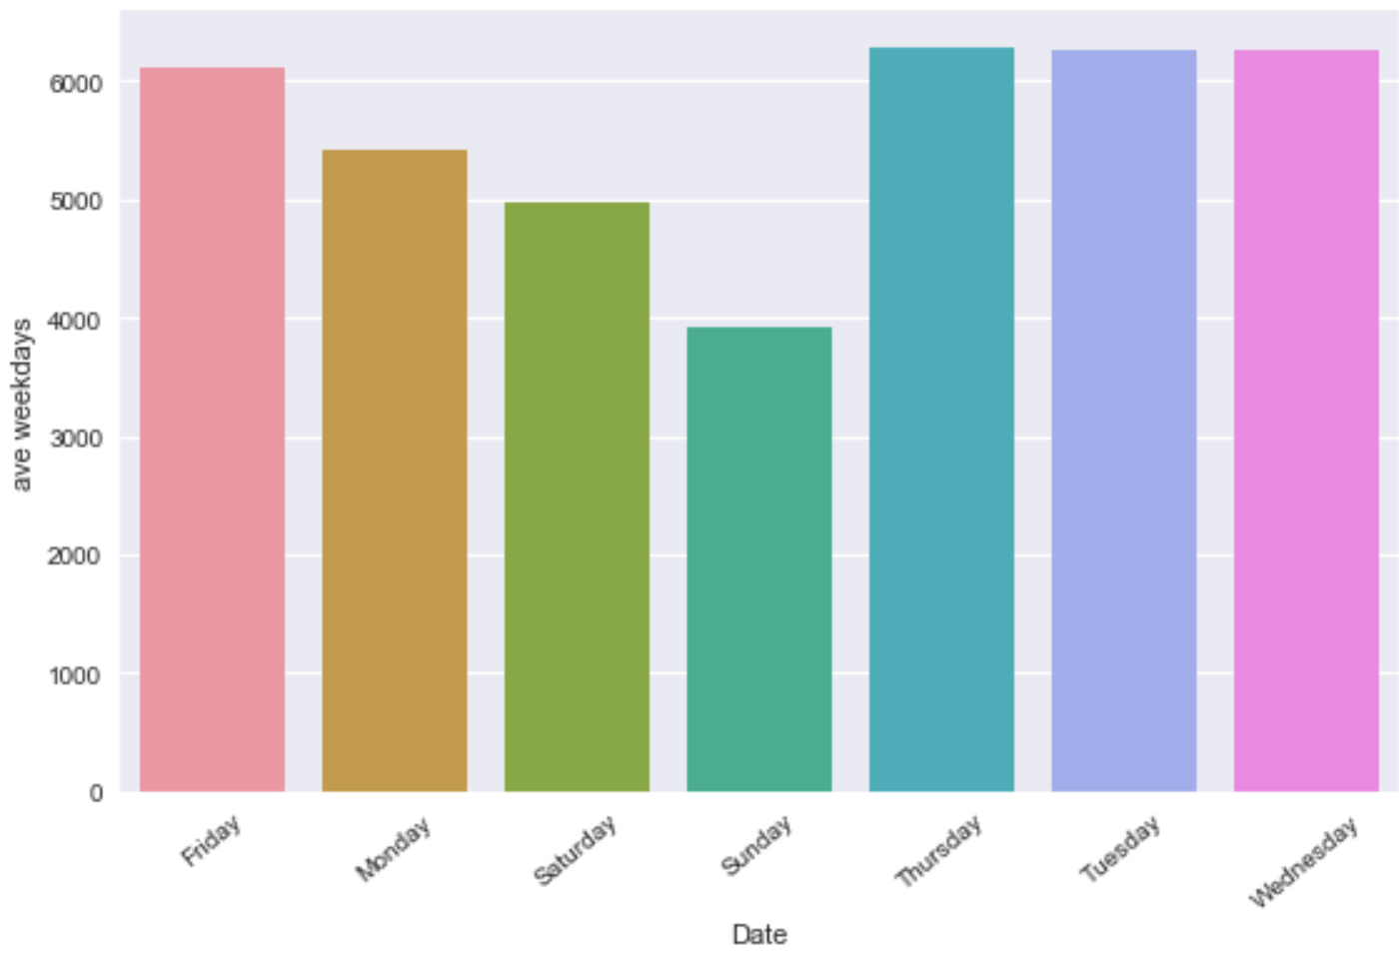
Weekdays Trend
Notes:
From

Slide 21
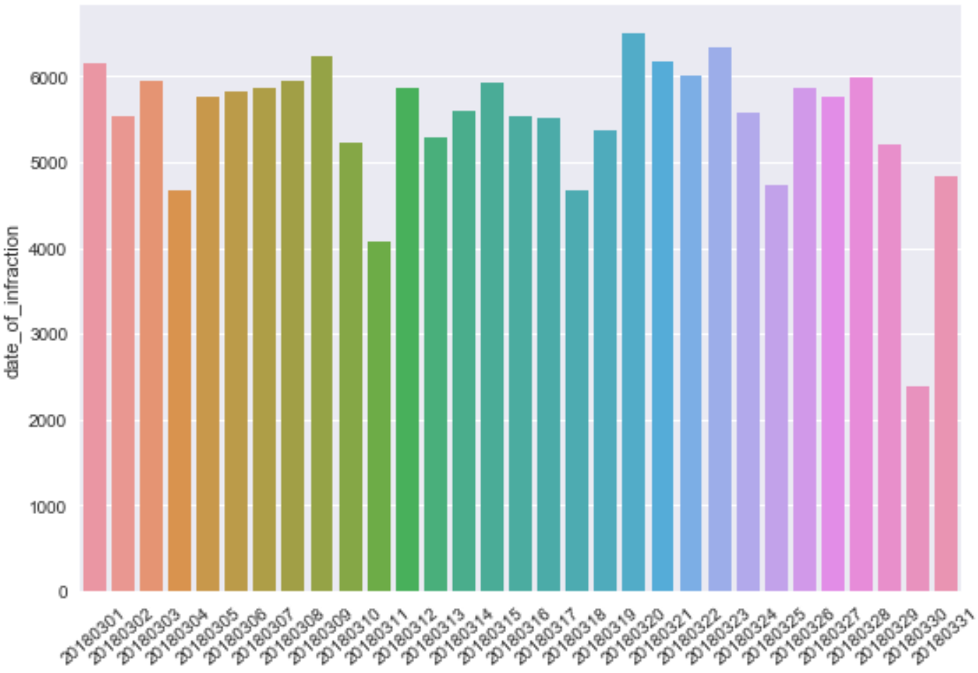
Monthly Trend (Eg:- March 2018)

Slide 22
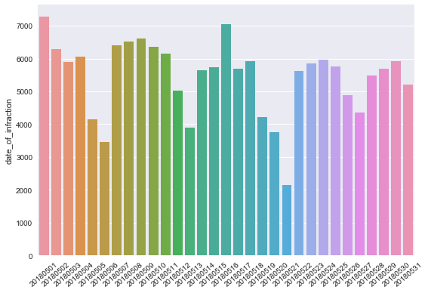
Monthly Trend (Eg:- May 2018)

Slide 23
Post Mortem
API RATE (mapbox) for huge amounts of geo data
Geo pandas/bokeh module conflicts
Toronto has multiple weather stations and not all station have all the data, So we collected datas from three stations which are close to each other (Toronto City, Toronto City Center and Toronto Inter A).
How to improve accuracy?

Slide 24
Discussion
After the analysis, we found out that the weather doesn’t really affect the total infractions much, either monthly-wise or seasonal-wise.
However, downtown area does show a higher infraction rate than other areas.
Limitations is that the location data is based on one month (February 2018).
Toronto has 8 weather stations and our analysis is based on 3 sources and hence the output may vary accordingly.

Slide 25
Any Questions?

