Slide 1
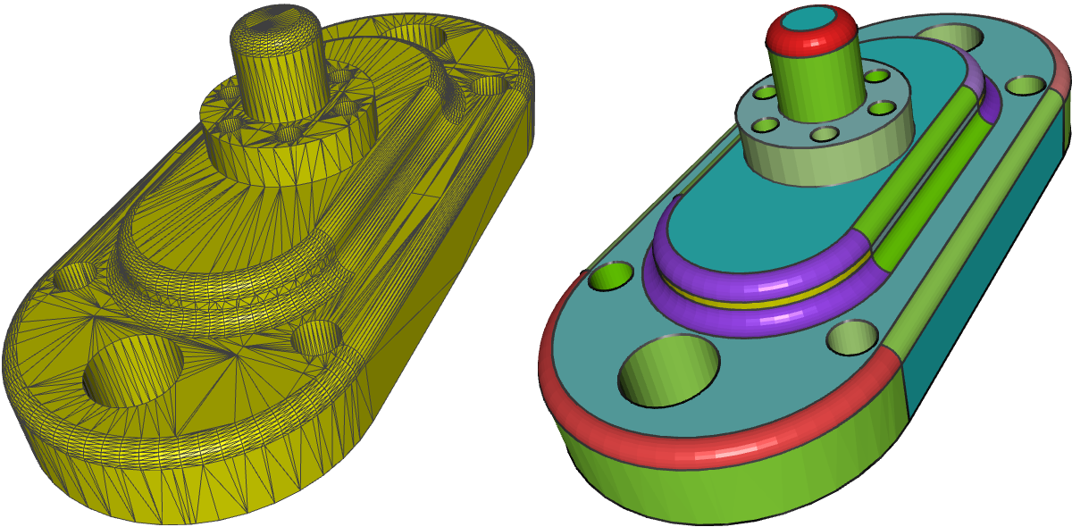
CAD Mesh Model Segmentation by Clustering
Dong Xiao, Hongwei Lin, Chuhua Xian, Shuming Gao
State Key Lab of CAD&CG, Zhejiang University

Slide 2
Introduction

Slide 3
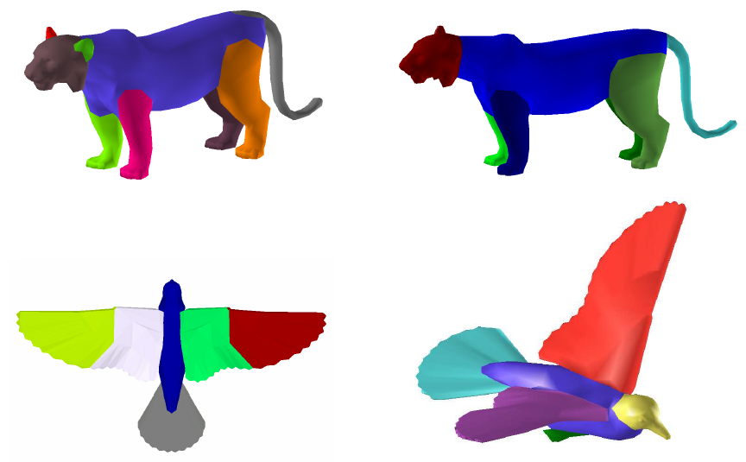
Mesh Segmentation
Notes:
Although there are lots of mesh segmentation methods in literature, the majority of them are suitable only to computer graphics mesh models, with dense mesh vertices and relatively uniform vertex distribution.
Source of the picture: Attene M, Katz S, Mortara M, Patane G, Spagnuolo M, Tal A. Mesh segmentation—a comparative study. In: IEEE international conference on shape modeling and applications, SMI2006. IEEE; 2006. p.7.

Slide 4
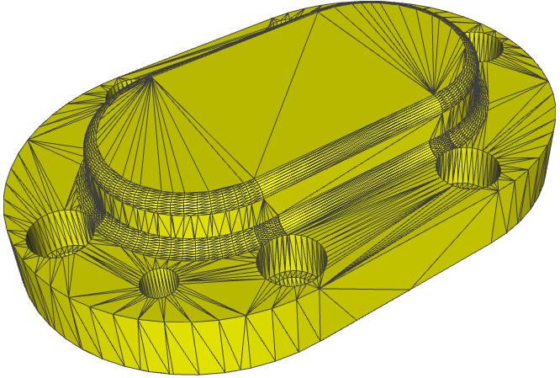
CAD Mesh Model
Notes:
A CAD mesh model usually contains two typical regions, dense and sparse regions.
Specifically, the sparse regions are generated from the triangulation of the planar, cylindrical and conical surfaces in a CAD model, while the dense regions are from the triangulation of the blending surfaces.

Slide 5
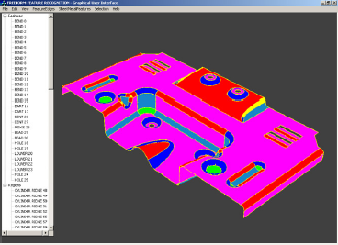
Related Work
V. Sunil, S. Pande, Automatic recognition of features from freeform surface CAD models, Computer-Aided Design 40 (2008) 502–517.
Divide the model into dense and coarse parts via feature edge detection.
Dense regions are segmented based on the signs of gauss curvature and mean curvature.
Coarse regions are segmented
into planar, cylindrical and ruled
regions via a heuristic method.

Slide 6
Our Work
The CAD mesh model is classified into sparse and dense regions by the agglomerative hierarchical clustering method.
The sparse region is partitioned into planar, cylindrical, and conical regions by the Gauss map and randomized Hough transformation.
The dense region is segmented by performing the mean shift operation on the mean curvature field.

Slide 7
Dense and Sparse Region Clustering

Slide 8
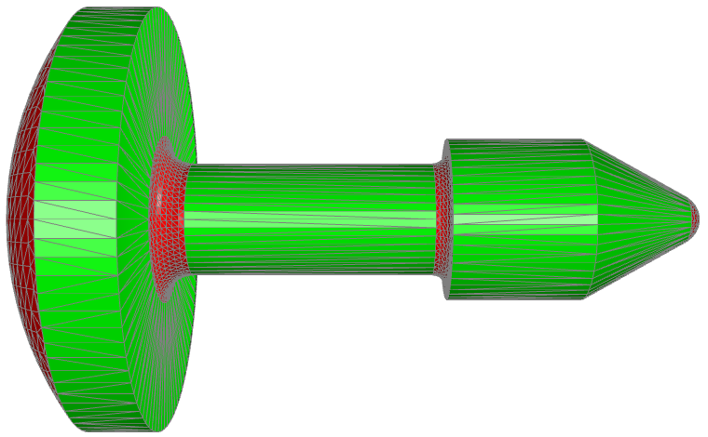
Triangles in Dense and Sparse Regions
Notes:
Sparse regions: large triangles and slender triangles.
Dense regions: small and relatively regular triangles.

Slide 9
Clustering Triangles
Calculate m = Area × EdgeRatio for each triangle, and store them in a sorted list. Treat each one as a cluster initially.
Among all pairs of adjacent clusters, pick out the pair with the minimum distance and merge them to one cluster. The distance is:
d = | log m₁ - log m₂ |
Continue step 2 until there are only two clusters left.
Notes:
EdgeRatio: the length ratio between the longest and shortest edges of a triangle.

Slide 10
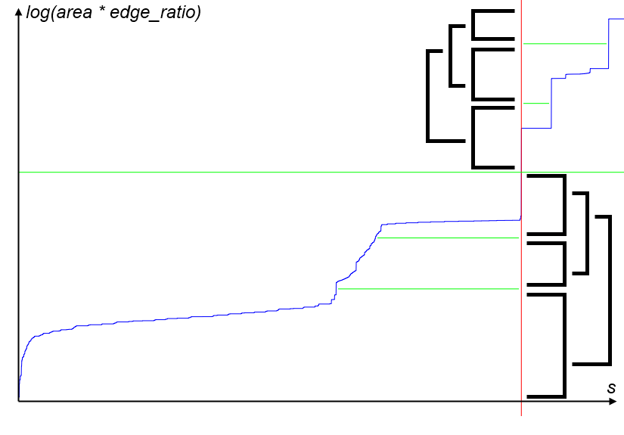
Clustering Triangles
Notes:
The blue curve is the Logarithm curve of logm versus s, the serials of the triangles in order.
The green horizontal lines are the dividing lines for the data set logm.
The red vertical line is the corresponding dividing line for the triangles.
The black brackets illustrate the last 4 merge operation (from 6 clusters to 2 clusters).

Slide 11
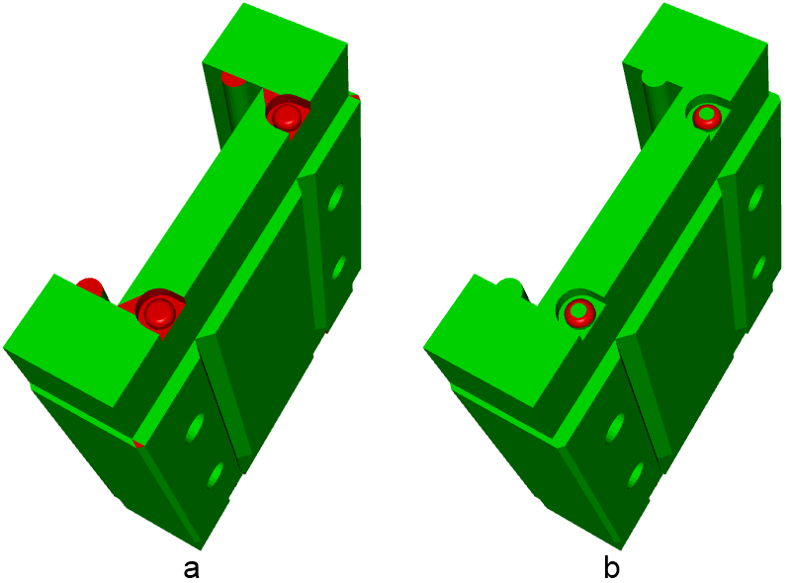
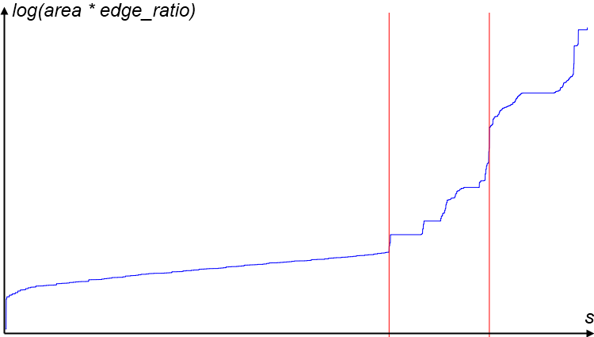
Issue of Automatic Clustering
Notes:
The above clustering algorithm works well for the most CAD models in our experiments.
Moreover, it is very easy for the users to improve the clustering results.
In our implementation, the users can adjust the dividing line directly on the logarithm curve, and the clustering result is updated interactively, till the users get the desired result.
Among all examples in the paper, only this model requires manual adjustment.

Slide 12
Segmentation of the Sparse Region

Slide 13
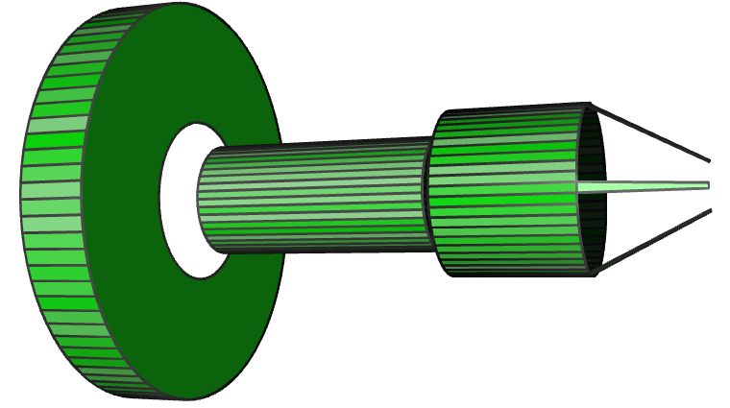
Planar Patch Recognition
Merge the adjacent sparse triangles with the same normal. (Inner product >= 1 – 10⁻⁵)
Some small triangles that are recognized as dense triangles by mistake are also merged if they are in the same plane with a neighboring sparse triangle.

Slide 14
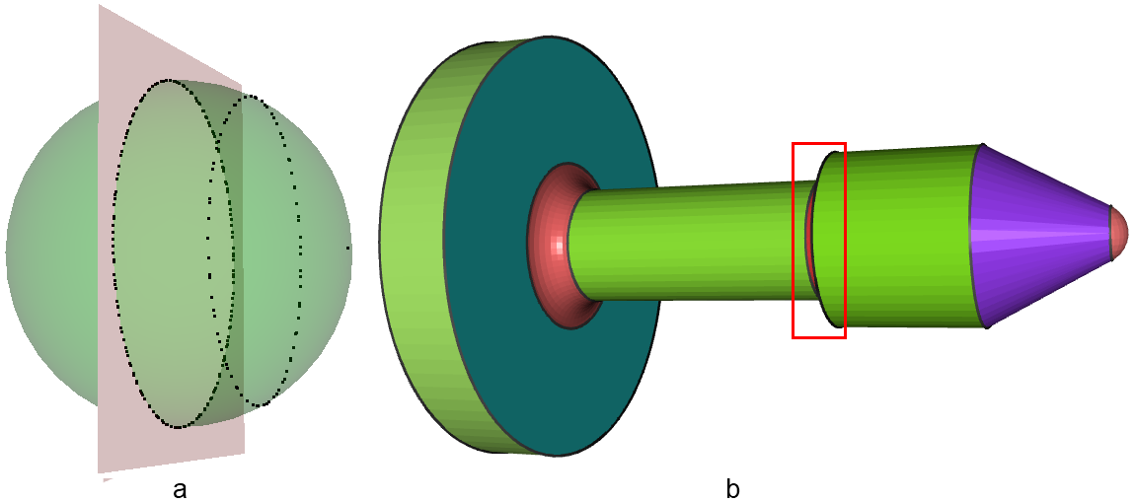
Gauss Map
The planar region is mapped to a point on the Gauss sphere surface. The cylindrical and conical regions are mapped to great and small circles on the Gauss sphere surface, respectively.

Slide 15
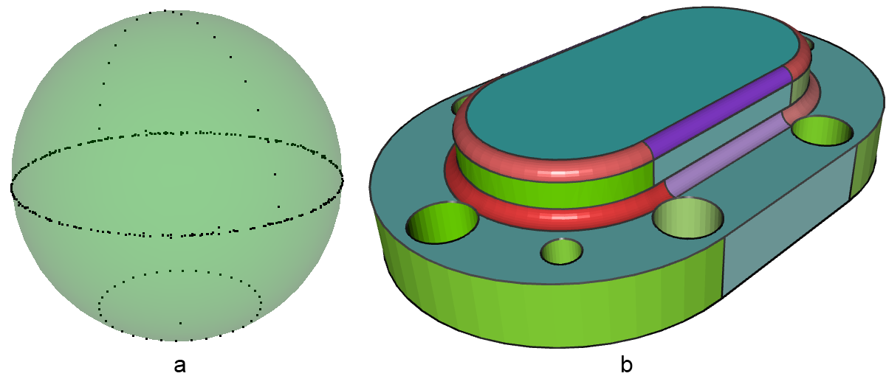
Gauss Map
Map the normalized normals of these merged planar patches and non-merged triangular patches into the Gauss sphere, then use randomized Hough transformation to recognize the planes.

Slide 16
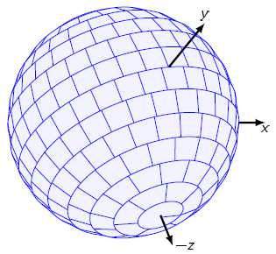
Randomized Hough Transformation
Randomly choose 3 points from the data points on the Gauss sphere, insert the plane constructed from them into the accumulator.
Repeat step 1 until a plane appears a number of times in the accumulator (e.g. 1,000 times). Report the plane and remove all points on the plane from the data set.
Repeat step 1 until there’re no enough points left (6).
In the accumulator, similar planes are
merged.
Notes:
D. Borrmann, J. Elseberg, K. Lingemann, A. Nuchter, A datastructure for the 3d hough transform for plane detection, in: Proceedings of the 7th IFAC Symposium on Intelligent Autonomous Vehicles (IAV ’10), Lecce, Italy.

Slide 17
Postprocessing
A great circle in the Gauss sphere may contain planar patches that:
are not connected in the model;
form several connected cylindrical regions with different but parallel axes;
form a cylindrical region and a tangential planar region;
is inside another cylindrical region with different direction.
Employ constraints on connectivity, dihedral angel (20˚) and area ratio (5 or 2.5) to recognize the real cylindrical regions.
The same for conical regions.

Slide 18
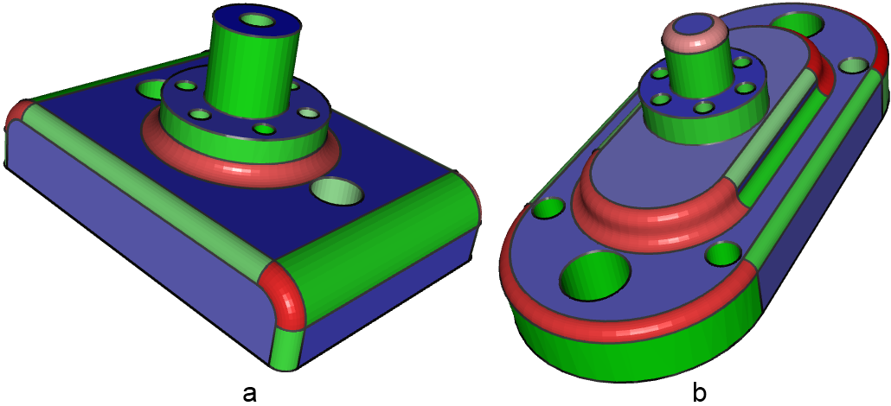
Current Results
Notes:
In many CAD models, the dense regions are isolated by the sparse regions, each of which is generated from a single blending surface, and does not require further segmentation.

Slide 19
Segmentation of the Dense Region

Slide 20
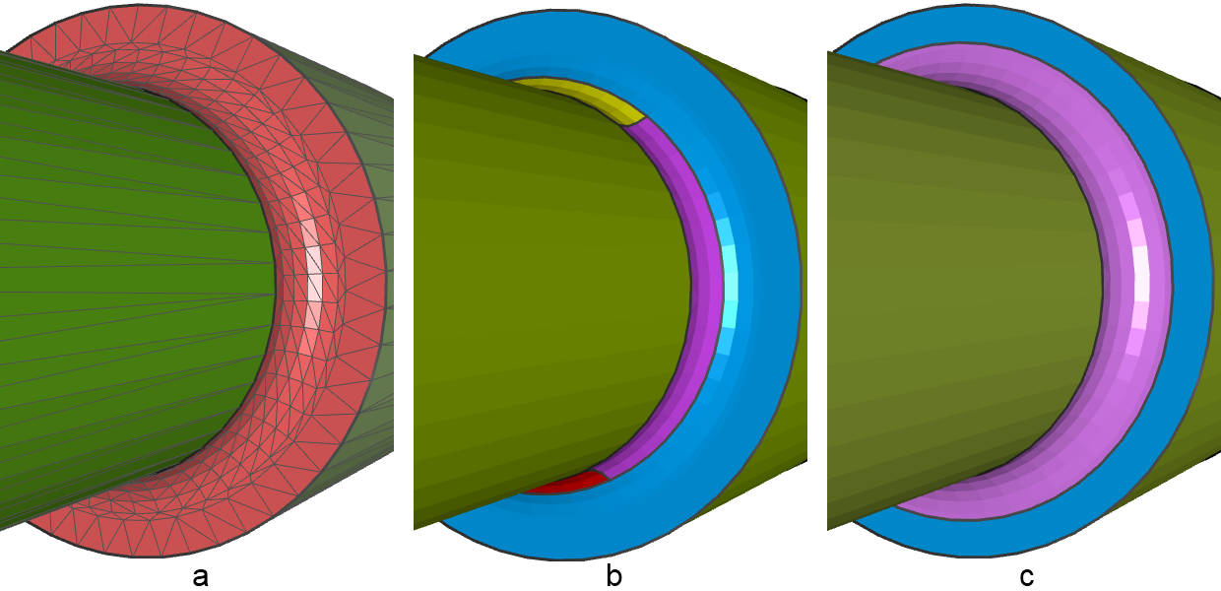
Mean Shift Normal & Curvature
Notes:
The mesh quality of dense region is relatively good, and many presented segmentation method can be employed.
But the aims of segmentation may be different for computer graphics models and CAD models.
The mean shift method presented by Yamauchi et al. will over-segment circular surfaces such as torus and spherical surfaces.
We propose a new segmentation method based on mean shift on the mean curvature.
H. Yamauchi, S. Lee, Y. Lee, Y. Ohtake, A. Belyaev, H. Seidel, Feature sensitive mesh segmentation with mean shift, in: Shape Modeling and Applications, 2005 International Conference, IEEE, pp. 236–243.

Slide 21
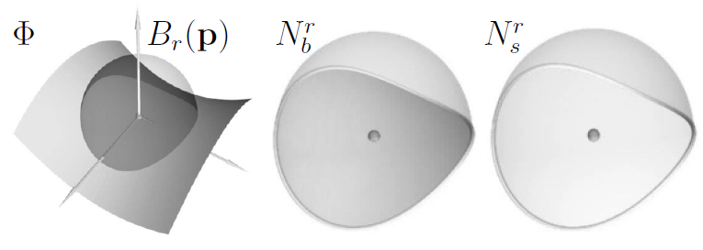


Curvature Computation in Triangles

Slide 22
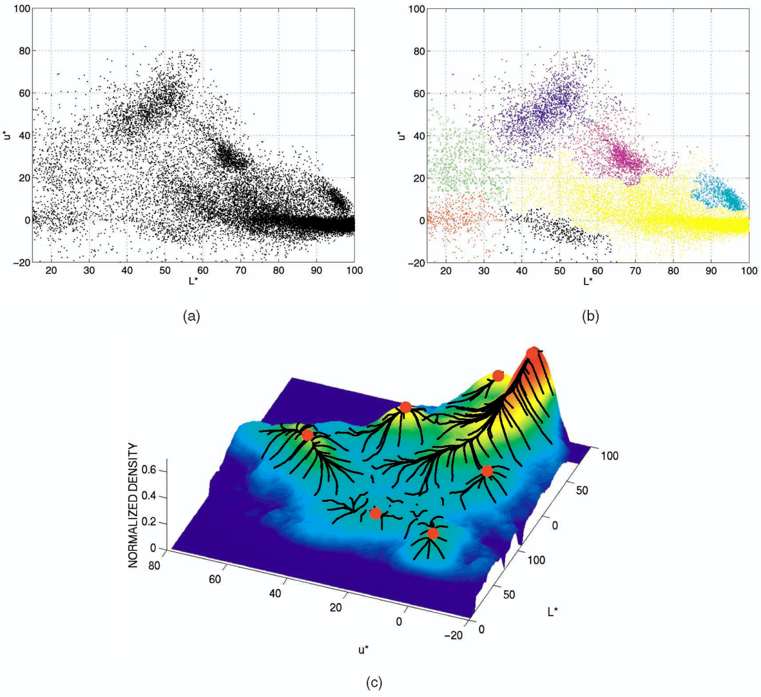
Mean Shift
Mean-shift is a non-parametric feature-space analysis technique.
It is a procedure for locating the maxima of a density function given discrete data sampled from that function. It is useful for detecting the modes of this density.

Slide 23
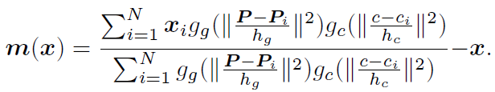
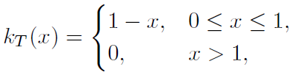
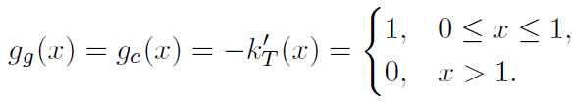
Mean Shift on Curvature
Mean curvature c_{i} at the center P_{i} of each triangle constitute the mean curvature field χ = {x_{i} = (P_{i}, c_{i}), i = 1, 2, …, n} in R⁴.

Slide 24

Mean Shift on Curvature
Mean shift clustering:
Initialize y_{i}^{[0]} with x_{i}, i = 1, 2, …, n;
Compute y^{[j + 1]} = y^{[j]} + m(y^{[j]}) until convergence.
Connected triangles with the same convergence point are segmented as one region.
Use a k-D tree to speed up the process.

Slide 25
Implementation and Results

Slide 26
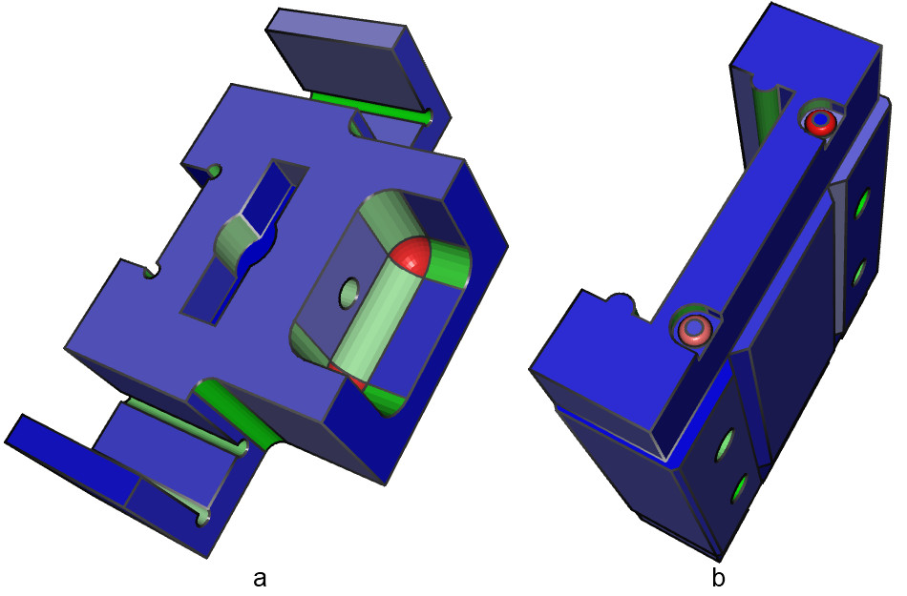
Results

Slide 27
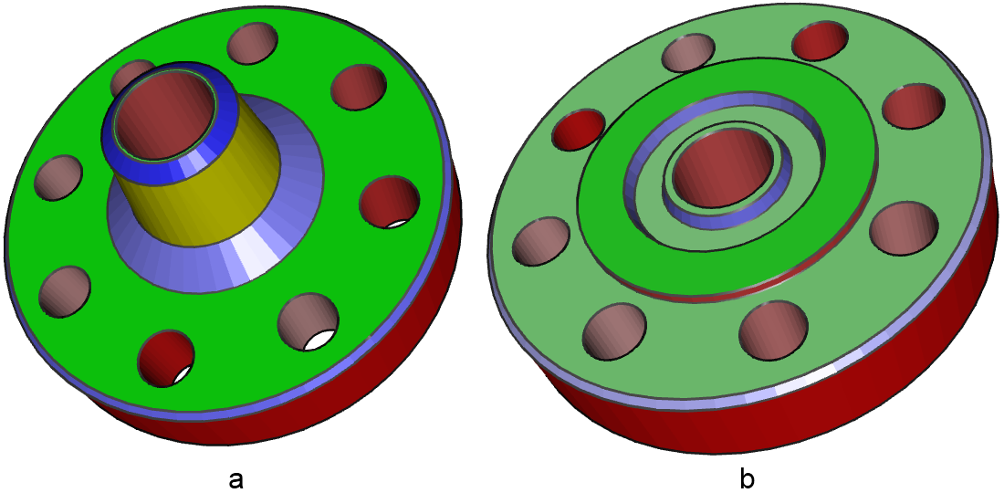
Results
Notes:
A model with only sparse region.

Slide 28
Results

Slide 29
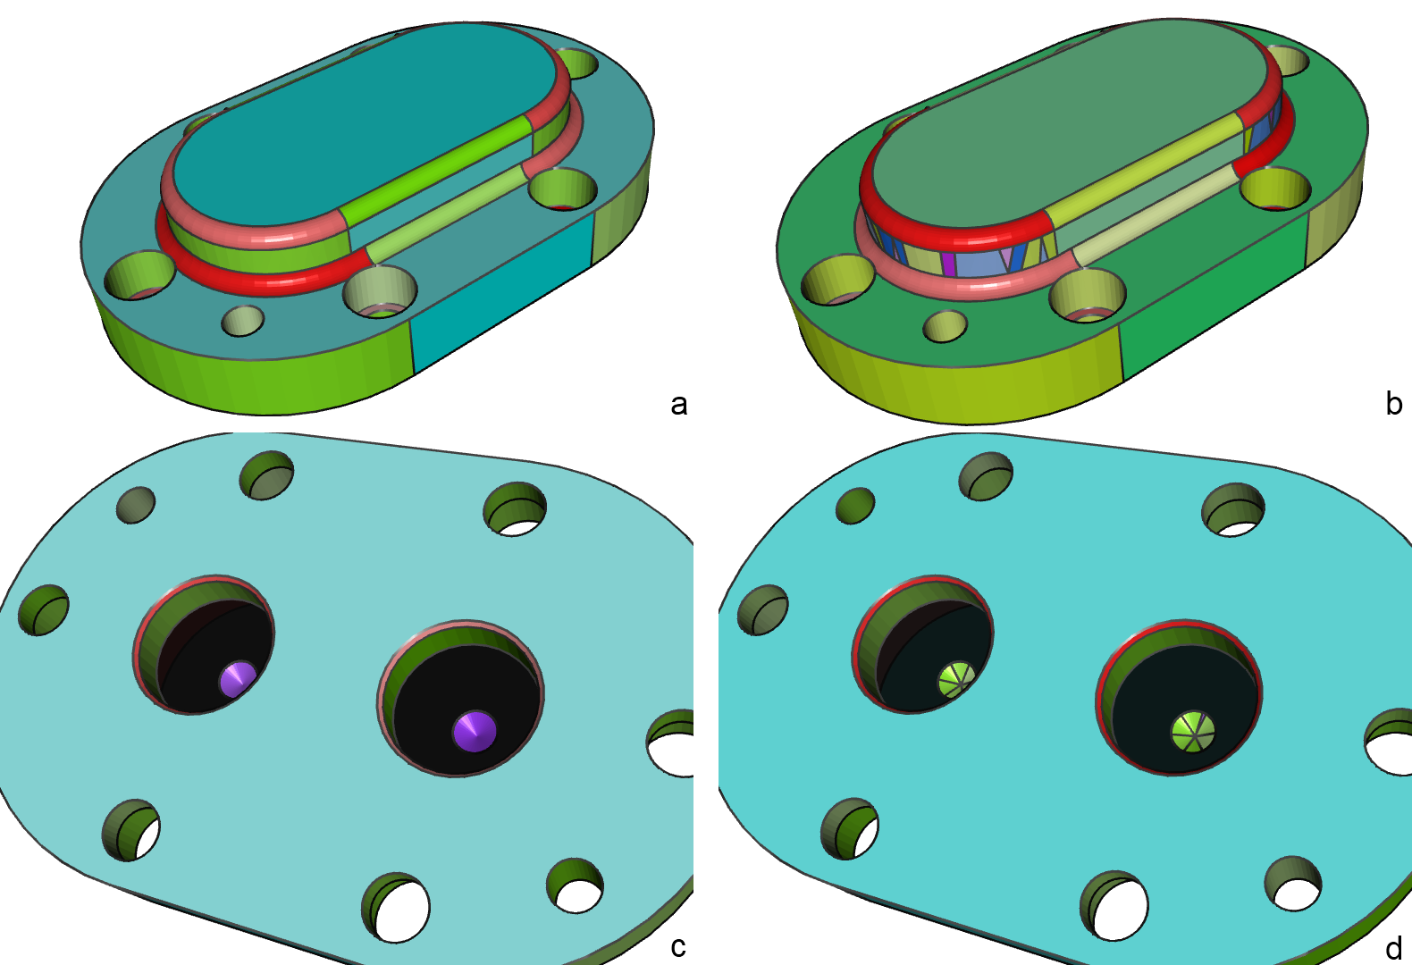
Comparison
Notes:
Comparison between our method and the method in [3] on a CAD mesh model. (a,c) Two views of the segmentation results by our method. (b,d) Two possible segmentation results by the method in [3].

Slide 30
Statistics of Segmentation
Fig | f | f_{d} | r_{s} | r_{d} | T_{c} | T_{s}
5 | 3466 | 2878 | 5 | 4 | 0.025s | 0.057s
8(a) | 1124 | 302 | 50 | 2 | 0.006s | 0.067s
8(b) | 3612 | 2380 | 64 | 4 | 0.005s | 0.069s
7(a) | 4098 | 2376 | 34 | 11 | 0.026s | 0.759s
7(b) | 6576 | 3752 | 37 | 12 | 0.039s | 1.492s
10 | 2912 | 0 | 24 | 0 | N/A | 1.227s
11 | 6798 | 4708 | 37 | 5 | 0.049s | 0.447s

Slide 31
Parameters and Time for Dense Regions
Fig | n_{f} | β_{r} | β_{g} | β_{c} | T_{u} | T_{m}
6(c) | 737 | 2.0 | 0.3 | 4.0 | 4.630s | 0.221s
11(c) | 1094 | 0.75 | 0.3 | 3.0 | 2.451s | 0.362s

Slide 32
Conclusions and Future Work

Slide 33
Pros
Clustering the triangles into sparse and dense parts is simpler and more robust than the feature edge detection method.
Recognizing the cylindrical and conical regions via Gauss map and Hough transformation is more robust than the heuristic method.
Segmentation of the dense regions by mean shift curvature can separate different blending surfaces well.

Slide 34
Cons and Future Work
Influence of neighboring sparse regions and the shapes of triangles in mean curvature computation.
Improve the computation method.
The parameters of mean shift is not easy to choose.
Automatically control them.
Can not distinguish a convex cylindrical region with an adjacent concave cylindrical region if both of them have a bit noise.
Need a robust method to distinguish them.

Slide 35
Q&A

Slide 36
Thank You!

