Slide 1
MySQL 索引最佳实践
宋武斌 2019.8

Slide 2
目录
MySQL 如何存储
MySQL 索引结构
索引实践

Slide 3
MySQL 如何存储？

Slide 4
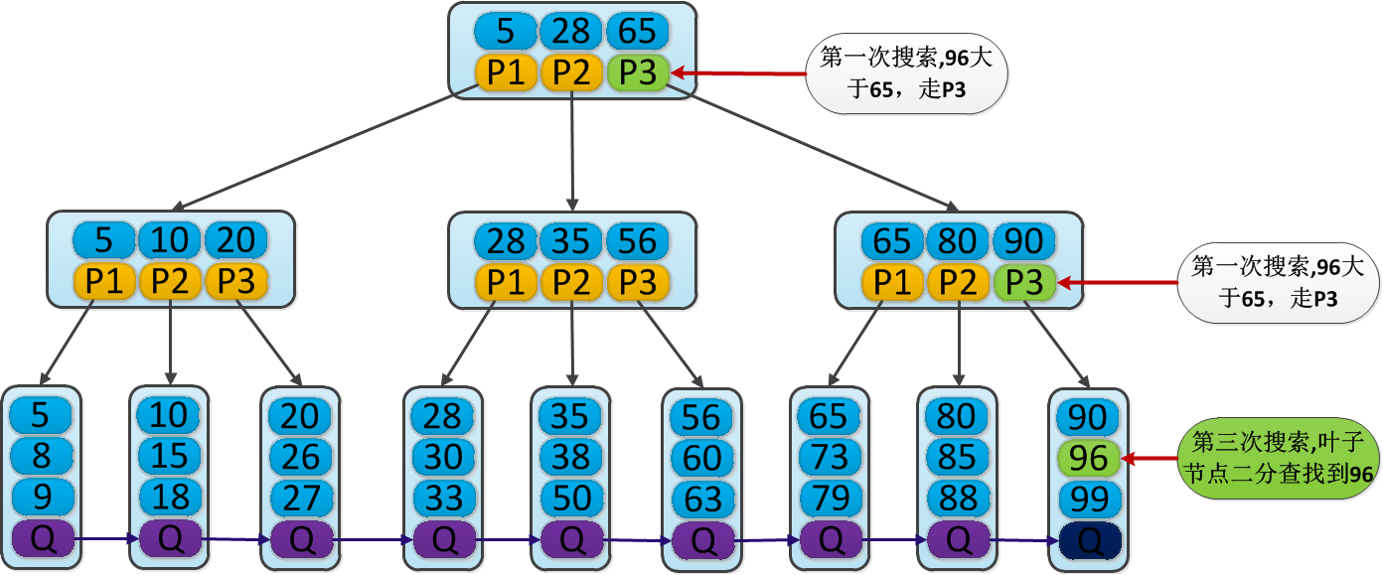
使用B+树数据结构

Slide 5
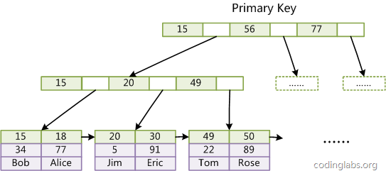
数据视图

Slide 6
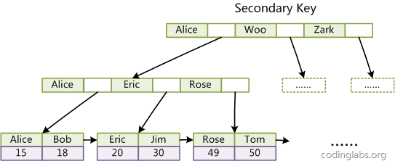
索引视图

Slide 7
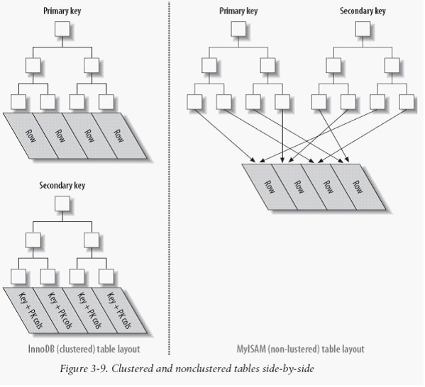
innodb VS myisam

Slide 8
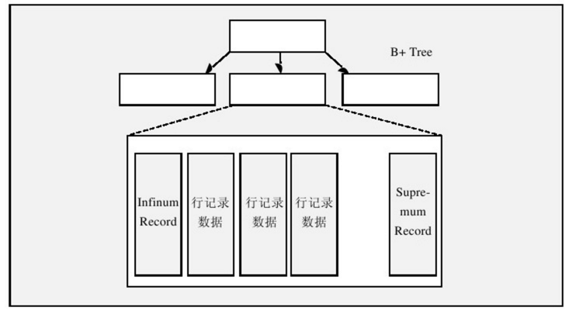
innodb B+tree

Slide 9

数据页链
Notes:
整体顺序，业内乱序

Slide 10

数据页

Slide 11
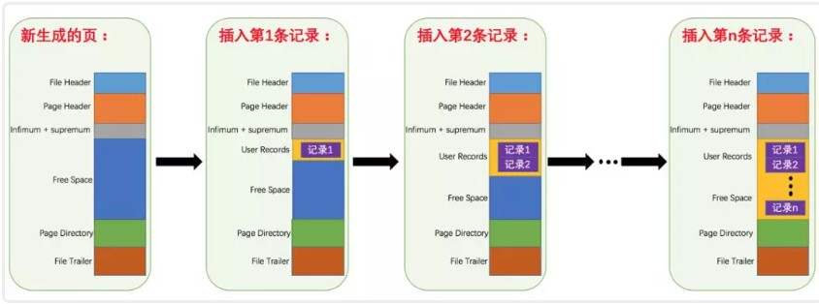
数据页

Slide 12
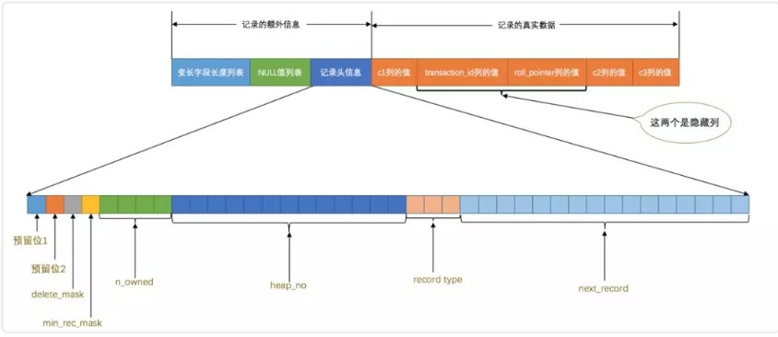
row 记录

Slide 13
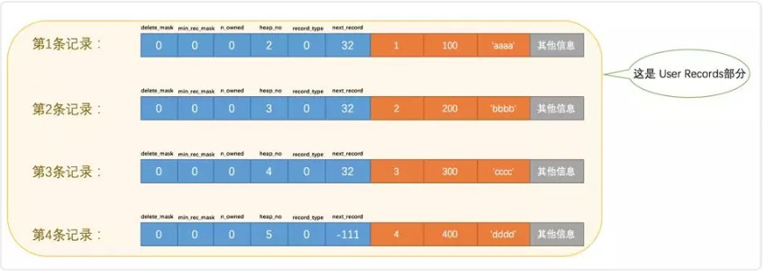
row 记录

Slide 14
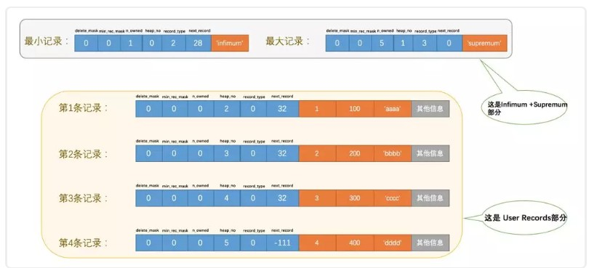
row 记录

Slide 15
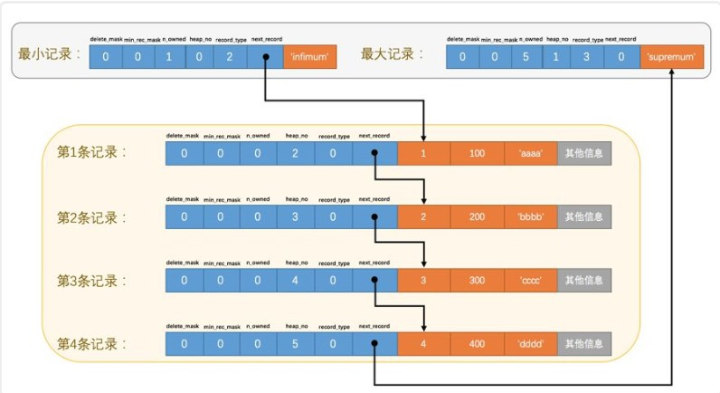
row 记录

Slide 16
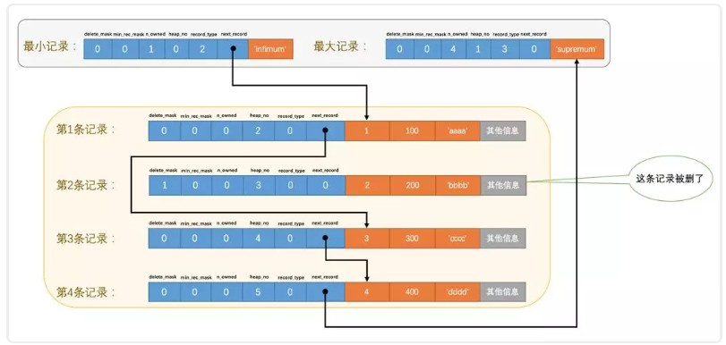
row 记录

Slide 17
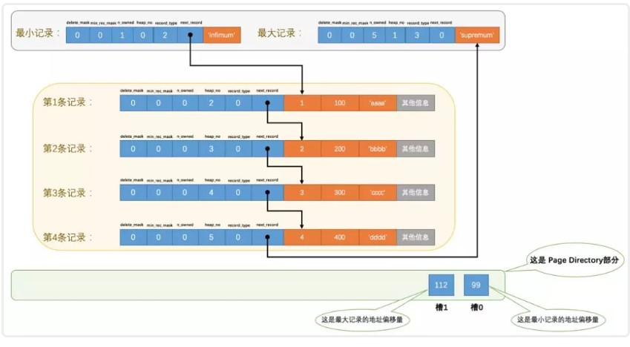
row 记录 PD – 跳表

Slide 18
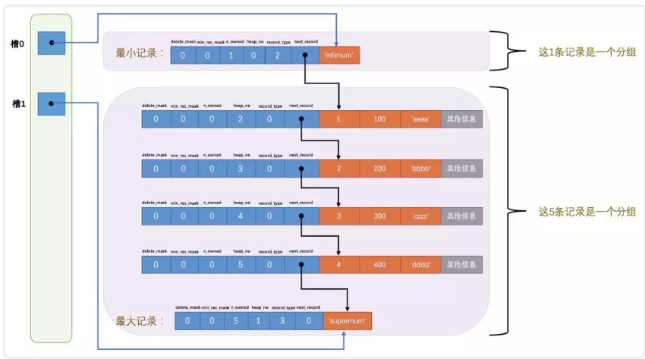
row 记录 PD – 跳表

Slide 19
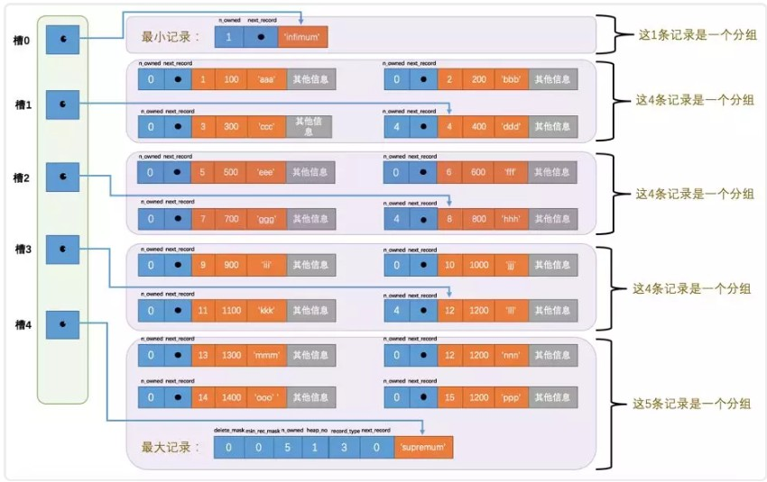
row 记录 PD – 跳表

Slide 20
MySQL索引结构

Slide 21
索引

Slide 22
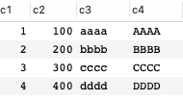
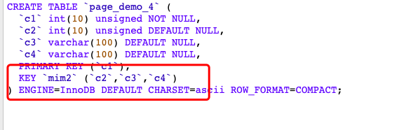
索引

Slide 23
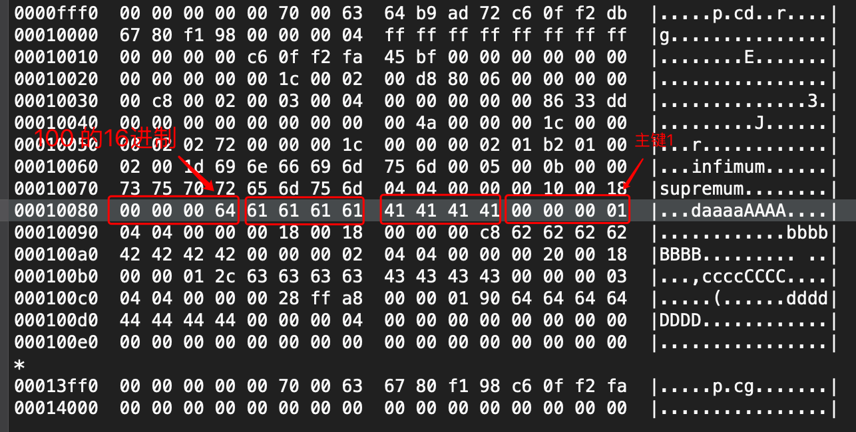
多列索引物理结构

Slide 24
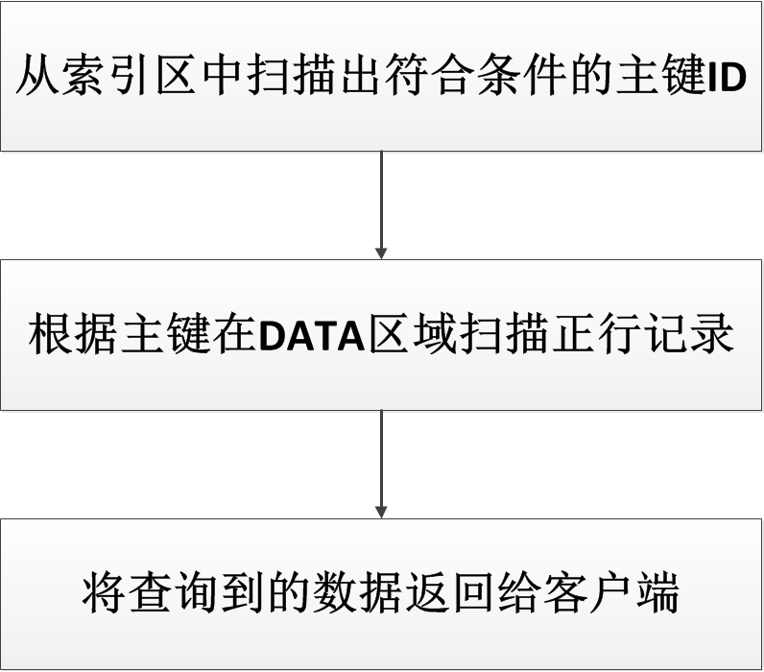
搜索过程

Slide 25
单列索引
article_id | city_id | column_id | article_time
1 | 10 | 1 | 10
2 | 11 | 1 | 20
3 | 12 | 8 | 30
4 | 11 | 1 | 40
5 | 11 | 2 | 50
6 | 13 | 4 | 60
7 | 11 | 1 | 70
8 | 14 | 5 | 80
9 | 14 | 5 | 90
10 | 11 | 2 | 100
11 | 11 | 2 | 110
12 | 15 | 6 | 120
13 | 11 | 1 | 130
city_id | article_id
10 | 1
11 | 2
11 | 4
11 | 5
11 | 7
11 | 10
11 | 11
11 | 13
12 | 3
13 | 6
14 | 8
14 | 9
15 | 12

Slide 26
复合索引
article_id | city_id | column_id | article_time
1 | 10 | 1 | 10
2 | 11 | 1 | 20
3 | 12 | 8 | 30
4 | 11 | 1 | 40
5 | 11 | 2 | 50
6 | 13 | 4 | 60
7 | 11 | 1 | 70
8 | 14 | 5 | 80
9 | 14 | 5 | 90
10 | 11 | 2 | 100
11 | 11 | 2 | 110
12 | 15 | 6 | 120
13 | 11 | 1 | 130
city_id | column_id | article_id
10 | 1 | 1
11 | 1 | 2
11 | 1 | 4
11 | 1 | 7
11 | 1 | 13
11 | 2 | 5
11 | 2 | 10
11 | 2 | 11
12 | 8 | 3
13 | 4 | 6
14 | 5 | 8
14 | 5 | 9
15 | 6 | 12

Slide 27
索引实战

Slide 28
复合索引
city_id | column_id | article_id
10 | 1 | 1
11 | 1 | 2
11 | 1 | 4
11 | 1 | 7
11 | 1 | 13
11 | 2 | 5
11 | 2 | 10
11 | 2 | 11
12 | 8 | 3
13 | 4 | 6
14 | 5 | 8
14 | 5 | 9
15 | 6 | 12
在索引上面能做的操作就是定位一个点，向前向后顺序的扫描一片数据

Slide 29
满足索引查询
等值查询 ‘=’
SELECT * FROM point_score WHERE NAME=?
离散查询 ‘IN’ ‘OR’
SELECT * FROM point_score
WHERE NAME IN(?,?,?)
范围查询 ‘>’ ‘<’
SELECT * FROM point_score
WHERE score > ? and score < ?

Slide 30
满足索引查询
模糊查询 ‘LIKE xxxx%’
SELECT * FROM point_score
WHERE date_index LIKE 201210%

Slide 31
不满足索引查询
非等值查询 ‘!=’ ‘NOT IN’
SELECT * FROM point_score WHERE NAME !=?
模糊查询 ‘LIKE %xxxx%’ ‘REGEXP xx’
SELECT * FROM point_score
WHERE date_index LIKE %09%
运算查询 ‘col + x = y’
SELECT * FROM point_score
WHERE date_index + 30 >= now //30天前分数

Slide 32
不满足索引查询
方法查询 ‘fun(x) = y’
SELECT * FROM point_score
WHERE abs(now - date_index) <= 30 //前后30天分数

Slide 33
多列满足左前缀
city_id | column_id | article_id
10 | 1 | 1
11 | 1 | 2
11 | 1 | 4
11 | 1 | 7
11 | 1 | 13
11 | 2 | 5
11 | 2 | 10
11 | 2 | 11
12 | 8 | 3
13 | 4 | 6
14 | 5 | 8
14 | 5 | 9
15 | 6 | 12
在索引上面能做的操作就是定位一个点，向前向后顺序的扫描一片数据
WHERE city_id=? AND column_id=?
WHERE city_id=? AND column_id>?
WHERE city_id=? ORDER BY column_id

Slide 34
多列不满足左前缀
city_id | column_id | article_id
10 | 1 | 1
11 | 1 | 2
11 | 1 | 4
11 | 1 | 7
11 | 1 | 13
11 | 2 | 5
11 | 2 | 10
11 | 2 | 11
12 | 8 | 3
13 | 4 | 6
14 | 5 | 8
14 | 5 | 9
15 | 6 | 12
在索引上面能做的操作就是定位一个点，向前向后顺序的扫描一片数据
WHERE column_id=?
WHERE city_id>? AND column_id=?
WHERE city_id IN(?) ORDER BY column_id
WHERE city_id >? ORDER BY column_id

Slide 35
理论案例分析
WHERE col1=? AND col2>? AND col2<?
AND col3 IN(?) AND col4 LIKE ‘xxx%’
index (col1,col2)
index (col1,col3)
index (col1,col4)

Slide 36
实际案例分析
WHERE col1=? AND col2>? AND col2<?
AND col3 IN(?) AND col4 LIKE ‘xxx%’
可能只需要 index (col2)
也可能只需要 index (col1)
其实主要是看列稀疏度或者说可筛选性

Slide 37
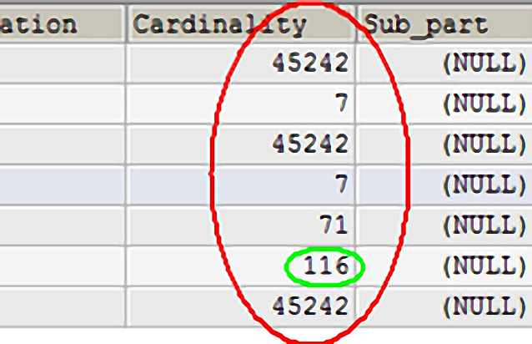
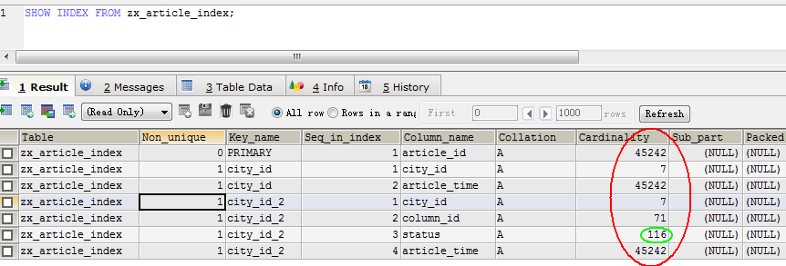
衡量索引的好坏
7 ~= SELECT count(DISTINCT city_id) FROM zx_article_index;
71 ~= SELECT count(DISTINCT city_id,column_id) FROM zx_article_index;
116 ~= SELECT count(DISTINCT city_id,column_id,status) FROM zx_article_index;
71到116 加了status并没有离散多少，所以status加了和没加对性能没多大变化,好的复合索引应该是越来越离散

Slide 38
index merge
案例 WHERE col1=? AND col2=? AND col3 > ?
能不能创建3个单列索引，让mysql 做 merge?
虽然支持，但是效果不好
如果有多列任意组合的需求，还是要用类似 ES的组件

Slide 39
总结
索引不是越多越好
索引不是越长越好
部分索引 -- KEY `c4` (`c4`(10))
定期清理
非主键搜索随机IO多，所以数据要做缓存

Slide 40
QA

