Slide 1
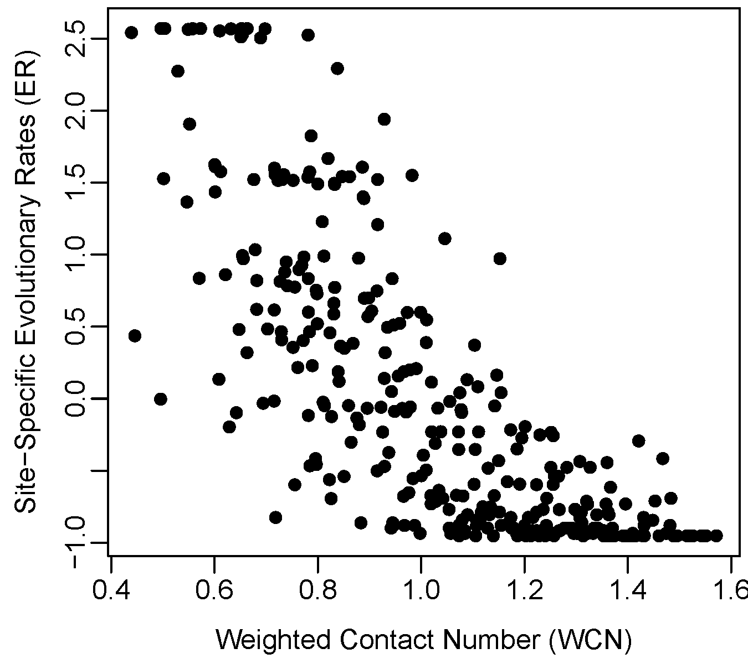
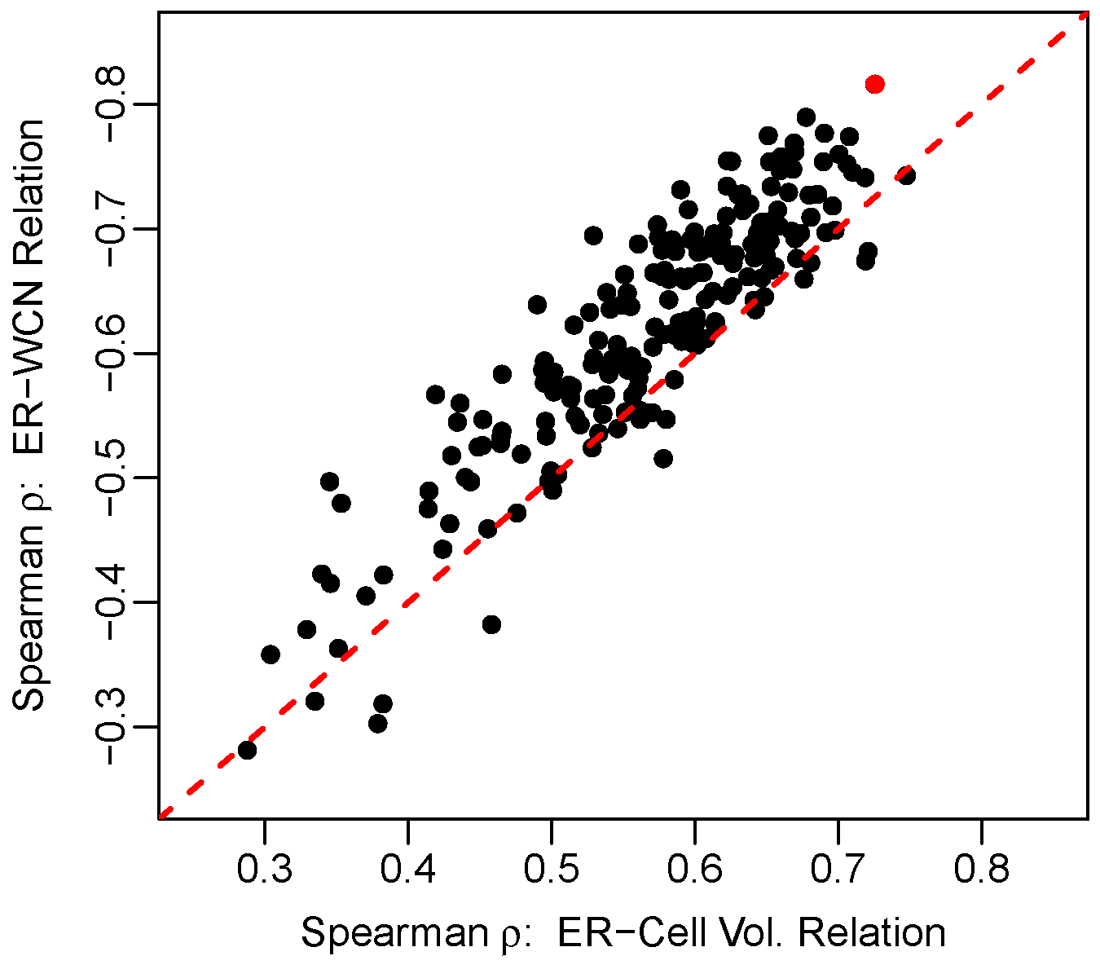
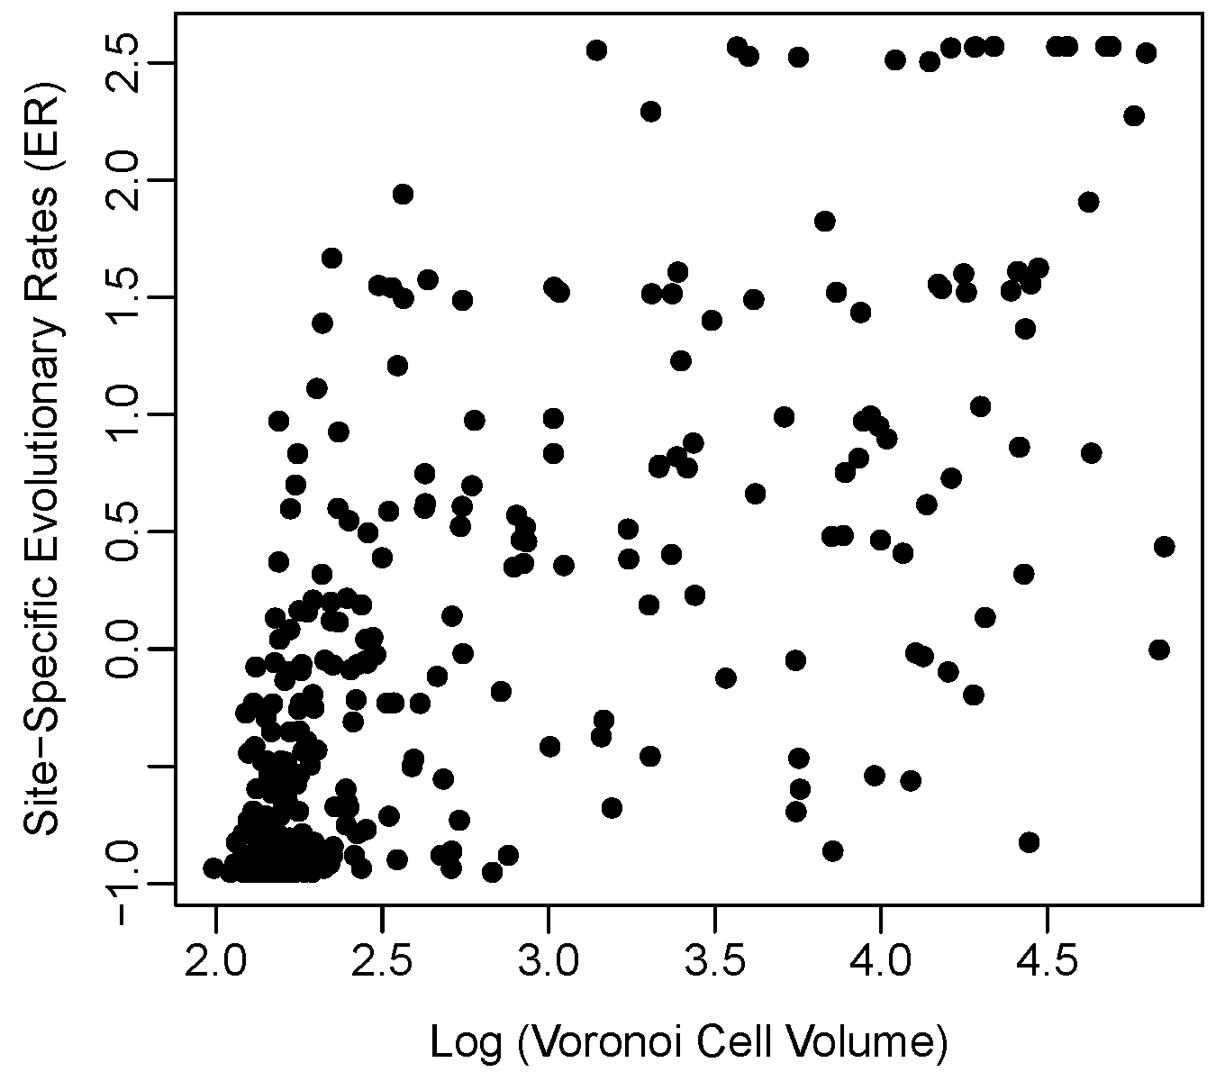
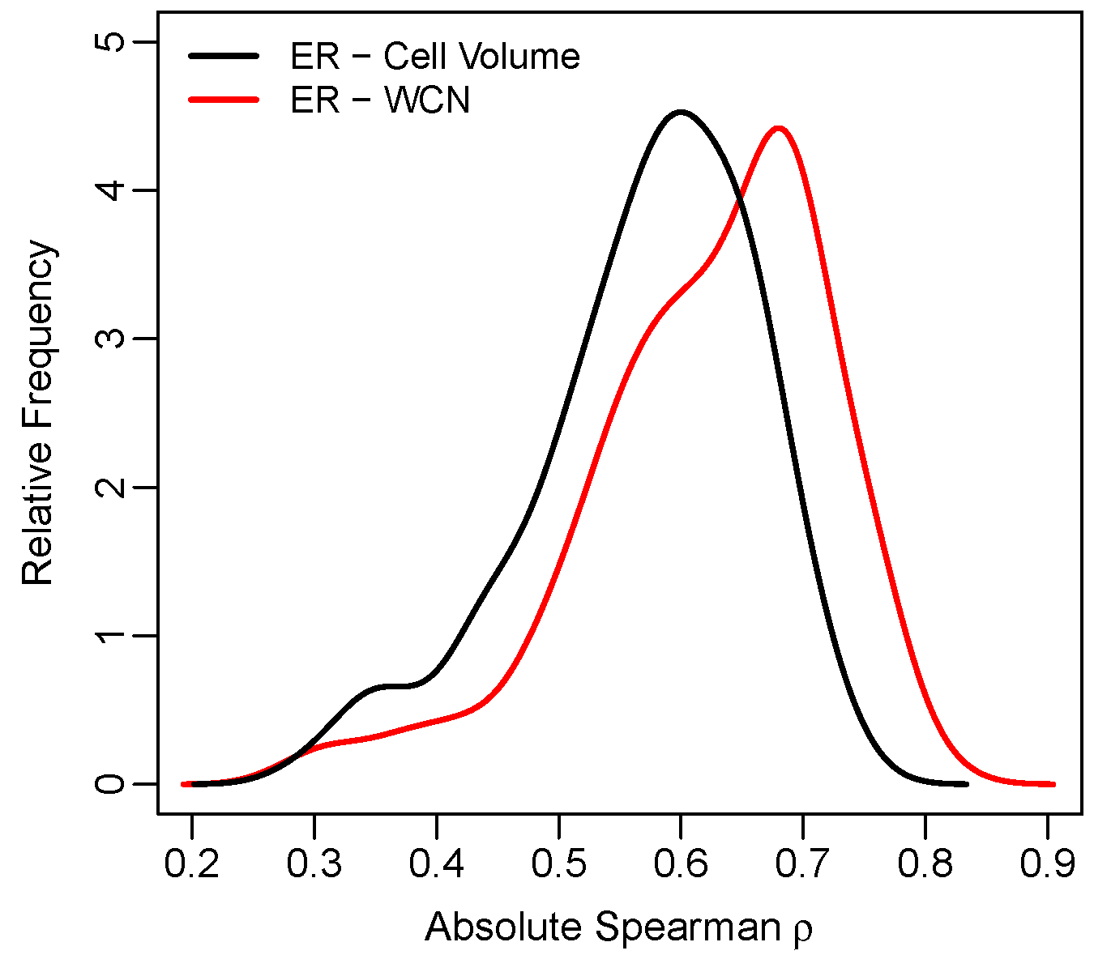


A
C
Spearman $ρ=−0.82$
PDB ID 1ONR
PDB ID 1ONR
B
D
PDB ID 1ONR
Spearman$ρ=0.73$

