Slide 1
Income Classification & Customer Segmentation
A Machine Learning Approach to Retail Marketing Targeting
Edison E Chukwuemeka
199,523
40
95.23%
3
Census Records
Feature Variables
Best ROC-AUC
Market Segments
Machine Learning Team | February 2026 |

Slide 2
Agenda
1. Executive Summary
Key Findings and Business Takeaways
5. Segmentation Model
PCA
Model Evaluation
Model Comparison
Optimal K selection
2. Business Problem Overview
Objective, Dataset and Project Scope
3. Data Exploration (EDA) & Preprocessing
Feature Analysis,
Distributions and Insights
Missing Values and Class Imbalance
Categorical Encoding
6. Business Recommendations
Model deployment for marketing
7. References
Data Sources and technical references
4. Classification Model
Training
Evaluation
Model Comparison
Feature Importance

Slide 3
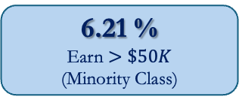
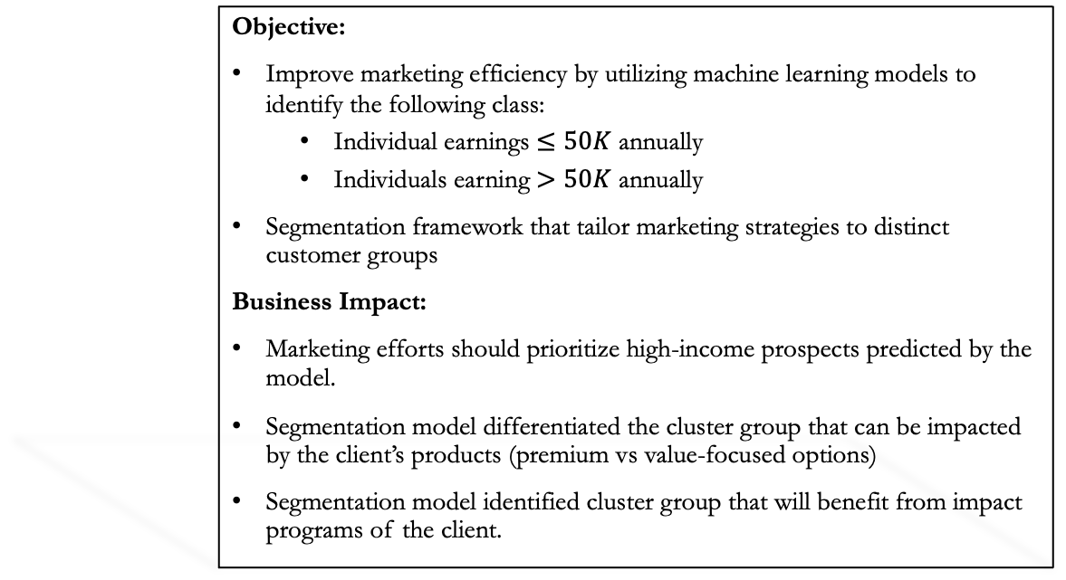
Executive Summary
199,523
Total Records
6.21 %
Earn $>\$50K$
(Minority Class)
94.81%
Best Model
ROC-AUC
2
Distinct Marketing Segments
Objective:
Improve marketing efficiency by utilizing machine learning models to identify the following class:
  Individual earnings $≤50K$ annually
  Individuals earning $>50K$ annually
Segmentation framework that tailor marketing strategies to distinct customer groups
Business Impact:
Marketing efforts should prioritize high-income prospects predicted by the model.
Segmentation model differentiated the cluster group that can be impacted by the client’s products (premium vs value-focused options)
Segmentation model identified cluster group that will benefit from impact programs of the client.
Key Results:
Classification Model Summary
  All models exceed 90% ROC-AUC
  Selected Model: Gradient Boosting Classifier (XGBoost)
    Efficient with class imbalance
    Test ROC-AUC: 94.81%
    Precision:
    Recall
    Class imbalance (15:1) handled with oversampling technique (SMOTE)
Segmentation Model Summary
  Clustering Model: KMEANS
  Cluster size: k =2
  Silhouette Score: 0.29
  Cluster 0: Working Class/Mainstream
  Cluster 1: Young Professional

Slide 4
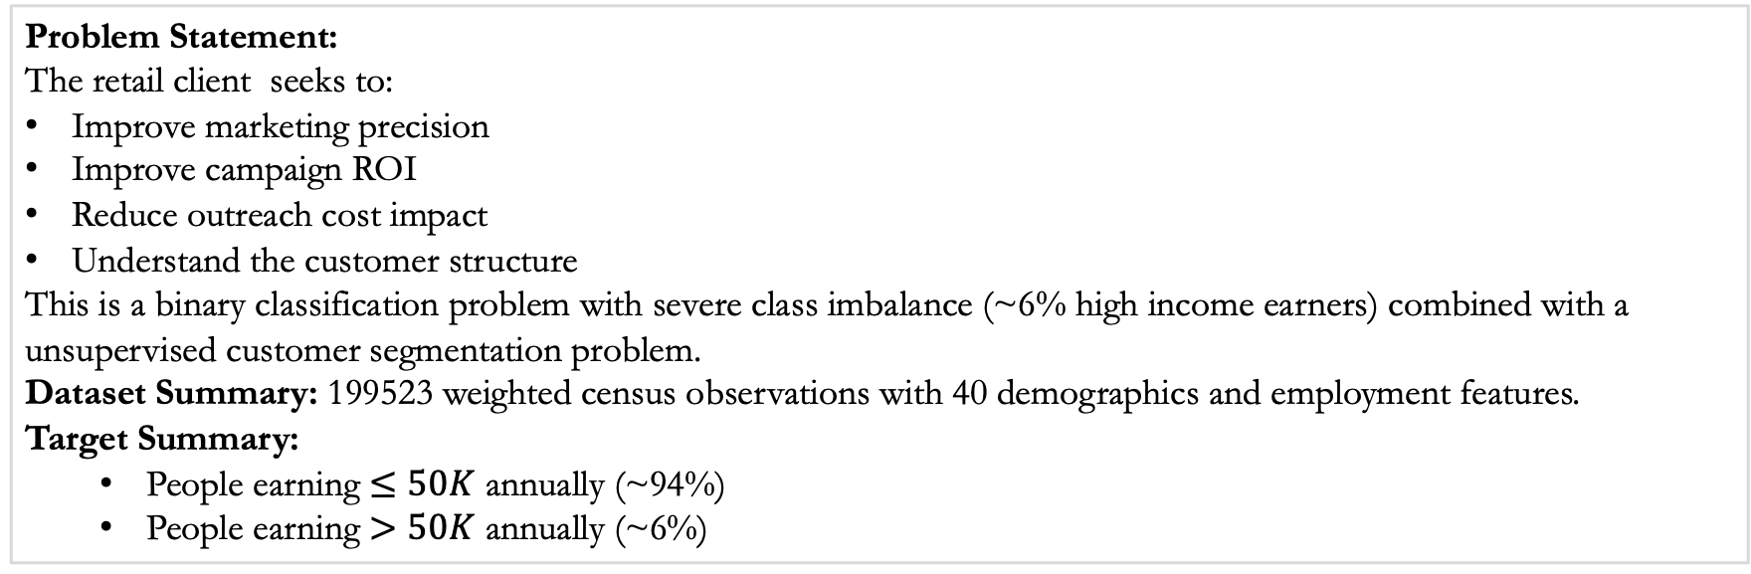
Business Problem Overview
Problem Statement:
The retail client seeks to:
Improve marketing precision
Improve campaign ROI
Reduce outreach cost impact
Understand the customer structure
This is a binary classification problem with severe class imbalance (~6% high income earners) combined with a unsupervised customer segmentation problem.
Dataset Summary: 199523 weighted census observations with 40 demographics and employment features.
Target Summary:
  People earning $≤50K$ annually (~94%)
  People earning $>50K$ annually (~6%)
Deliverables
Classification Model
  Predict the income class of any individual given demographic and employment features
Segmentation Model
  Develop a machine learning pipeline to group the customer population.

Slide 5
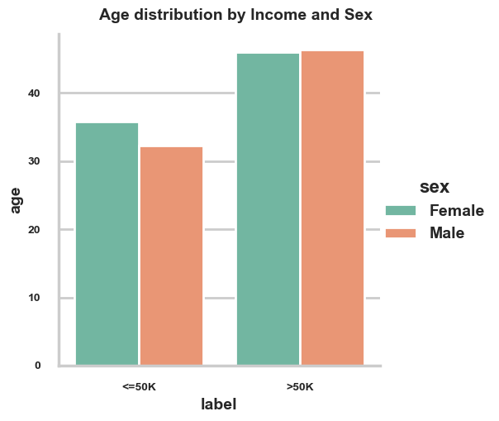
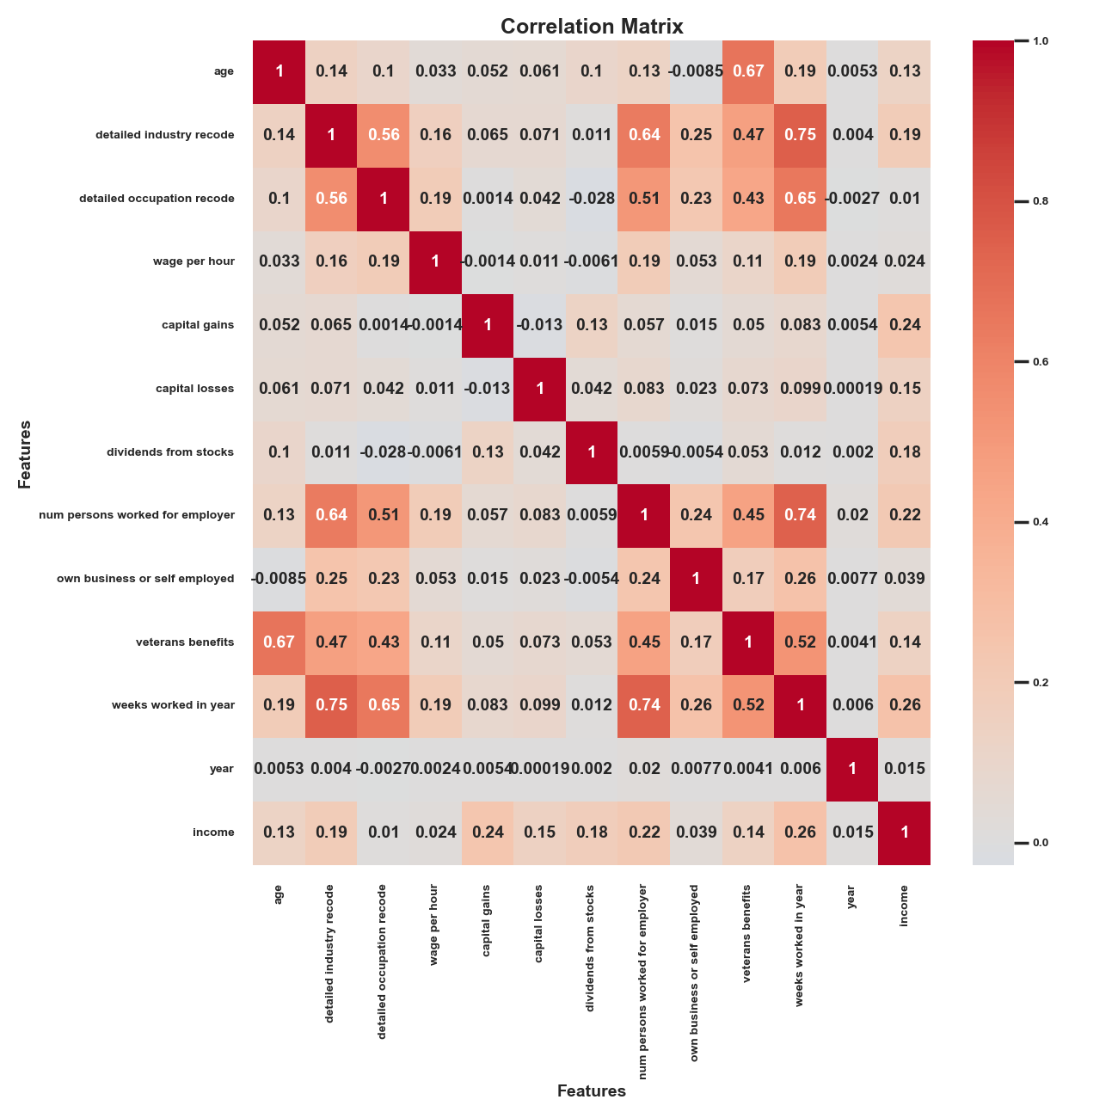
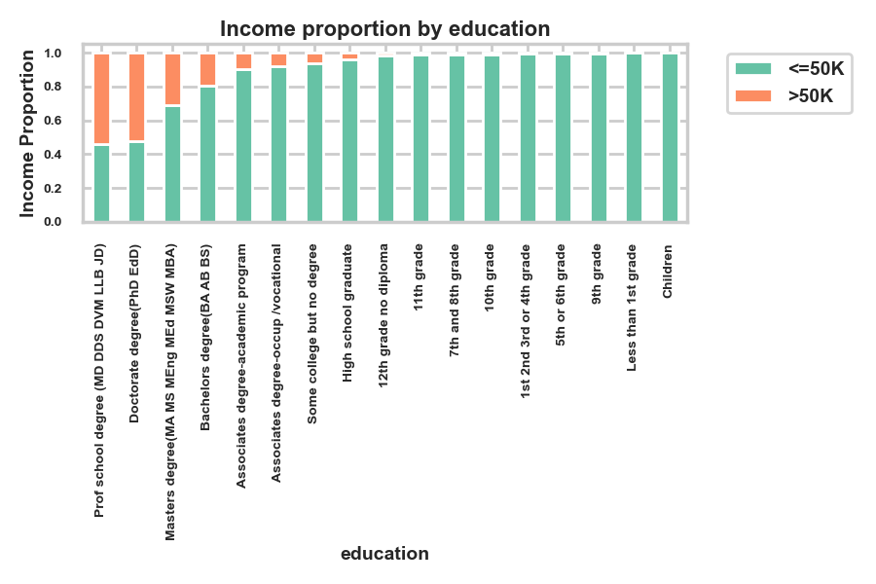
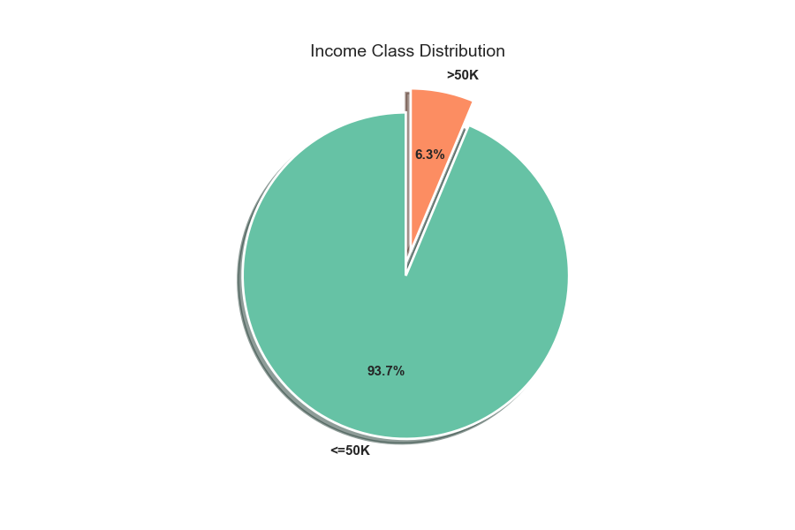
Exploratory Data Analysis & Preprocessing
Class Imbalanced:
The dataset was imbalanced. Only 6% of the target class (high income earners) was available in the dataset.
Metrics of evaluation: Accuracy is not sufficient for evaluation. ROC-AUC metric is prioritized.
The imbalanced class was stratified using SMOTE algorithm during model training.
Missing Data:
‘?’ and ‘Not in Universe’ are missing values
Numerical features were imputed with median values
Categorical features were imputed with most-frequent data (mode)
Removed columns with > 70% missing values
Preprocessing were applied during cross-validation steps of the training
Feature Encoding:
Numeric features were standardized
Categorical features were encoded with the OneHotEncoder
Train/Test Split:
The dataset was split in 70% Training and 30% Test
Cross validation fold= 5 was applied during model training.
Class Imbalance:
Only 6.21% earn ≥$50K — 15:1 ratio. Accuracy alone is misleading; ROC-AUC and balanced weighting are essential.
Impact of Education:
Professional/PhD degree holders earn ≥$50K at 50%+. High school grads under 5%. Strongest categorical predictor.
Gender Imbalance:
Males earn ≥$50K at 10.1% vs females at 2.5%, reflecting 1994-95 labor market inequalities.
Work Commitment
High earners work nearly 52 weeks/year. Low earners are dispersed across part-time and seasonal work.

Slide 6
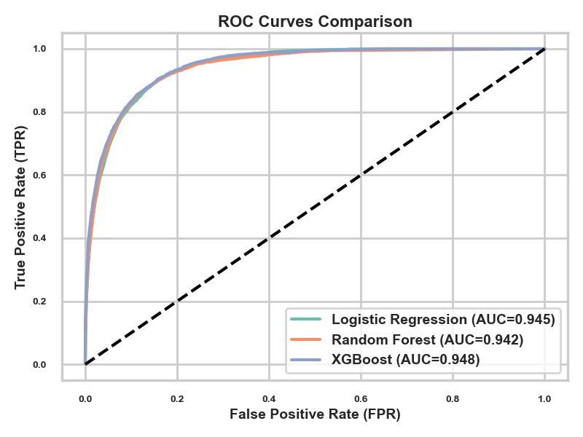
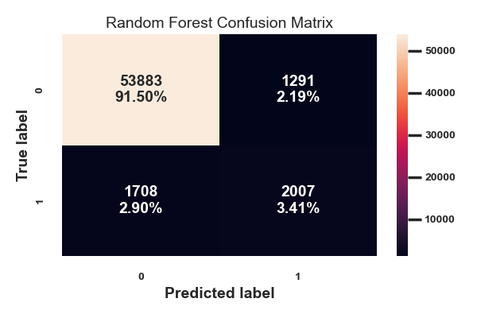
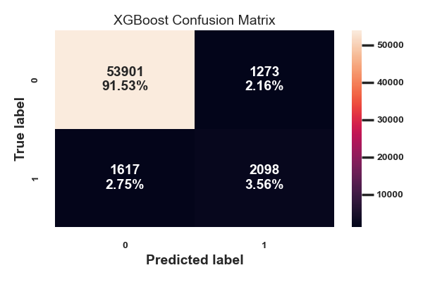
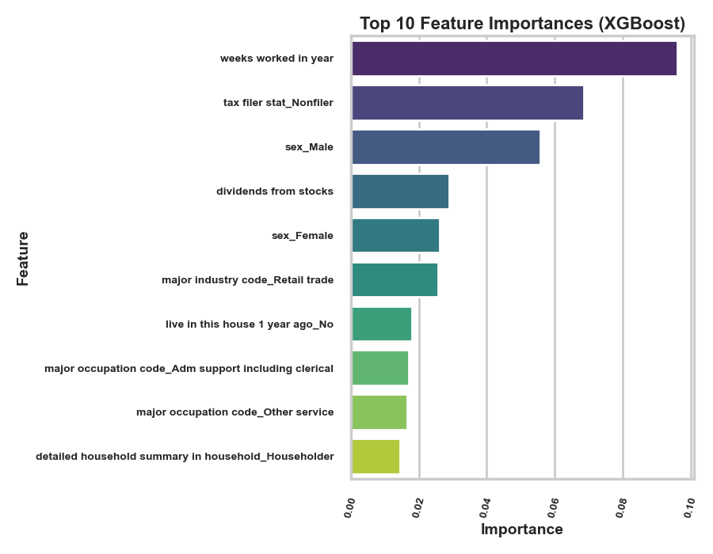
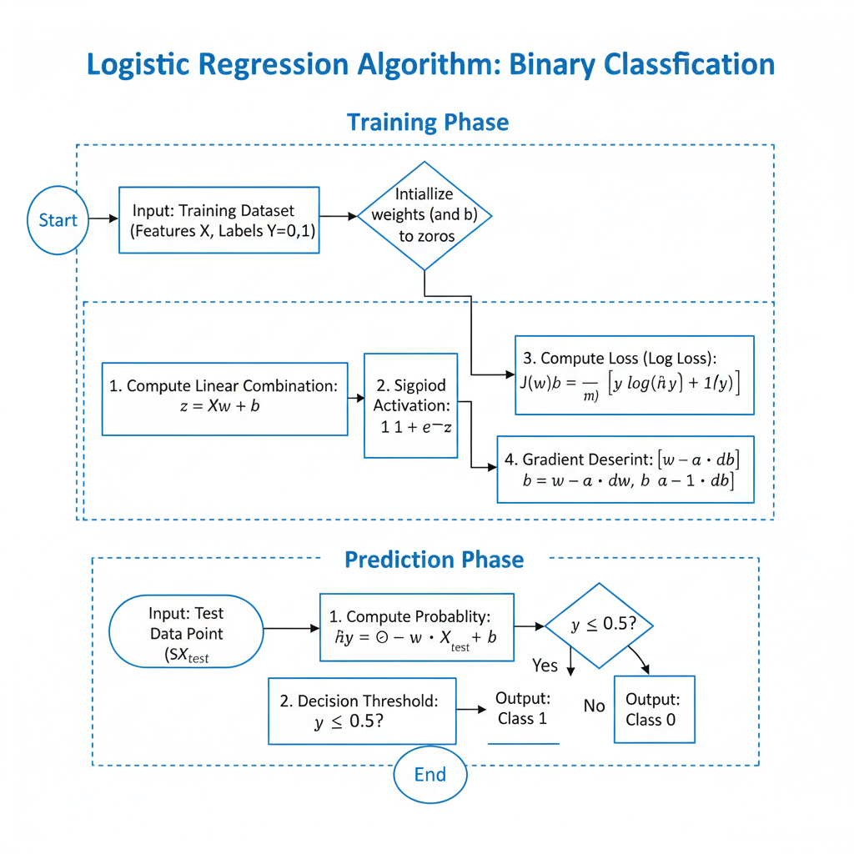
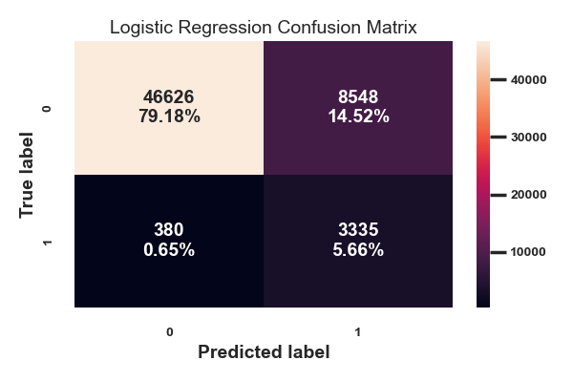
Classification Model: Training and Evaluation
Models: Logistic Regression | RandomForest | XGBoost
Models were trained and evaluated using a balanced stratified 5-fold sets of dataset.
Evaluation metric was ROC-AUC scores. The metric generalizes as a good metric for classification because it encompasses other metrics accuracy, precision, recall.
Hyper-parameter tuning of the model parameters indicated that the optimal parameters of the models demonstrated a high ROC-AUC score of above 94%.
XGBoost model evaluated higher than other models using the ROC-AUC score. The ROC-AUC score is 94.82%
Model | ROC-AUC (Test) | Accuracy | Precision (≥$50K) | Recall (≥$50K) | Selected
Logistic Regression (Baseline) | 94.46% | 84.84% | 28% | 89.77% | Baseline
Random Forest | 94.25% | 94.91% | 60.86% | 54.02% | —
Gradient Boosting ✓ | 94.82% | 95.09% | 62.24 | 56.47% | ★ BEST

Slide 7
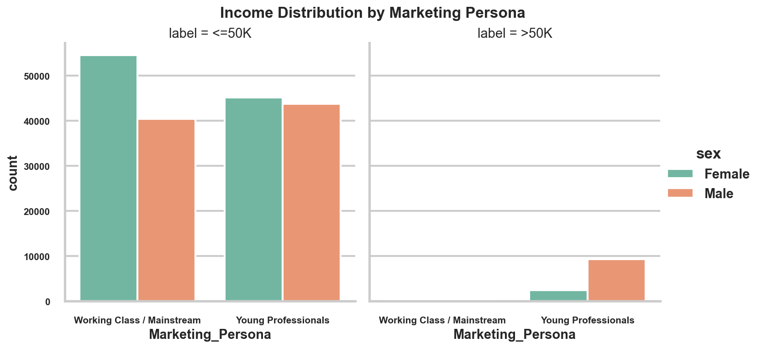
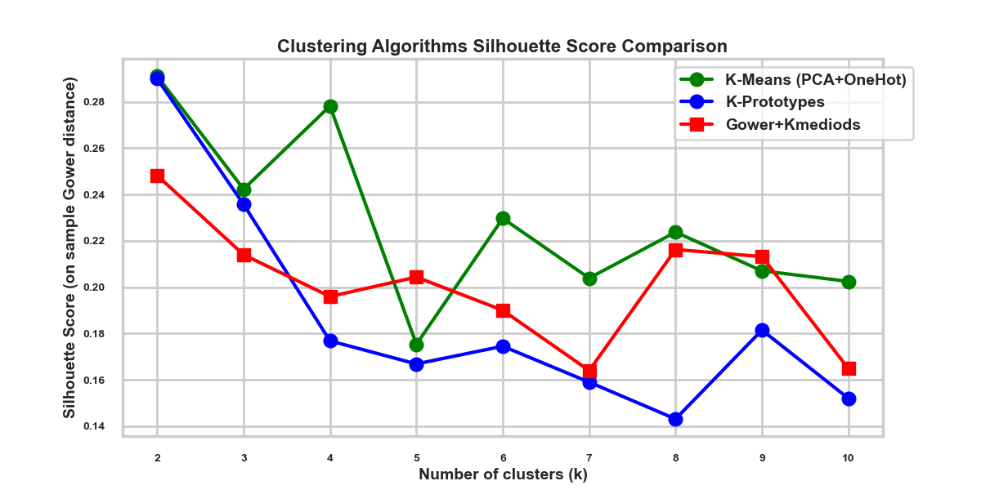
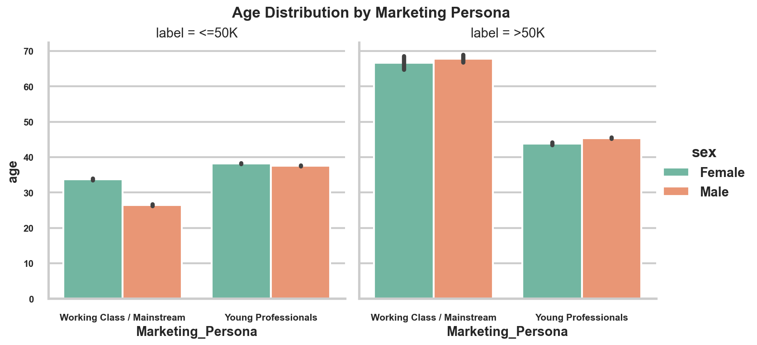
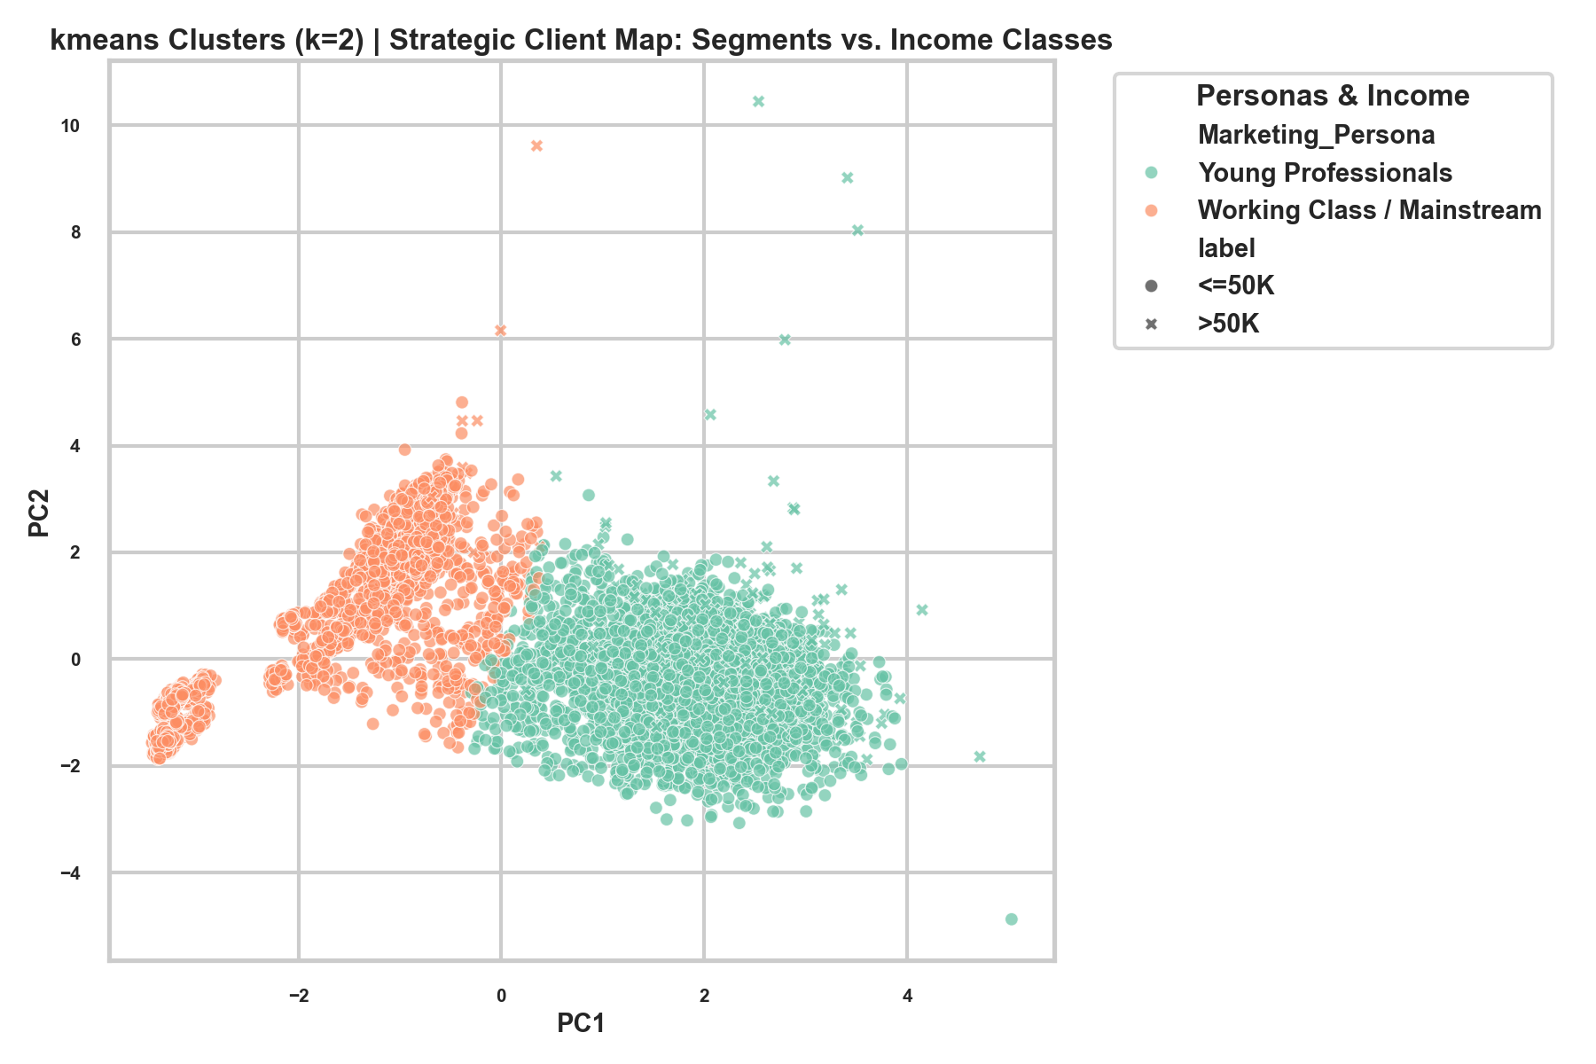
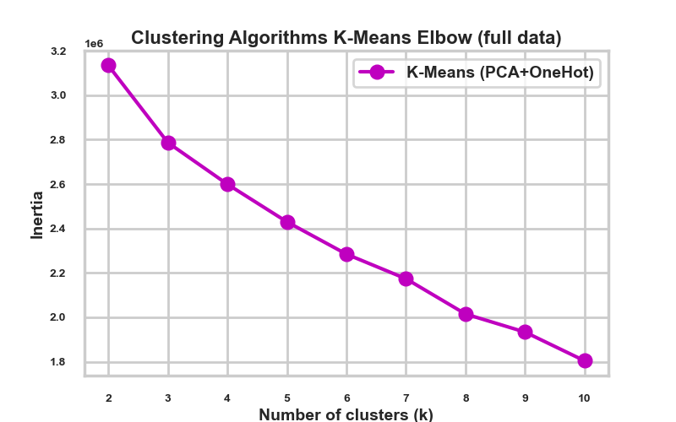
Segmentation Model: Clustering
KMEANS CLUSTERING ALGORITHM
Step 1: Preprocessing
Scale Numeric features (Standardscaler)
OneHotEncode Categorical Features
[300+ dimensions]
Step 2: PCA Dimension Reduction
61 components with 95% variance
Step 3: Optimal K selection
Using the Silhouette and Elbow method, the optimal clusters k is computed
Step 4: KMEANS (k=2)
Use the optimal cluster size k=2
Models: kmeans | kprototypes | kmediods + gower
The datasets is a mixed datasets. Three models were evaluated for the clustering.
The models were evaluated by the silhouette scores such that the model with the highest silhouette scores is selected.
KMEANS with cluster size=2, had the maximum Silhouette score of 0.29.
Result:
Average Age of Cluster 0: Working class /Mainstream is 30yrs and cluster 1: Young Professional is 38yrs
Average weeks worked for cluster 0: Working class/Mainstream is 1 week/year and cluster 1: Young Professional is 45weeks/year.
Average wage per hour for cluster 0: 1hr and cluster 1: $109/hr.
Business Application:
Premium products marketing should target cluster 1
Value added product marketing should target cluster 0
Apply A/B testing by cluster group

Slide 8
Business Recommendation
Recommendation
Deploy XGBoost model to predict high earning customers for targeted marketing.
To improve customer’s financial stability and resilience, the model can predict customers who will benefit from the impact program.
The model determined income disparity in gender and race. It can be used to determine the gender and race of participants in the building wealth and legacies program of the client.
Prioritize cluster 1: Young Professional customer for targeted marketing.
Monitor the model for model and data drift over time.
Retrain the model with updated census data
Limitations
Census data (1994 – 1995) may not reflect income structures
Silhouette scores indicates a moderate cluster separation
Economic shifts may impact the stability of the model
Performance of the model depends on accurate inputs.
Future Improvements
Threshold Optimization using key business cost parameters
Investigate the regulatory compliance concerns of using the ML model.
Due to lack of recent dataset for training, I would recommend the ML be trained with more current census bureau dataset.
Explore cost-sensitive learning
Evaluate PR-AUC explicitly
Conduct fairness stress testing
Explore UMAP for non-linear cluster segmentation.
Conclusion
The machine learning framework identifies:
Two customer segmentation clusters for target marketing
The best classification models for the dataset as XGBoost
Business threshold optimization

Slide 9
Reference
Huang, Z.: Clustering large data sets with mixed numeric and categorical values, Proceedings of the First Pacific Asia Knowledge Discovery and Data Mining Conference, Singapore, pp. 21-34, 1997. [HUANG98]
Scikit-Learn kmeans clustering documentation: https://scikit-learn.org/stable/modules/clustering.html#k-means
Scikit-learn supervised learning documentation: https://scikit-learn.org/stable/supervised_learning.html
Chen T, He T, Benesty M, Khotilovich V, Tang Y, Cho H, Chen K, Mitchell R, Cano I, Zhou T, Li M, Xie J, Lin M, Geng Y, Li Y, Yuan J, Cortes D (2026). xgboost: Extreme Gradient Boosting. R package version 3.3.0.0, https://github.com/dmlc/xgboost.
Géron, A. (2019). Hands-on machine learning with Scikit-Learn, Keras, and TensorFlow: Concepts, tools, and techniques to build intelligent systems (2nd ed.). O'Reilly.

