Slide 1
CUHK Philosophy Orientation Camp
Game Session

Slide 2
GAME
LANGUAGE ARCHITECT

Slide 3
SCENARIO

Slide 4
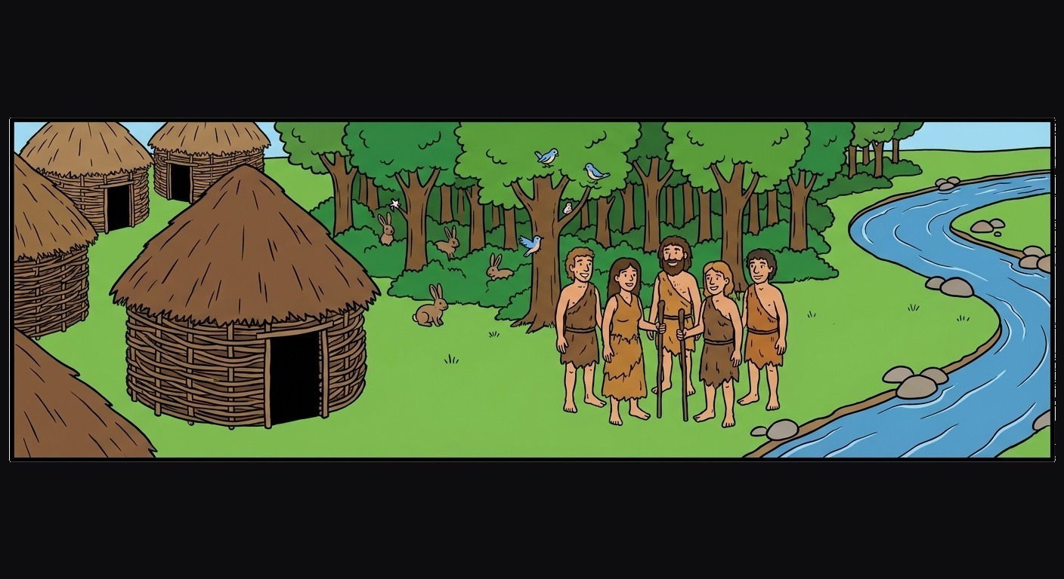

Slide 5
There is an early human community.
It has three settings: a village (where people live), a forest (where animals and prey are found), and a river (where water is collected).
This community does not yet have a language.
People survive mainly by hunting, which sometimes requires making weapons.
The hunters include people of different genders.
Your task: design a language for this community.

Slide 6
ROOM SETUP
Form four large circles of 7–8 people. Each circle corresponds to one section of the whiteboard.
A
B
C
D
WORD LIST
WORD LIST
WORD LIST
WORD LIST
Left: write your group’s word list. Ten boxes on the right: record each round’s votes.

Slide 7
VIDEO DEMO

Slide 8


Slide 9
WARM-UP

Slide 10
STEP 2 · WARM-UP WORD LIST (10 MINUTES)
Each group discusses and designs 10 words, then writes them in the blank area on the left of the whiteboard.
Definition of “word”: every word you propose must appear in at least one formally published modern Chinese dictionary.
If a word is challenged, accept it as long as its proposer can identify a modern Chinese dictionary that includes it.

Slide 11
ROUND PROCEDURE
1. Show a scene and the meaning its character wants to express. Everyone reads it.
2. Each group discusses for 3 minutes and combines words from its list into one sentence expressing what the character says or thinks. Then write the sentence on the whiteboard.
3. One person from each group has 30 seconds to explain why the group’s sentence expresses the intended meaning.
4. After all four explanations, everyone votes. Judge each sentence separately: “Can this sentence express the intended meaning?”
Raise your hand for every group whose sentence works. You may vote for any number of groups from 0 to 4.
Count raised hands; the facilitator records each total in the corresponding box.
5. Reveal the reference answer. The facilitator briefly explains which boundary of language the round tests.
Vote according to your own genuine judgement.

Slide 12
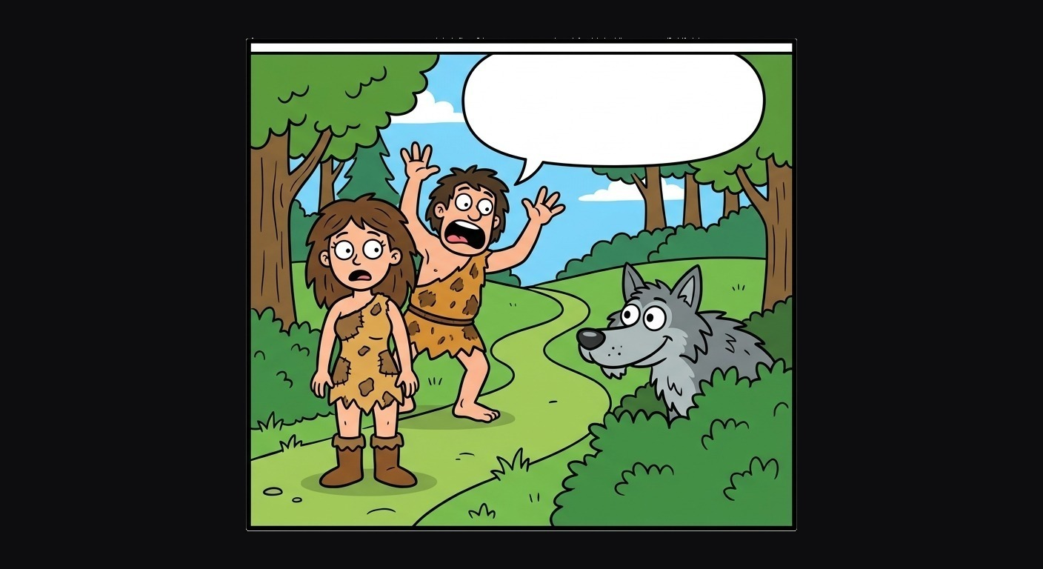
WARM-UP 1
“Watch out!”

Slide 13
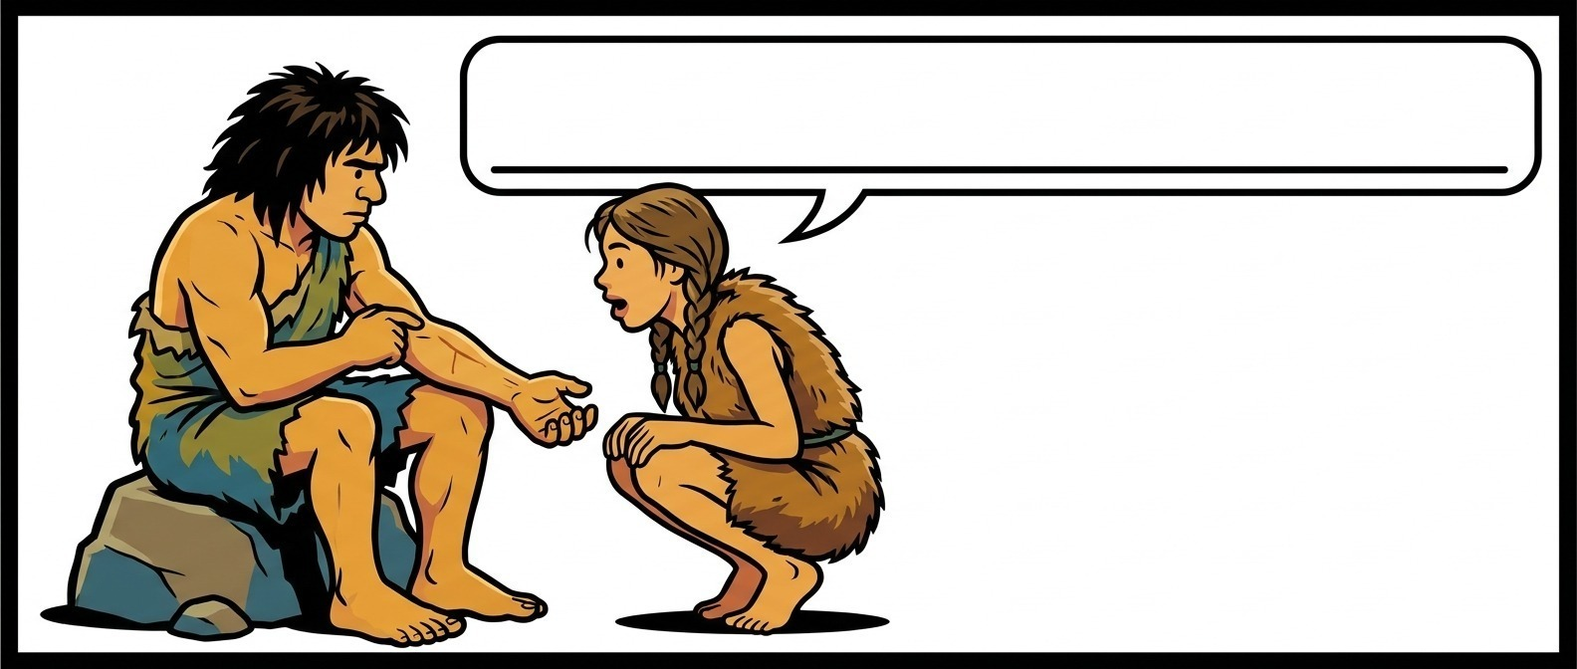
WARM-UP 2
“Are you in pain?”

Slide 14
MAIN ROUND

Slide 15
STEP 4 · MAIN WORD LIST (15–20 MINUTES)
Each group redesigns the community’s language, this time with 30 words.
What difficulties arose during the warm-up? What was missing from your original language?
Take those gaps into account as you redesign it.

Slide 16
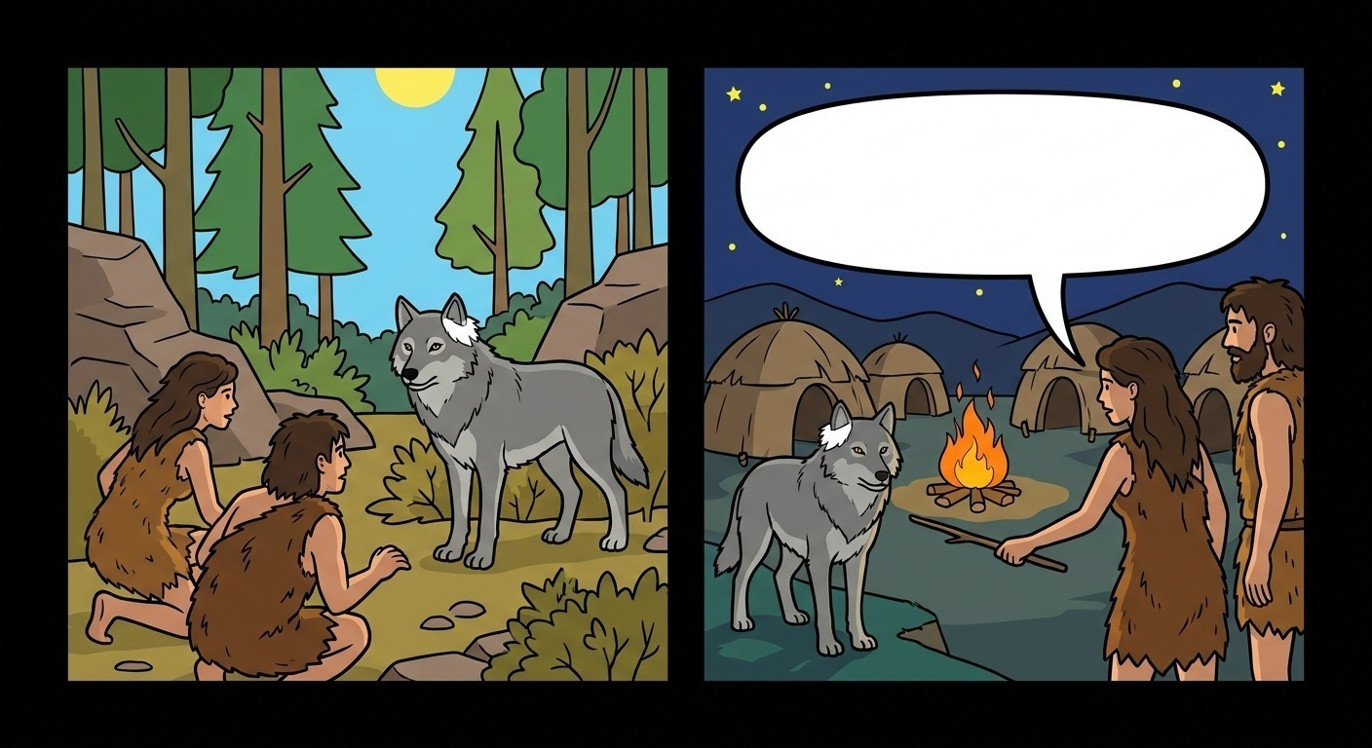
QUESTION 1
“This is the same wolf we saw in daylight.”

Slide 17
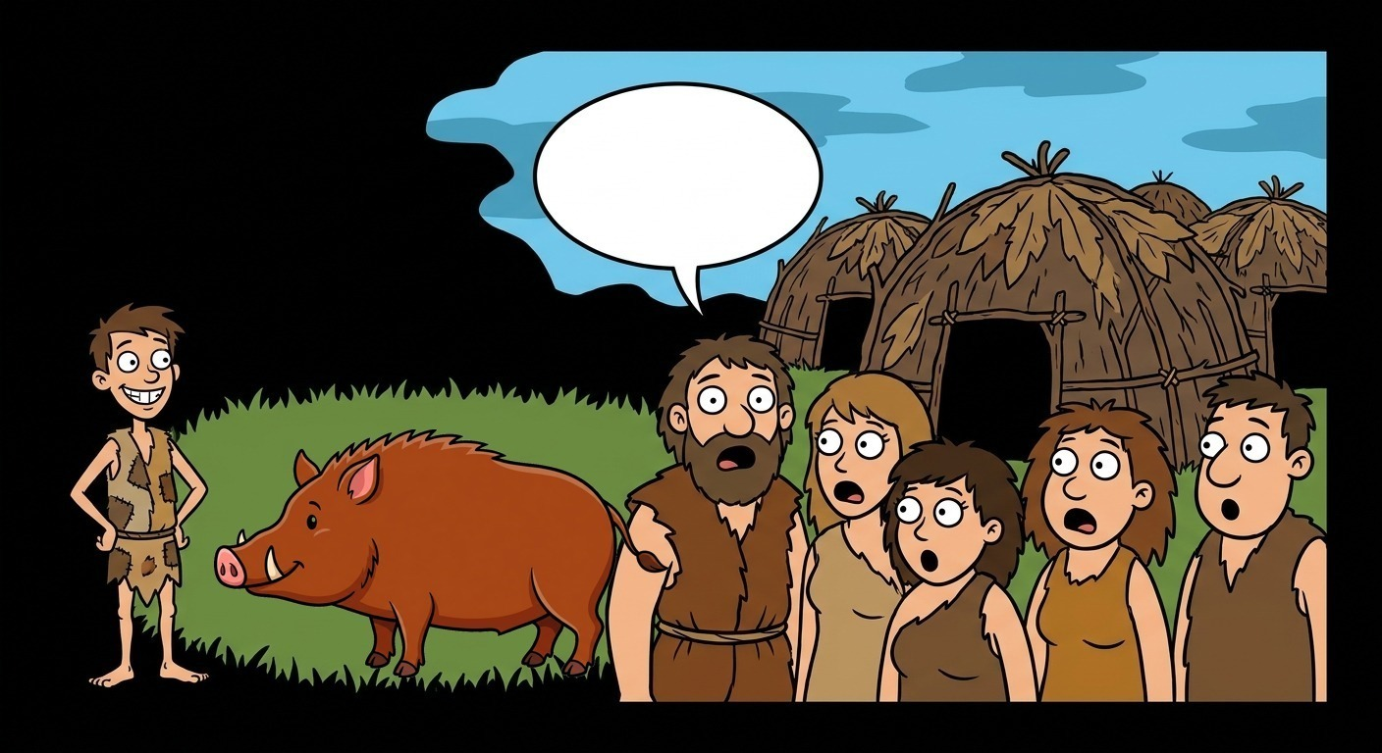
QUESTION 2
“Even that person managed to hit a wild boar.”

Slide 18
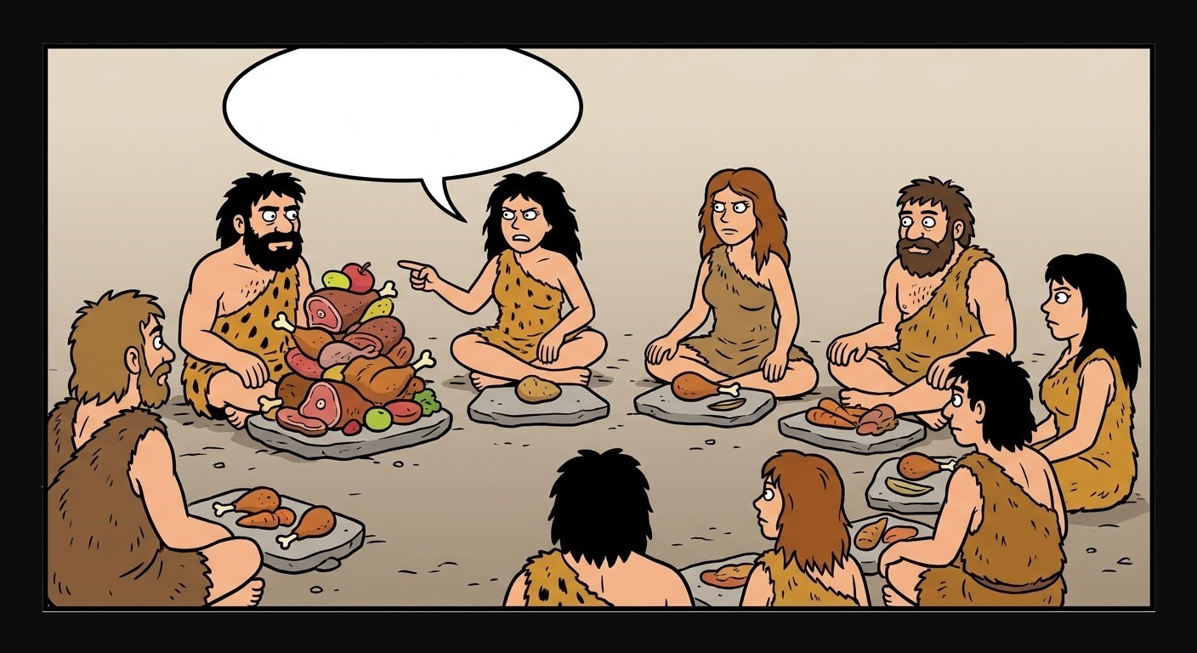
QUESTION 3
“You took too much meat.”

Slide 19
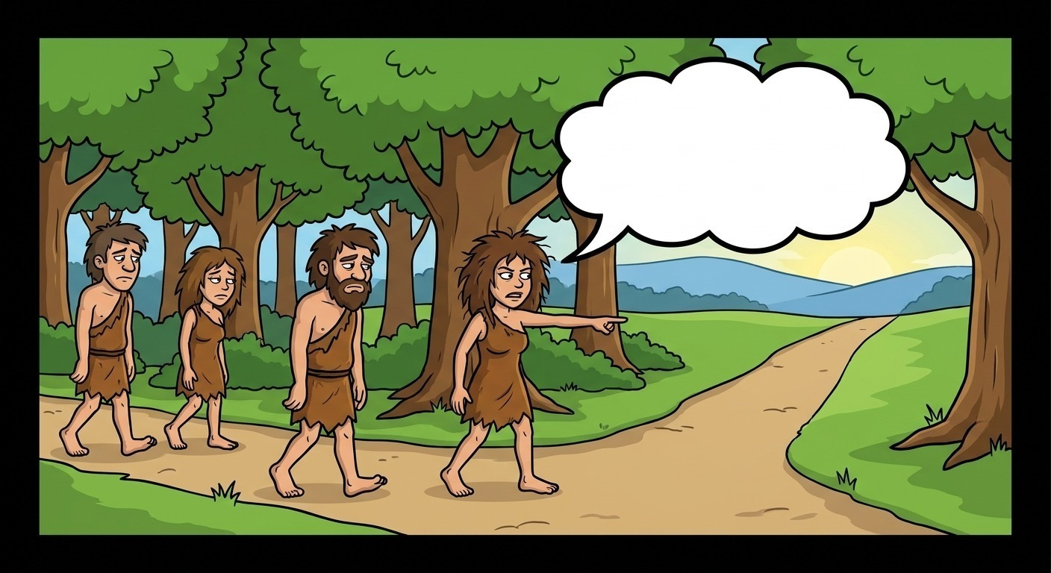
QUESTION 4
“If we had gone right then, we would have caught up.”

Slide 20
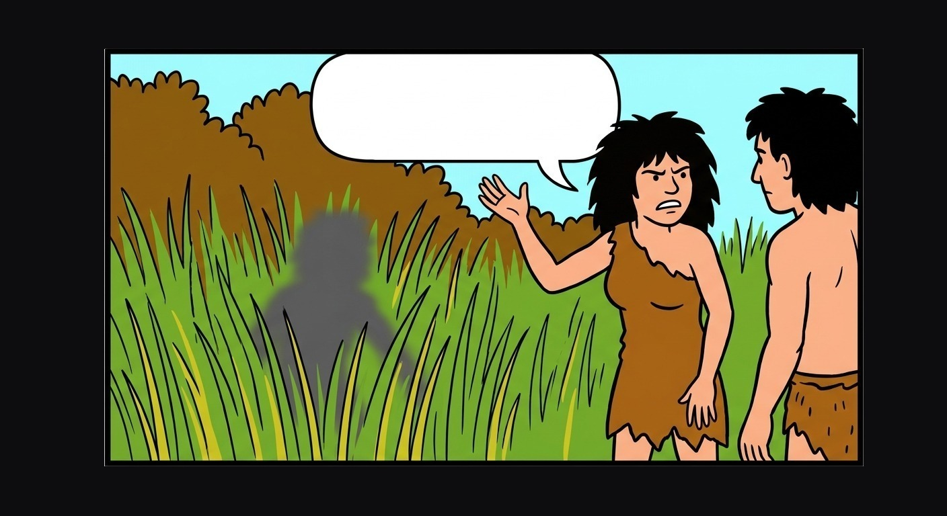
QUESTION 5
“I think I saw something move just now, but I may have been mistaken.”

Slide 21
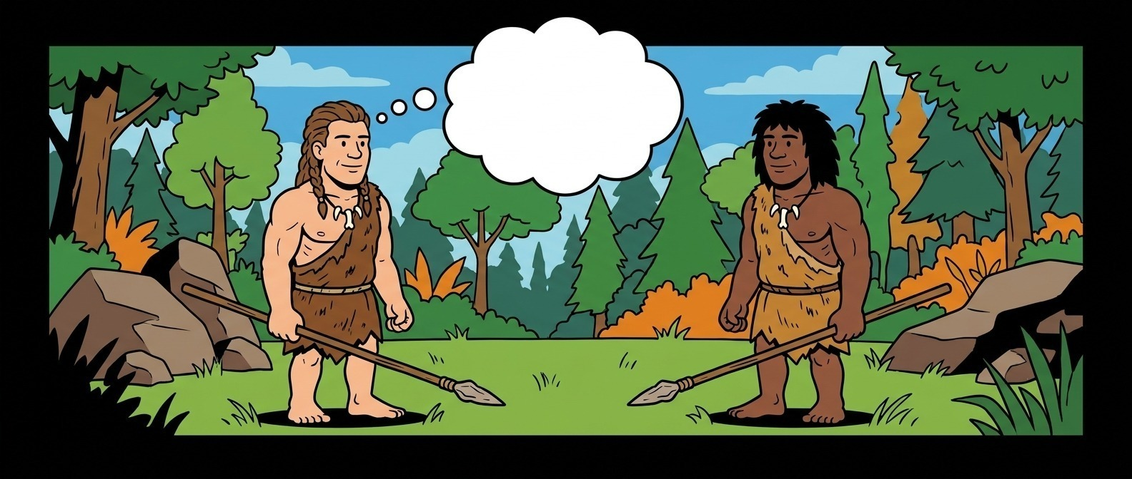
QUESTION 6
“I ought to treat that person in a friendly way.”

Slide 22
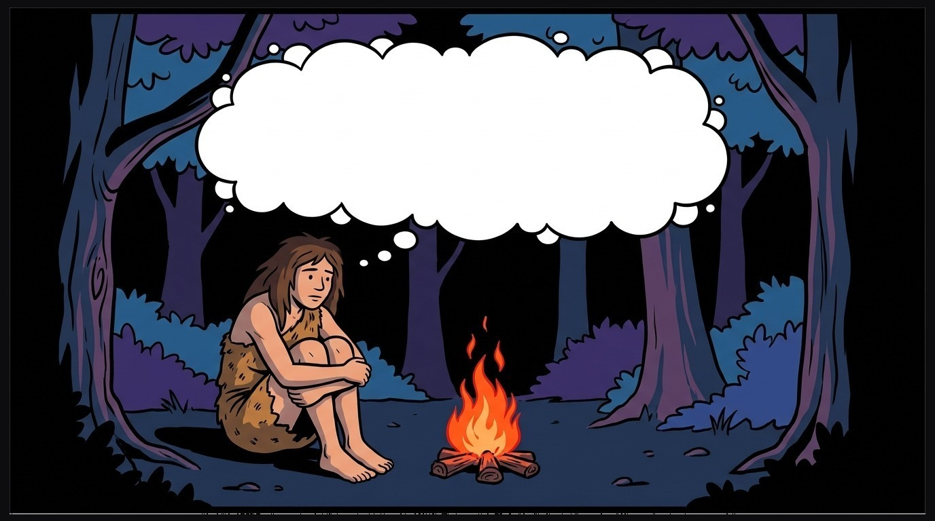
QUESTION 7
“I am lonely.”

Slide 23
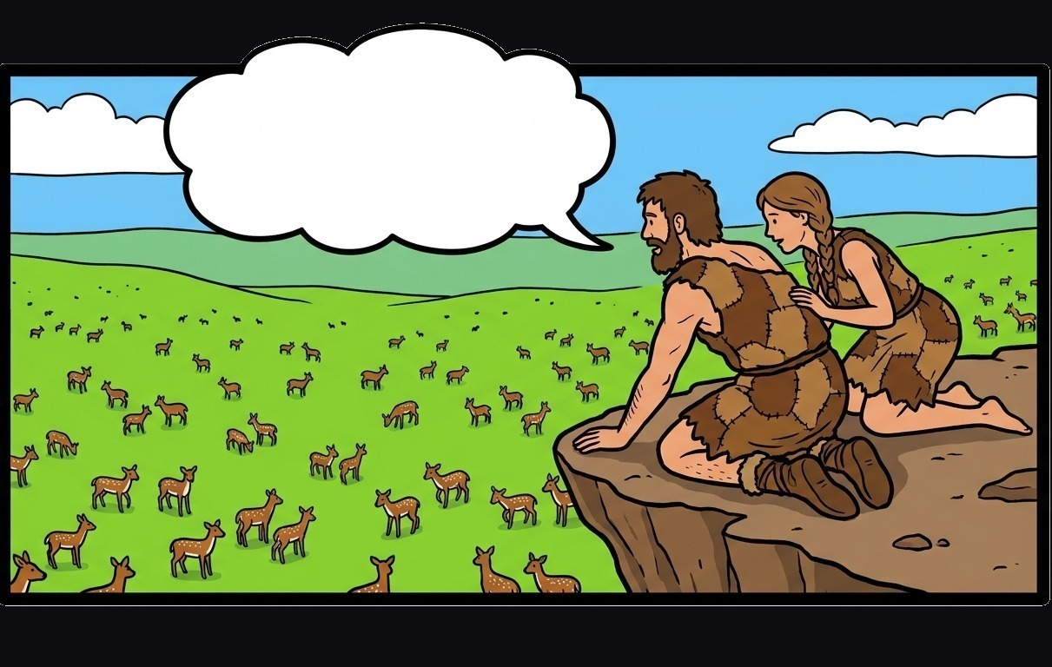
QUESTION 8
“I estimate there are at least thirty.”

Slide 24
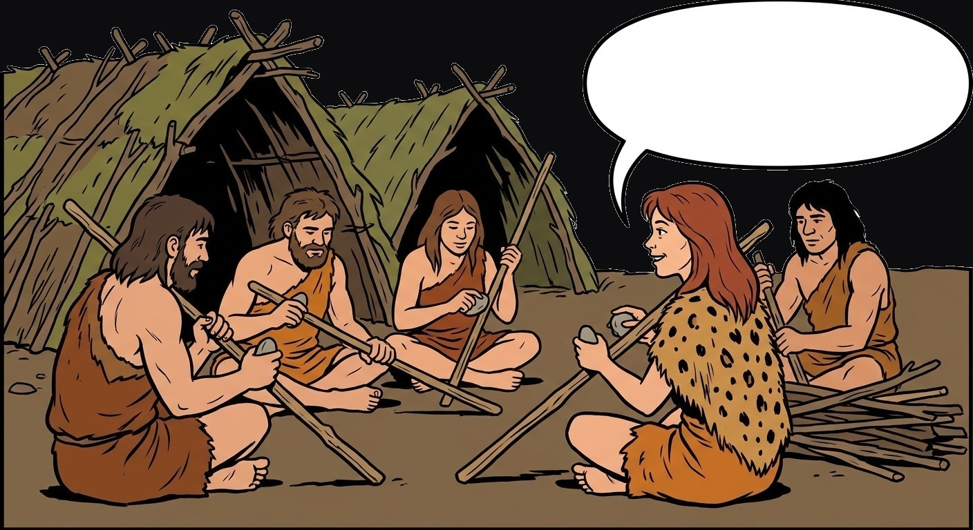
QUESTION 9
“To hunt successfully tomorrow, we need to make weapons now.”

Slide 25
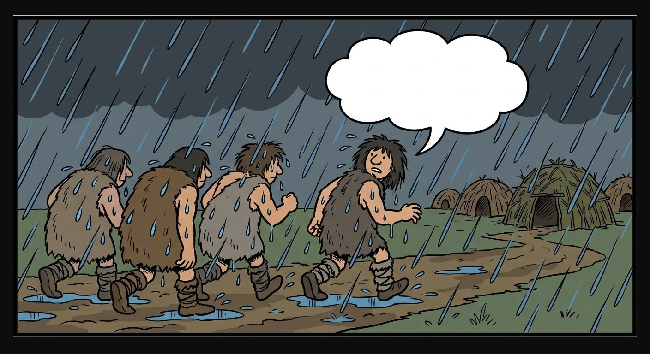
QUESTION 10
“Although it is raining heavily, we must return to the village before dark.”

Slide 26
DEBRIEF

