Slide 1
CUHK Philosophy Orientation Camp
Game Session

Slide 2
PICK A SIDE

Slide 3
VIDEO DEMO

Slide 4
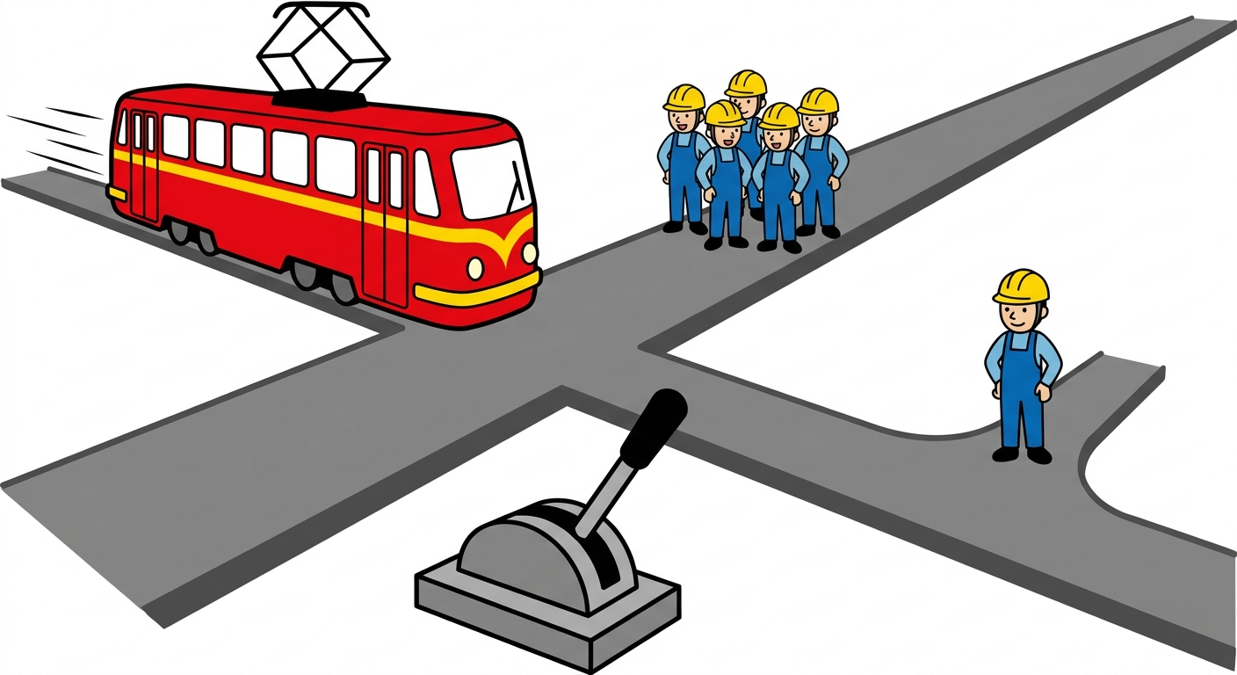

Slide 5
WARM-UP

Slide 6
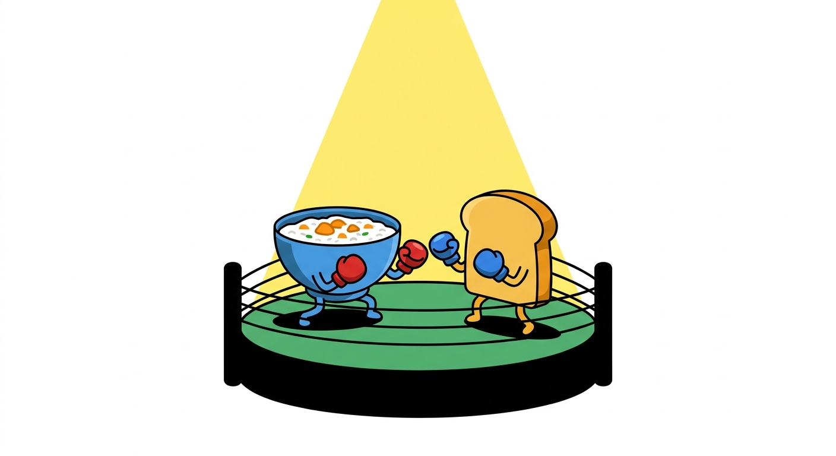
Congee or bread for breakfast?
Left: congee. Right: bread.

Slide 7
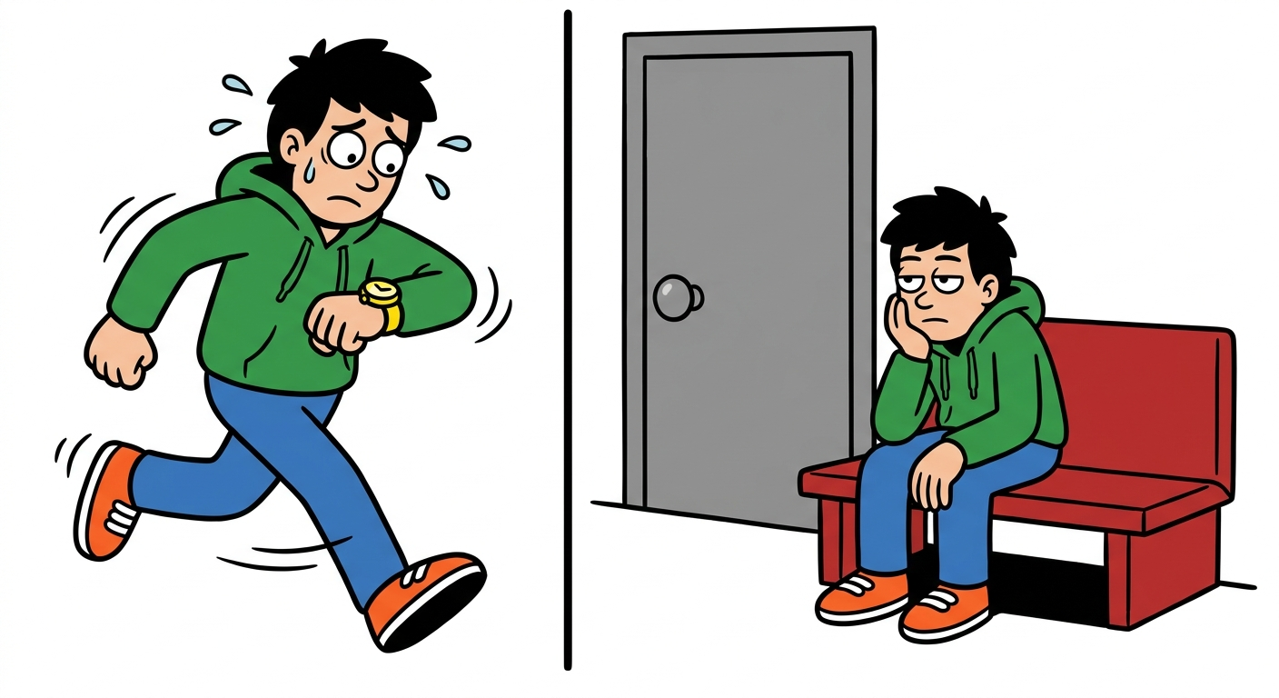
Would you rather always be five minutes late, or twenty minutes early?
Left: five minutes late. Right: twenty minutes early.

Slide 8
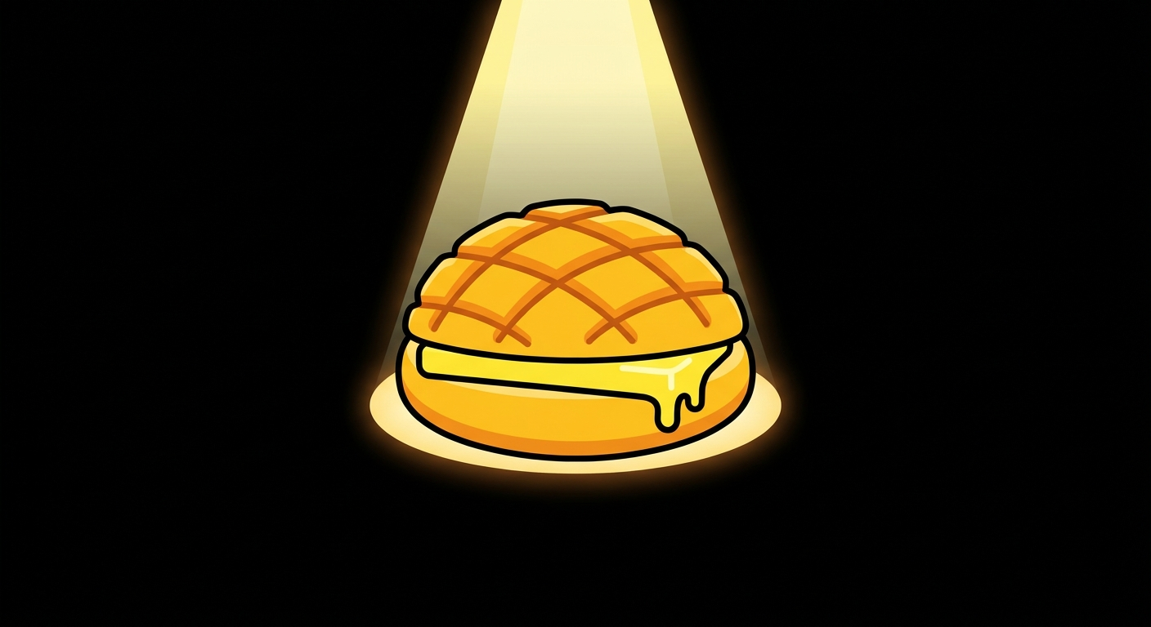
A pineapple bun must be served with butter.
Left: agree. Right: disagree.

Slide 9
MAIN ROUND

Slide 10
ROUND 1
A runaway trolley is heading towards five people. Pulling the lever will divert it onto a side track with one person.
Left: pull. Right: do not pull.

Slide 11
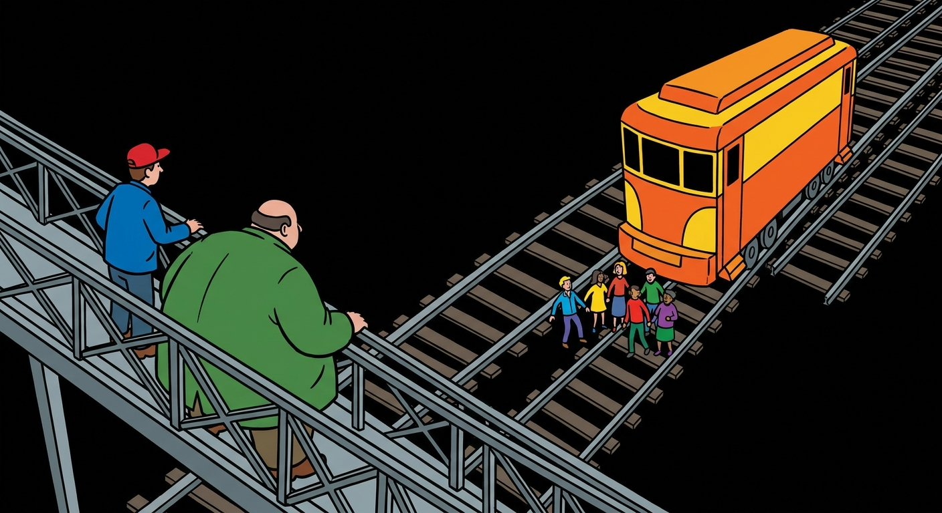
ROUND 2
A trolley is about to kill five people. Pushing a nearby stranger off the footbridge would stop it, but that person would die.
Left: push. Right: do not push.

Slide 12
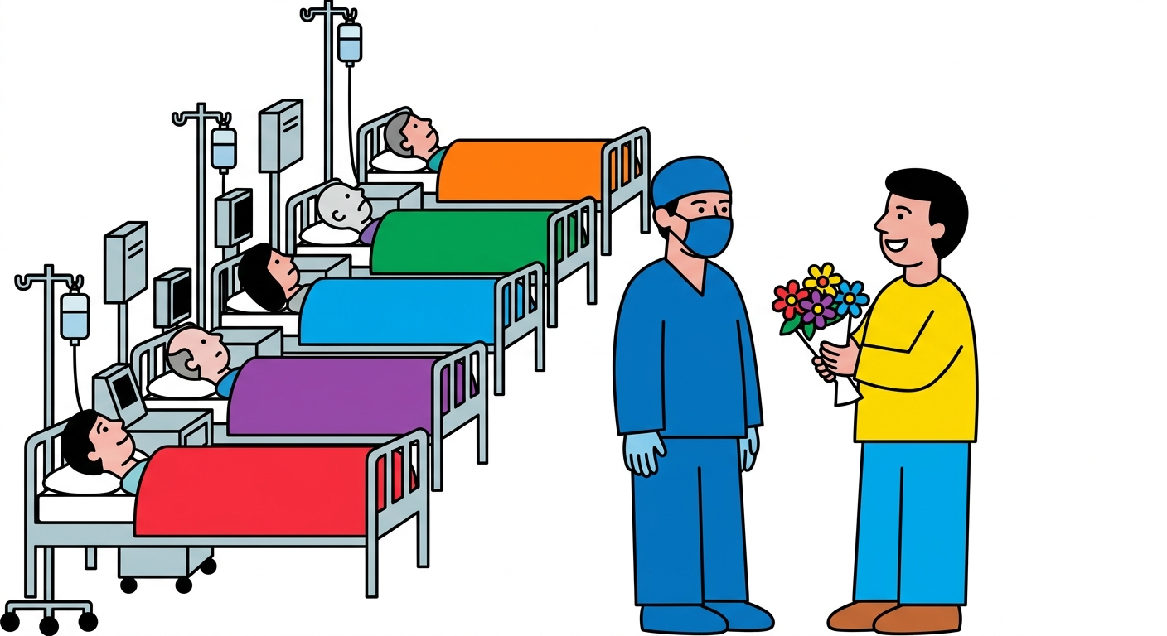
ROUND 3
Five patients each need a different organ and will die today. Killing one healthy person could save them.
Left: kill. Right: do not kill.

Slide 13
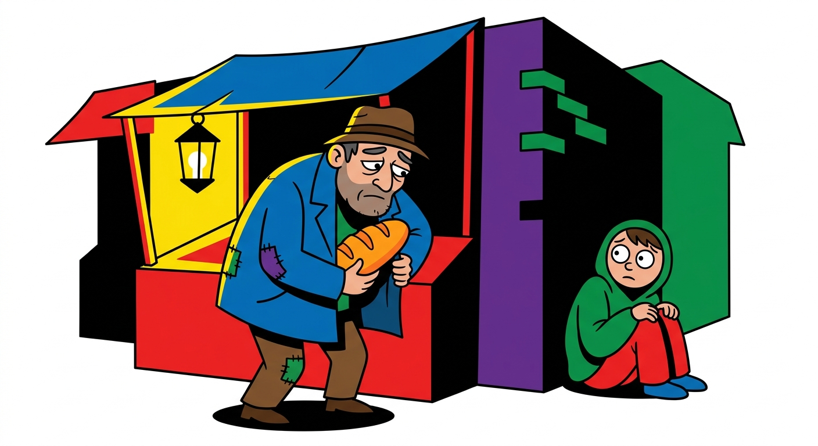
ROUND 4
A parent steals a loaf of bread to feed a child who is close to starvation.
Left: find guilty. Right: do not find guilty.

Slide 14
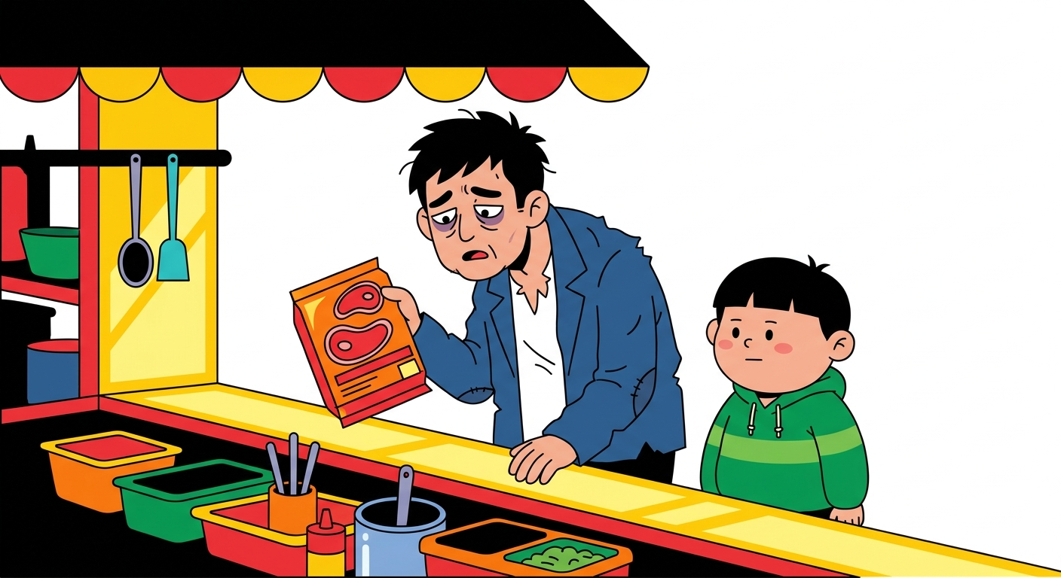
ROUND 5
A parent steals a steak. The child is not at risk of starvation, but has not eaten meat for a long time.
Left: find guilty. Right: do not find guilty.

Slide 15
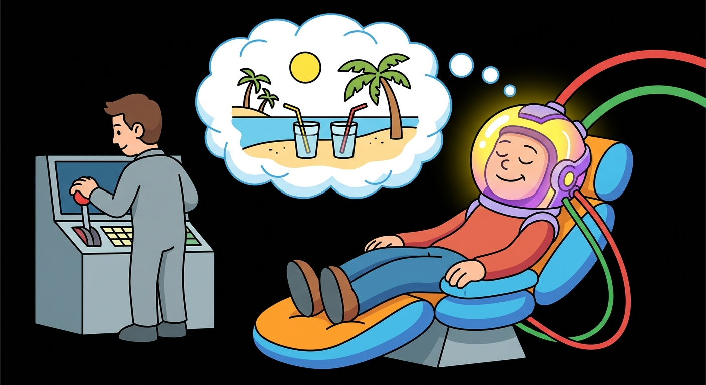
ROUND 6
A machine can give you everlasting bliss in a simulation, and you would never realise it is an illusion.
Left: connect. Right: do not connect.

Slide 16
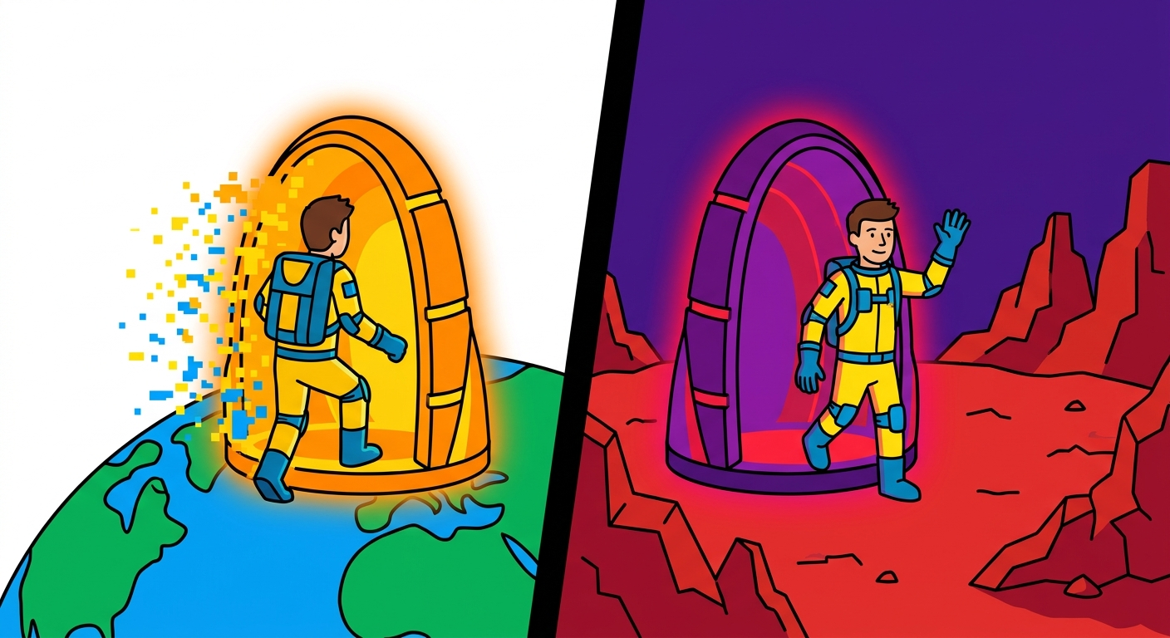
ROUND 7
You are travelling to Mars. A teleporter will disassemble you and reconstruct you there.
Left: use it. Right: do not use it.

Slide 17
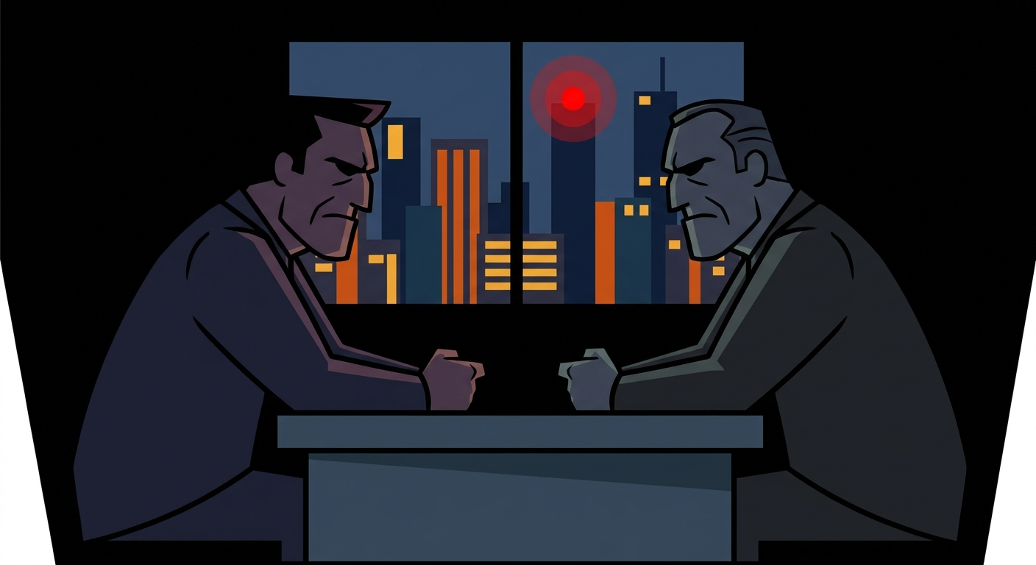
ROUND 8
A terrorist has hidden a bomb in the city that will kill 10,000 people. The bomb will stop only if the terrorist is killed.
Left: kill. Right: do not kill.

Slide 18
ROUND 9
A terrorist has hidden a bomb in the city that will kill 10,000 people. The bomb will stop only if a hostage is killed.
Left: kill. Right: do not kill.

Slide 19
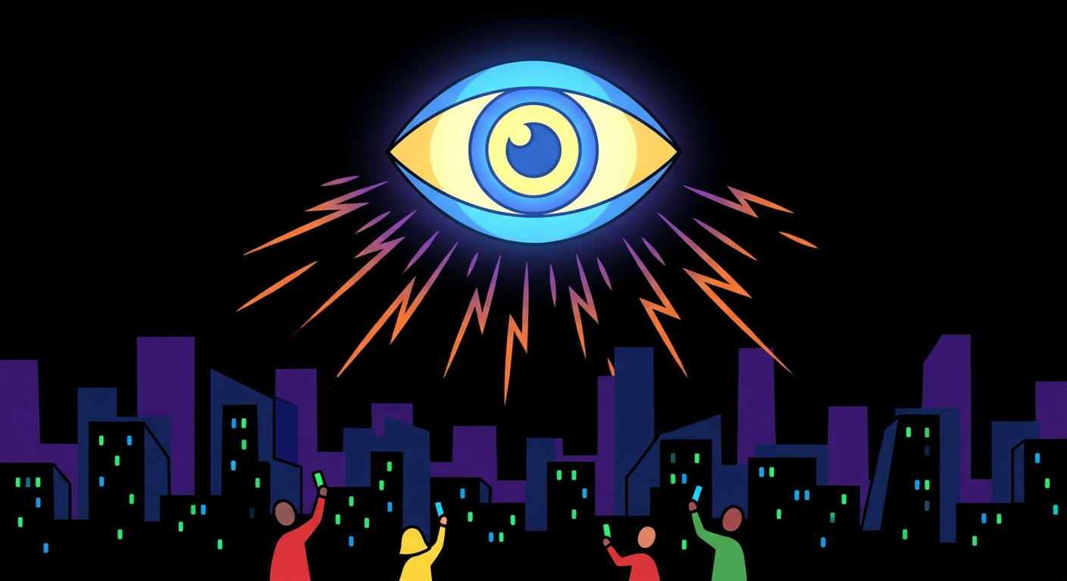
ROUND 10
The government installs surveillance in every public place to prevent crime. The crime rate will fall sharply.
Left: support. Right: oppose.

Slide 20
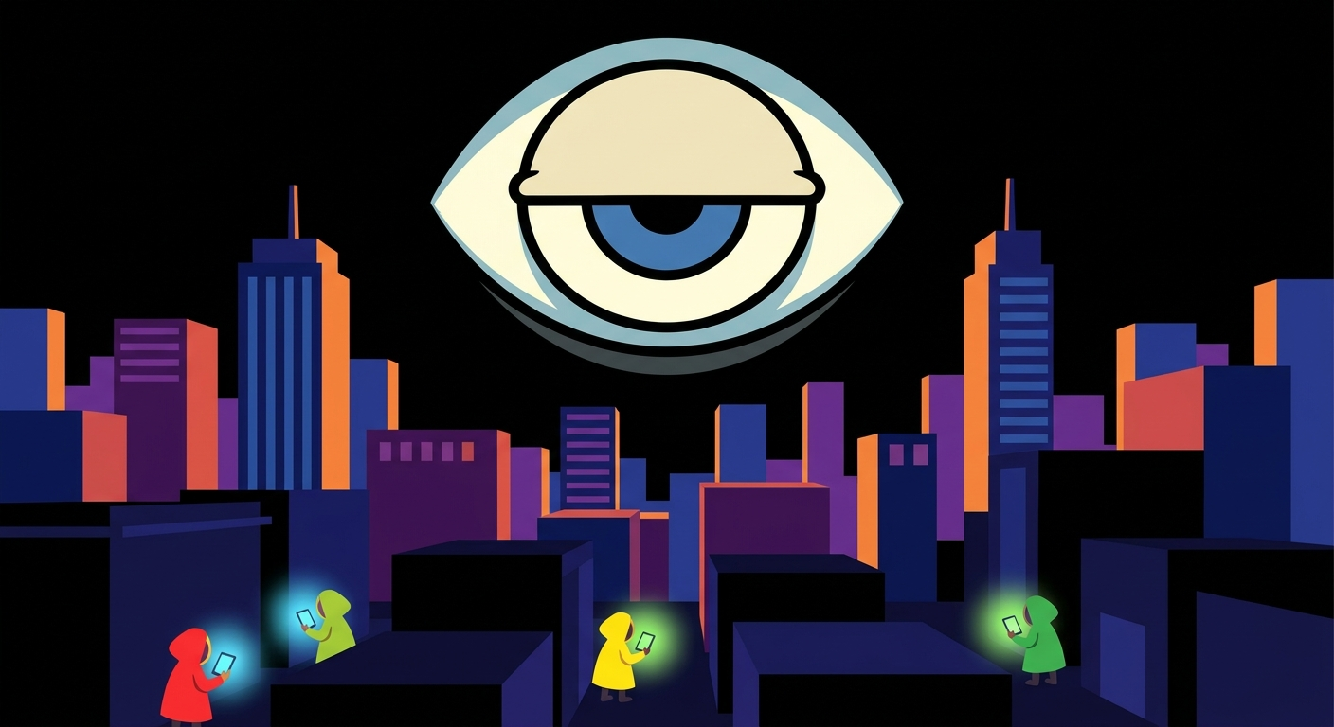
ROUND 11
The government monitors everyone’s browsing history to prevent crime. The crime rate will fall sharply.
Left: support. Right: oppose.

Slide 21
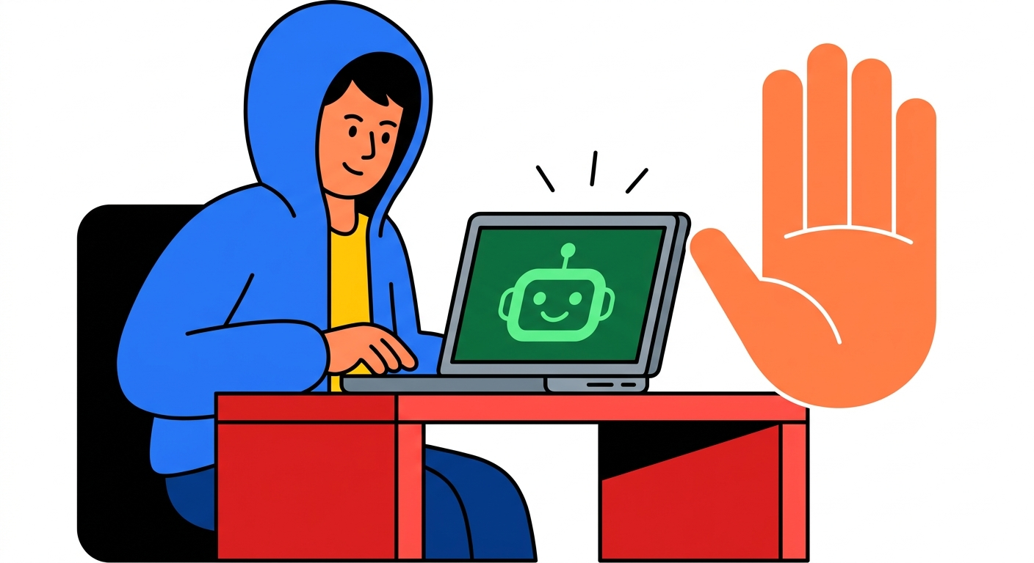
ROUND 12
Should secondary-school students use AI?
Left: yes. Right: no.

Slide 22
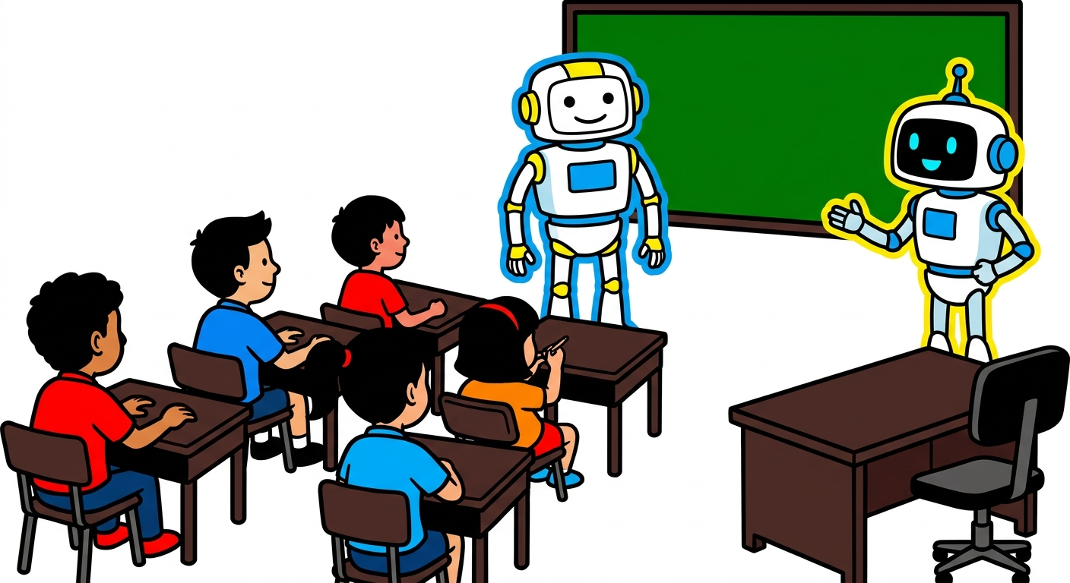
ROUND 13
Should secondary-school teachers be replaced by AI?
Left: yes. Right: no.

Slide 23
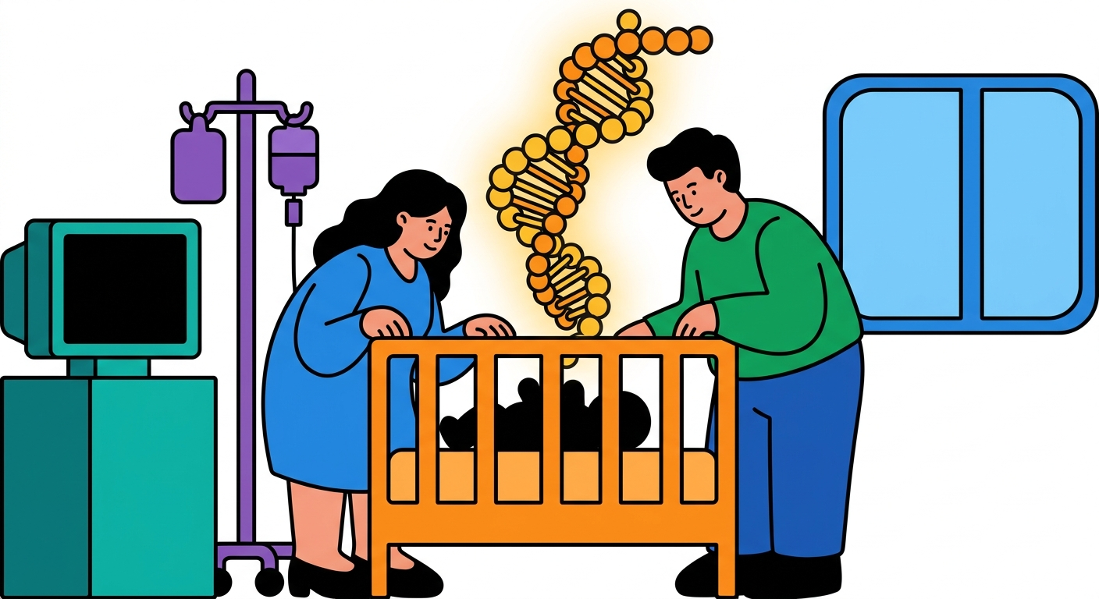
ROUND 14
A hearing couple learn that their embryo will be born deaf. They want to edit its genes so the child can hear.
Left: acceptable. Right: unacceptable.

Slide 24
ROUND 15
A deaf couple learn that their embryo will be born hearing. They want to edit its genes so the child will be deaf.
Left: acceptable. Right: unacceptable.

Slide 25
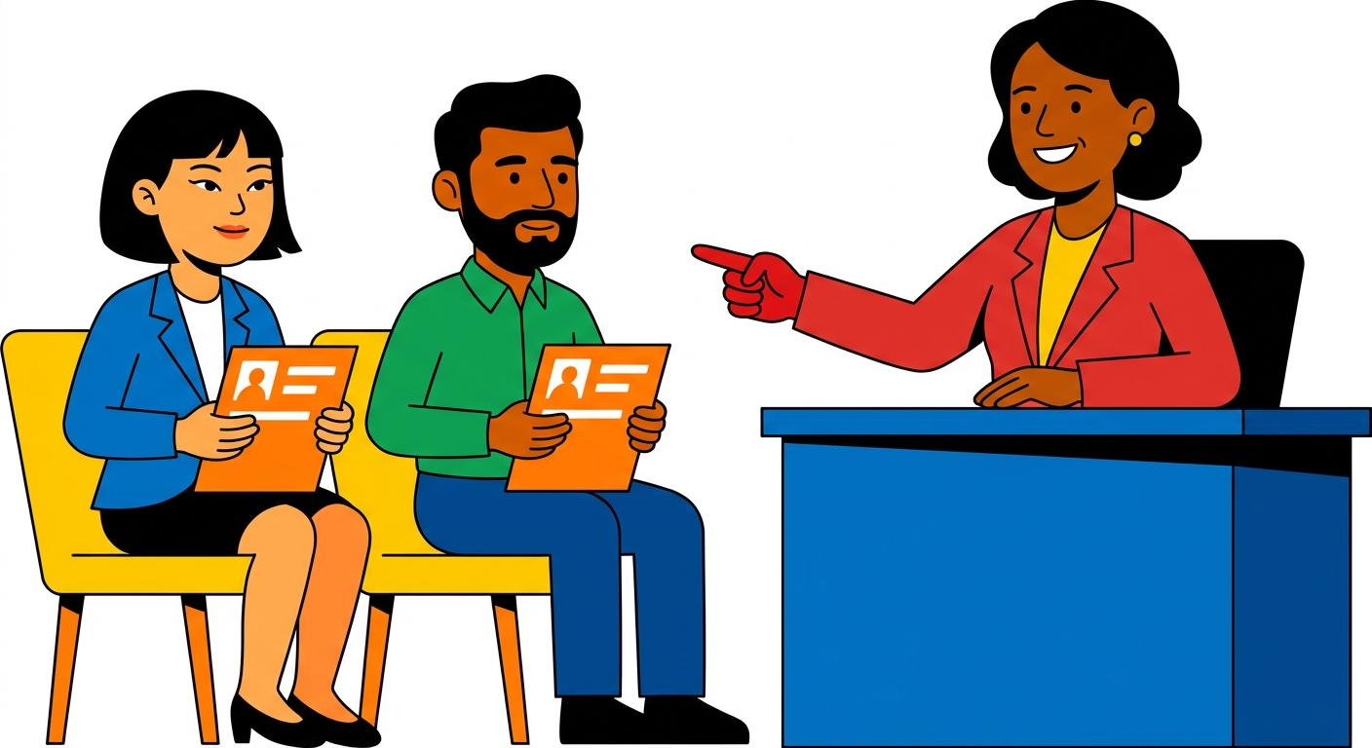
ROUND 16
A local candidate and an ethnic-minority candidate apply for the same job. The ethnic-minority candidate performs better, but the company hires the local candidate. Is this reasonable?
Left: reasonable. Right: unreasonable.

Slide 26
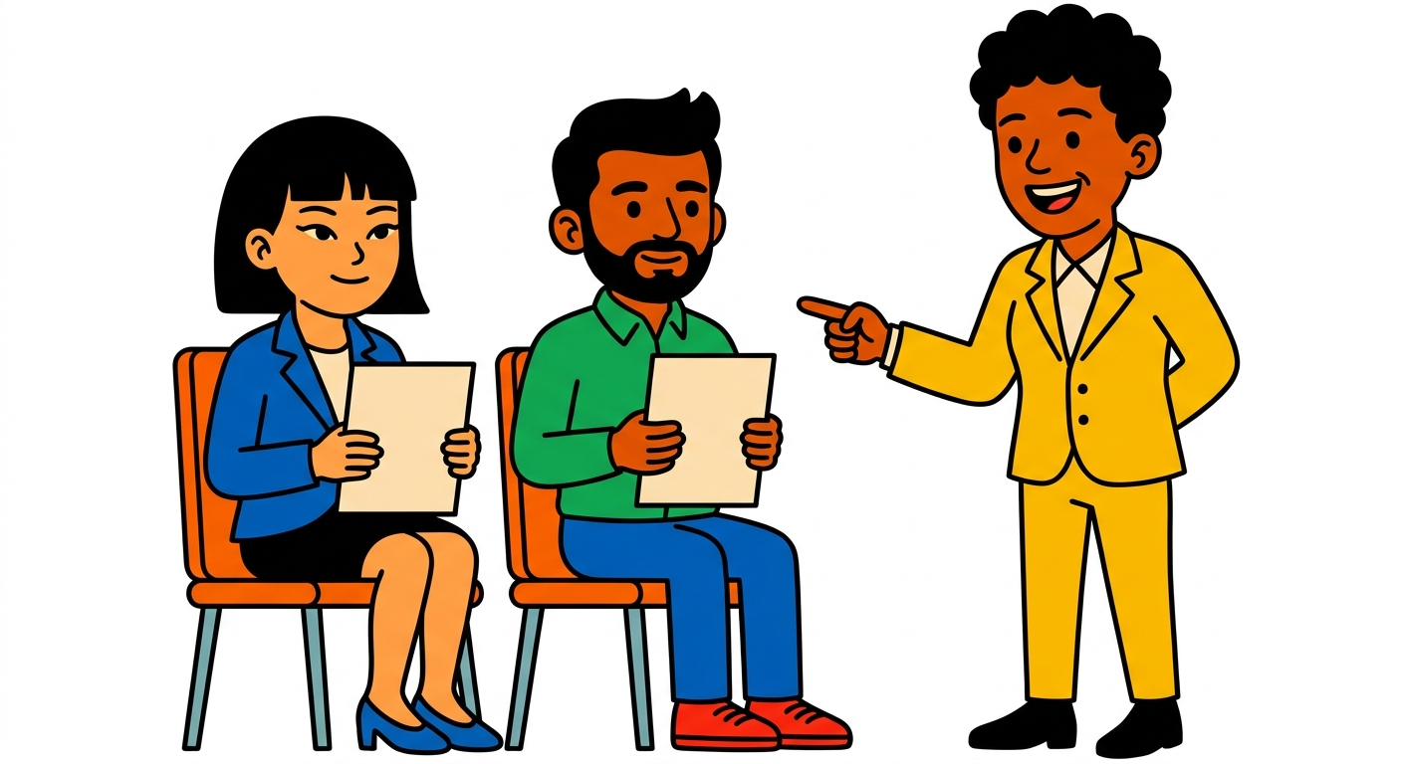
ROUND 17
A local candidate and an ethnic-minority candidate apply for the same job. The local candidate performs better, but the company hires the ethnic-minority candidate. Is this reasonable?
Left: reasonable. Right: unreasonable.

Slide 27
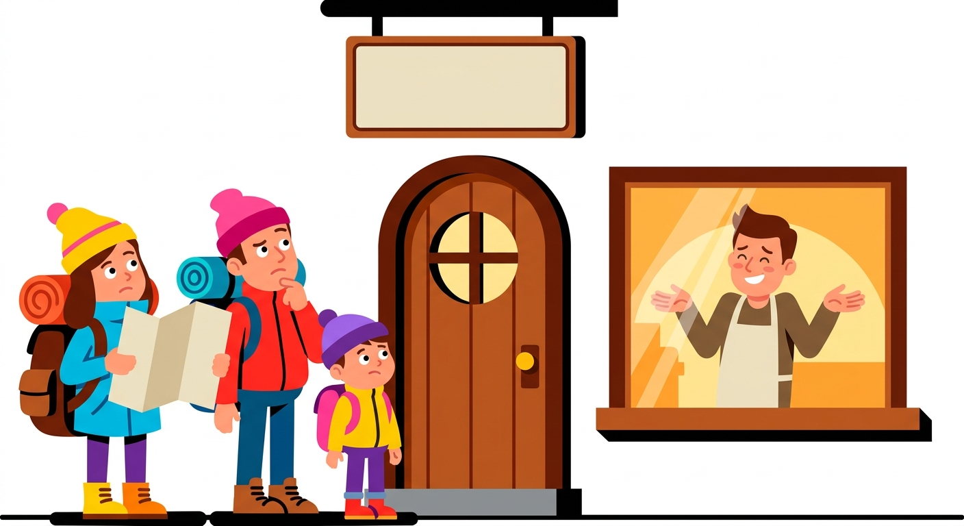
ROUND 18
A Hong Kong cha chaan teng displays a sign: “Local customers only.” Is this reasonable?
Left: reasonable. Right: unreasonable.

Slide 28
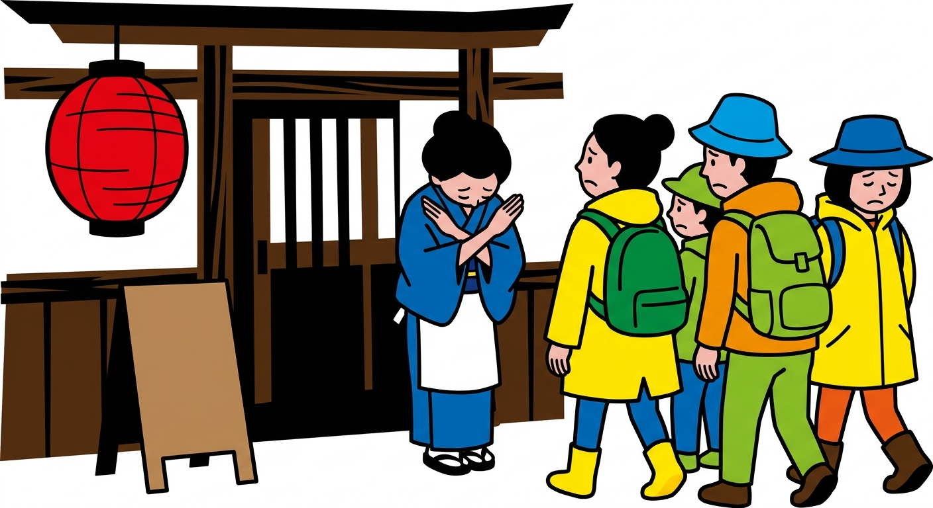
ROUND 19
A Japanese izakaya displays a sign: “Local customers only.” Is this reasonable?
Left: reasonable. Right: unreasonable.

Slide 29
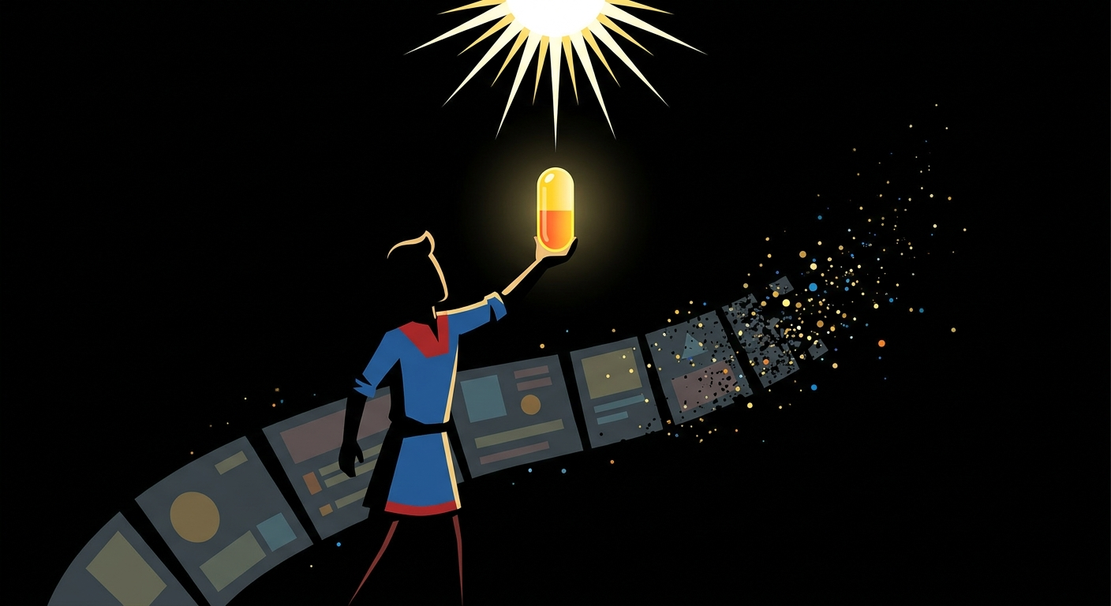
ROUND 20
You have a pill. If you take it, you will feel completely at peace with every belief you hold and never be troubled by any question again.
Left: take it. Right: do not take it.

Slide 30
DEBRIEF

