Slide 1
CUHK Philosophy Orientation Camp
Game Session

Slide 2
GAME
REPUBLIC BEHIND THE VEIL OF IGNORANCE

Slide 3
SCENARIO

Slide 4

SCENARIO
You will legislate for a new country.

Slide 5
SCENARIO
A new country is about to be founded. It does not yet have any laws.
Each of the four groups is a legislature. Every group must draft a constitution.
The constitution has six sections: property, labour, healthcare, education, punishment, and taxation.

Slide 6
ROOM SETUP
Form four large circles of 7–8 people. Each circle corresponds to one section of the whiteboard.
A
B
C
D
WARM-UP
WARM-UP
WARM-UP
WARM-UP
MAIN ROUND
MAIN ROUND
MAIN ROUND
MAIN ROUND
CLAUSES
CLAUSES
CLAUSES
CLAUSES
REVISION
REVISION
REVISION
REVISION
Left: write your clauses large enough for the back row to read. Three boxes on the right: record votes.

Slide 7
NUMBERING

Slide 8
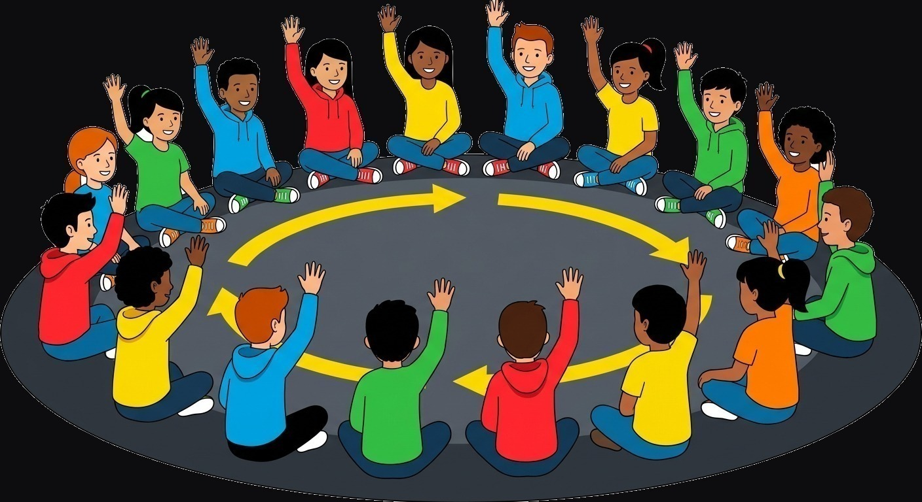
NUMBERING
Each group chooses one person. Starting with that person, count clockwise.

Slide 9
NUMBERING
Each group first chooses one person. You will soon learn why.
Starting with that person, count clockwise: one, two, three …
Remember your number.
Its meaning will be revealed only after drafting is complete.

Slide 10
MODEL CLAUSE
SLOGAN
CLAUSES
Leave should be reasonable.
Each person receives at least 14 days of paid leave per year. The employer schedules it; denied leave must be granted later.
Write like the example on the right: who, how much, and who decides.

Slide 11
VIDEO DEMO

Slide 12


Slide 13
WARM-UP

Slide 14
WARM-UP (15 MINUTES)
1. Show the question. Everyone reads it.
2. Each group discusses for 8 minutes and writes one clause in its whiteboard section.
3. One person from each group has 3 minutes to explain the group’s clause.
4. Everyone votes on each group in turn: “Can you accept this clause?” Raise your hand if yes.
5. Count raised hands; the facilitator records each total in the WARM-UP box.
Write large enough for the back row to read.

Slide 15
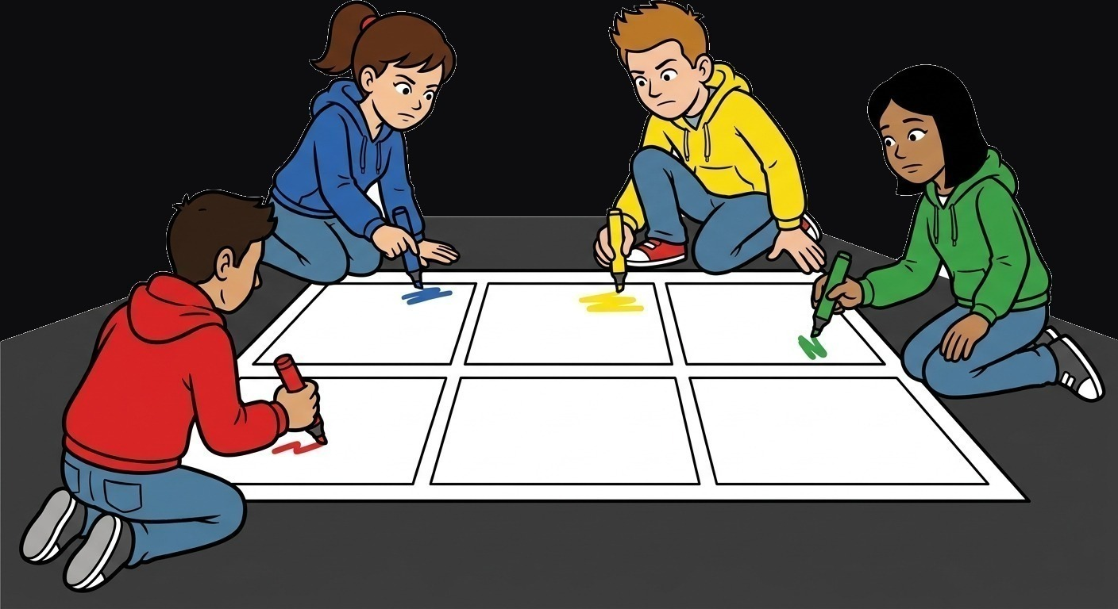
WARM-UP QUESTION
“How many days of leave should everyone receive each year? Who decides? Are there exceptions?”

Slide 16
MAIN ROUND

Slide 17
MAIN DRAFTING (45 MINUTES)
Each group drafts a constitution with six sections: property, labour, healthcare, education, punishment, and taxation.
Each section has one question and one clause. The questions appear on the next six slides and on the front of the worksheet.
The six clauses must be mutually consistent: together, they form one constitution.
Draft on the worksheet first. Once finalised, copy the clauses to your whiteboard section in writing large enough for the back row to read.
Stop writing when time is called. After presentations and voting, you will have one chance to revise.

Slide 18

SECTION 1 · PROPERTY
How far should the government go in limiting inequality of wealth?
Example: each person may own at most $1 million; any excess goes to the state.

Slide 19

SECTION 2 · LABOUR
When efficiency conflicts with protection, which takes priority?
Example: the minimum wage is $60 per hour, monitored by the Labour Department.

Slide 20

SECTION 3 · HEALTHCARE
Is healthcare a right or a commodity?
Example: public hospitals are free, funded through taxation.

Slide 21
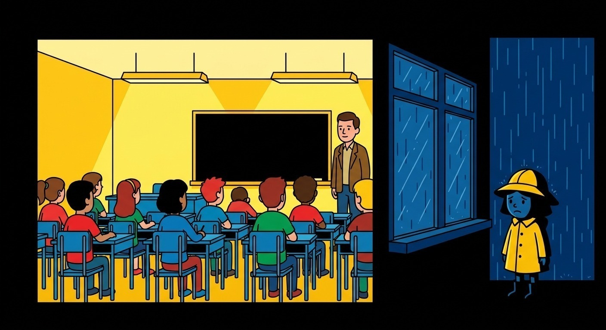
SECTION 4 · EDUCATION
Is education for selecting talent, or for making people equal?
Example: primary and secondary education are free; university is self-funded.

Slide 22

SECTION 5 · PUNISHMENT
Is prison for punishment or rehabilitation?
Example: a person who steals food because of hunger receives community service instead of prison.

Slide 23

SECTION 6 · TAXATION
Is taxing the wealthy more heavily fair, or does it punish success?
Example: tax rates rise with income, with brackets set by the tax authority.

Slide 24
IDENTITY

Slide 25
IDENTITY (10 MINUTES)
Do this step only after all clauses have been placed on the whiteboard.
The facilitator distributes identity cards by number. Your number determines your identity.
Take the perspective of the person on your card and reconsider the four constitutions.
Do not change any clause yet. After all presentations and voting, you will have one chance to revise.

Slide 26
PRESENTATIONS

Slide 27
ROUND PROCEDURE (ABOUT 10 MINUTES PER GROUP)
1. One person presents the group’s constitution and has 5 minutes to explain how it would work in practice.
2. The other three groups ask questions for 3 minutes; the presenting group responds.
3. Everyone votes. From the identity on your card, ask yourself:
“Would I be willing to be born in this country?” Raise your hand if yes.
4. Count raised hands; the facilitator records the total in the MAIN ROUND box.

Slide 28
GROUP 1
PRESENTATION · 5 MINUTES
QUESTIONS · 3 MINUTES
VOTE

Slide 29
GROUP 2
PRESENTATION · 5 MINUTES
QUESTIONS · 3 MINUTES
VOTE

Slide 30
GROUP 3
PRESENTATION · 5 MINUTES
QUESTIONS · 3 MINUTES
VOTE

Slide 31
GROUP 4
PRESENTATION · 5 MINUTES
QUESTIONS · 3 MINUTES
VOTE

Slide 32
REVISION

Slide 33
REVISION (20 MINUTES)
1. Those who voted “no” raise a hand and identify the clause that made the country unacceptable.
2. Each group hears up to three reasons, then has 10 minutes to revise its constitution.
3. Mark every change on the whiteboard with a different pen.
4. Everyone votes again: “Would I now be willing to be born in this country?”
5. Count raised hands; the facilitator records the total in the REVISION box.

Slide 34
TWO OPTIONS
When you face an objection, you have two options.
Revise the clause: you decide the objection is sound, so you change the clause.
Keep the clause: you decide the objection is mistaken, so you explain why it does not succeed.
Either counts as completion. The aim is consistency between your clauses and judgement—not universal satisfaction.

Slide 35
TOTAL VOTES

Slide 36
CONCLUSION
Add the votes from all four sections. The group with the highest total wins.
Compare the MAIN ROUND and REVISION boxes. Which group gained the most votes? Which clause did it change?
Did any group gain votes without changing a clause? What did it say?
Did you change your mind? Did the clause change, or did your judgement change?

Slide 37
DEBRIEF

