Slide 1

NLP Analysis of amazon video game reviews
Chuck Tucker

Slide 2

The Problem
There are benefits to quickly classifying text as positive or negative
Identifying unsatisfied/satisfied customers to influence decisions
Generate predictions based on the satisfaction level for certain products
Create action plans for improving products based on reviews

Slide 3
The Data
The data came from an NLP study and are available online
The selected subset of the Amazon data were video game reviews, filtered to only include games for which there were at least 5 reviews
Citation:
Justifying recommendations using distantly-labeled reviews and fined-grained aspects Jianmo Ni, Jiacheng Li, Julian McAuley Empirical Methods in Natural Language Processing (EMNLP), 2019 https://nijianmo.github.io/amazon/index.html#files

Slide 4
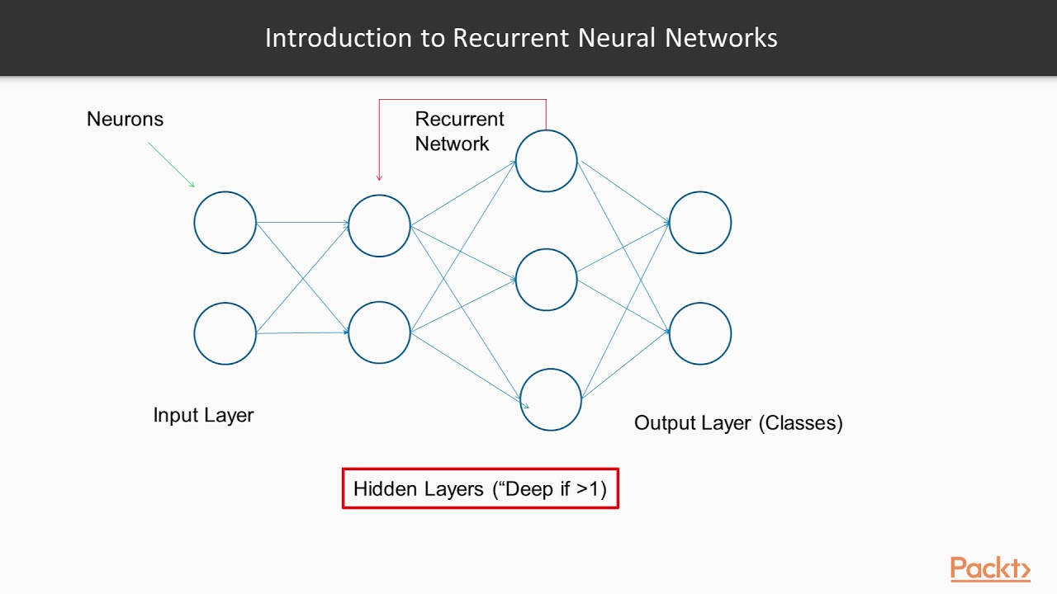
Approach
Exploratory Analysis
Read in the data file
Explore the data structure
Remove any missing values
Visualize summary information like word counts,
Classification Model
Try Flair NLP pre-trained model (trained on IMDB reviews)
If Flair pre-trained model is inadequate, train a model using a recurrent neural network

Slide 5
Exploratory Results
Initial analysis of the data found many emojis and odd characters among the text data
This was dealt with by creating a function to remove all special characters
It would not be practical to include these in the data, as variations and customizations meant most of the emojis only appeared once in the data
Examples
\m/(>_<)\m/
\(^0^)/
\(^u^)/

Slide 6
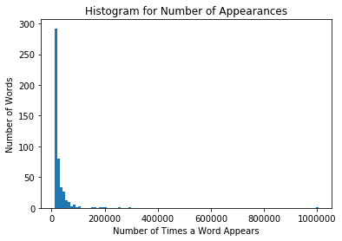
Word Counts
Analysis found a total of 26,737,141 clean words in the reviews
There were only 262,853 unique words
Further analysis showed that about 60% of words were only used once, meaning
This means that only about 105,141 words accounted for 99% of the total words appearing in the reviews
Most words appeared infrequently

Slide 7
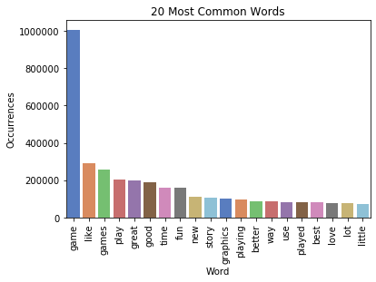
Most Common Words
The word ‘game’ accounted for nearly 4% of all the words in the reviews, and this was by far the most encountered word

Slide 8
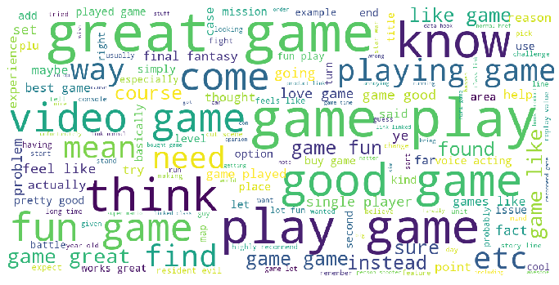
Word Cloud – top words/phrases

Slide 9
Sentiment Analysis
Step 1: Flair Pre-Trained Model
Poor performance:
Accuracy 76% (not bad)
Negative precision: 28% (horrible)
Negative F1 score: 41% (really bad)
Positive precision: 96% (great)
Positive F1 score: 85% (really good)
Ok performance on predicting positive results, but very poor performance predicting negative results
This is not good if you want to identify unsatisfied customers
Why did this happen?

Slide 10
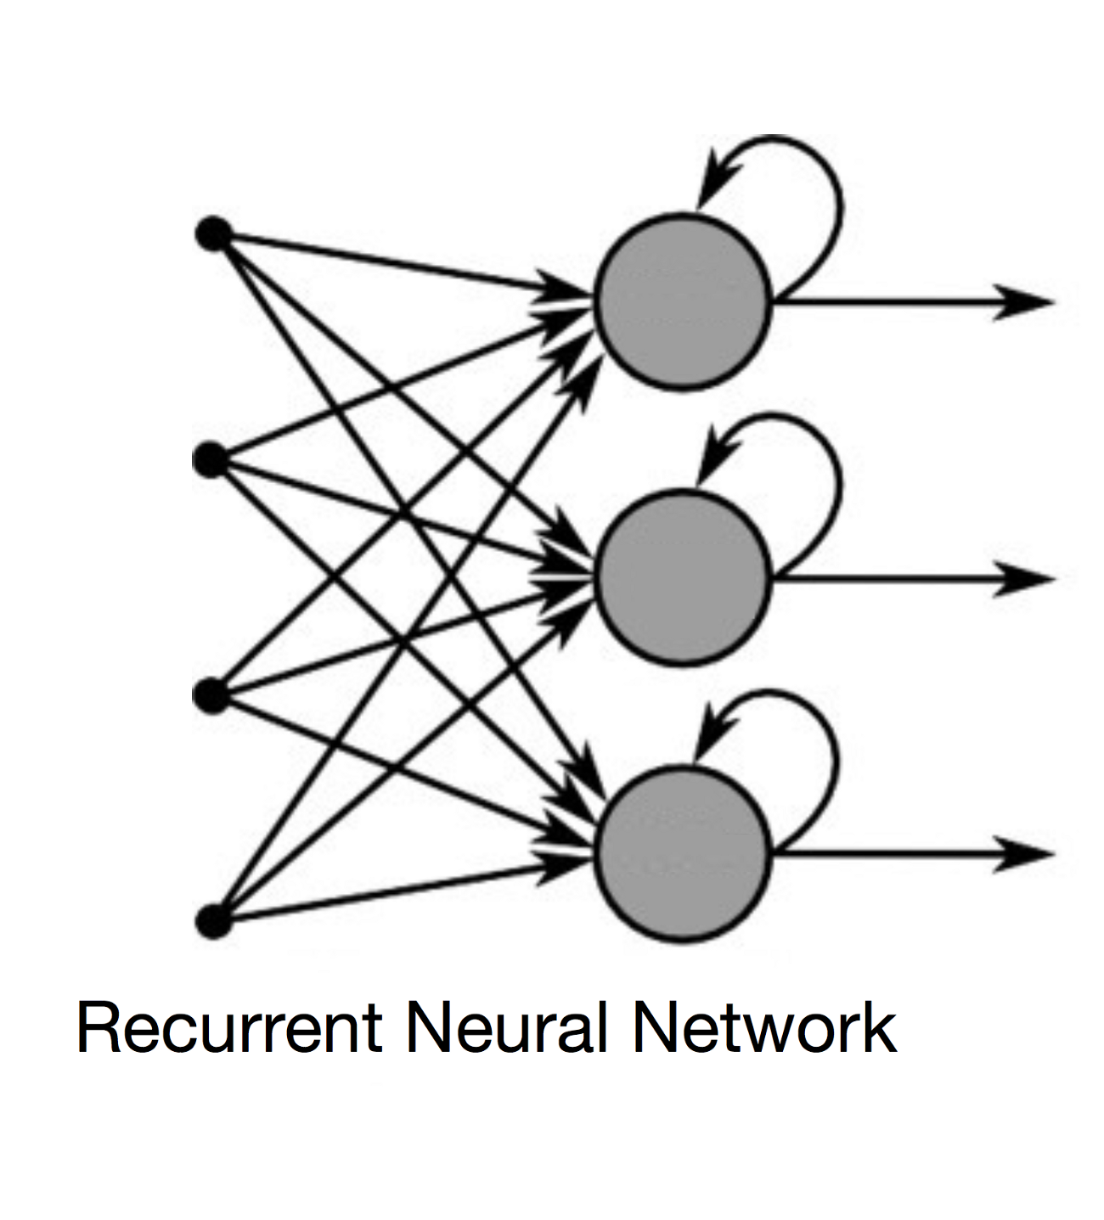
Interpreting Pre-Trained Results
The Flair model was trained on movie reviews
The data come from different sources, and the vocabularies used could be very different
A custom model was trained using the video games data to try and achieve better results using a recurrent neural network

Slide 11
Custom Model Methods
The custom model was created using LSTM to process the sequence of the text data
512 hidden layers were used with standard document embeddings (GloVe, news-forward-fast, news-backward-fast)
A maximum of 10 epochs was chosen due to the length of time and computational resources necessary to train this model
The model was fed the cleaned text with the special characters removed
The data was downsampled to balance the classes prior to training
An 80%, 10%, 10% split was used for training data, validation data, and test data
The model ran for a total of about 13.5 hours on paid Google Colab Pro using a high RAM and GPU runtime

Slide 12
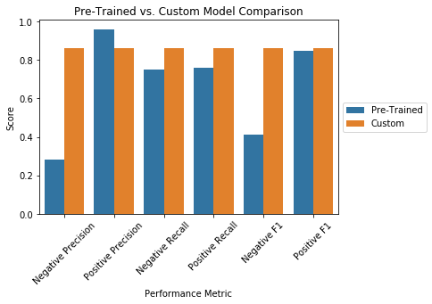
Custom Model Results
The final best model produced F1 scores of about 85% for both classes, greatly surpassing the pre-trained model performance of 41% for the negative class
Accuracy was about same at 76%, but the vast improvement on the negative class indicates this was a superior model
Precision and recall were both also right at 86% for both classes, surpassing the pretrained model

Slide 13

Recommendations: NLP and Usage
This analysis revealed that it is important to evaluate the performance of any pre-trained model prior to deploying
It also demonstrated the importance of tailoring NLP models to the specific use case as much as possible
Yes it would be possible to overfit, but with text information, it is important to train on a set of features that is meaningful
This model can be used to quickly assess a customer’s sentiment regarding video games
This information could be used to help with support cases or create recommendations for other products based on sentiment

