Slide 1
WEEK 2
Network Traffic Analysis, Nmap and Windows Logging
DG Interns Hub Cybersecurity Internship | Chukwu PraiseGod

Slide 2
An isolated lab I own
2 GB
2 GB
4 GB
Kali
Ubuntu
Windows
Sends ping, curl, nslookup and Nmap scans
192.168.98.130
Apache web server and dnsmasq DNS
192.168.98.129
Evaluation VM: target for scans and event logging
192.168.98.131
VMware Workstation Pro | Network 192.168.98.0/24 | Free tools only | Only my own systems

Slide 3
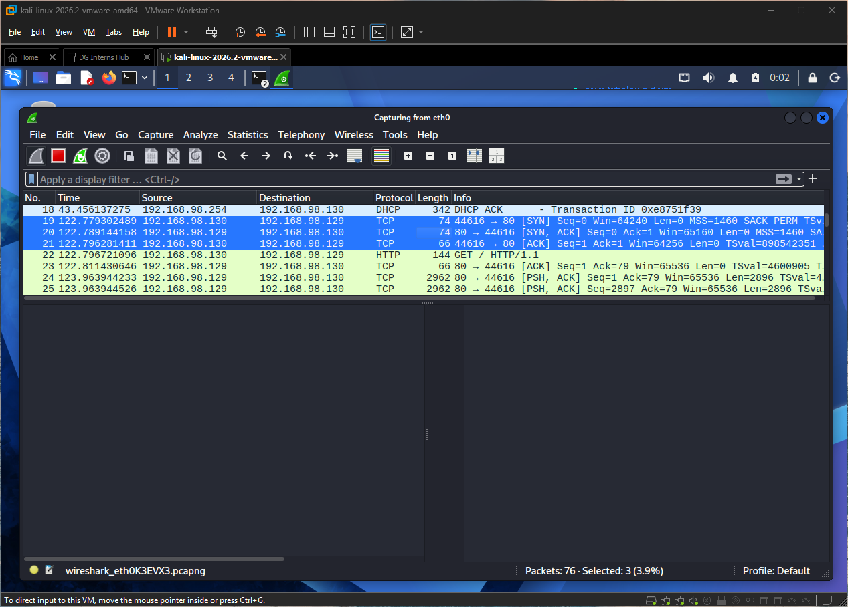
Reading traffic in Wireshark
SYN
→
SYN/ACK
→
ACK
The handshake, captured from Kali to Apache on Ubuntu
HTTP GET from curl
DNS query for ubuntu.lab, answered by dnsmasq on Ubuntu
ICMP echo from ping
Fix: nothing answered DNS at 192.168.98.1, so I set up dnsmasq

Slide 4
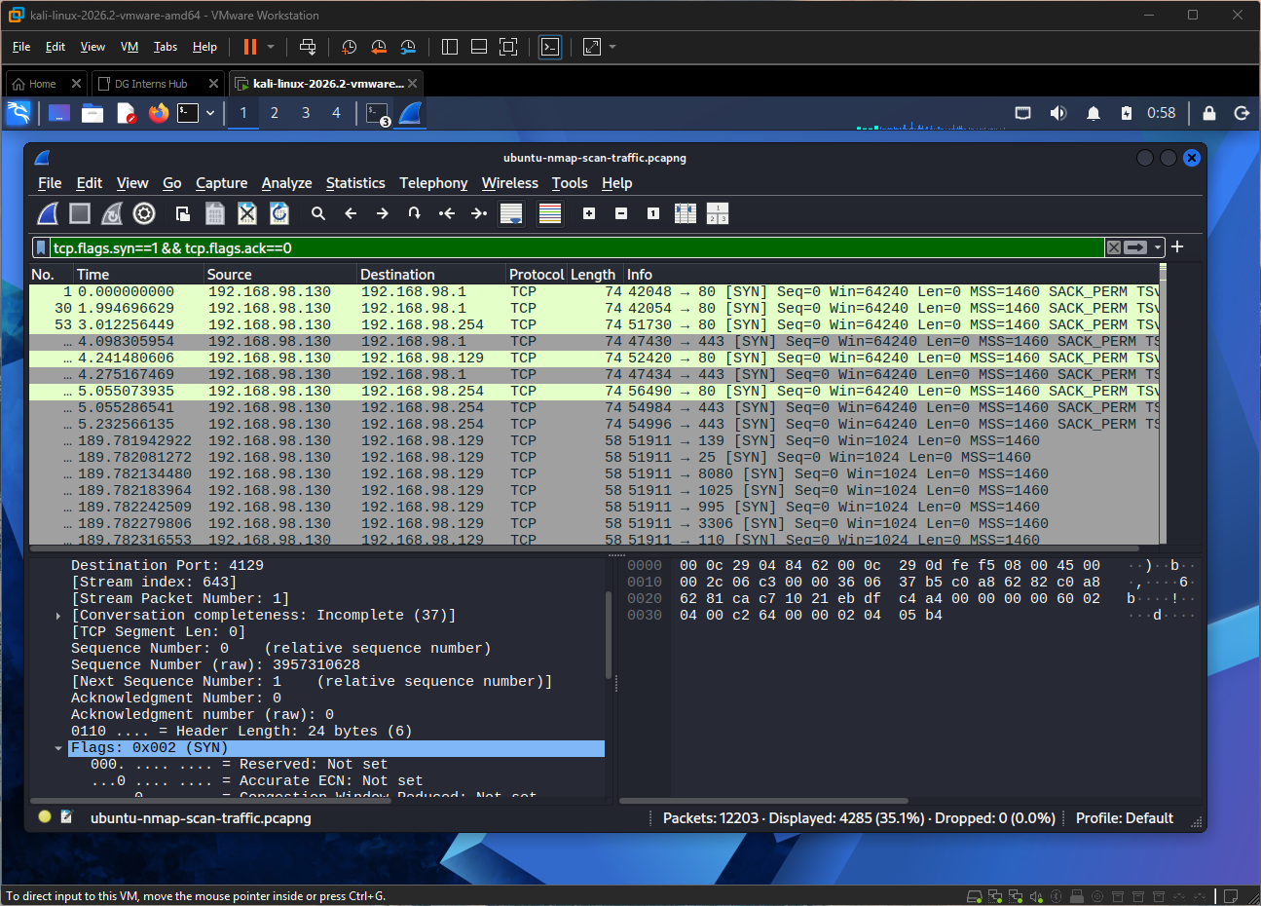
What a port scan looks like
tcp.flags.syn==1 && tcp.flags.ack==0
One source (Kali) sends a burst of SYNs to many ports
Closed ports answer with RST; the handshake is never finished
Ran -sn, -sS, -sV, -O and -A on the Ubuntu and Windows VMs
Output saved with -oN and -oX; scans captured as PCAPs

Slide 5
Windows events I generated
Event ID | Meaning | How I made it
4625 | Failed logon | net use with wrong passwords; lock screen
4624 | Successful logon | Signed in; read the logon type
4720 | User created | net user
4732 | Added to Administrators | net localgroup
7045 | Service installed (System log) | sc.exe create / delete
1102 | Audit log cleared | wevtutil cl Security (last)
Logon type 5 = service (normal noise). Logon type 2 = interactive sign-in as the new user.

Slide 6
Hunting failed logons with PowerShell
Get-WinEvent -FilterHashtable, Export-Csv, Group-Object
A pattern to flag
4720 new user, then 4732 added to Administrators, then a type 2 logon by the same account

Slide 7
What I learned
1
A burst of SYNs with no finished handshakes is a probe
2
Read the error first: the DNS fix was a missing server
3
Logon type tells the story: type 5 is noise, type 2 for a new admin is not
4
Clear the log last, after saving the evidence

