Slide 1
Yelp
Analysis of Coffee Shops in California

Slide 2
Background
I want to open up a coffee shop in California. What amenities should I provide?

Slide 3
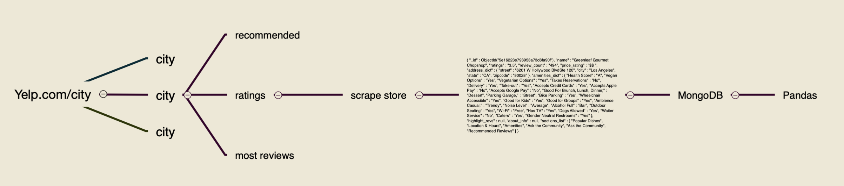
Pipeline
> scrape yelp
>insert json to MongoDB
>load to pandas

Slide 4
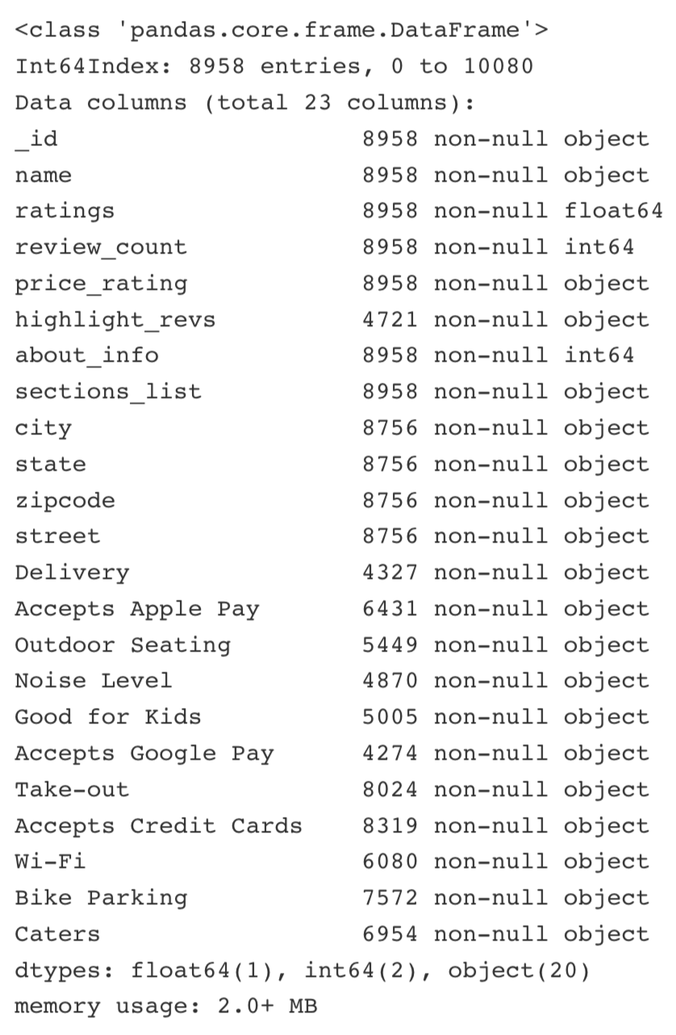
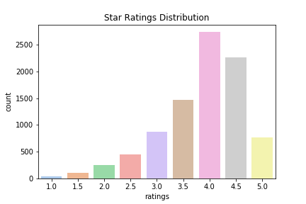
EDA
Key variables:
Star ratings
Number of Reviews

Slide 5
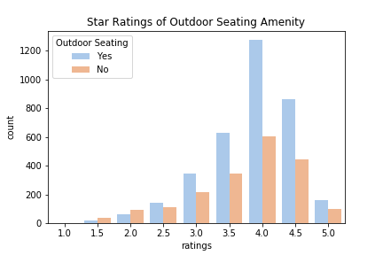
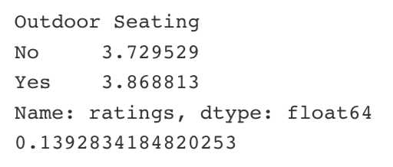
EDA
Looking at star rating distributions across all amenities.

Slide 6
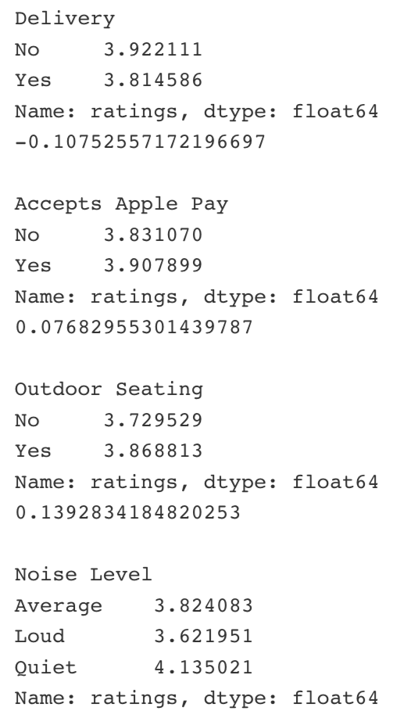
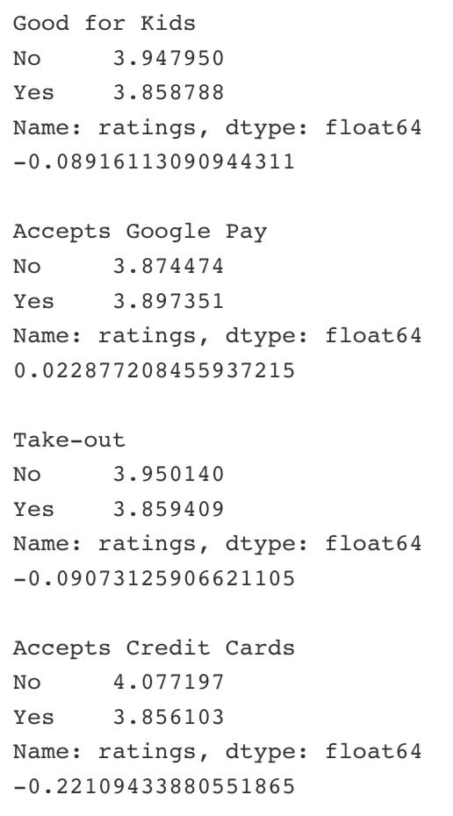
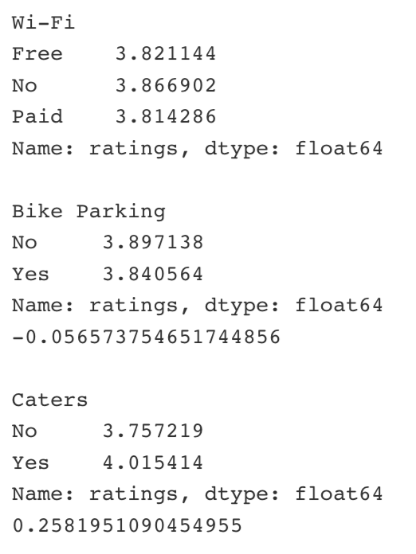
Star Ratings

Slide 7
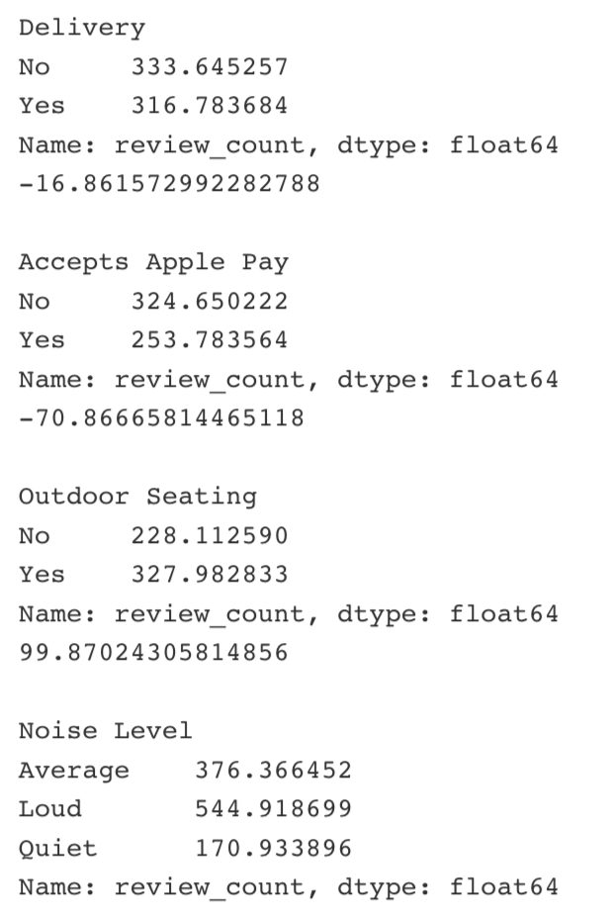
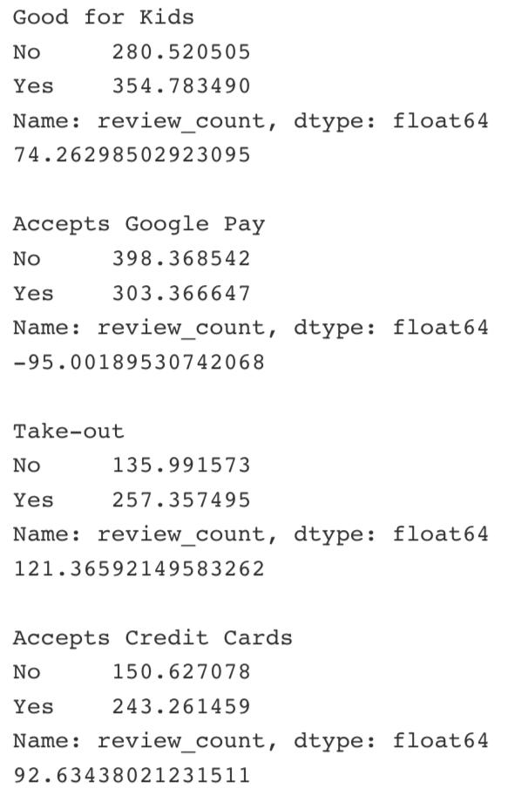
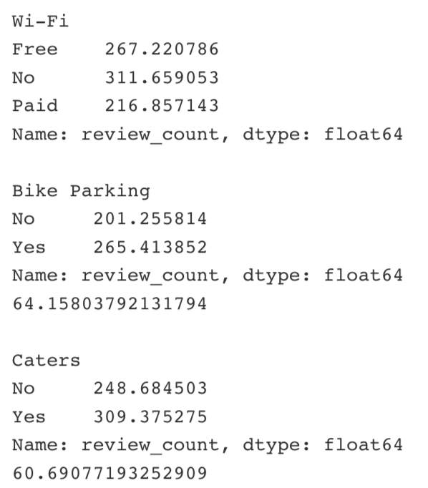
Review counts

Slide 8
Conclusions
By controlling the types of amenities to provide and avoid, you can to a certain extend create more customer value.
I learned what it really feels like when data scientists say the work is 80% all data preparation and 20% analysis. ( More like 99:1 )
Improvements:
Autogui
Plotly
Continuous data

