Slide 1
Cricket Fielding Statistics
W205 Final Project
Chula Watugala

Slide 2
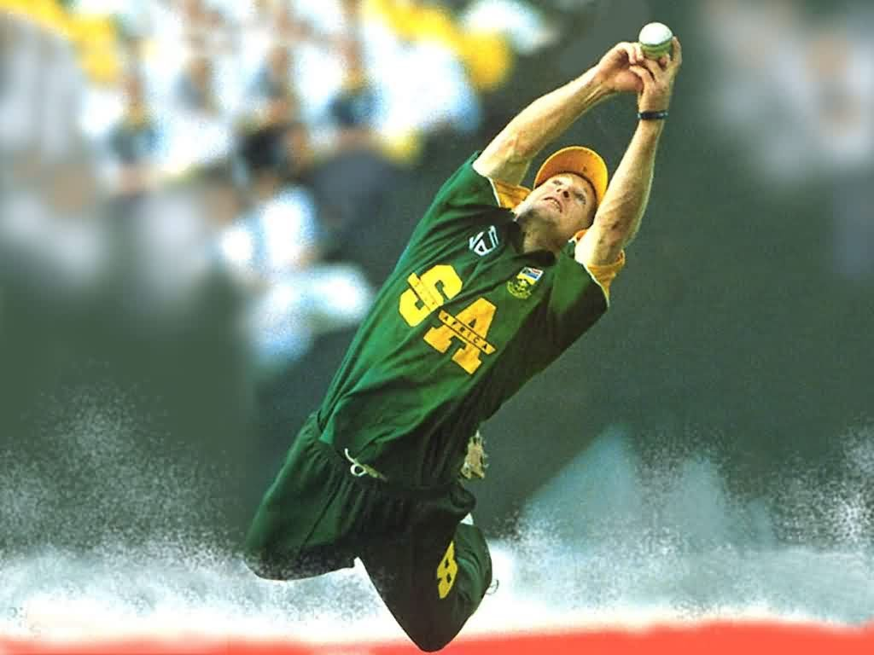
Introduction
Cricket does not have fielding statistics similar to Baseball’s error stats
Lack of an objective way to define good fielding is the reason
Batting has batting average (runs on average when you bat)
Bowling has bowling average (runs given to opposing team per out)
Fielding events during a match are not formally captured
Potential myths involving fielding skill have crept into the sport: “he would’ve caught that 99 times out of a 100” – need for solid data-based performance metrics to evaluate fielders

Slide 3
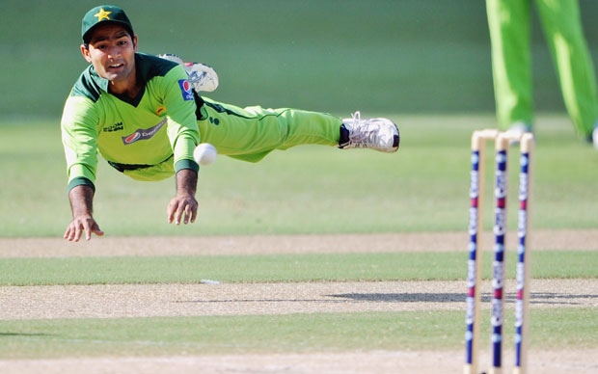
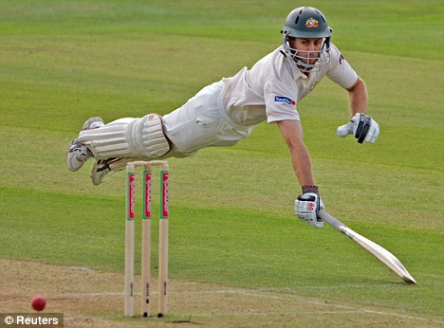
Fielding Events
Fielding events considered was expanded since commentary is informative enough:
Negative
Dropped Catches
Misfields
Missed Stumpings
Positive
Direct Hits (Run-outs)
Great Catches
Catches
Runs Saved

Slide 4
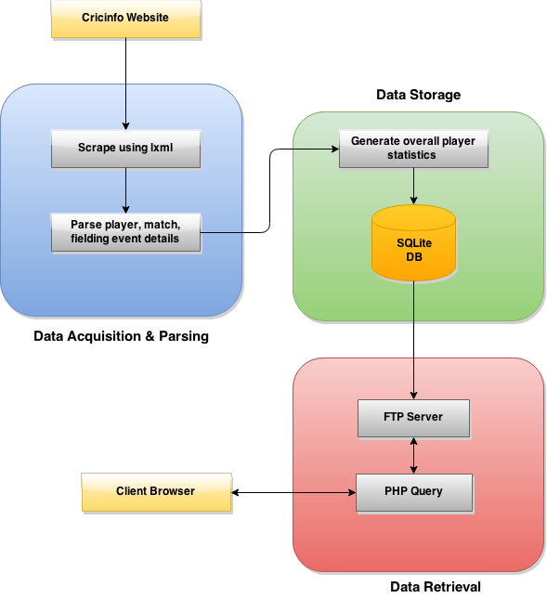
Solution Architecture
Each fielding event is parsed
Attributed player fielding performance for each match is stored
lxml is used to scrape and parse xml text
SQLite used for data storage
Both convenient packages in Python
Generated statistics displayed in website

Slide 5


Technology Selection
SQL vs NoSQL:
No real-time data
Data size ~150MB – not massive (Volume)
Rigid schemas not an issue
Data grows steadily – no viral growth
Local vs EC2
No requirement for multiple servers
Run time to parse and store 10 years’ match data is 4-5 hours
After initially setup, future matches can be run quickly in <5 min

Slide 6
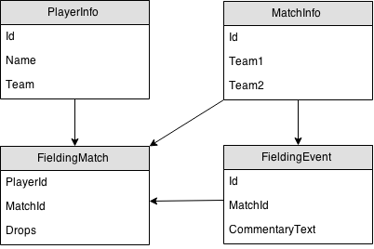
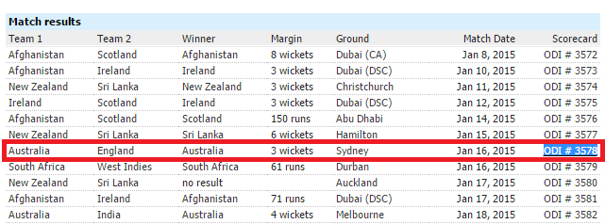
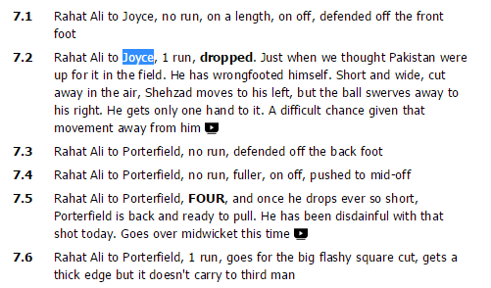
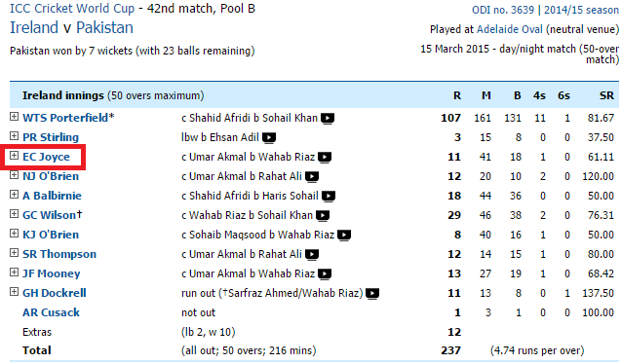
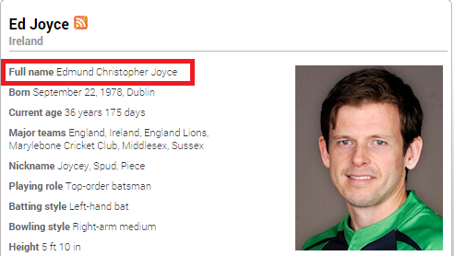
Implementation
Match Text Commentary
Match List
Match Scorecard
Player Profile

Slide 7
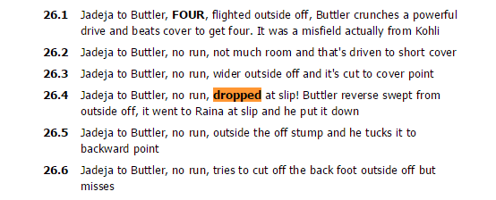
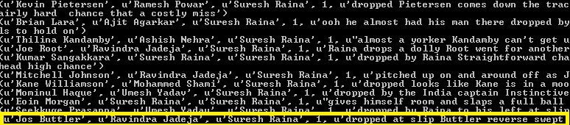
Implementation
Raw commentary data stored in fieldingEventODI table
Capitalized words are checked with player lists to identify fielder involved
Commentary text parsed for key words that denote fielding events
Fielder’s fielding events of a match stored in fieldingMatchODI table
select batsman, bowler, fielder, droppedCatch, commentary FROM fieldingEventODI where droppedCatch=1 and fielder=?',("Suresh Raina",)

Slide 8
Parsing Natural Language
"bobbles the chance", "has made a meal of it", "sitter", "dolly", "spills", "put down", "dropping the ball", "gets both hands to it but drops it", "drops an easy catch", "fails to take the catch", "dropped", "shelled", "grassed"
Dropped Catch Key Words
NLTK vs Simple Word Match
Cricketing terms make NLTK not as useful
Dropped Catches much harder to parse
The “dropped” keyword is unreliable
Some catches too difficult to be considered a true drop (Variety)
Other fielding keywords more straightforward
"dolly on the toes", "dropped right", "dropped with", "dropped just", "dropped it short" , "dropped short", "dropped well in front" , "drops the wrist", "dropped from" , "earlier he was dropped", "dropped his" , "dropped a touch short", "dropped catches" , "dropped behind", "dropped at his feet" , "dropped in", "dropped a bit" , "dropped into", "dropped softly" , "dropped his bat", "dropped catch and" , "dropped it into", "dropped to" , "dropped him earlier", "dropped far too short" , "dropped over", "tough chance", "hard chance", "hard to call it dropped", "hard to call that dropped", "like a football goalkeeper", "desperate effort", "difficult chance", "superb attempt", "good effort", "screaming past", "would have been a very good", "terrific effort", "harsh to blame", "great attempt", "what an effort", "would have been a terrific catch", "would have been a wundercatch", "tough one", "fabulous attempt", "tremendous effort", "difficult one", "would have been a stunner", "would have been a superb", "would have been a mind-blowing", "valiant effort", "harsh to call it", "would have been a classic catch", "would have been a cracker"
Dropped Catch Invalidating Key Words
"direct hit", "accurate with the throw", "throw has beaten him", "hits the stumps direct"
Direct Hit Key Words

Slide 9
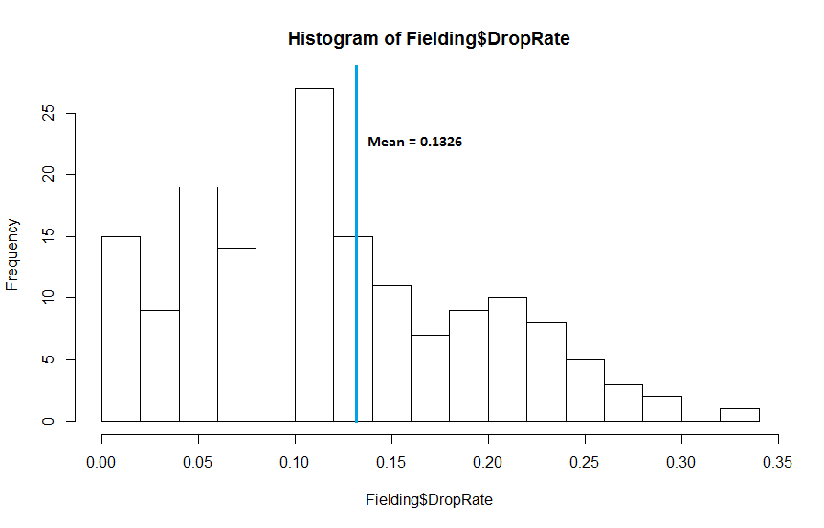
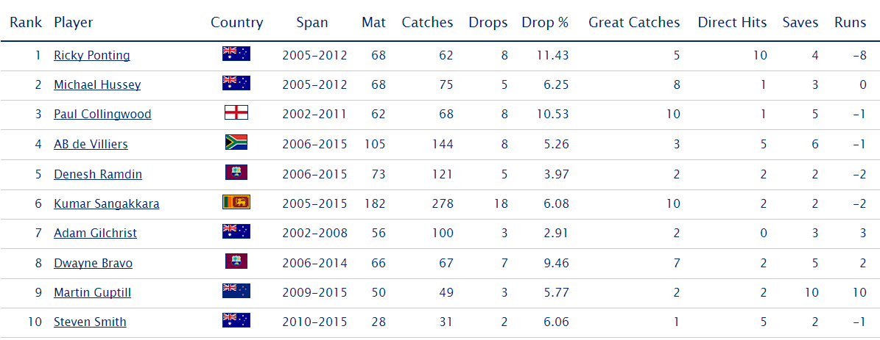
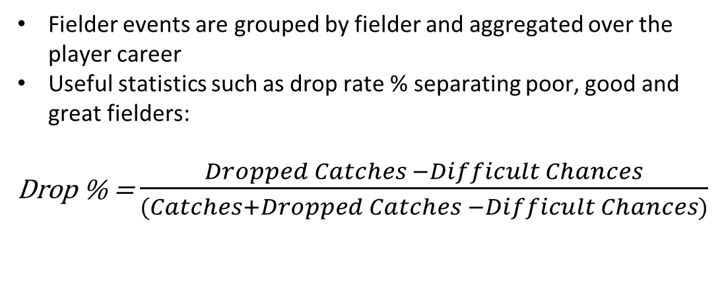
Results
Fielder events are grouped by fielder and aggregated over the player career
Useful statistics such as drop rate % separating poor, good and great fielders:
Drop % = $\frac{Dropped Catches −Difficult Chances}{(Catches+Dropped Catches −Difficult Chances)}$

Slide 10
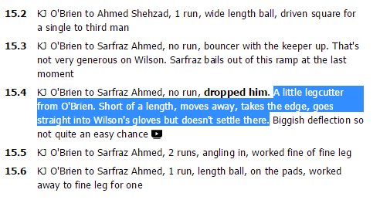

Challenges
Misattribution of events – bowler and fielder both in commentary text
Missing key events altogether due to misspellings or synonyms that are not part of key word list
Manual checks of games suggest 90%+ accuracy
Identifying players involved accurately
Flexibility – relatively rigid setup not allowing portability
Long-term Viability – requires permission from source, near perfect accuracy

Slide 11
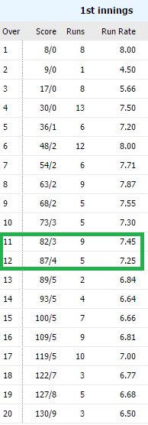
Future Iterations
Valuing fielding performance accurately would enable franchises to evaluate player value properly
Next step would be evaluate impact of fielding using Win Percentage Added (WPA) measure
From the 11th over to the 12th over, the score goes from 82/3 to 87/4
All historical matches that had similar scores at the same stage used to calculate win odds % change (55% to 50%)
If the wicket was due to a great catch or a direct hit, fielder gets attributed the win percentage change (+0.05)
Fielding impact (and batting/bowling impact) will be more accurately valued

Slide 12
Questions?

