Slide 1
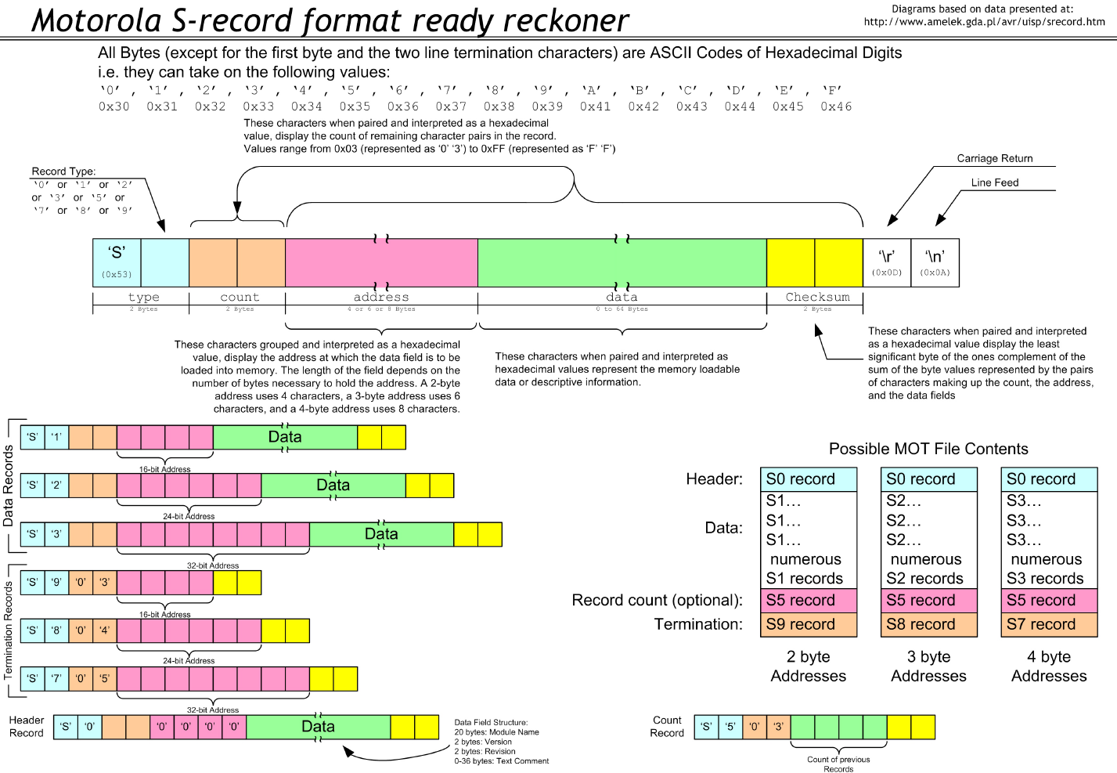

Slide 2
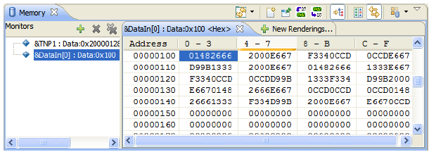
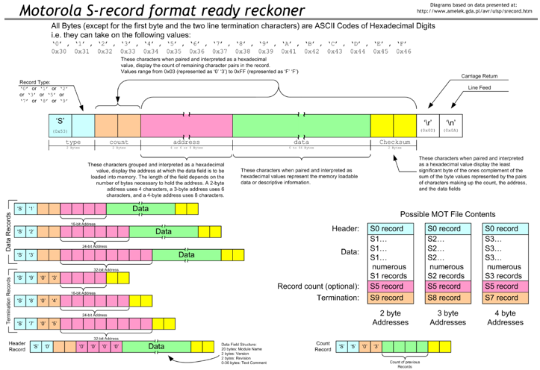
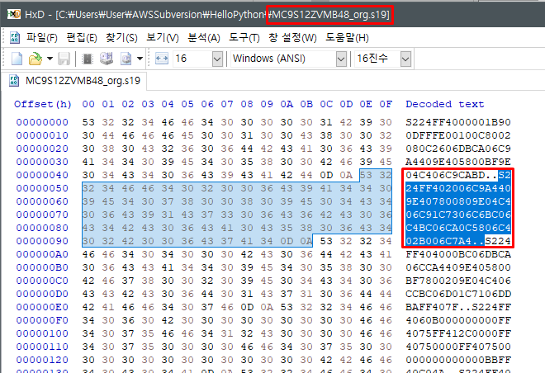
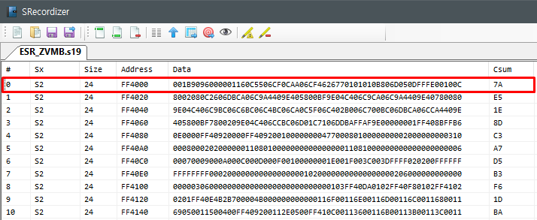
분석
Updater
BL
Erase App Sector Command
0x53 0x04
Erase App Sector
Erase Finished
0x41 0x31 0x31 (ACK)
Tx App Binary
Write App
Restore Registor when write app finished
Write App Finished
0x41(ACK)
Tx Vector Binary
Write Vector
Restore Reset Vector when write vector finished
Write Vector Finished
0x41(ACK)

