Slide 1
Webpage Figure
부제목
2021. 09. 23
심철동

Slide 2
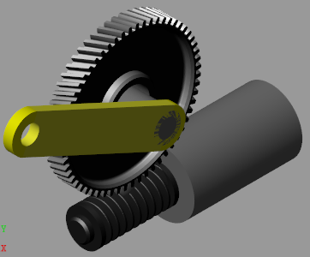
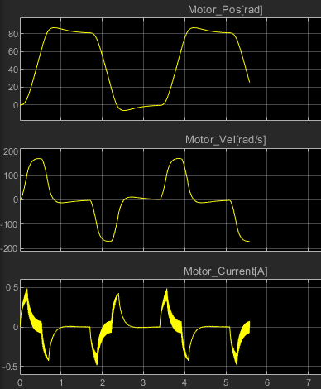
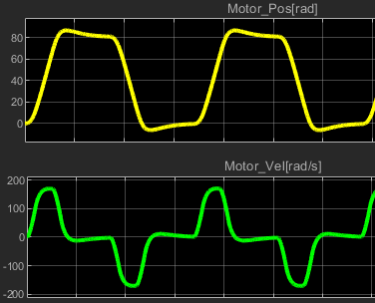
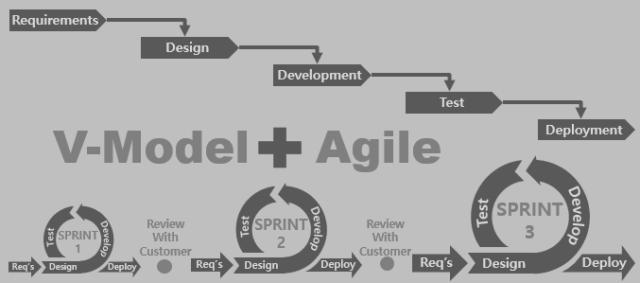
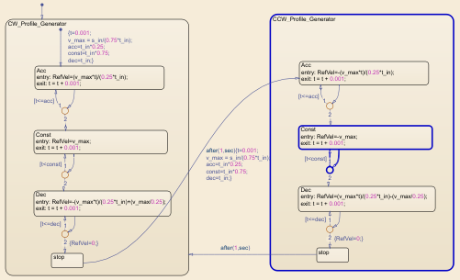
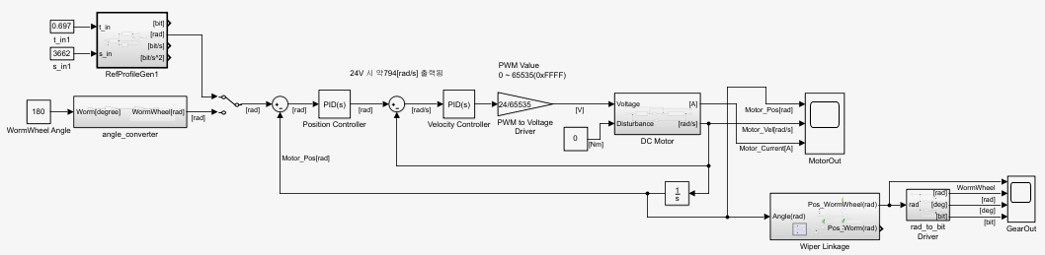
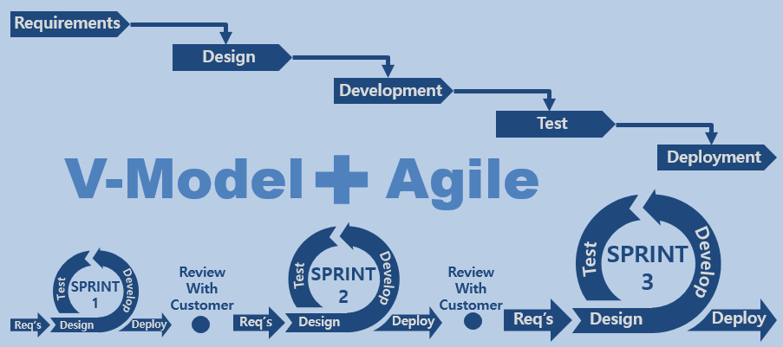
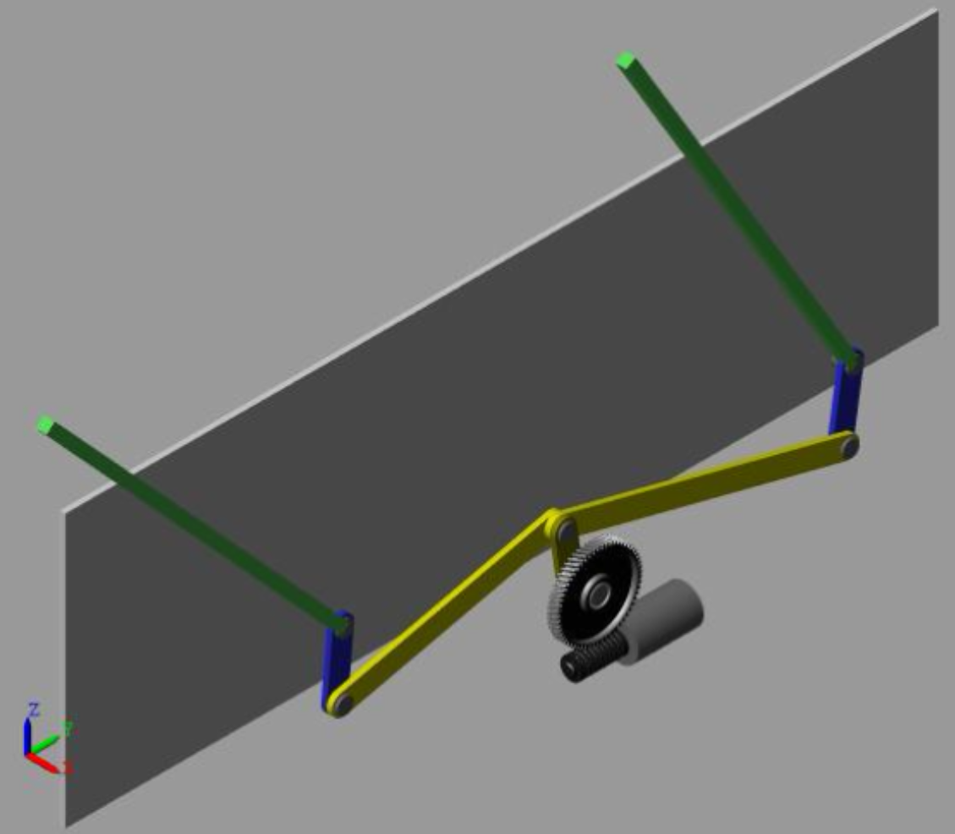
웹페이지 첫화면 이미지
Requirements
Design
Development
Test
V-Model
Agile
Deployment
SPRINT
3
Review
With
Customer
SPRINT
2
Review
With
Customer
Test
Develop
SPRINT
1
Test
Develop
Test
Develop
Req’s
Design
Deploy
Req’s
Design
Deploy
Req’s
Design
Deploy
Requirements
Design
Requirements
Development
Design
Test
Development
Agile with V-Model
Deployment
Test
V-Model
Agile
Deployment
SPRINT
3
Review
With
Customer
SPRINT
2
Review
With
Customer
Test
Develop
SPRINT
1
Test
Develop
SPRINT
3
Test
Develop
Review
With
Customer
SPRINT
2
Review
With
Customer
Test
Develop
Req’s
Design
Deploy
Req’s
Design
Deploy
Req’s
Design
Deploy
SPRINT
1
Test
Develop
Test
Develop
Req’s
Design
Deploy
Req’s
Design
Deploy
Req’s
Design
Deploy

Slide 3
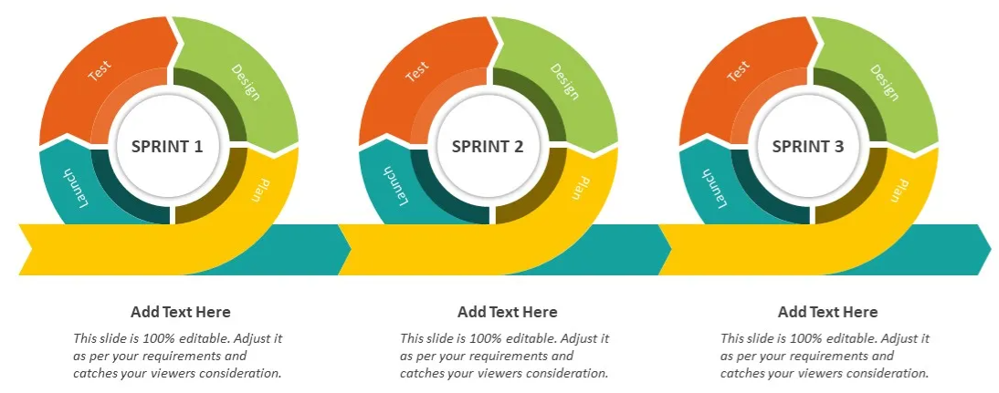
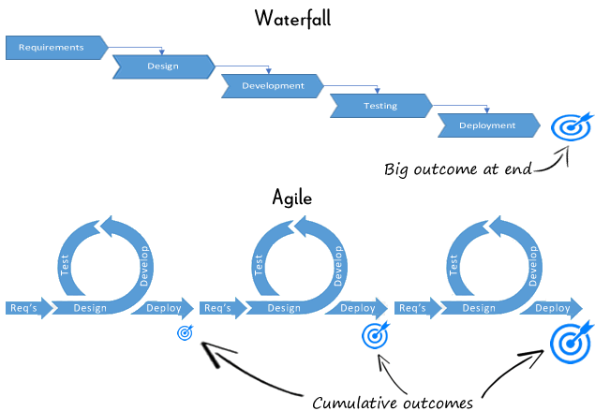
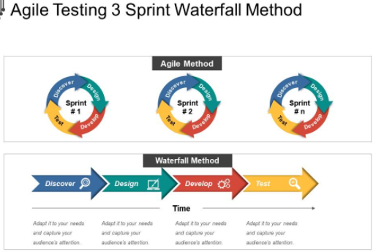
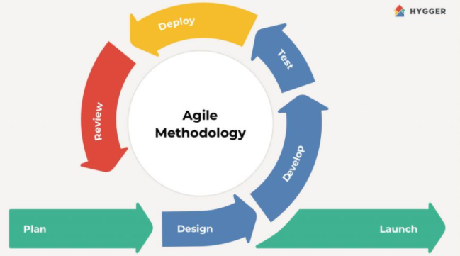
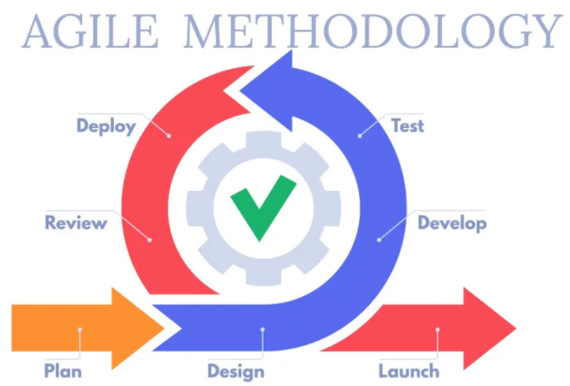
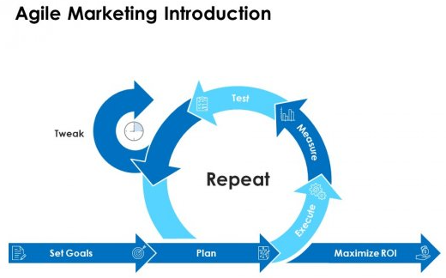

Slide 4

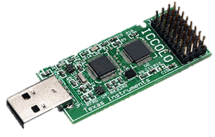
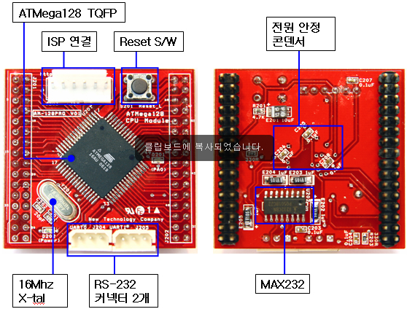
웹페이지 첫화면 이미지
Requirements
Design
Development
Test
V-Model
Agile
Deployment
SPRINT
3
Review
With
Customer
SPRINT
2
Review
With
Customer
Test
Develop
SPRINT
1
Test
Develop
Test
Develop
Req’s
Design
Deploy
Req’s
Design
Deploy
Req’s
Design
Deploy

Slide 5
웹페이지 첫화면 이미지
Requirements
Requirements
Design
Design
Development
Development
Test
Test
V-Model
V-Model
Agile
Agile
Deployment
Deployment
SPRINT
3
SPRINT
3
Test
Test
Develop
SPRINT
2
Develop
Review
With
Customer
SPRINT
2
Review
With
Customer
Review
With
Customer
Test
Review
With
Customer
Test
Develop
SPRINT
1
Develop
SPRINT
1
Test
Test
Develop
Develop
Deploy
Req’s
Deploy
Req’s
Design
Deploy
Design
Req’s
Deploy
Req’s
Design
Deploy
Design
Req’s
Deploy
Req’s
Design
Design

Slide 6
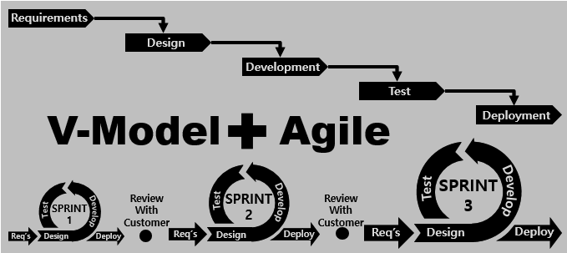
웹페이지 첫화면 이미지
Requirements
Requirements
Requirements
Requirements
Design
Design
Design
Design
Development
Development
Development
Development
Test
Test
Test
Test
V-Model
V-Model
Agile
Agile
V-Model
V-Model
Agile
Deployment
Agile
Deployment
Deployment
Deployment
SPRINT
3
SPRINT
3
SPRINT
3
Test
SPRINT
3
Test
Test
Develop
Test
Develop
Develop
SPRINT
2
Develop
SPRINT
2
SPRINT
2
Review
With
Customer
SPRINT
2
Review
With
Customer
Review
With
Customer
Review
With
Customer
Review
With
Customer
Review
With
Customer
Review
With
Customer
Test
Review
With
Customer
Test
Test
Develop
Test
Develop
Develop
SPRINT
1
Develop
SPRINT
1
SPRINT
1
Test
SPRINT
1
Test
Test
Develop
Test
Develop
Develop
Deploy
Develop
Deploy
Deploy
Req’s
Deploy
Req’s
Req’s
Design
Req’s
Design
Design
Deploy
Design
Deploy
Deploy
Req’s
Deploy
Req’s
Req’s
Design
Req’s
Design
Design
Deploy
Design
Deploy
Deploy
Req’s
Deploy
Req’s
Req’s
Design
Req’s
Design
Design
Design

