Slide 1
Webpage Figure
부제목
2021. 09. 23
심철동

Slide 2
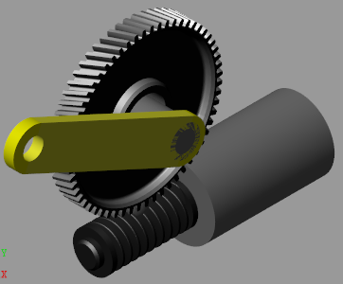
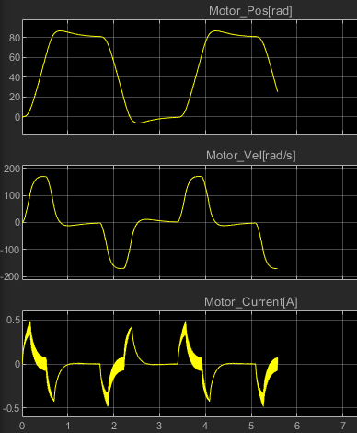
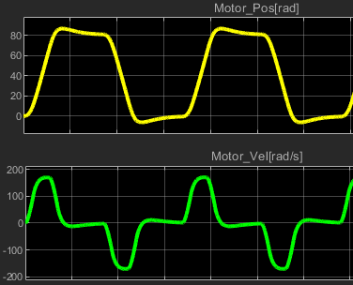
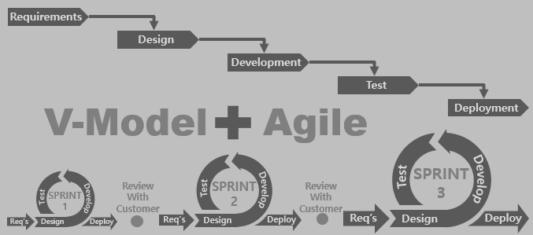
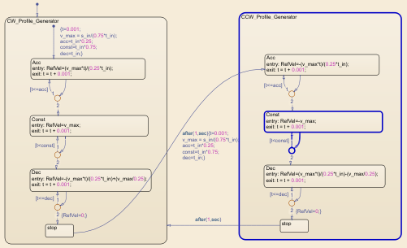
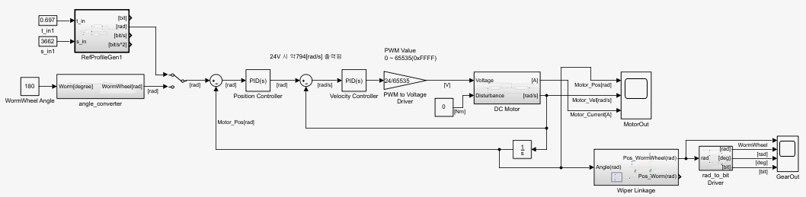
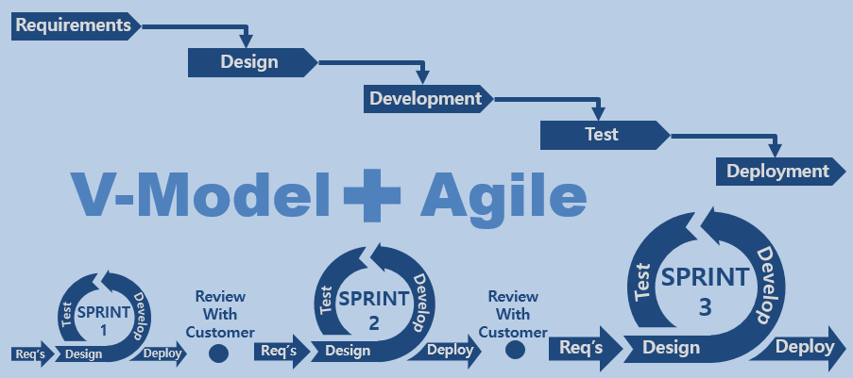
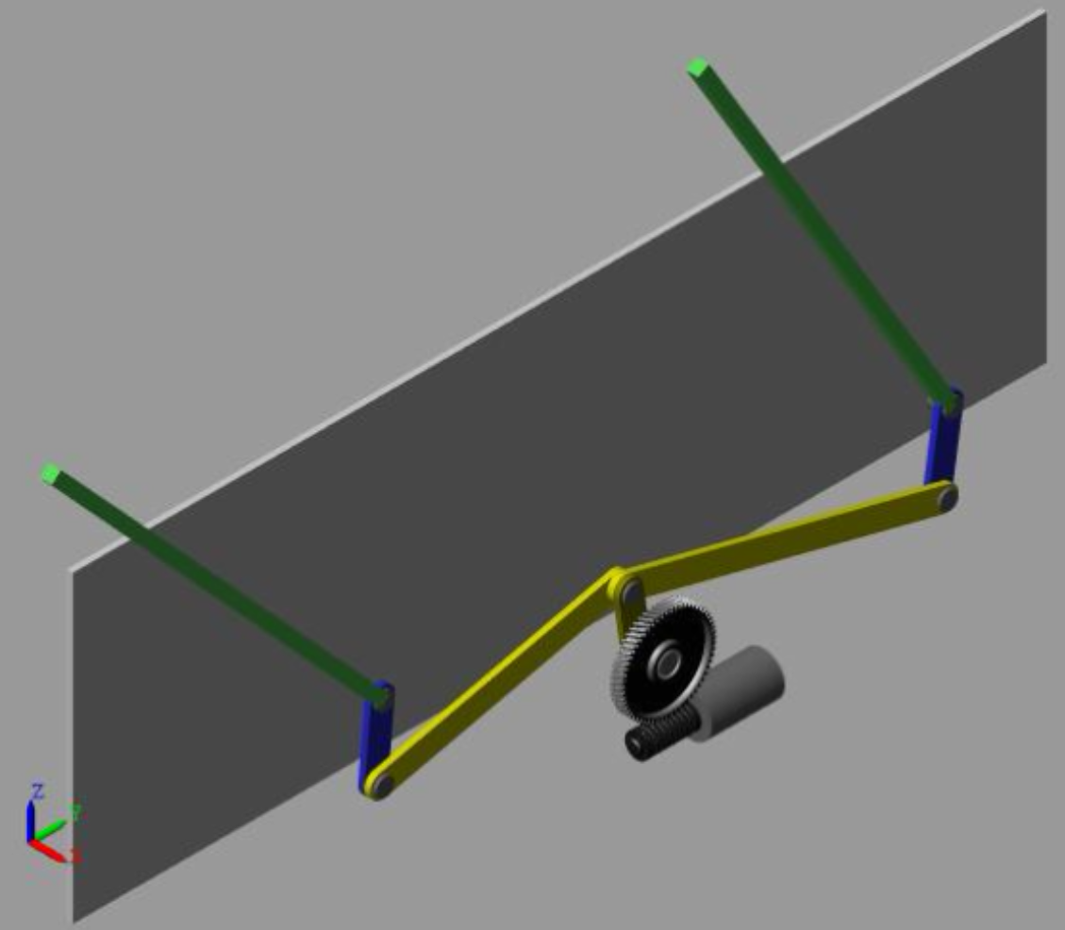
웹페이지 첫화면 이미지
Requirements
Design
Development
Test
V-Model
Agile
Deployment
SPRINT
3
Review
With
Customer
SPRINT
2
Review
With
Customer
Test
Develop
SPRINT
1
Test
Develop
Test
Develop
Req’s
Design
Deploy
Req’s
Design
Deploy
Req’s
Design
Deploy
Requirements
Design
Requirements
Development
Design
Test
Development
Agile with V-Model
Deployment
Test
V-Model
Agile
Deployment
SPRINT
3
Review
With
Customer
SPRINT
2
Review
With
Customer
Test
Develop
SPRINT
1
Test
Develop
SPRINT
3
Test
Develop
Review
With
Customer
SPRINT
2
Review
With
Customer
Test
Develop
Req’s
Design
Deploy
Req’s
Design
Deploy
Req’s
Design
Deploy
SPRINT
1
Test
Develop
Test
Develop
Req’s
Design
Deploy
Req’s
Design
Deploy
Req’s
Design
Deploy

Slide 3
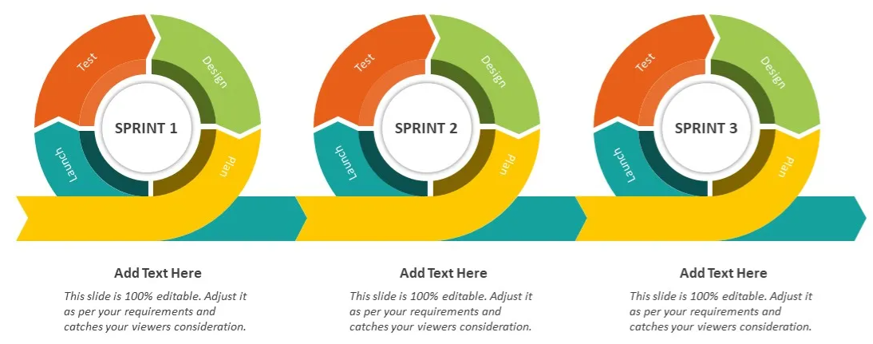
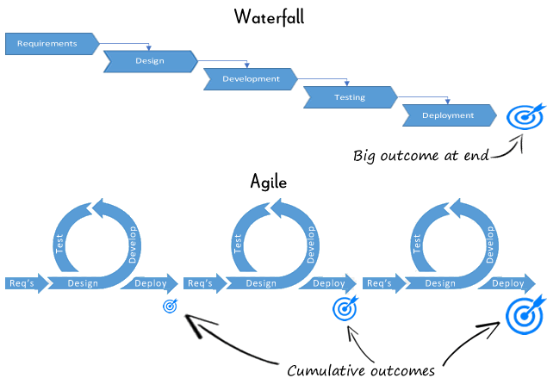
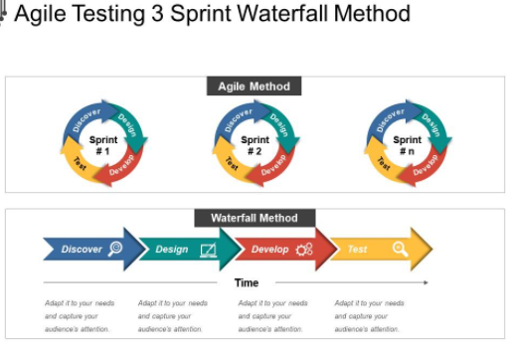
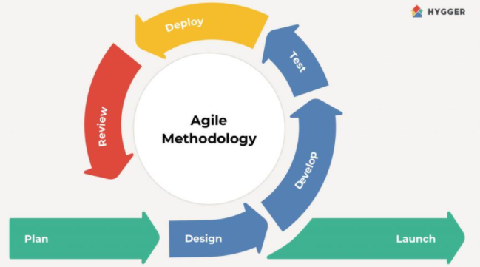
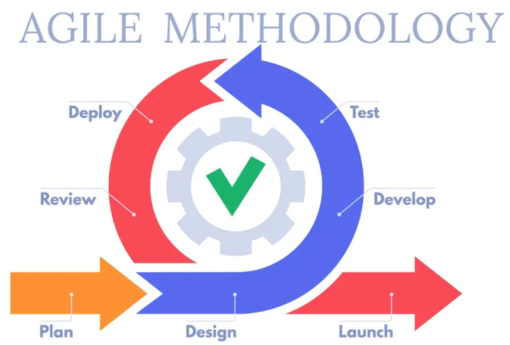
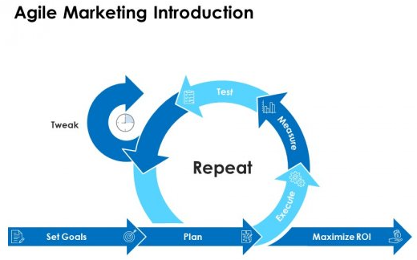

Slide 4
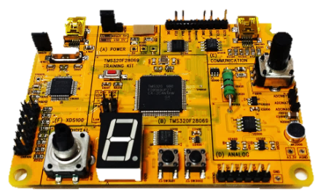
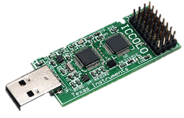
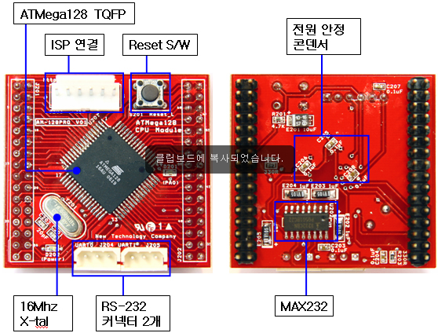
웹페이지 첫화면 이미지

