Slide 1
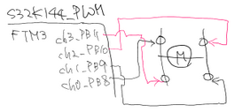
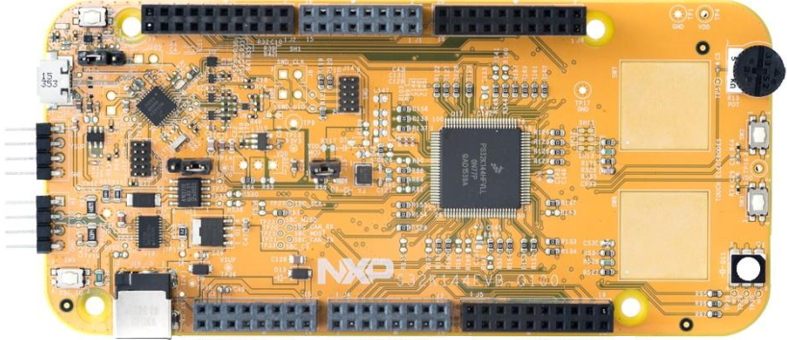
CAN
LIN
전원
디버깅
SW9
Reset
External Power Supply
(5~12V)
OpenSDA
JTAG
Reset 버튼
PTE10,A3
D15/I2C_CLK
NC
GPIO
CAN → CAN or SPI
J2
PTE11,A2
D14/I2C_SDA
NC
GPIO
3
-
Analog REF
PTA14
GPIO
GPIO
-
VIN
선택
-
GND
PTE7
GPIO
PTB6
GPIO
-
IOREF
1
PTB2
D13/SPI0_SCK
PTC13
GPIO
PTB7
GPIO
PTA5
RESET
PTB3
D12/SPI0_SIN
PTC12
GPIO
Period 측정
SW3
SW2
PTE0
GPIO
-
3V3
PTB4
D11/SPI0_SOUT
PTE8
GPIO
PTE9
전원선택
D10/SPI0_CS0
P5V0
PTC5
GPIO
-
5V
J3
P3V3
PTB5
D9/PWM
PTD0
GPIO
PTD0 : Blue LED
PTD16 : Green LED
PTD15 : Red LED
GPIO
-
GND
PTD14
D8/PWM
PTD16
GPIO
PTC4
GPIO
-
GND
PTD13
PTD15
RGB
LED
PTA10
GPIO
-
VIN
PTC11,E8
D7
GPIO
PTA4
S32K144
JTAG
PTC10,C3
D6
PTE3
GPIO
PTC7
UART1_TX
PTD4
ADC0
전류측정
PTB11
D5
PTD3
GPIO
SDA
Uart1
RxTx
PTC6
UART1_RX
PTB12
ADC1
PTB10
D4
PTD5
GPIO
FTM3_Ch3_PTB11
FTM3_Ch2_PTB10 – high_side
FTM3_Ch1_PTB9
FTM3_Ch0_PTB8 – high_side
PTB17
SPI1_CS3
PTB0
ADC0_SE4
PTB9
D3
PTD12
GPIO
PTB14
SPI1_SCK
PTB1
ADC0_SE5
PTB8
D2
PTD11
GPIO
M2_PWM
PTD11 - FTM2_QD_PHA
PTD10 - FTM2_QD_PHB
PTA12 - FTM2_QD_PHB
PTA13 - FTM2_QD_PHA
Vcc
-
GND
SPI1
SPI1_SIN
PTA2,A6,E11
ADC4
PTA3
D1
PTD10
GPIO
M1_PWM
MISO
NC
PTB15
SPI1_SOUT
PTC0,E10,A3
ADC5
PTA2
D0
PTA17
GPIO
M2_Dir
NC
MOSI
PWM 생성
PTB16
GPIO
PTE2
ADC6
PTA11
GPIO
M1_Dir
Ch0_PTA2 – Dir
CLK
MLX90363
MR Hall Sensor
/CS
PTC14
GPIO
PTE6
ADC7
J4
J1
PTA9
D14
PTC3
D15
PTE4
GPIO
GPIO
ADC8
PTA8
PTE5
CAN0
RxTx
PTE16
GPIO
PTA15,D11
ADC9
PTE12
D16
PTA12
GPIO
PTE15
GPIO
PTA16,D10
ADC0_SE1
S32K144
PTD17
D17
PTA13
GPIO
PTE14
GPIO
PTA1
ADC0_SE0
PTC9
D18
-
GPIO
PTE13
VCC
PTA0
ADC0_SE3
PTC8
D19
-
GND
-
VDD
PTA7
ADC13
PTD8
D20
PTC16
VDD
-
GPIO
PTB13
ADC14
PTD9
D21
PTC17
GPIO
PTE1
UART2_TX
PTC1
ADC15
PTD2
GPIO
PTD3
GPIO
LIN
Uart2
RxTx
PTD7
UART2_RX
PTC2
GPIO
J5
J6
PTD0
GPIO
PTD1
GPIO
PTD6
GPIO
NC
N/A
GPIO
PTC15
NC
RGB LED
Blue – PTD0
Red – PTD15
Green – PTD16
SW3
PTC13
SW2
PTC12
Potentiometer
ADC0_SE12 - PTC14

