Slide 1
AZ-204T00A Learning Path 09: Develop event-based solutions
Notes:
These Learn modules are part of the AZ-204: Develop event-based solutions (https://learn.microsoft.com/training/paths/az-204-develop-event-based-solutions/) learning path.

Slide 2
Agenda
Explore Azure Event Grid
Explore Azure Event Hubs

Slide 3
Module 1: Explore Azure Event Grid
Notes:
https://learn.microsoft.com/training/modules/azure-event-grid/

Slide 4
Learning objectives
Describe how Event Grid operates and how it connects to services and event handlers.
Explain how Event Grid delivers events and how it handles errors.
Implement authentication and authorization.
Route custom events to web endpoint by using Azure CLI.

Slide 5
Introduction
Azure Event Grid is deeply integrated with Azure services and can be integrated with third-party services.
It simplifies event consumption and lowers costs by eliminating the need for constant polling.
Event Grid efficiently and reliably routes events from Azure, and non-Azure resources, and distributes the events to registered subscriber endpoints.

Slide 6
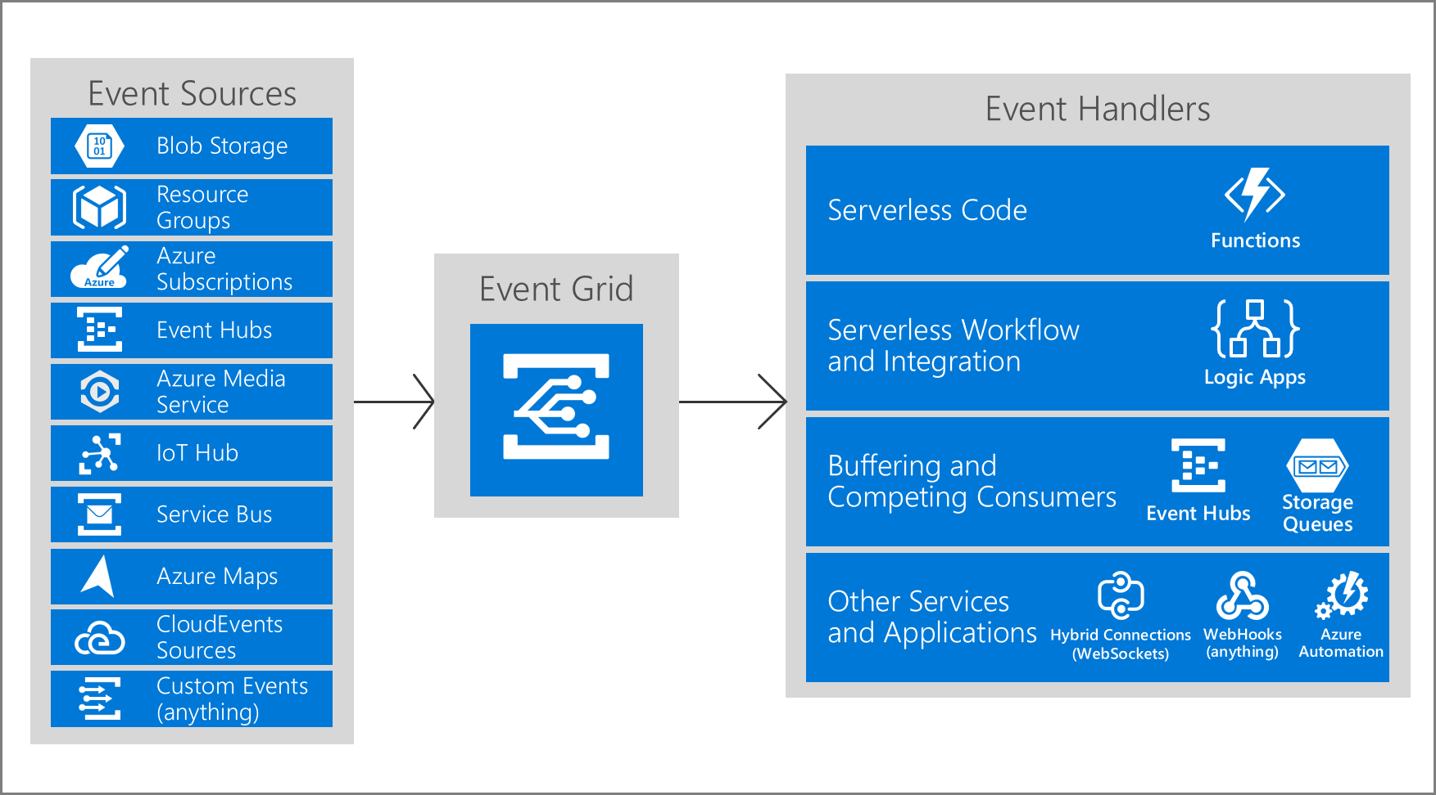
Explore Azure Event Grid (1 of 2)
What is the event grid
Azure Event Grid is an eventing backplane
Built-in support for events coming from Azure services
Create events with custom topics
Use filters to route specific events to different endpoints
Notes:
In an event-driven architecture, events are delivered in nearly real time, so that consumers can respond immediately to events as they occur.
An event-driven architecture can use a pub/sub model or an event-stream model.
Pub/sub: The messaging infrastructure keeps track of subscriptions. When an event is published, it sends the event to each subscriber. After an event is received, it cannot be replayed, and new subscribers do not observe the event.
Event streaming: Events are written to a log. Events are strictly ordered (within a partition) and durable. Clients don't subscribe to the stream. Instead, a client can read from any part of the stream. The client is responsible for advancing its position in the stream. That means that a client can join at any time, and can replay events.
On the consumer side, there are some common variations:
Simple event processing. An event immediately triggers an action in the consumer. For example, you could use Microsoft Azure Functions with a Service Bus trigger, so that a function executes whenever a message is published to a Service Bus topic.
Complex event processing. A consumer processes a series of events, observing patterns in the event data by using a technology such as Azure Stream Analytics or Apache Storm. For example, you could aggregate readings from an embedded device over a time window, and generate a notification if the moving average crosses a certain threshold.
Event stream processing. Use a data-streaming platform, such as Azure IoT Hub or Apache Kafka, as a pipeline to ingest events and feed them to stream processors. The stream processors act to process or transform the stream. There may be multiple stream processors for different subsystems of the application. This approach is a good fit for Internet of Things (IoT )workloads.
The source of the events might be external to the system, such as physical devices in an IoT solution. In that case, the system must be able to ingest the data at the volume and throughput that is required by the data source.

Slide 7
Explore Azure Event Grid (2 of 2)
Five key concepts
Events - An event is the smallest amount of information that fully describes what is happening in the system.
Event sources - An event source is where the event happens. Each event source is related to one or more event types.
Topics - The event grid topic provides an endpoint where the source sends events. A topic is used for a collection of related events.
Event subscriptions - A subscription tells Event Grid which events on a topic you're interested in receiving. You can filter the events that are sent to the endpoint.
Event handlers - An event handler is the place where the event is sent. The handler takes some further action to process the event.

Slide 8
Discover event schemas (1 of 2)
Event properties
Property | Type | Required
topic | string | No
subject | string | Yes
eventType | string | Yes
eventTime | string | Yes
id | string | Yes
data | object | No
dataVersion | string | No
metadataVersion | string | No
[
{
"topic": string,
"subject": string,
"id": string,
"eventType": string,
"eventTime": string,
"data":{
object-unique-to-each-publisher
},
"dataVersion": string,
"metadataVersion": string
}
]
Notes:
Property descriptions
The example shows the properties that are used by all event publishers
topic: Full resource path to the event source. If not included, Event Grid will stamp onto the event. If included it must match the event grid topic Azure Resource Manager ID exactly. Event Grid provides this value.
subject: Publisher-defined path to the event subject.
eventType: One of the registered event types for this event source.
eventTime: The time the event is generated based on the provider's UTC time.
id: Unique identifier for the event.
data: Event data specific to the resource provider.
dataVersion: The schema version of the data object. The publisher defines the schema version.
metadataVersion: The schema version of the event metadata. Event Grid defines the schema of the top-level properties.

Slide 9
Discover event schemas (2 of 2)
Azure Blob storage event example
[{
"topic": "...", "subject": "...",
"eventType": "Microsoft.Storage.BlobCreated",
"eventTime": "2017-06-26T18:41:00.9584103Z",
"id": "831e1650-001e-001b-66ab-eeb76e069631",
"data": {
"api": "PutBlockList", "eTag": "0x8D4BCC2E4835CD0",
"storageDiagnostics": { "batchId": "b68529f3-68cd-4744-baa4-3c0498ec19f0" },
"clientRequestId": "6d79dbfb-0e37-4fc4-981f-442c9ca65760",
"requestId": "831e1650-001e-001b-66ab-eeb76e000000",
"contentType": "application/octet-stream", "contentLength": 524288,
"blobType": "BlockBlob", "sequencer": "00000000000004420000000000028963",
"url": "https://test.blob.core.windows.net/container/blob"
},
"dataVersion": "", "metadataVersion": "1"
}]

Slide 10
Explore event delivery durability
Retry schedule - When Event Grid receives an error for an event delivery attempt, it decides whether it should retry the delivery, dead-letter the event, or drop the event based on the type of the error.
Retry policy - You can customize the retry policy when creating an event subscription through the maximum number of attempts and event time-to-live settings.
Output batching - You can configure Event Grid to batch events for delivery for improved HTTP performance in high-throughput scenarios.
Delayed delivery - If an endpoint experiences delivery failures, Event Grid will delay the delivery and retry of events to that endpoint.
Dead-letter events - If an event can not be delivered within a certain time period, or a certain number of attempts, it can send the undelivered event to a storage account.
Notes:
Event Grid provides durable delivery. It tries to deliver each event at least once for each matching subscription immediately.
If a subscriber's endpoint doesn't acknowledge receipt of an event or if there is a failure, Event Grid retries delivery based on a fixed retry schedule and retry policy.
Event Grid doesn't guarantee order for event delivery, so subscribers may receive them out of order.
Retry schedule
If the error returned by the subscribed endpoint is a configuration-related error that can't be fixed with retries (for example, if the endpoint is deleted), EventGrid will either perform dead-lettering on the event or drop the event if dead-letter isn't configured.
If Dead-Letter isn't configured for an endpoint, events will be dropped when those types of errors happen. Consider configuring Dead-Letter if you don't want these kinds of events to be dropped.
Output batching
Batching is turned off by default and can be turned on per-subscription via the portal, CLI, PowerShell, or SDKs.
Two settings:
Max events per batch - Maximum number of events Event Grid will deliver per batch. This number will never be exceeded, however fewer events may be delivered if no other events are available at the time of publish.
Preferred batch size in kilobytes -

Slide 11
Control access to events (1 of 2)
Built-in roles
Azure Event Grid allows you to control the level of access given to different users to do various management operations such as list event subscriptions, create new ones, and generate keys. Event Grid uses Azure role-based access control (Azure RBAC).
Role | Description
Event Grid Subscription Reader | Read Event Grid event subscriptions.
Event Grid Subscription Contributor | Manage Event Grid event subscription operations.
Event Grid Contributor | Create and manage Event Grid resources.
Event Grid Data Sender | Send events to Event Grid topics.

Slide 12
Control access to events (2 of 2)
Permissions for event subscriptions
If you're using an event handler that isn't a WebHook (such as an event hub or queue storage), you need write access to that resource. This permissions check prevents an unauthorized user from sending events to your resource.
Topic Type | Description
System topics | Need permission to write a new event subscription at the scope of the resource publishing the event.
Custom topics | Need permission to write a new event subscription at the scope of the event grid topic.
Notes:
You must have the Microsoft.EventGrid/EventSubscriptions/Write permission on the resource that is the event source. You need this permission because you're writing a new subscription at the scope of the resource. The required resource differs based on whether you're subscribing to a system topic or custom topic.

Slide 13
Receive events by using webhooks
Three Azure services
Azure Logic Apps with Event Grid Connector
Azure Automation via webhook
Azure Functions with Event Grid Trigger
Two ways to verify subscription
Synchronous handshake - At the time of event subscription creation, Event Grid sends a subscription validation event to your endpoint.
Asynchronous handshake - In certain cases, you can't return the ValidationCode in response synchronously.

Slide 14
Filter events
Event type filtering
By default, all event types for the event source are sent to the endpoint.
You can decide to send only certain event types to your endpoint.
Subject filtering
For simple filtering by subject, specify a starting or ending value for the subject.
You can filter the subject with /blobServices/default/containers/testcontainer to get all events for that container but not other containers in the storage account.
Advanced filtering
To filter by values in the data fields and specify the comparison operator, use the advanced filtering option.

Slide 15
Exercise: Route custom events to web endpoint by using Azure CLI
In this exercise you learn how to use the Azure CLI to Event Grid resources, subscribe to a custom topic, and send an event to a custom topic.
Objectives
Create a resource group
Enable an Event Grid resource provider
Create a custom topic
Create a message endpoint
Subscribe to a custom topic
Send an event to your custom topic
Clean up resources
Notes:
https://learn.microsoft.com/training/modules/azure-event-grid/8-event-grid-custom-events/

Slide 16
Summary and knowledge check
In this module, you learned how to:
Describe how Event Grid operates and how it connects to services and event handlers.
Explain how Event Grid delivers events and how it handles errors.
Implement authentication and authorization.
Route custom events to web endpoint by using Azure CLI.
1
Which event schema properties requires a value?
2
Which Event Grid built-in role is appropriate for managing Event Grid resources?
Notes:
The subject property specifies the publisher-defined path to the event subject and is required.
The Event Grid Contributor role has permissions to manage resources.

Slide 17
Module 2: Explore Azure Event Hubs
Notes:
https://learn.microsoft.com/training/modules/azure-event-hubs/

Slide 18
Learning objectives
Describe the benefits of using Event Hubs and how it captures streaming data.
Explain how to process events.
Perform common operations with the Event Hubs client library.

Slide 19
Introduction
Azure Event Hubs is a big data streaming platform and event ingestion service.
It can receive and process millions of events per second.
Data sent to an event hub can be transformed and stored by using any real-time analytics provider or batching/storage adapters.

Slide 20
Discover Azure Event Hubs (1 of 2)
Azure Event Hubs provides a unified streaming platform with time retention buffer, decoupling event producers from event consumers.
It is a scalable event-processing service that ingests and processes large volumes of events and data, with low latency and high reliability.
Feature | Description
Fully managed PaaS | Event Hubs is a fully managed service with little configuration or management overhead
Real-time and batch processing | Event Hubs uses a partitioned consumer model, enabling multiple applications to process the stream concurrently and letting you control the speed of processing.
Scalable | Scaling options, like Auto-inflate, scale the number of throughput units to meet your usage needs.
Rich ecosystem | Event Hubs for Apache Kafka ecosystems enables Apache Kafka (1.0 and later) clients and applications to talk to Event Hubs

Slide 21
Discover Azure Event Hubs (2 of 2)
Key components
An Event Hub client is the primary interface for developers interacting with the Event Hubs client library.
An Event Hub producer is a type of client that serves as a source of telemetry data, diagnostics information, usage logs, or other log data, as part of an embedded device solution, a mobile device application, a game title running on a console or other device, some client or server based business solution, or a web site.
An Event Hub consumer is a type of client which reads information from the Event Hub and allows processing of it. Processing may involve aggregation, complex computation and filtering.
A partition is an ordered sequence of events that is held in an Event Hub. Partitions are a means of data organization associated with the parallelism required by event consumers.
A consumer group is a view of an entire Event Hub. Consumer groups enable multiple consuming applications to each have a separate view of the event stream, and to read the stream independently at their own pace and from their own position.
Event receivers - Any entity that reads event data from an event hub. All Event Hubs consumers connect via the AMQP 1.0 session.
Throughput units or processing units - Pre-purchased units of capacity that control the throughput capacity of Event Hubs.

Slide 22
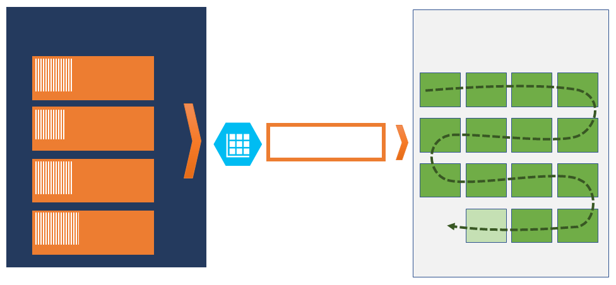
Explore Event Hubs Capture (1 of 2)
Azure Event Hubs enables you to automatically capture the streaming data in Event Hubs in an Azure Blob storage or Azure Data Lake Storage account of your choice.
Event Hubs Capture enables you to process real-time and batch-based pipelines on the same stream.
Event hub
Azure Blob storage
Azure Data Lake storage
Partition 1
Partition 2
Capture
Partition 3
Partition 4

Slide 23
Explore Event Hubs Capture (2 of 2)
Capture windowing
Event Hubs Capture enables you to set up a window to control capturing.
Each partition captures independently and writes a completed block blob at the time of capture, named for the time at which the capture interval was encountered.
Scaling to throughput units
Event Hubs traffic is controlled by throughput units.
Event Hubs Capture copies data directly from the internal Event Hubs storage, bypassing throughput unit egress quotas and saving your egress for other processing readers.
Event Hubs Capture runs automatically when you send your first event.
Notes:
Capture windowing
This window is a minimum size and time configuration with a "first wins policy," meaning that the first trigger encountered causes a capture operation.
Scaling to throughput units
A single throughput unit allows 1 MB per second or 1000 events per second of ingress and twice that amount of egress. Standard Event Hubs can be configured with 1-20 throughput units, and you can purchase more with a quota increase support request.

Slide 24
Scale your processing application (1 of 2)
The key to scale for Event Hubs is the idea of partitioned consumers. In contrast to the competing consumers pattern, the partitioned consumer pattern enables high scale by removing the contention bottleneck and facilitating end to end parallelism.
Example scenario
When designing the consumer in a distributed environment, the solution must handle the following requirements: scale, load balance, seamless resume on failures, and event consumption.
Event processor or consumer client
You don't need to build your own solution to meet these requirements.
The Azure Event Hubs SDKs provide this functionality.
For most production scenarios use the event processor client for reading and processing events.

Slide 25
Scale your processing application (2 of 2)
Partition ownership tracking
An event processor instance typically owns and processes events from one or more partitions.
Each event processor is given a unique identifier and claims ownership of partitions by adding or updating an entry in a checkpoint store.
Receive messages
When you create an event processor, you specify the functions that will process events and errors.
We recommend that you do things relatively fast. That is, do as little processing as possible.
Checkpointing
Checkpointing is a process by which an event processor marks or commits the position of the last successfully processed event within a partition.
By specifying a lower offset from this checkpoint process, you can return to older data.
Thread safety and processor instances
By default, the function that processes the events is called sequentially for a given partition. As the event pump continues to run in the background of other threads, subsequent events from the same partition and calls to this function are queued in the background.

Slide 26
Control access to events
Azure built-in roles:
Azure Event Hubs Data Owner: Use this role to give complete access to Event Hubs resources.
Azure Event Hubs Data Sender: Use this role to give send access to Event Hubs resources.
Azure Event Hubs Data Receiver: Use this role to give receiving access to Event Hubs resources.
You can:
Authorize access with managed identities
Authorize access with Microsoft Identity Platform
Authorize access to Event Hubs publishers with shared access signatures
Authorize access to Event Hubs consumers with shared access signatures
Notes:
Authorize access with managed identities
To authorize a request to Event Hubs service from a managed identity in your application, you need to configure Azure role-based access control settings for that managed identity.
Authorize access with Microsoft Identity Platform
A key advantage of using Microsoft Entra ID with Event Hubs is that your credentials no longer need to be stored in your code.
Instead, you can request an OAuth 2.0 access token from Microsoft identity platform.
Authorize access to Event Hubs publishers with shared access signatures
An event publisher defines a virtual endpoint for an Event Hub. The publisher can only be used to send messages to an event hub and not receive messages.
Each Event Hubs client is assigned a unique token which is uploaded to the client.
All tokens are assigned with shared access signature keys.
Authorize access to Event Hubs consumers with shared access signatures
To authenticate back-end applications that consume from the data generated by Event Hubs producers, Event Hubs token authentication requires its clients to either have the manage rights or the listen privileges assigned to its Event Hubs namespace or event hub instance or topic.

Slide 27
Perform common operations with the Event Hubs client library (1 of 3)
Inspect an Event Hub
await using (var producer = new EventHubProducerClient(connectionString, eventHubName))
{
string[] partitionIds = await producer.GetPartitionIdsAsync();
}
Notes:
Many Event Hub operations take place within the scope of a specific partition.
To understand what partitions are available, you query the Event Hub using one of the Event Hub clients.
The EventHubProducerClient is demonstrated in these examples, but the concept and form are common across clients.

Slide 28
Perform common operations with the Event Hubs client library (2 of 3)
Publish events to an Event Hub
await using (var producer = new EventHubProducerClient(connectionString, eventHubName))
{
using EventDataBatch eventBatch = await producer.CreateBatchAsync();
eventBatch.TryAdd(new EventData(new BinaryData("First")));
eventBatch.TryAdd(new EventData(new BinaryData("Second")));
await producer.SendAsync(eventBatch);
}
Notes:
Producers publish events in batches and may request a specific partition, or allow the Event Hubs service to decide which partition events should be published to.
It is recommended using automatic routing when the publishing of events needs to be highly available or when event data should be distributed evenly among the partitions.

Slide 29
Perform common operations with the Event Hubs client library (3 of 3)
Read events from an Event Hub
string consumerGroup = EventHubConsumerClient.DefaultConsumerGroupName;
await using (var consumer = new EventHubConsumerClient(consumerGroup, connectionString, eventHubName))
{
using var cancellationSource = new CancellationTokenSource();
cancellationSource.CancelAfter(TimeSpan.FromSeconds(45));
await foreach (PartitionEvent receivedEvent in consumer.ReadEventsAsync(cancellationSource.Token))
{
// At this point, the loop will wait for events to be available in the Event Hub. When an event
// is available, the loop will iterate with the event that was received. Because we did not
// specify a maximum wait time, the loop will wait forever unless cancellation is requested using
// the cancellation token.
}
}
Notes:
Our example reads all events that have been published to the Event Hub using an iterator.
This approach to consuming is intended to provide a general example.
For production use it is recommended to use the Event Processor Client (https://github.com/Azure/azure-sdk-for-net/blob/main/sdk/eventhub/Azure.Messaging.EventHubs.Processor), as it provides a more robust and performant experience.

Slide 30
Summary and knowledge check
In this module, you learned how to:
Describe the benefits of using Event Hubs and how it captures streaming data.
Explain how to process events.
Perform common operations with the Event Hubs client library.
1
Which Event Hubs concept represents an ordered sequence of events that is held in an Event Hubs?
2
Which process represents when an event processor marks or commits the position of the last successfully processed event within a partition?
Notes:
A partition is an ordered sequence of events that is held in an Event Hub.
Checkpointing is a process by which an event processor marks or commits the position of the last successfully processed event within a partition.

Slide 31
Discussion and lab

Slide 32
Group discussion questions
Can you describe the differences between the capabilities of Azure Event Grid and Azure Event Hubs? When would you use one over the other?
Contoso Inc is using Event Grid in their solution, but many events are being lost during delivery. What can they do to improve delivery and retain the events being lost?
Can you list the three Azure built-in roles for Event Hubs and what permissions they grant?

Slide 33
Lab 09: Publish and subscribe to Event Grid events
In this lab, you will start with a proof-of-concept web app, hosted in a container, that will be used to subscribe to your Event Grid. This app will allow you to submit events and receive confirmation messages that the events were successful.
http://aka.ms/az204labs
Exercise 1: Create Azure resources
Exercise 2: Create an Event Grid subscription
Exercise 3: Publish Event Grid events from .NET

Slide 34
End of presentation

