Slide 1
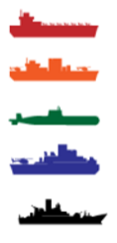
1 | 0 | 0 | 0 | 1
0 | 1 | 1 | 1 | 0
0 | 1 | 1 | 1 | 0
0 | 1 | 1 | 1 | 0
1 | 0 | 0 | 0 | 1
1 | 1 | 1 | 1 | 1
1 | 0 | 0 | 0 | 1
1 | 0 | 0 | 0 | 1
1 | 0 | 0 | 0 | 1
1 | 1 | 1 | 1 | 1
Your Strategy
(‘mat_your’)
Your Friend’s Strategy (‘mat_friend’)

Slide 2
1 | 0 | 0 | 1
0 | 1 | 1 | 0
0 | 1 | 1 | 0
1 | 0 | 0 | 1
1 | 1 | 1 | 1
1 | 0 | 0 | 1
1 | 0 | 0 | 1
1 | 1 | 1 | 1
Your Strategy
(‘mat_your’)
Your Friend’s Strategy (‘mat_friend’)

