Slide 1
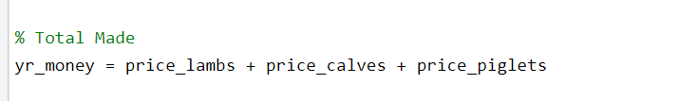

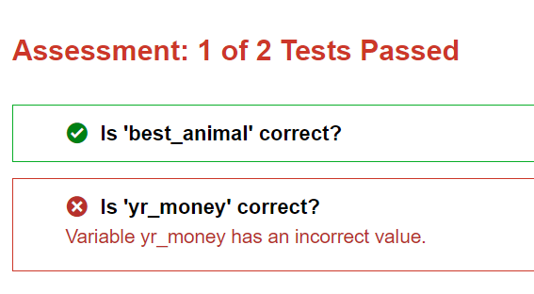
Common Errors
correct script
Case 1. Incorrect value

Slide 2
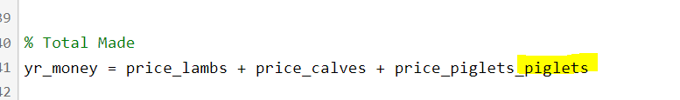
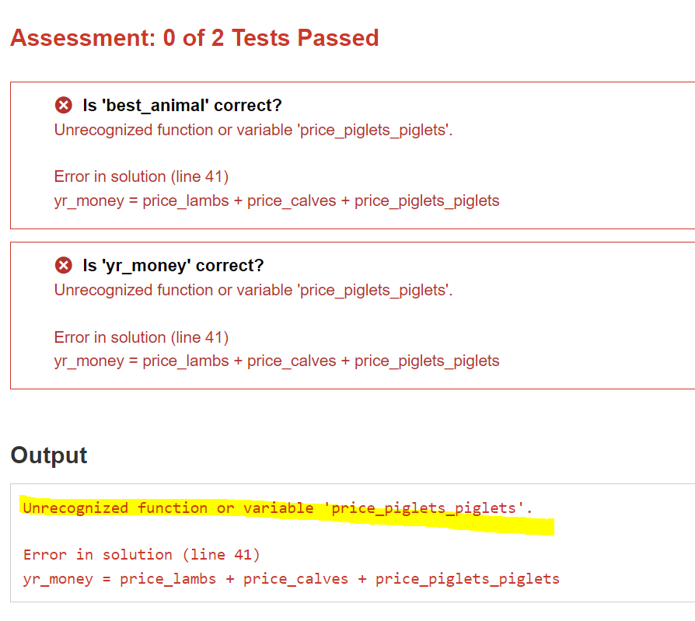
Common Errors
correct script
Case 2. Wrong variable name (potential runtime error)

Slide 3
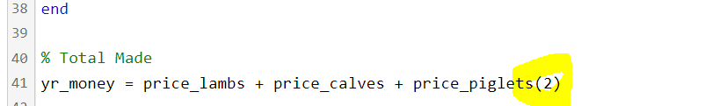
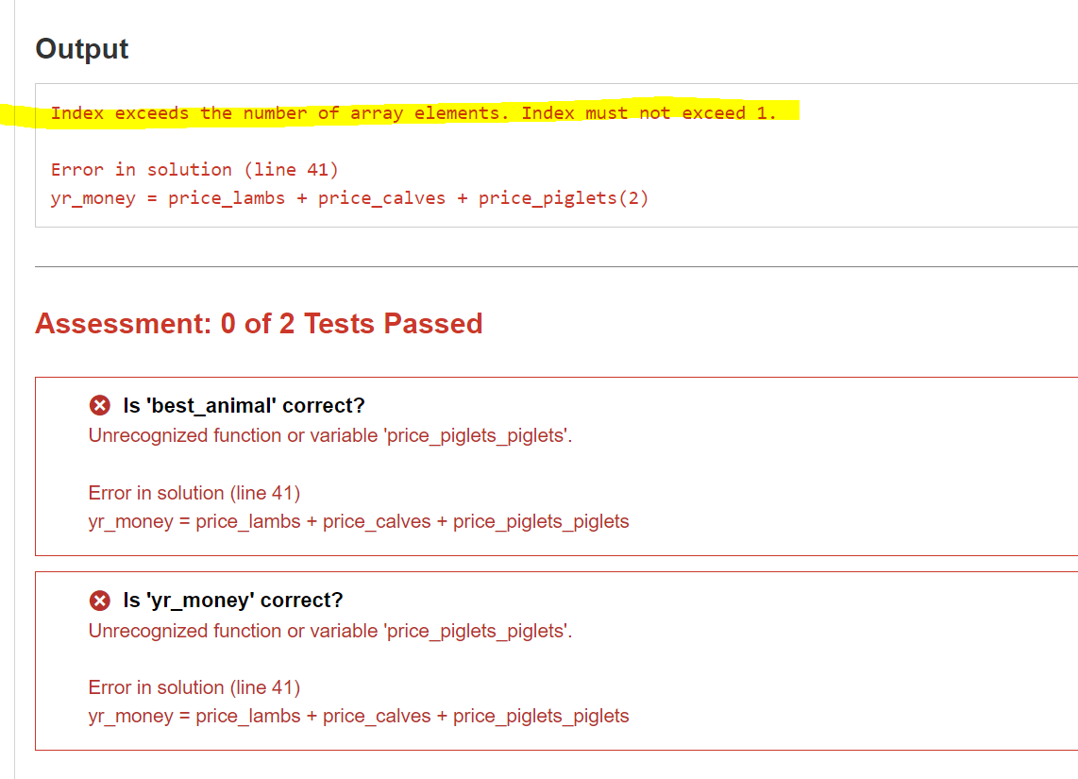
Common Errors
correct script
Case 3. Exceeding index (potential runtime error)

