Slide 1
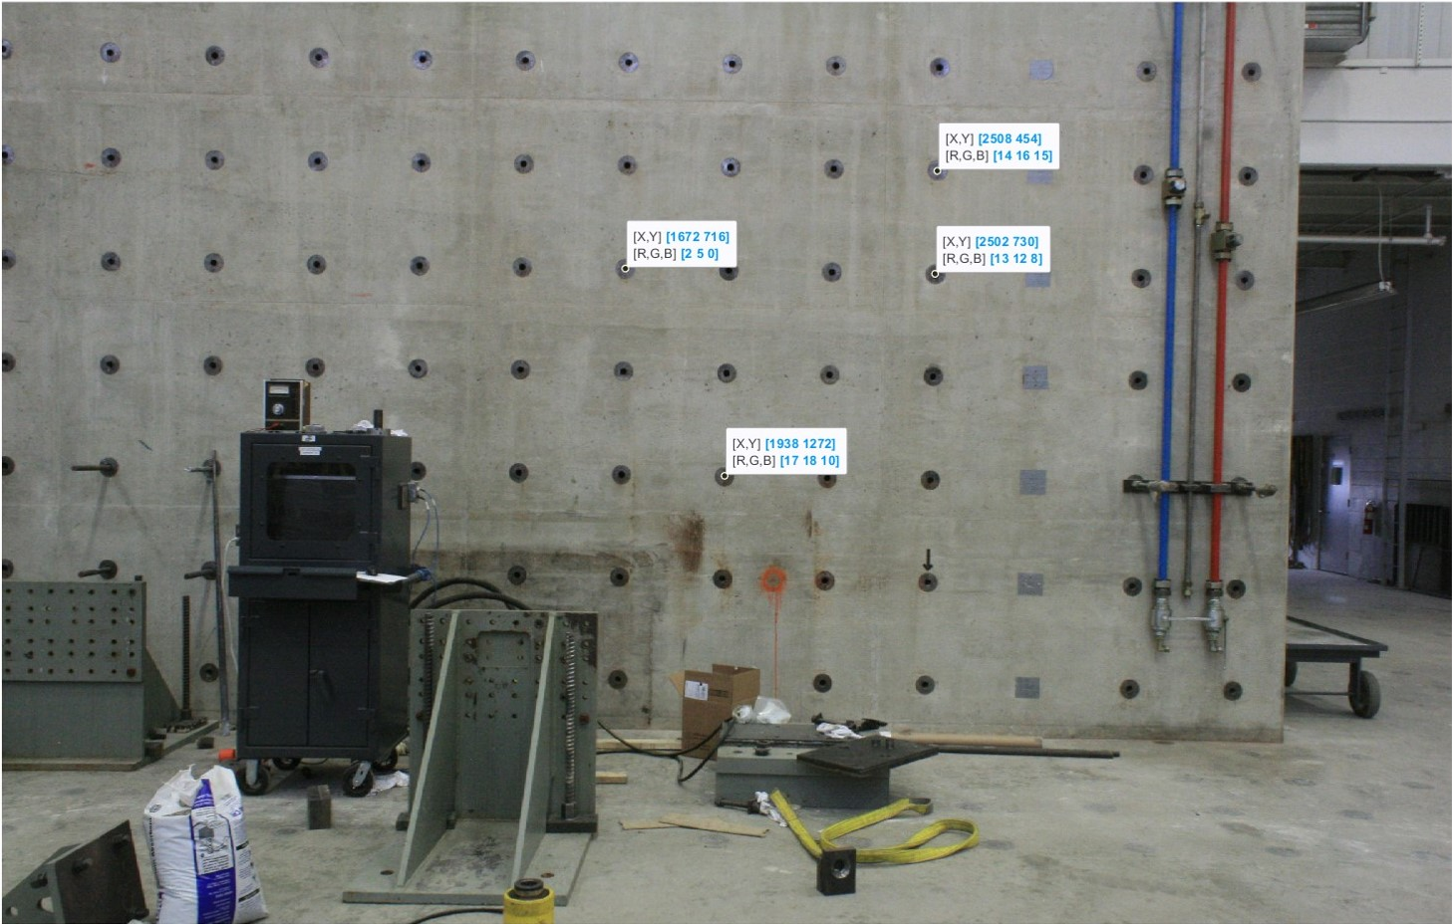
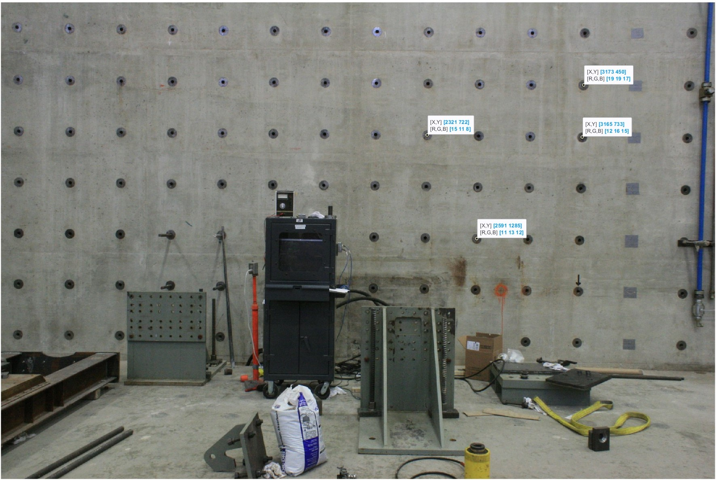
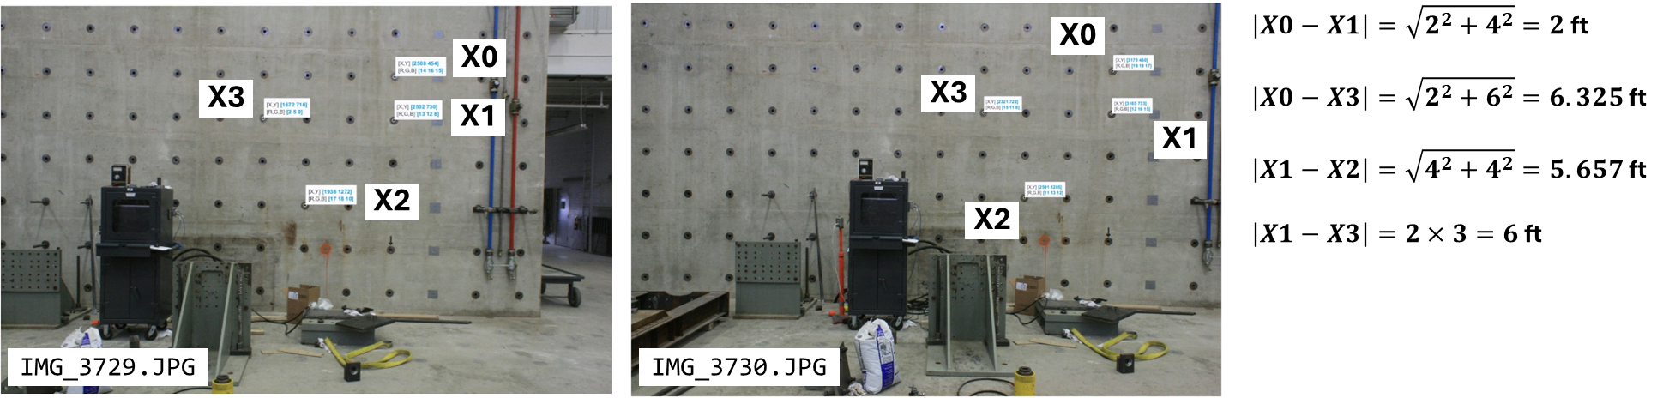
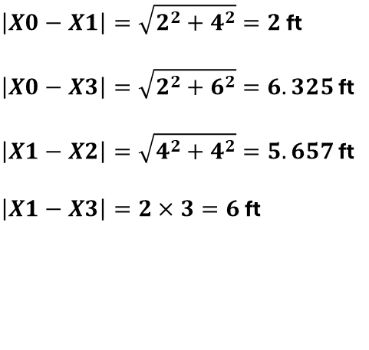
X0
$\left|X0−X1\right|=\sqrt{2^{2}+4^{2}}=2$ ft
$\left|X0−X3\right|=\sqrt{2^{2}+6^{2}}=6.325$ ft
$\left|X1−X2\right|=\sqrt{4^{2}+4^{2}}=5.657$ ft
$\left|X1−X3\right|=2×3=6$ ft
X0
X3
X3
X1
X1
X2
X2
IMG_3729.JPG
IMG_3730.JPG

