Slide 1
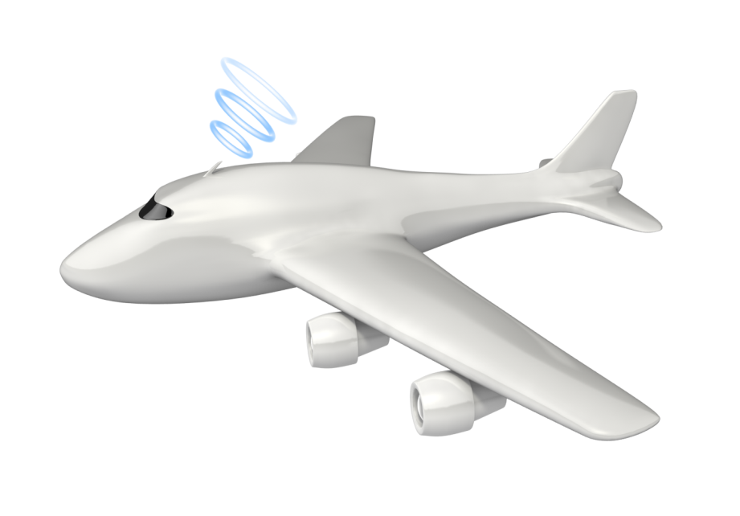
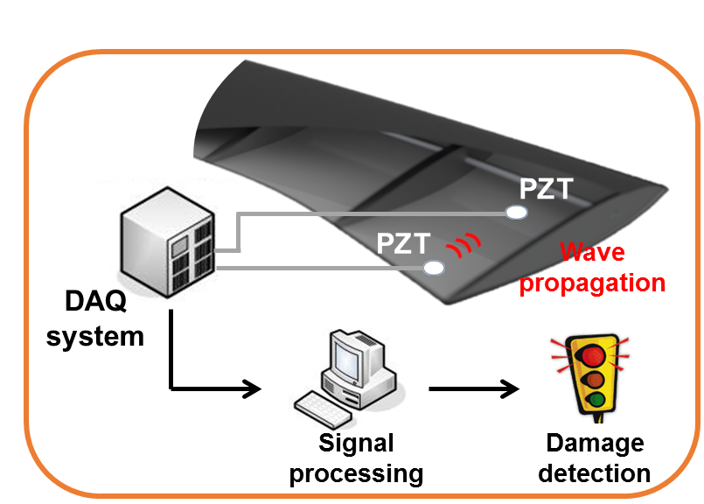
Real-time autonomous delamination detection
Composite
air vehicle

