Slide 1
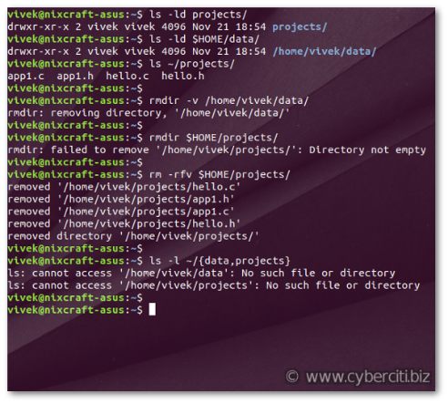
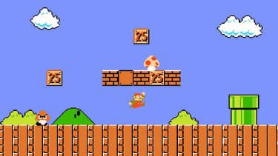
Python libraries
From terminal to gaming

Slide 2
In the previous lesson
Events = call a function when user click or type text
An event can be bind to a shape with a tag
An event can also be bind to « root » (root is everywhere)
def myEventTrigger(event):
print("User have clicked at position : ", event.x, event.y)
randomColor = random.choice(colors)
canvas.itemconfig(oval, fill=randomColor)
canvas.move(oval, 10, 10)
canvas = tk.Canvas(frame)
colors = ["red", "orange", "yellow", "green", "blue", "indigo", "violet"]
oval = canvas.create_oval(50, 50, 300, 300, fill="red", tags="PNCTarget")
canvas.tag_bind("PNCTarget","<Button-1>",myEventTrigger)
root.bind("<Button-1>",myEventTrigger)
Change a shape position and color
Call function when click on shape
Call function when click anywhere

Slide 3
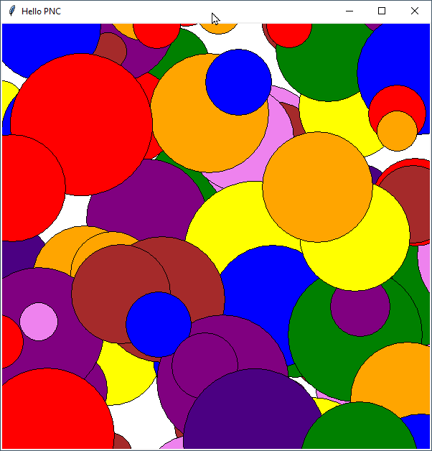
The circle mess
Activity
15 minutes
Use the starting code 01-randomCircles-startCode.py
Everytime user clicks : create a random circle (random position, random color, random size)
Notes:
01-randomCircles-startCode.py

Slide 4
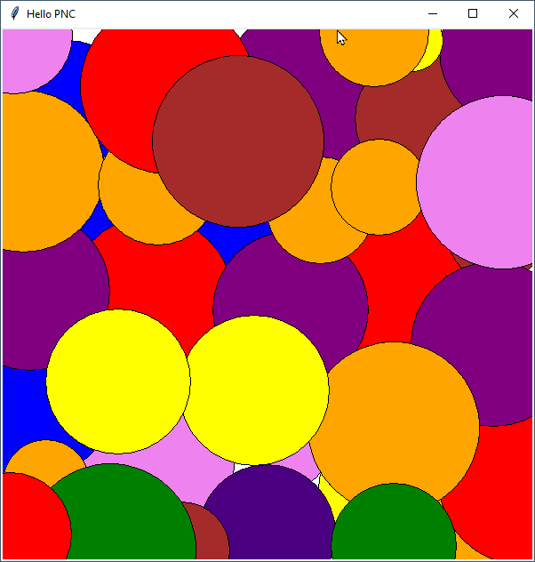
The painter
Activity
15 minutes
Use the previous code.
Everytime user clicks :
Create a random circle at the mouse position (random color, random size)
Use event.x and event.y inside drawCircle function to get mouse poisition
Notes:
01-randomCircles-startCode.py

Slide 5
Scope of variable : local VS global
total = 0
def sum( arg1, arg2 ):
total = arg1 + arg2
print("Inside : ", total)
return total
sum(10,20);
print("Outside : ", total)
What will be the output of this code ?
Notes:
03-sum-global-local.py

Slide 6
Scope of variable : local VS global
total = 0
def sum( arg1, arg2 ):
total = arg1 + arg2
print("Inside : ", total)
return total
sum(10,20);
print("Outside : ", total)
Inside : 30
Outside : 0
Notes:
03-sum-global-local.py

Slide 7
Scope of variable : local VS global
Python creates a global variable total.
This variable exists everywhere.
total = 0
def sum( arg1, arg2 ):
total = arg1 + arg2
print("Inside : ", total)
return total
sum(10,20);
print("Outside : ", total)
Python creates a local variable total.
This variable exists only inside function.
Inside of function Python use local variable by default
Outside of function Python use global variable
Notes:
03-sum-global-local.py

Slide 8
Scope of variable : local VS global
total = 0
def sum( arg1, arg2 ):
global total
total = arg1 + arg2
print("Inside : ", total)
return total
sum(10,20);
print("Outside : ", total)
With this line we tell to python to use global variable instead of local
What will be the output of this code ?
Notes:
03-sum-global.py

Slide 9
Scope of variable : local VS global
points = []
def drawCircle(event):
points.append(event.x)
points.append(event.y)
print(points)
def drawShape(event):
points = []
print(points)
root.bind("<Button-1>", drawCircle) #LEFT CLICK
root.bind("<Button-3>", drawShape) #RIGHT CLICK
Try this code.
Left click 2 times
➔ what is printed ?
Right click
➔ what is printed ?
Left click
➔ what is printed ?
Notes:
04-theArtist-startCode.py

Slide 10
Scope of variable : local VS global
« points » is a global variable
points = []
def drawCircle(event):
points.append(event.x)
points.append(event.y)
print(points)
def drawShape(event):
points = []
print(points)
root.bind("<Button-1>", drawCircle) #LEFT CLICK
root.bind("<Button-3>", drawShape) #RIGHT CLICK
Python use « points » global variable because there is no other variable name points
Python creates a local variable named « points ».
This variable exists only inside function.
Notes:
04-theArtist-startCode.py

Slide 11
Scope of variable : local VS global
points = []
def drawCircle(event):
points.append(event.x)
points.append(event.y)
print(points)
def drawShape(event):
global points
points = []
print(points)
root.bind("<Button-1>", drawCircle) #LEFT CLICK
root.bind("<Button-3>", drawShape) #RIGHT CLICK
With this line I say to Python « dont create a local variable, use the global variable »
Notes:
04-theArtist-startCode.py

Slide 12
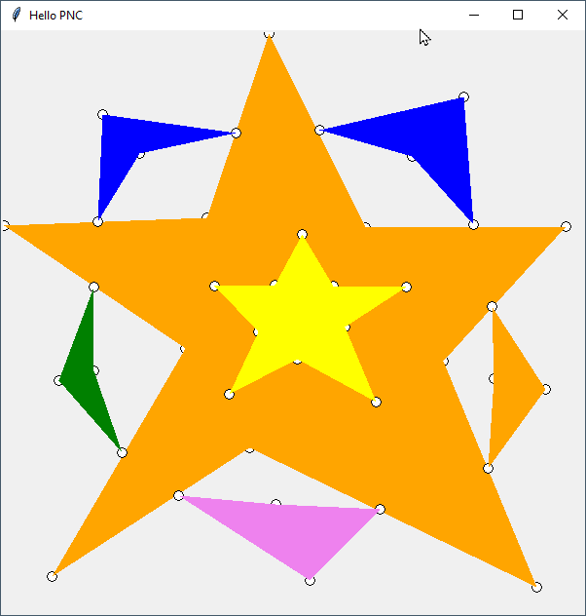
The artist
Activity
30 minutes
Use the previous code with array « points » 04-theArtist-startCode.py
When user left click : draw a small circle and append x and y to array
When user right click : draw a polygon using the array points. Then empty the array. canvas.create_polygon(points)
Notes:
04-theArtist-correction.py

