Slide 1
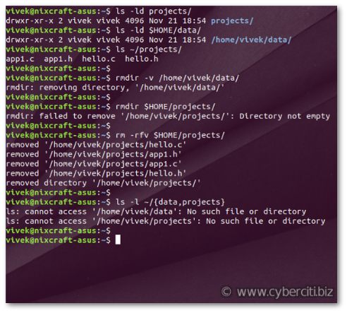
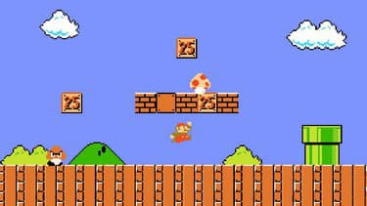
Python libraries
From terminal to gaming

Slide 2
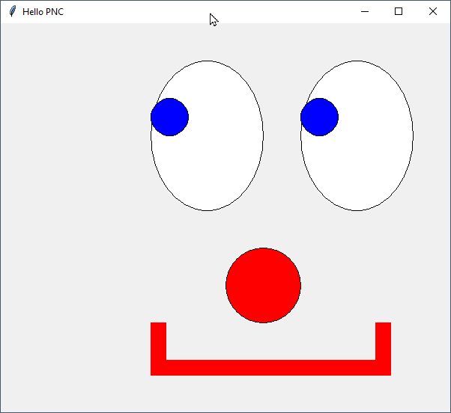
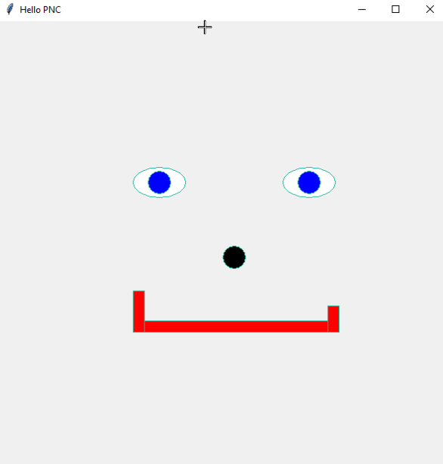
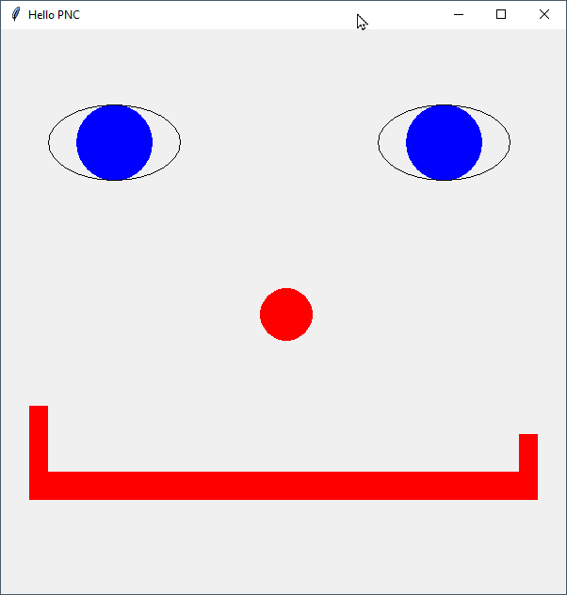
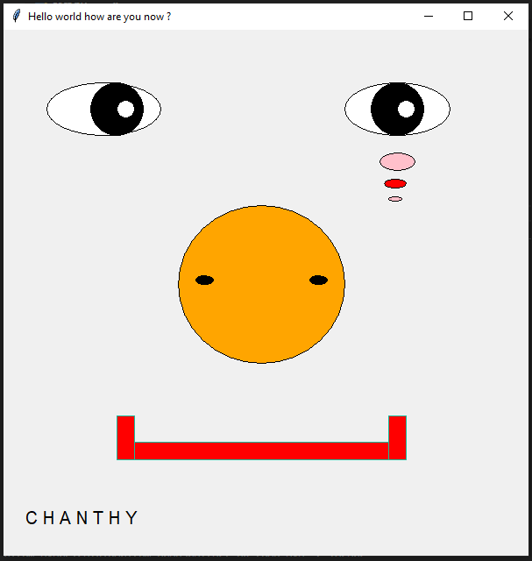
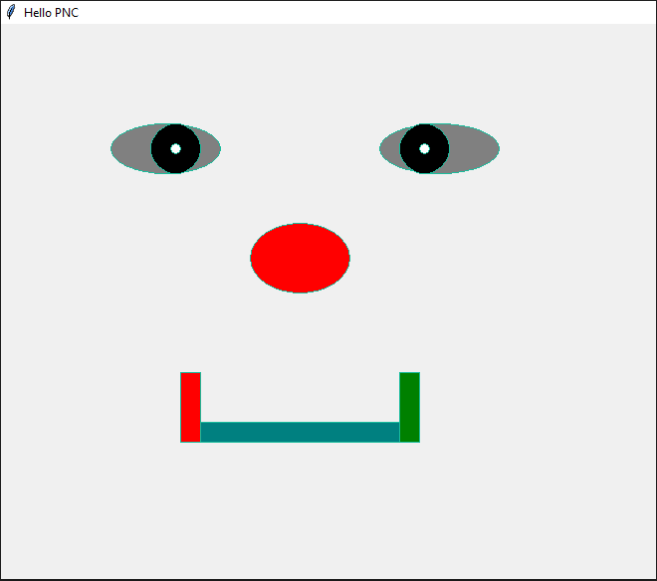
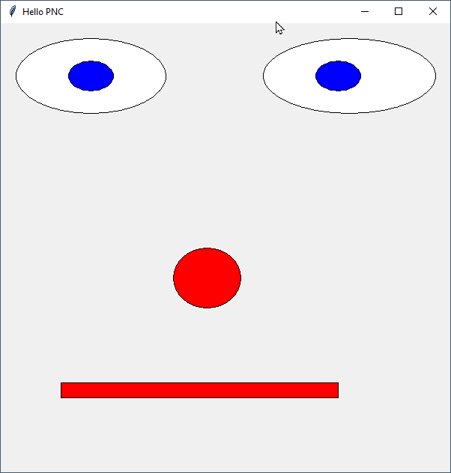
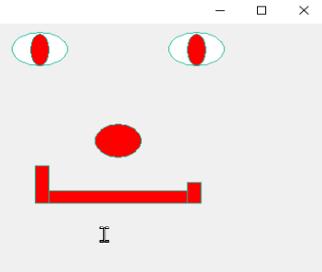
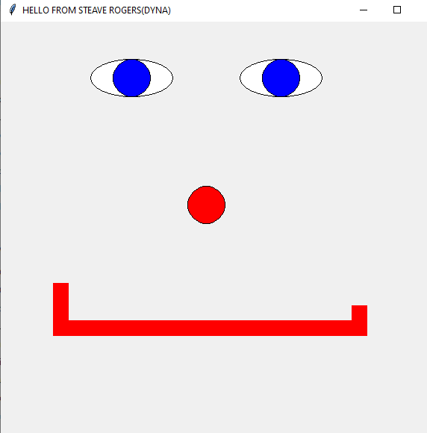
Blue eyes clowns – Hall of Fame – Class A – page 1
Notes:
Top row = Lyhor – Narath – Koemsak - Chanthy
Lower row = Sok Chhat – Dyna – Chainy - Chanry

Slide 3
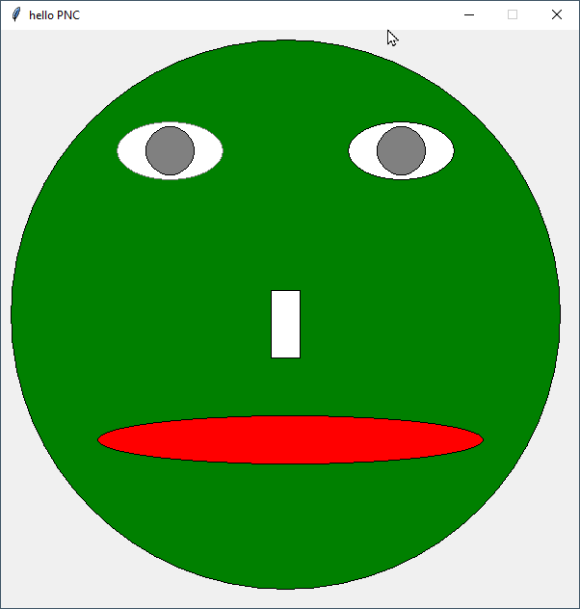
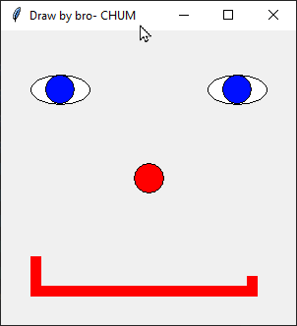
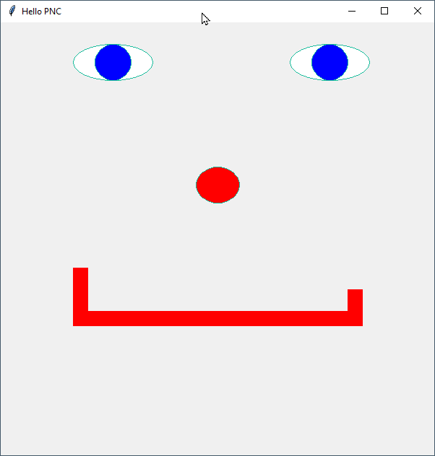
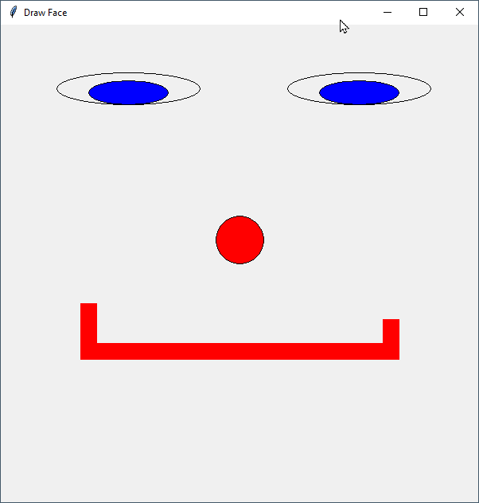
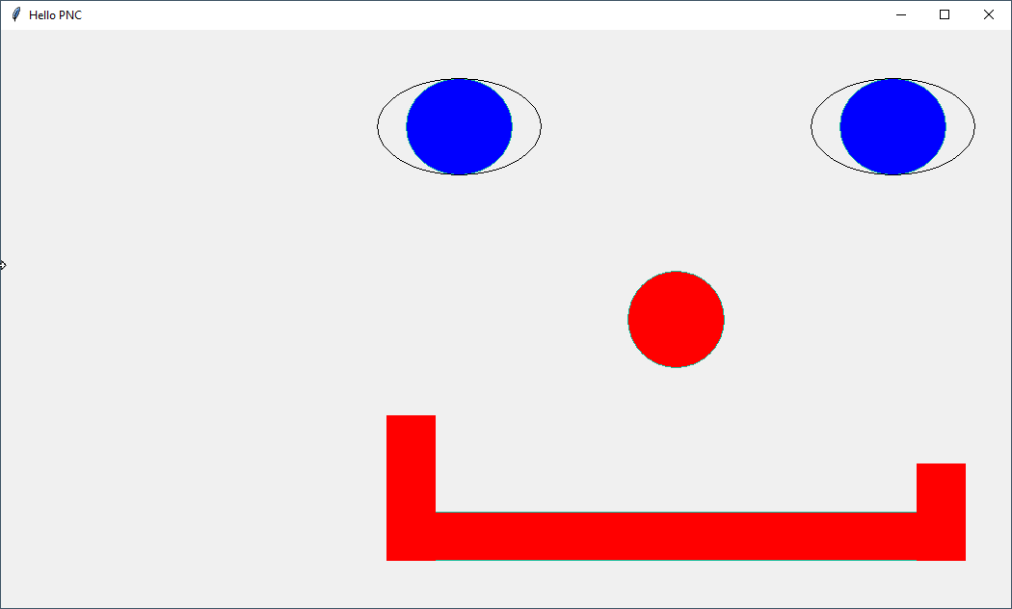
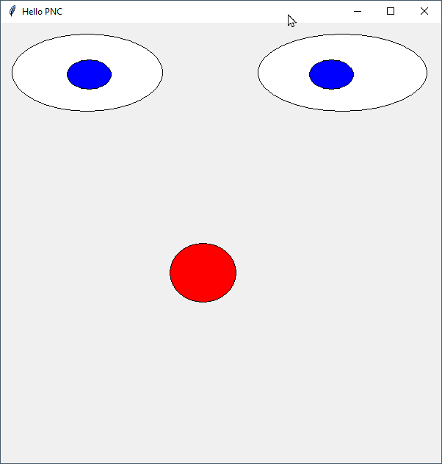
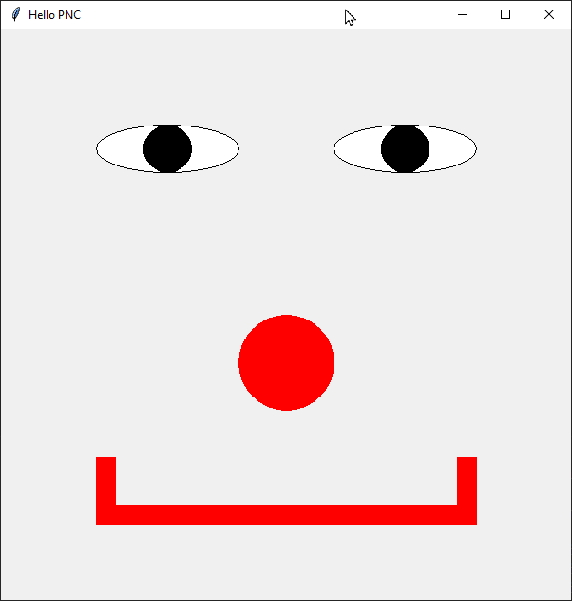
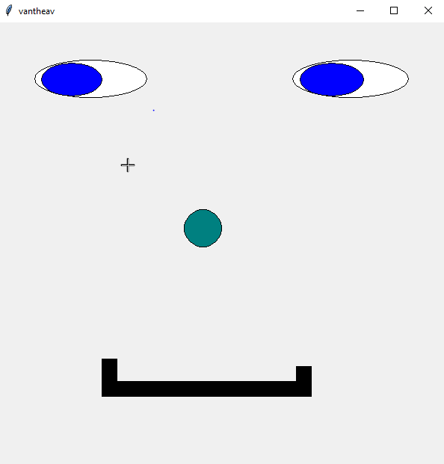
Blue eyes clowns – Hall of Fame – Class A – page 2
Notes:
Top row = Chrang – Chum – Molika - Nisai
Lower row = Sokthang – Sreyhieb – Sreyngit - Vantheav

Slide 4
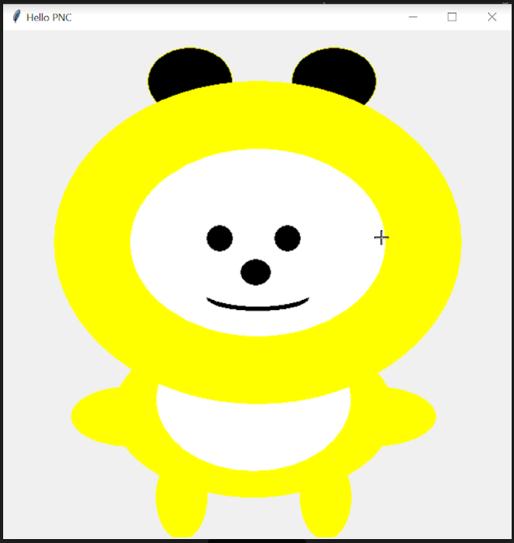
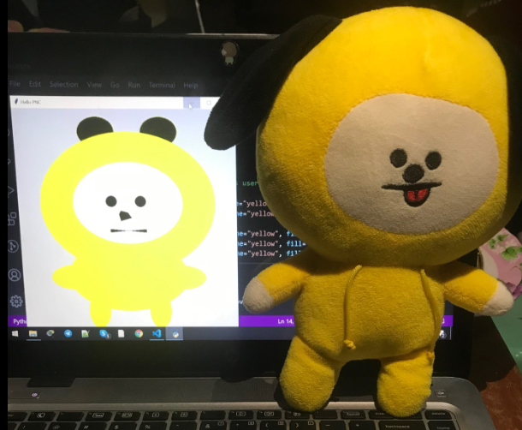
Notes:
Sophanna

Slide 5
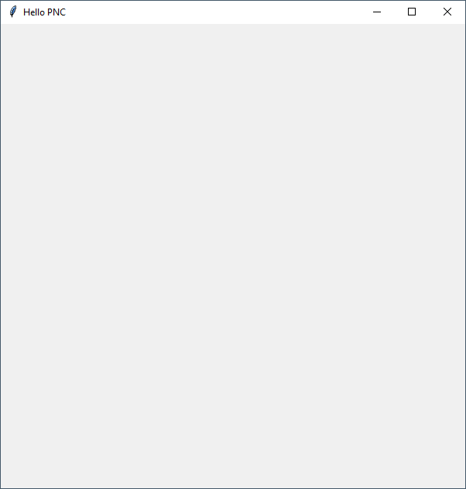
create_rectangle(x1, y1, x2, y2, optional parameters…)
create_rectangle(10, 20, 50, 100, fill="#0000FF")
X1 X2
10 50
x
0
Y1 20
Y2 100
y

Slide 6
Quizz
canvas.create_oval(50, 50, 150, 100, fill="#0000FF")
A
B
C
Notes:
01-quizz01.py

Slide 7
Quizz
canvas.create_oval(50, 50, 100, 100, fill="#FF0000")
canvas.create_oval(100, 100, 200, 200, fill="#00FF00")
canvas.create_oval(200, 200, 400, 400, fill="#0000FF")
A
B
C
Notes:
01-quizz02.py

Slide 8
Quizz
for index in range(0,5):
canvas.create_oval(index * 50, 50, 50 + (index * 50), 100, fill="#FF0000")
A
B
C
Notes:
01-quizz03.py

Slide 9
Quizz
for index in range(0,5):
canvas.create_oval(index * 50, index * 50, 50 + (index * 50), 50 + (index * 50))
A
B
ERROR
C
Notes:
01-quizz04.py

Slide 10
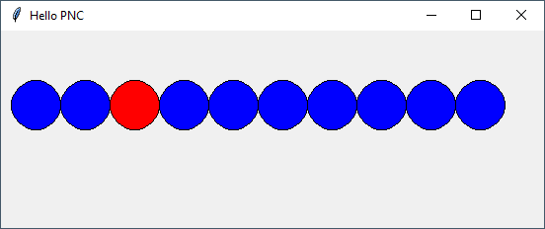
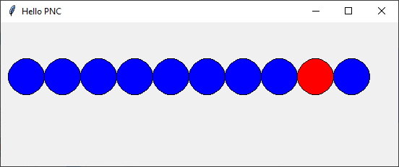
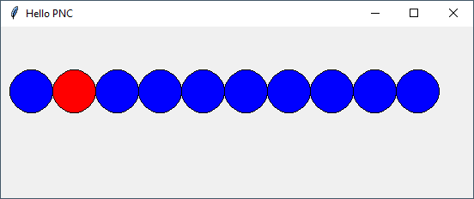
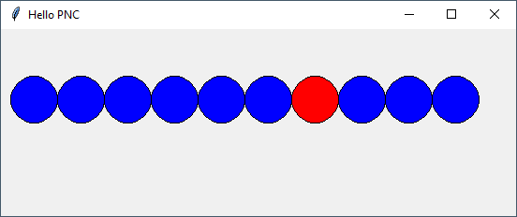
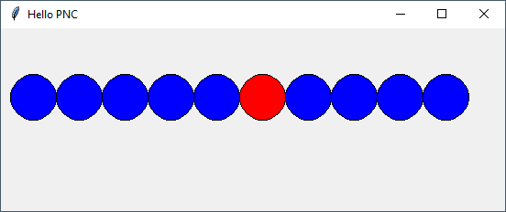
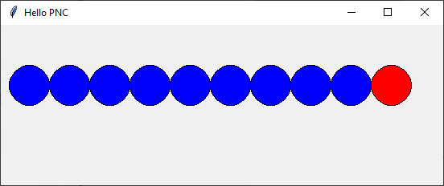
The line
Practice
20 min
Using only 1 loop, 1 if and 1 random number draw the following:
The red circle should have different position everytime you run the code.
Notes:
02-theLine-CORRECTION.py

Slide 11
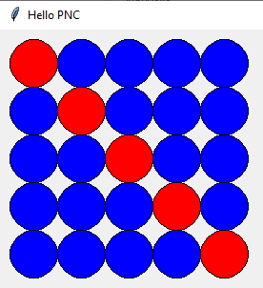
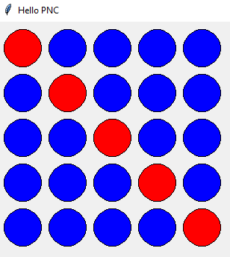
The grid
Practice
20 min
Using only 2 loops and 1 if/else, draw the following :
Bonus: Can you add margins between the circles ? ➔
Notes:
03-theGrid-CORRECTION.py

Slide 12
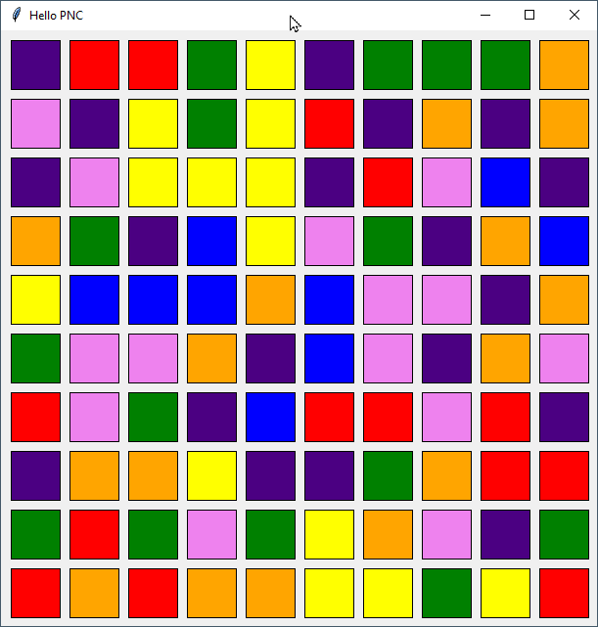
The colorful grid
Practice
20 min
Using 2 loops
Using an array of colors.
Using a random number
colors = ["red", "orange", "yellow", "green", "blue", "indigo", "violet"]
Notes:
04-theColorfulGrid-CORRECTION.py

Slide 13
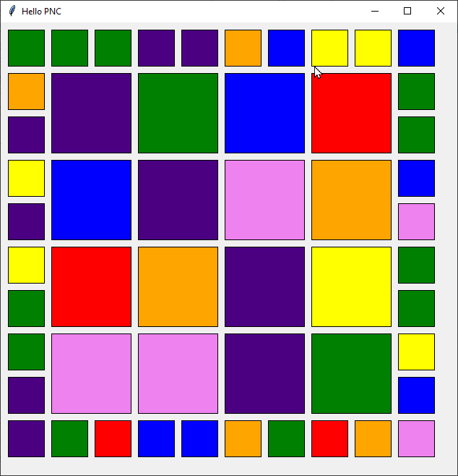
The colorful grid with different square size
Practice
20 min
Using :
2 loops
1 if and 1 elif
an array of colors.
a random number
Tips : Start by doing the border of the square
Notes:
05-theColorfulBorderGrid-CORRECTION.py

