Slide 1
DESIGN & IMPLEMENTATION OF FINAL YEAR PROJECT MANAGEMENT SYSTEM FOR POLYTECNICS IN NIGERIA
(A CASE STUDY OF ENUGU STATE POLYTECHNIC, IWOLLO.)
BY
CHUKWUMA JOSHUA MGBEOSOROCHUKWU
(ESPOLY/CS/HND/2018/2019/0024)
A PROJECT REPORT SUBMITTED IN PARTIAL FULFILMENT OF THE REQUIREMENTS FOR THE AWARD OF NATIONAL DIPLOMA IN THE DEPARTMENT OF COMPUTER SCIENCE, ENUGU STATE POLYTECHNIC, IWOLLO.
FEBRUARY, 2024

Slide 2
CERTIFICATION
This is to certify that this project was carried out by Chukwuma Joshua Mgbeosorochukwu under the supervision of Dr. Mrs. Okwueze Chisom in the Department of computer science: Enugu State Polytechnic, Iwollo

Slide 3
DEDICATION
This project is dedicated to my family for the support and guidance they gave me and the sacrifice they had to make for me to realize my dream and reach this far, especially my dear sister Mrs. Florence Ada Onu, who stood by me in all situations even at the times of financial needs.

Slide 4
ACKNOWLEDGEMENT
First of all I would like to thank God the Almighty for his grace, strength and keeping me throughout the period of my study, to have enabled me to do research and write this work in sound mind and good healthy.
Secondly special thanks goes to my Project Supervisor Dr. Mrs. Okwueze Chisom for her ideas, guidance and support with full of wide experience and endless dedication to see that I finish my project.
Thirdly I thank my sister Mrs. Florence Ada Onu for her endless love, care, prayers and encouragement with full moral and financial support.
Finally, I would like to thank those who have directly or indirectly helped and co-operated in accomplishing this report.

Slide 5
ABSTRACT
The final year project is a mandatory course for any diploma in Computer Science program at the Faculty of Informatics and Computing, Enugu State Polytechnic Iwollo. It is a final course for students and a platform where students can showcase the knowledge and skills they obtained during classes and become an asset for the needed practical skills in the industry. Final year project system management is an academic system that enables the students to upload project topics, proposal, submission of project and enhance smoothly communication between the student and their supervisor assign to them. Among the problems faced during the progress of the project is the absence of a systematic approach to provide a complete report. Consequently, supervisors faced difficulties in managing students and their project. polytechnics in Nigeria.

Slide 6
The objective of this study is to propose the implementation of the Final Year Project Management System for monitoring and supervising student’s project progress. The system is built to smoothen the communication between supervisors, students and heads of department, improving the efficiency in supervision and thus increase the chances for students to enhance their performance. This system is designed to efficiently handle processes like inputting data from student, Inputting data's from project supervisor, inputting data from the top Adm, Storing dates, storing project. The usual manual process now reached a level where it is difficult for the available, in the given time span, The balance between the manpower availability and the magnitude of the project co-coordinator work result in the delay in the running of the project . The most effective measure, which can improve the efficiency of the project system, the reform is the introduction of computerization especially with the use of Final year project management system Software in various activities related to the conduct of project reduces the time span . A study in to the

Slide 7
manual process reveals the inefficiencies and the rigorous nature final year project management system; therefore the existing manual process was analyzed and converted into an automated system. The manual activities was modeled with an object-oriented methodology and the system was implemented with JavaScript, a scripting language, Php as back-end JavaScript runtime environment and Mysql database management t systems. It provides s a robust database that generates various reports that is relevant to the department. There suit of this research work is a system that automates final year project management system, which can be used in any department of most universities and

Slide 8
CHAPTER ONE
INTRODUCTION
1.1 Background of the Study
One of the recent advances in the world of information technology is the rapid development of communication which has turned the world into a global village, we can send mails electronically (e-mail), search for information (www), buy goods online (e-commerce), withdraw/ transfer money (e-banking), school online (e-learning); this has affected the society positively to a great extent, as a result, computerization of project management should not be exempted in this revolution.
Project Management (FYPM) is the discipline of planning, organizing, and managing resources to bring about the successful completion of a specific project goals and objectives. A project is a finite endeavor having a specific start and completion date, undertaken to create a unique product or service which brings about beneficial change or added value. This finite characteristic of a project stand in sharp contrast to processes, or operations, which are permanent or semi-permanent functional works to repetitively produce the same product or service. In practice, the management of these two systems is often found to be quite different

Slide 9
and as such requires the development of distinct technical skills and the adoption of separate management philosophy, which is the subject of this study.
As part of the requirements to graduate, a High diploma certificate are need, Students and supervisors keep them in a degree student must successfully complete his final year dedicated file. Manually recorded data is error-prone and project (FYP) (Lynch, K., A. Heinze and E. Scott, 2014).The FYP has been very challenging, a exposed to mishandling and missing out somewhere. stage where students exhibit their ability to apply the Moreover, using this type of manual monitoring system, knowledge and skills they have obtained throughout their study, student needs to arrange appointments with supervisors tenure as High national diploma to carry out their project(Collins. T,S.I wooley, N,c .Rawson and L.Haroon, etal.2013 – fraile ,R,Etal. 2015). The FYP and present an update of project assignment on the normally runs for one whole semester or in some weekly basis. Forms must be brought together to record polytechnic, it is spread over two semesters. In the the progress of the project while supervisors provide computer science faculty, a student

Slide 10
must agree upon one comments and validate the student’s work. Indeed, it is of many choices of the project which can generally be difficult for a supervisor to determine exactly the current categorized into developing a software application for status of the project if the student missed out the supporting real-world needs, conducting an experiment to appointment. In addition, supervisors may encounter study the real-world problem via computer simulation or problems in dividing the supervision time among students developing a prototype for answering to innovation whenever there are many students under his supervision. needs. In reality, some students find FYP hard to follow Additionally, the manual process is considerably difficult and they may end up with a low-quality result or even fail in a situation where there is a need to locate student’s to meet the minimum objectives. Experience shows that a files to retrieve previously stored data because it takes a proper monitoring of students’ progress can be very long time due to the volume of data and sometimes, the useful in making sure the student remains on the right data sought may not necessarily exist. Moreover, during track and thus completes the project. the evaluation phase, the supervisor marks the students’ data related to FYP is recorded manually using forms and works based on the continuous involvement of the application also includes another role for the head of students.

Slide 11
1.2 Statement of the Problem
It has become widely recognized that manual storage of student projects has inherent problems. Looking at the Enugu Sate Polytechnic Iwollo, as a case study, students submit hard copies of projects to their various departmental libraries. The disadvantages of this manual method are as listed below;
Possibility of repeating project topics without detection by a project supervisor
Records of project topics carried out by a student are stored in the departmental library for a long time which occupies valuable office space
Projects are prone to loss due to natural disasters such as fire outbreak.
Backing up projects becomes a problem since more space will be employed.
Faced with the need to organize projects, the proposed system for management of student final year projects is unique and totally innovative in its integrated approach. Its functionality of making project storage easier makes it called for. The system to be developed makes use of rich internet technology to replace desktop application with web application running on a remote server. The system shares the advantage of both web application and desktop application, and removes the most disadvantages of both.

Slide 12
1.3 Aim and Objectives of the Study
The aim of this research study is to develop a student final year project management system for Enugu State Polytechnic Iwollo to effectively manage students’ research projects.
The objectives of this research study are as listed below;
To create a modules that upload both students and supervisors into the system as excel file format that serve as social plugin and also for authentication and authorizations
To train and educate the staff on how the new system work and how to operate on it.
To design a database for the system
To test the student final year project management system using Espoly as a case study.
1.4 Significance of the Study
The significance of this study is to move from manual documentation of projects to Computerized documentation of projects for easy retrieval, storage, accuracy and security. This research work will offer the following advantages to the various departments in the Enugu State Polytechnic Iwollo;
Reduced Storage: The cost of commercial property and the need to store documentation for e.g. retrieval, regulatory compliance means that paper based project storage competes with people for space within an organization. Scanning projects and integrating them into a project management system can greatly reduce the amount of prime storage space required by paper.
Improved Security: A final year project management system can provide better, more flexible control over sensitive projects. Many final year project management system solutions allow access to projects to be controlled at the folder and/or document level for different groups and individuals. Paper projects stored in a traditional filing cabinet or filing room does not have the same level of security i.e. if you have access to the cabinet you have access to all items in it.
Improved, faster and more flexible search: final year Project Management Systems can retrieve files by any word or phrase in the document - known as full text search - a capability that is impossible with paper.
Disaster Recovery: A final year project management system provides an easy way to back-up projects for offsite storage and disaster recovery providing failsafe archives and an effective disaster recovery strategy. Paper is a bulky and expensive way to back-up records and is vulnerable to fire, flood, vandalism and theft.
No Lost Files: Lost projects can be expensive and time-consuming to replace. Within a final year Project Management System, imaged projects remain centrally stored when being viewed, so none are lost or misplaced. New documents are less likely to be incorrectly filed and even if incorrectly stored can be quickly and easily found and moved via the full-text searching mechanisms.
Digital Archiving: Keeping archival versions of projects in a final year project management system helps protect paper documents that still have to be retained, from over-handling.

Slide 13
Reduced Storage: The cost of commercial property and the need to store documentation for e.g. retrieval, regulatory compliance means that paper based project storage competes with people for space within an organization. Scanning projects and integrating them into a project management system can greatly reduce the amount of prime storage space required by paper.
Improved Security: A final year project management system can provide better, more flexible control over sensitive projects. Many final year project management system solutions allow access to projects to be controlled at the folder and/or document level for different groups and individuals. Paper projects stored in a traditional filing cabinet or filing room does not have the same level of security i.e. if you have access to the cabinet you have access to all items in it.
Improved, faster and more flexible search: final year Project Management Systems can retrieve files by any word or phrase in the document - known as full text search - a capability that is impossible with paper.
.

Slide 14
Disaster Recovery: A final year project management system provides an easy way to back-up projects for offsite storage and disaster recovery providing failsafe archives and an effective disaster recovery strategy. Paper is a bulky and expensive way to back-up records and is vulnerable to fire, flood, vandalism and theft.
No Lost Files: Lost projects can be expensive and time-consuming to replace. Within a final year Project Management System, imaged projects remain centrally stored when being viewed, so none are lost or misplaced. New documents are less likely to be incorrectly filed and even if incorrectly stored can be quickly and easily found and moved via the full-text searching mechanisms.
Digital Archiving: Keeping archival versions of projects in a final year project management system helps protect paper documents that still have to be retained, from over-handling

Slide 15
1.5 Scope of the Study
The scope of this project covers Students’ Research final year Project Management in the Enugu State Polytechnic Iwollo. This scope will be achieved in the following areas;
Keeping track of research projects both approved and completed
Harnessing the energy of staff at a faster pace
Managing complex changes in an organized way
Retrieving data as at when required.
1.6 Limitations of the Study
During the course of this research work, some constraints were encountered. Most prevailing among the constraints is the limited time for the conclusion of the study; other factors considered as challenging in the cause of this work include the following;
Reluctance by the officials to freely give out official information on how projects are being managed
Financial implication of the research work.

Slide 16
CHAPTER TWO
LITERATURE REVIEW
In the realm of modern education, final year projects play a pivotal role in assessing students' knowledge and skills. Effective management of these projects is crucial for ensuring successful outcomes. This literature review explores the design and implementation of a final year project management system, aiming to enhance the efficiency and effectiveness of project supervision, coordination, and evaluation.

Slide 17
What Student Final Project Management Entails
A project is a research study carried out by a student with the aim of solving an already identified problem. Final year projects in educational institutions serve as a capstone experience, allowing students to apply and demonstrate the knowledge and skills acquired throughout their academic journey. Effective project management is essential to ensure the successful execution of these projects, such as below:
Project Selection and Definition: Student final year project management begins with the selection and definition of project topics. This phase involves aligning projects with academic objectives and student interests (Smith & Johnson, 2019).
Planning and Scheduling: Once projects are defined, students need to create detailed project plans. This includes defining project objectives, identifying tasks and milestones, and creating schedules (Brown & Jones, 2020).
Resource Allocation: Managing resources effectively is a critical aspect of project management. Students must allocate time, budget, and materials efficiently to complete their projects (Gupta et al., 2018).

Slide 18
Team Collaboration: Many final year projects are conducted in teams. Effective collaboration and communication within student teams are crucial for project success (White & Anderson, 2017).
Progress Monitoring: Regularly monitoring project progress against the plan is essential. This involves tracking tasks, identifying and mitigating issues, and adjusting the project plan as needed (Clark, 2016).
Documentation and Reporting: Students are required to maintain thorough documentation of their project activities. This includes project reports, research findings, and presentations (Smith, 2021).
Evaluation and Assessment: At the end of the project, evaluation and assessment processes are conducted to measure project outcomes against the defined objectives (Johnson, 2018).

Slide 19
Review of Related Literature
Early Work on Project Management Systems:
In the early stages of research on project management systems, Taylor (2018) laid the foundation for systematic project management with his principles of scientific management. He emphasized the need for structured planning, time management, and efficient resource allocation.
Computer-Based Project Management Systems:
The advent of computer technology marked a significant shift in project management. Works like Muspratt (2019) introduced the concept of computer-based project management systems, highlighting the advantages of automation and data analysis in project planning and execution.
Integration of Project Management and Information Systems:
As information systems evolved, researchers like DeLone and McLean (2020) explored the integration of project management and information systems. Their work emphasized the importance of aligning project management tools with information technology to improve project outcomes.

Slide 20
Cloud-Based Project Management Solutions:
In the context of modern technology, research by Chen and Jin (2018) delved into cloud-based project management systems. They discussed the advantages of cloud computing, such as scalability and accessibility, in the design and implementation of project management solutions.
Educational Application of Project Management Systems:
Focusing on the educational sector, Smith and Brown (2020) explored the integration of project management systems into final year projects in higher education. They discussed the benefits of using such systems to enhance student learning and project supervision.
These selected works provide a chronological overview of the evolution of project management systems, from their early conceptualization to their contemporary application in educational settings. They collectively contribute to the understanding of the design and implementation of final year project management systems.

Slide 21
CHAPTER THREE
SYSTEM ANALYSIS AND METHODOLOY
System Analysis and Design is the process of examining the business of an Organization with the intention of improving it through better procedures and methods. Analysis of a system specifically involve looking at a system, determining how well it functions, specifying changes that needs to be made and the quality or impact of the output that will be achieved. Designing a system involve integrating various procedures into the subsystems components and articulating them together into the main system in other to achieve the expected goal. Analysis and design of a new system requires a modeling methodology. The modeling methodology creates a representation of the real-world entities of the system the object-oriented model was used for the design of the final year project management system because it simplifies the software design process by presenting each module as an object and provides an efficient way of Communicating with these objects. Object-oriented model represents the real-world entities as systems objects

Slide 22
3.2 The Research Methodology
For us to achieve all these stated above, we made use of the internationally accepted software engineering model, which are Structured System Analysis and Design Methodology (SSADM). Structured System Analysis and Design Methodology (SSADM) is a systems approach to the analysis and design of information systems. SSADM method involves the application of a sequence of analysis, documentation and design tasks concerned with analysis of the current system, logical data design, logical process design etc. the steps involved are

Slide 23
1 Analysis of the Existing System
Final year Project management is currently done manually in the Enugu State Polytechnic Iwollo. Hard copies of projects are received, sorted and processed by each department in the polytechnic and stored in the departmental library.
Advantages of the Existing System
The existing system of final year Project management has the following advantages:
● Special skills are not required to operate the existing system.
● The existing system does not rely on electric power to function. Hence, the erratic nature of power supply in Nigeria does not affect its availability and performance.
Disadvantages of the Existing System
Though the existing system of final year Project management seems effective, there are some difficulties inherent in the system. Some of these difficulties are;
● Inefficient office space management.
● Time consuming retrieval of projects to be accessed.

Slide 24
Analysis of the Proposed System
Faced with the incredibility of the existing system in recording information, the proposed computerized system will go a long way to minimize the long aged inefficiency and ineffectiveness of the current system. The proposed system is easy to use and allows users store and retrieve projects easily. In the proposed system, students will submit both hard and soft copies of their projects, the hard copy will be destroyed after two years to free office space. It consists of two main user categories: the general user and the administrator. Though each user has different levels of privilege, the administrator has all privileges available in the system. The entire system consists of the client and server section. The client section is what application users can see and interact with through the browser on the machines. The server section is where the processing logic resides and home for the database for storing information. The client side is designed using Hypertext Markup Language and Cascading Style Sheet (CSS), while the application logic is developed using Hypertext Preprocessor (PHP). The database used is MySQL sitting on XAMMP which is the local server.

Slide 25
Advantages of the Proposed System
The proposed system seeks to improve on the existing system by overcoming the shortcomings inherent in the existing system.
The advantages are;
● It is very fast, hence it promotes instant transactions or processes.
● It can be accessed from any geographical location, using any device that supports internet resources, hence geographical limitation is completely eliminated.
● Once installed, it is easy to operate and maintain.
● Projects can easily be duplicated and backed up, hence the danger of losing important documents is reduced.
● It has an efficient space management system since projects could be stored on a computer.

Slide 26
3.4 Justification of the Proposed System
An Object-Oriented software enables:
● Increased understanding - Software design process when presented with the Object-oriented analysis makes the understanding of the software easier. Using the Final year project management system for example, the system will have objects such as Students, suppervisor and administrator. The system will support behaviors such as project submit ion, student s profile update and supervisor profile update. Further class refinement can be achieved by breaking down the objects into different levels. Example, the project class can be refined as OND , 2nd HND. Each program project can further be broken down into OND and HND final year project.
● Code Reusability: the code for a particular function is articulated under one file, this function can be called up as often as possible for reuse. E.g. the header files. The header or title for the software Final year project management system is placed in one Html file and it is called up for reuse in all the files such that every web page has the header name or title.

Slide 27
CHAPTER FOUR
SYSTEM DESIGN AND IMPLEMENTATION
4.1 System Specification and Design
The objective of Implementation is to ensure that the system perform as required and hand over is successful. This chapter looks at how the system will be implemented to achieve the purpose for which it was designed. The application package for Document Management system was realized using PHP (Hypertext Preprocessor) as the main scripting language, CSS (Cascading Style Sheet) to style the interface, MySQL server as the database server, and XAMPP as the web server. The application can be accessed using any web browser. I also implement the system with three users such as:
Top Admin: This is a staff authorized to have access to the software, possibly the school ICT unit. At the beginning of the session, he first of all updates the session and uploads various files in an excel format. He uploads department and supervisors that will be in charge of the project

Slide 28
for that year, students who have registered for the project.
The Student: The student can register for their final year project, he can revisit the site, view registered project for that year and also see the supervisor assign to him and see the feedback from the supervisor either via feedback container or chat message box.
The Supervisor: This is a staff authorized to have access to the software, and also in charge of a particular project, he or she first of all gets a list of the students who registered his or her final year project from the student page. He view the file uploaded from student, and give feedback to the students

Slide 29
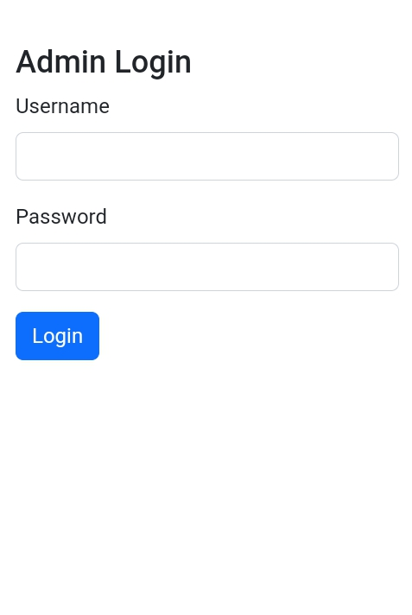
4.1.1 Input Specification and Design
The input design shows the template for the user’s input. Data is entered into the system through the input form. The students enter data through the course registration forms while the admin officer and lecturers have separate forms for uploading excel files.

Slide 30
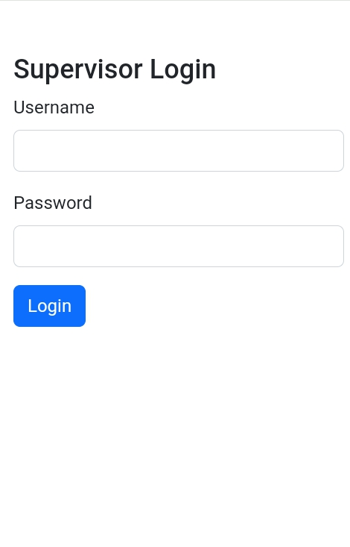

Slide 31
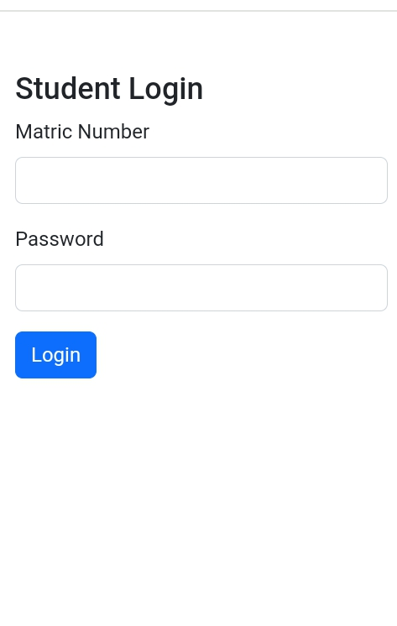

Slide 32
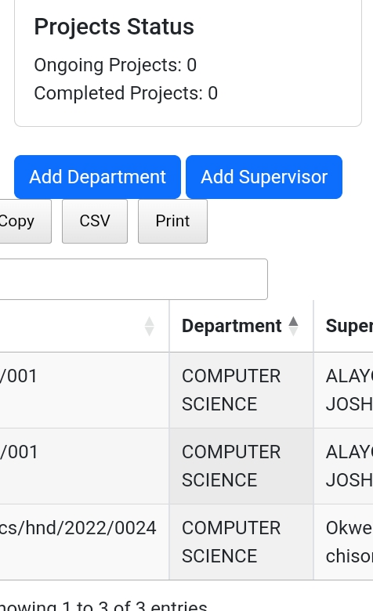

Slide 33
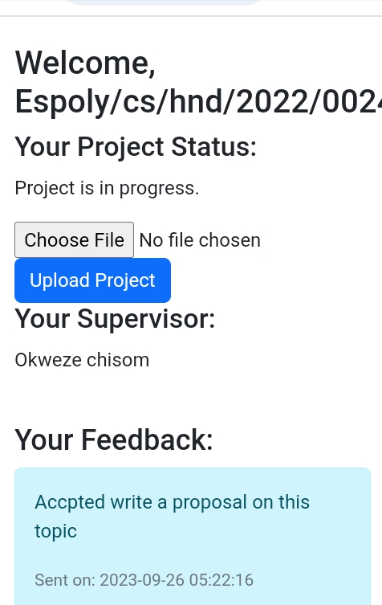
Student view

Slide 34
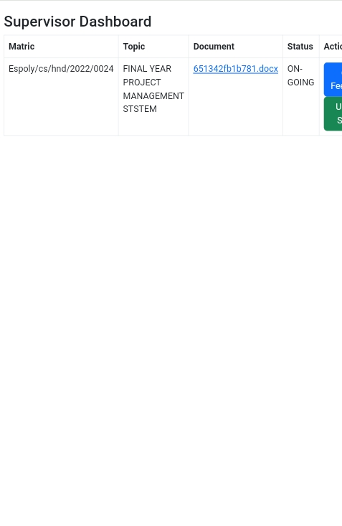

Slide 35
Implementation of the Proposed System
The new final year project management system automates all operations and administrative activities related to final year project in a department of a polytechnic. Thus the basic activities carried out in a manual system are performed by a computer. The system has three levels of users, the students, the Supervisor and Top Admin. The primary source of a student's list comes from the admission list. The admission list is typed in an excel spreadsheet and submitted to the Top admin. He uploads the file into the MySQL database for storage vai the Top Admin dashboard. When a student comes to register for their project, he logs into the portal with a registration number and a password.
This is to enable the student to log on to the portal. After logging in, the portal opens a page with the students' information. This is to show that this student has logged into the software. When this is done, he will be given access to upload the project topic, proposal, and submission of the project, feedback from the supervisor either via chat message box or using feedback container. Student registration is stored into the MSQL database in a registration table. The Top Adm add supervisor, assign

Slide 36
Top Adm Users
Add Supervisor
Add department
View Student
View Profile
Supervisor
Edit Profile
View Student
View Project
Student
View Feedback
View Supervisor, Upload Project & Feedback
Block Diagram of the Proposed System

Slide 37
Functionality of the Use Case diagram.
The functional use case explains the functionality of each of the activities symbolized in the use case diagram.
Upload Bio data:- this is a web-page that inserts the student’s profile data into the database system. The raw data is gotten from the department and transferred into a digital form by typing into an excel template. The excel data is then uploaded into the system.
Register - this page allows a student to register for his/her project online.
Upload Students: - this is a module that transfers a student's list from excel file to the portal system.
Add department: - the web-page inserts into the database system that helps to add department.
Add Supervisor :- this is a module that transfers a supervisor’s list from excel file to the portal system
Add & Edit Staff: - this is a page that adds the names and qualifications of all staff in the department into the database.

Slide 38
CHAPTER FIVE
SUMMARY, CONCLUSION AND RECOMMENDATION
5.1 Summary
This research work presents a comparative study of how final year projects Management system can be effectively managed in the Enugu State Polytechnic Iwollo. It is implemented as a web-based application. The system was developed using PHP as the scripting language and MySQL as the database. With the evolution of this system, projects can now be easily stored and retrieved. Though the system can exist as a standalone application running on a server, it can be integrated with an existing system, making it modular.
The first chapter discussed the need for a final year project management system. The second chapter gave a review on the existing system of final year project management. The third chapter gave an analysis of the proposed system which was carried out using Structured System Analysis and Design Methodology (SSADM). The fourth chapter gave a guide on how the system should be implemented and tested. The system was designed to curb the difficulties inherent in the traditional method of

Slide 39
managing final year projects.
5.2 Conclusion
We have been able to design a final year project Management system which stores and retrieves projects easily and provide security for projects against repetition. The relevance of this application cannot be over emphasized in a school environment; especially in this era of digitization.

Slide 40
5.3 Recommendations
The following are the recommendation required in order to effectively use the proposed system are:
The hardware and software requirement should be as specified
To ensure effective use of this system, there is the vital need to install an uninterrupted power supper (USP) and if possible a power generating set to help prevent unnecessary file corruption due to power fluctuations
Staff should be trained on how to use the new system; it is user-friendly no special training is needed to achieve full implementation.
Routine maintenance and repairs of the existing computer systems are needed if there is any problem with the system. This will only increase the life span of the computers and will help in protecting the system files.

Slide 41
Vote of thanks, I want to use this moment to appreciate almighty God who made this project successful today , secondly , my acknowledgement goes to my supervisor and external supervisor to see that this project was accomplished may God bless you all and reward you all in jesus name Amen!

