Slide 1


Report Web Programming Project
Group 3:
Chu Manh Hai
Nguyen Thanh Long
Bui Manh Tu
Teacher:
Dao Thanh Chung

Slide 2
Blueprints
Topic introduction
Project Structure
General use case
Database design

Slide 3

Topic introduction
The needs of shopping
Shopping online is easier and more convenient
E-commerce Web Application

Slide 4
Work distribution
Full name | Student ID | Work
Nguyen Thanh Long | 20180128 | Develop service
Chu Manh Hai | 20184253 | Design system, Develop pages for supplier
Bui Manh Tu | 20194870 | Develop pages for customer

Slide 5
Project structure
Project
client
network (Model)
component (View + Controller)
service
database (Model)
route (Controller)
Technology
Front-end: ReactJS
Backend: ExpressJS, Mysql

Slide 6
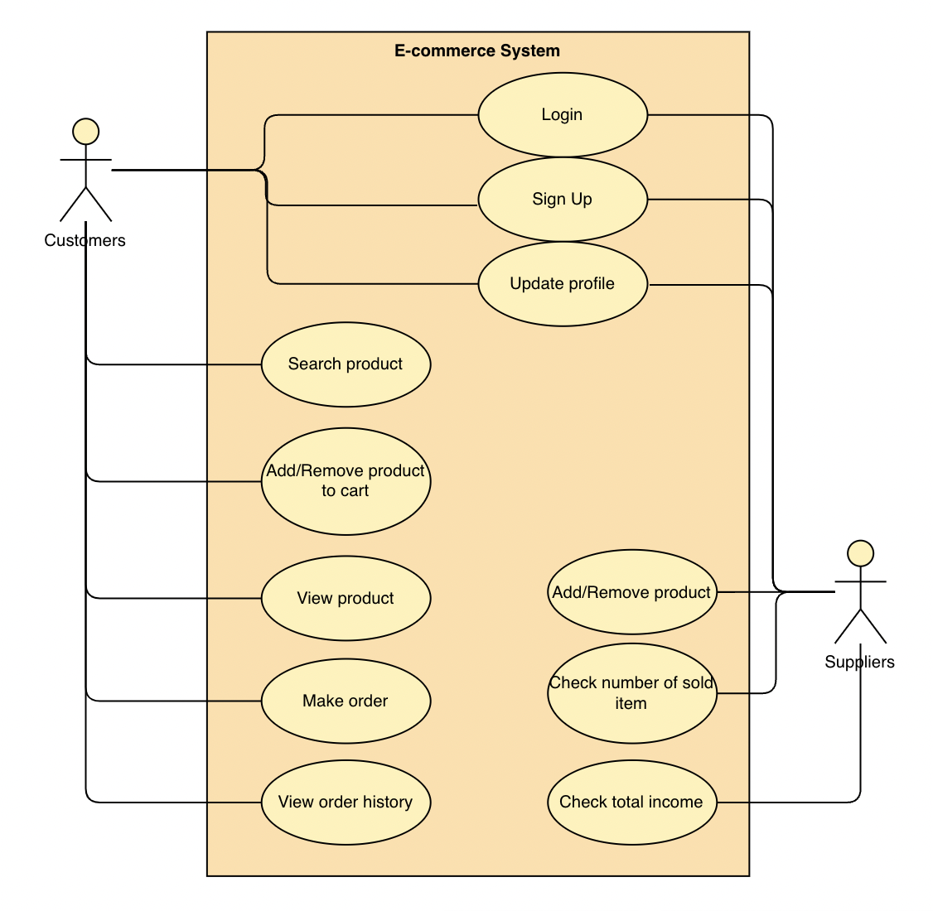
General use case

Slide 7
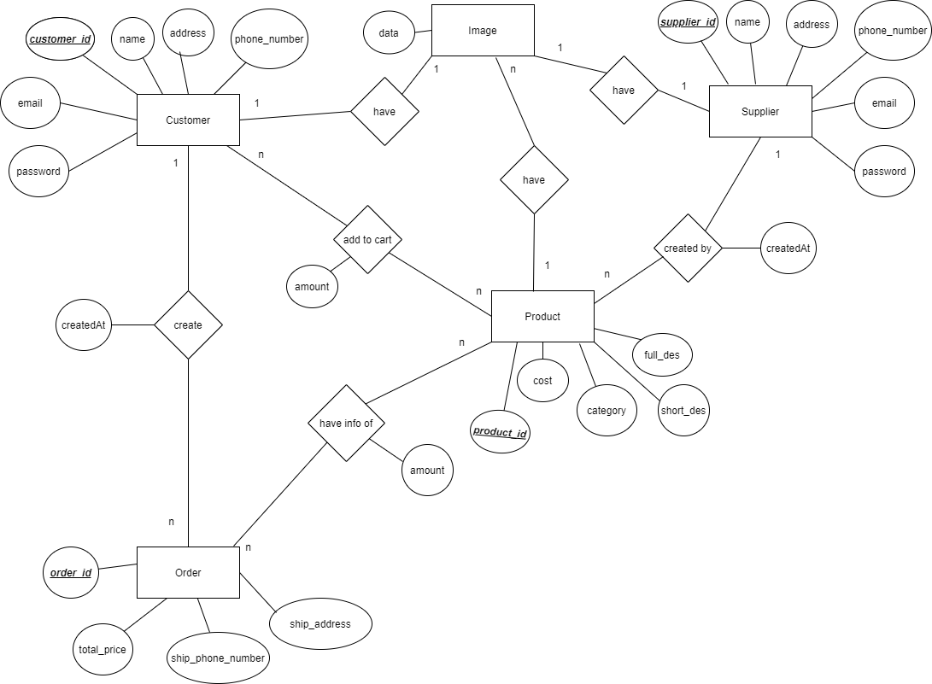
Entity Relationship Diagram

Slide 8
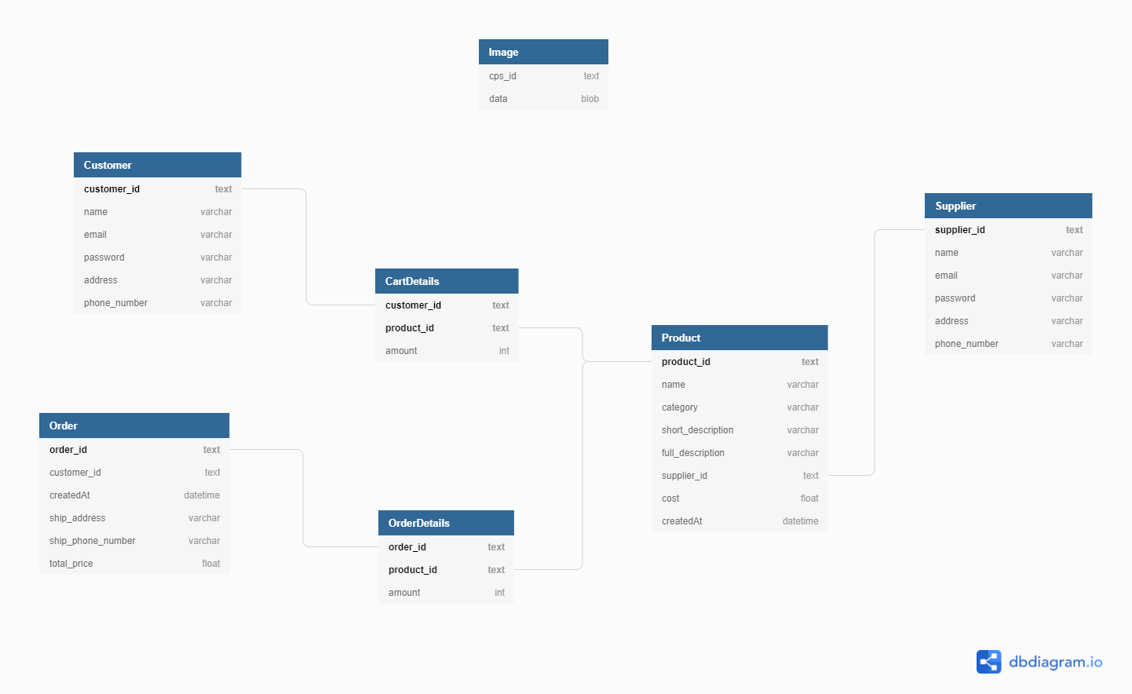
Table Relationship Diagram

Slide 9
Thank you for listening

