Slide 1
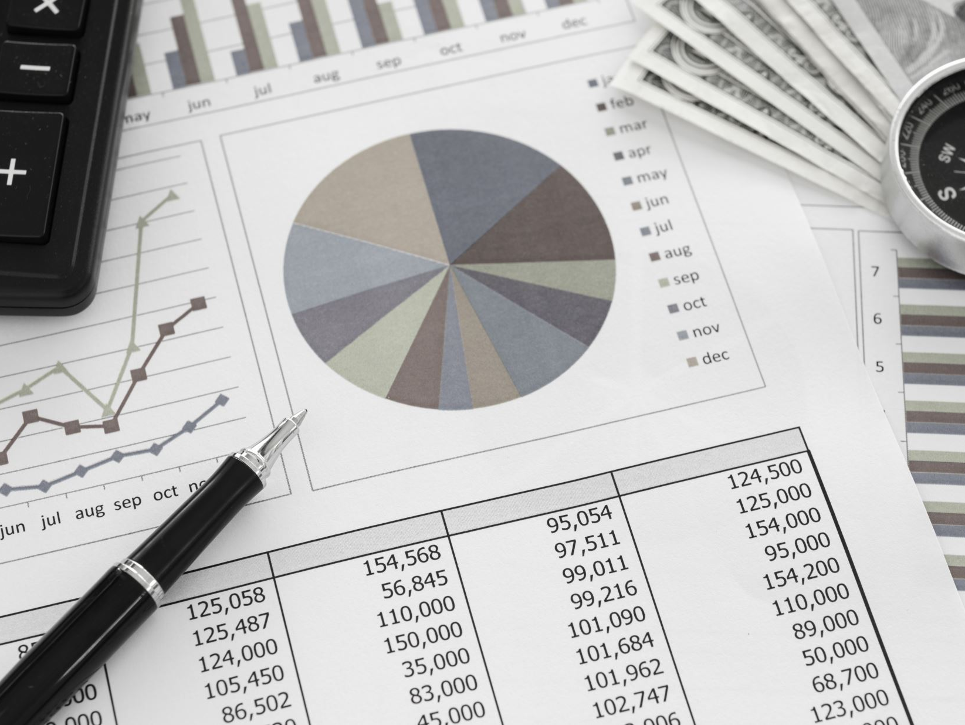
AI Income Predictor
Department of Computer Science, CUI, Islamabad
Submitted by:
Umar Hassan (SP23-BSE-052)
Zubaria Sajjad (SP23-BSE-055)
Supervisor: Ms. Farah Saeed
6th June 2025

Slide 2
Abstract
The AI Income Predictor is a desktop application designed to provide individuals with insights into their potential annual income bracket based on various demographic and socio-economic factors. Leveraging machine learning techniques, specifically a Random Forest Classifier trained on a publicly available dataset, the system offers a user-friendly graphical interface. It predicts whether a user's income is likely to be above or below $50,000 per year and provides personalized, rule-based recommendations emphasizing actionable areas tied to their input and model insights.

Slide 3
1. Introduction
This document outlines the AI Income Predictor system, which helps users understand how factors such as education, work hours, and occupation relate to income. It provides data-driven predictions and personalized advice. The project involves machine learning, GUI design using Tkinter, data visualization, and recommendation generation.

Slide 4
2. Proposed System
The system collects user inputs, preprocesses them (encoding, scaling), and uses a trained Random Forest model to predict income class (<=50K or >50K). It calculates prediction confidence, identifies influential features, and generates personalized recommendations.

Slide 5
3. Advantages / Benefits
• Personalized insights based on user data
• Data-driven support for career and financial decisions
• User-friendly GUI using Tkinter
• Actionable recommendations to boost income
• Educational visualizations
• Local processing to preserve privacy

Slide 6
4. Scope
The system is a standalone desktop app for income prediction and guidance. It collects structured inputs, uses a pre-trained model, shows predictions, confidence, and influential features. Includes recommendations and visualizations. It doesn't use external APIs or support multiple users or cloud sync.

Slide 7
5. Modules Overview
5.1 Data Preprocessing and Model Training
5.2 GUI & Input Management
5.3 Prediction Engine & Output Display
5.4 AI-Powered Recommendations
5.5 Data Visualization

Slide 8
Module 1: Preprocessing & Training
Handles cleaning (missing values, dropping 'fnlwgt'), encoding (LabelEncoder), and scaling (StandardScaler). Splits data, trains Random Forest Classifier with GridSearchCV, saves best model using pickle.

Slide 9
Module 2: GUI & Input Management
Built with Tkinter. Contains Entry and Combobox widgets for user input. Manages layout and validation of inputs before prediction.

Slide 10
Module 3: Prediction & Output
Takes user input, preprocesses it, and predicts income using the Random Forest model. Displays prediction, confidence score, and influential features in a new result window.

Slide 11
Module 4: AI Recommendations
Provides personalized rule-based advice post-prediction. For example, suggests more education or investments depending on user data and model insights.

Slide 12
Module 5: Visualization
Uses Matplotlib and Seaborn to show:
• Feature Importances
• Prediction Probability Histogram
• Confusion Matrix
• Correlation Heatmap
• Cumulative Probability Plot

Slide 13
6. System Limitations
• Model performance limited to dataset quality
• Generalization issues outside the dataset scope
• Rule-based (non-generative) recommendations
• No real-time external data sources or API integration

Slide 14
7. Tools & Technologies
• VS Code v1.100 - IDE
• Python v3.13 - Programming language
• Scikit-learn v1.0 - Machine Learning
• Matplotlib, Seaborn - Data Visualization
• Tkinter - GUI Development

Slide 15
8. Conclusion
The AI Income Predictor offers a robust, educational, and privacy-respecting tool for income prediction. It effectively combines machine learning, GUI design, and personalized recommendations to support users in understanding and potentially improving their financial outlook.

Slide 16
9. References
• UCI Adult Dataset - https://archive.ics.uci.edu/ml/datasets/Adult
• Scikit-learn Docs - https://scikit-learn.org
• Pandas Docs - https://pandas.pydata.org/docs
• Matplotlib Docs - https://matplotlib.org
• Real Python - https://realpython.com
• Towards Data Science - https://towardsdatascience.com

