Slide 1
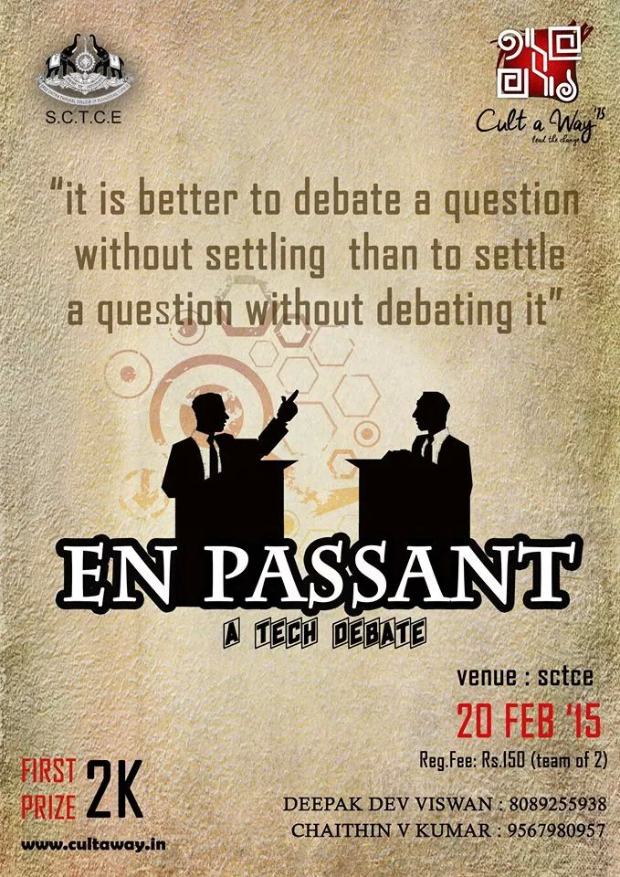

Slide 2
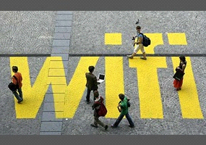


Should cities offer free public Wi-Fi?

Slide 3
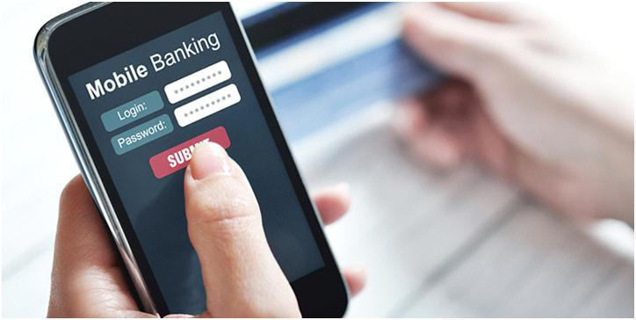

Is mobile banking more secure than online banking??

Slide 4
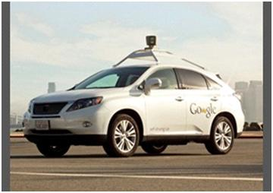

Google's self driving cars in city streets: Are driverless cars a danger to people on the street? for or against?

Slide 5
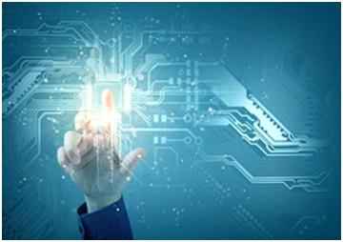
Do you believe we will see human-like artificial intelligence created within our lifetime?

Slide 6
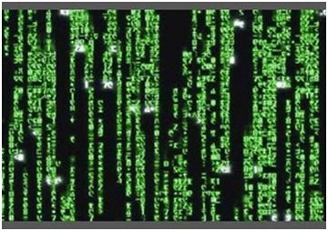
If You Were On Your Deathbed And It Was Possible To Download Your Mind Into A Virtual World Would You Do It?

Slide 7
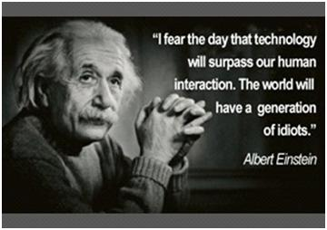


Slide 8
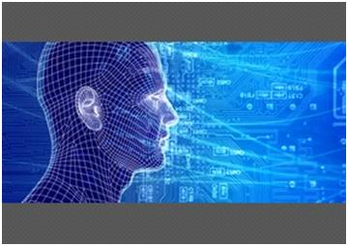

Should cyber warfare hits against major companies be considered crioffenses?

