Slide 1
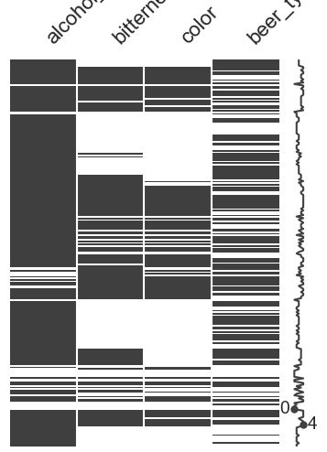
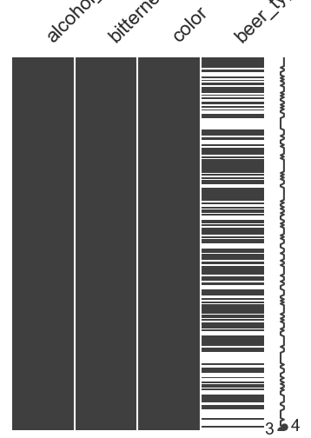
Some visualization

Slide 2
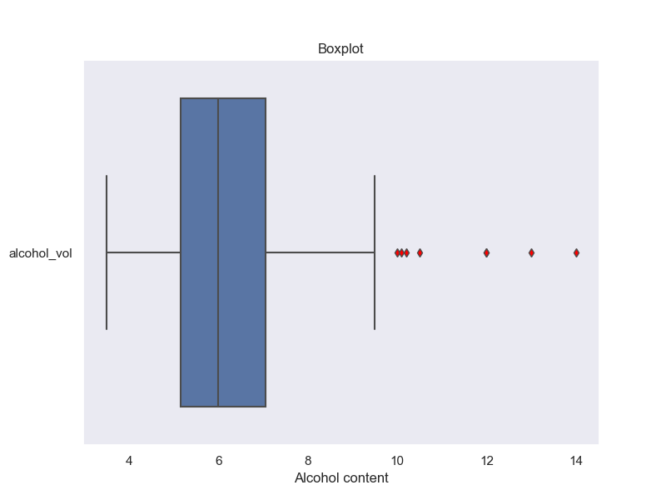
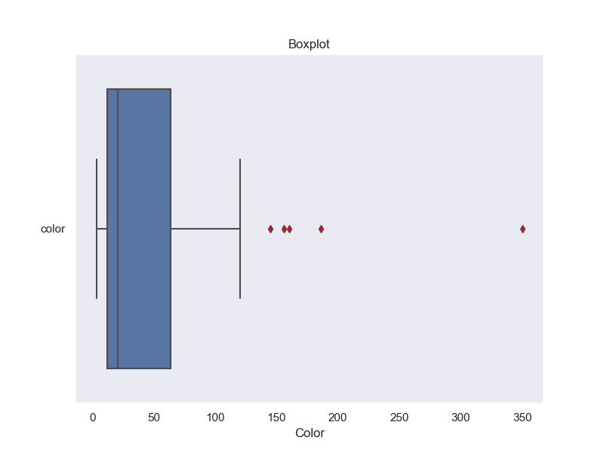
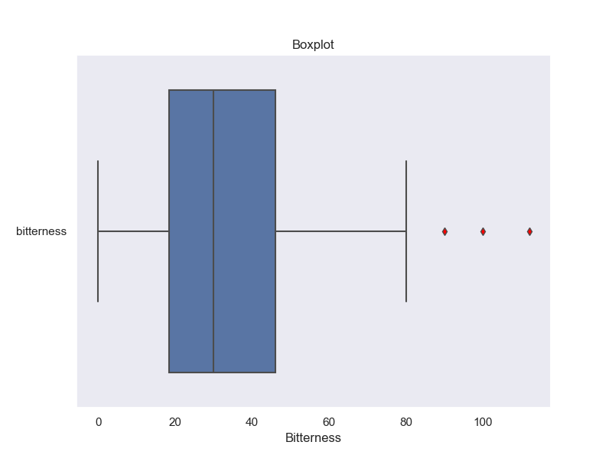
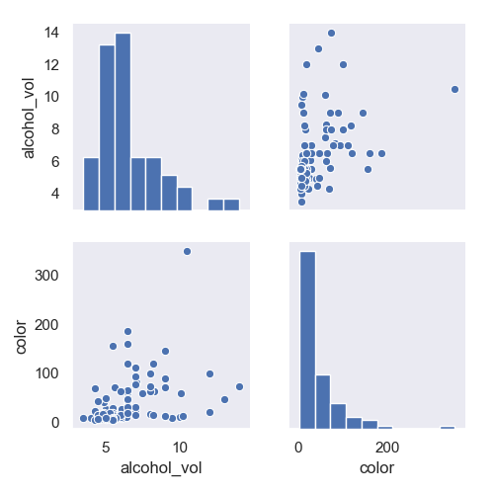
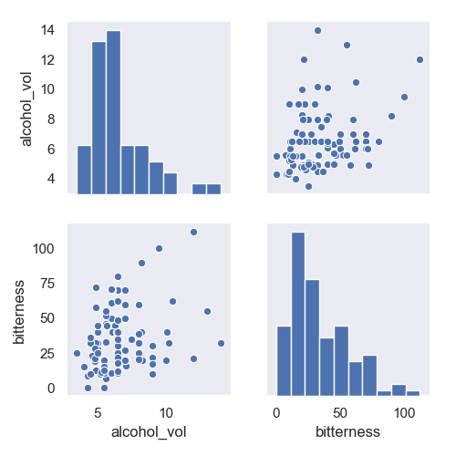
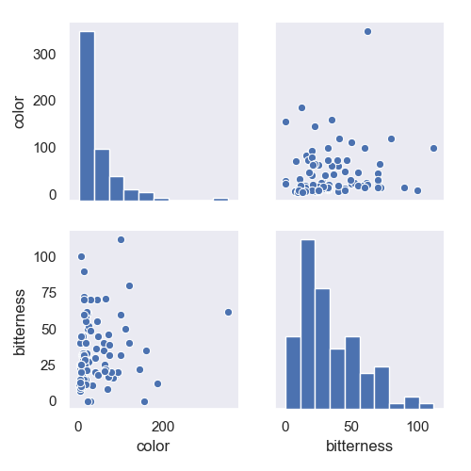
Data

Slide 3
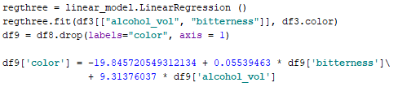

Missing Data handling
Originally 99 data → Regression training
Additional 33 data
Rest → Mode/Median

Slide 4
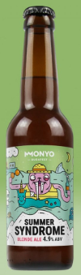
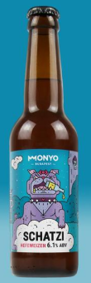
Correlations
KAGGLE | Bitterness | Color | Alcohol_vol
Bitterness | 1 | 0,02 | 0,72
Color | 0,02 | 1 | 0,2
Alcohol_vol | 0,72 | 0,2 | 1
OUR DATA | Bitterness | Color | Alcohol_vol
Bitterness | 1 | 0,13 | 0,27
Color | 0,13 | 1 | 0,4
Alcohol_vol | 0,27 | 0,4 | 1

Slide 5

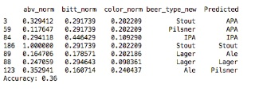
KNN

