Slide 1
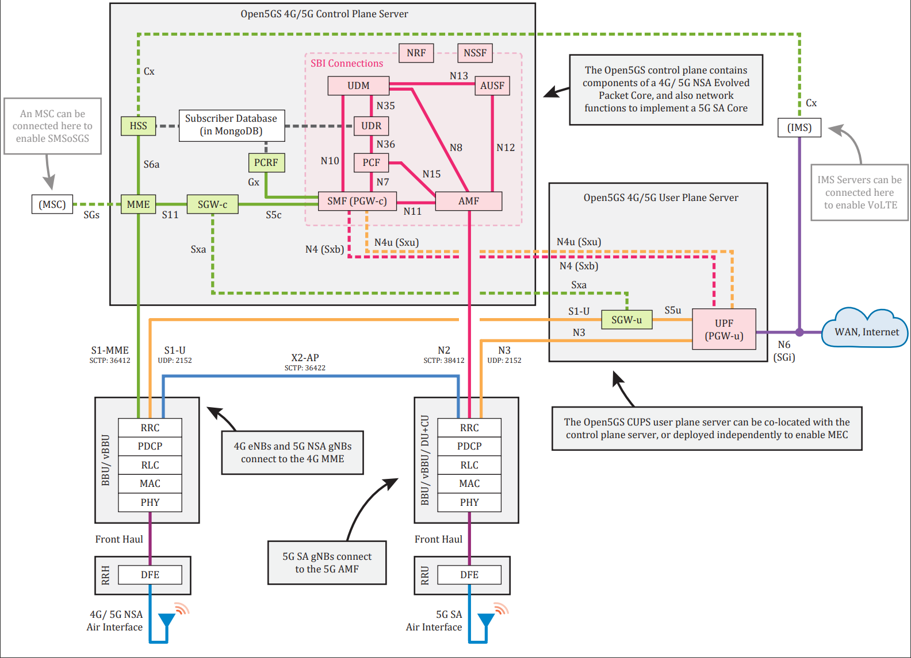
127.0.0.7

Slide 2
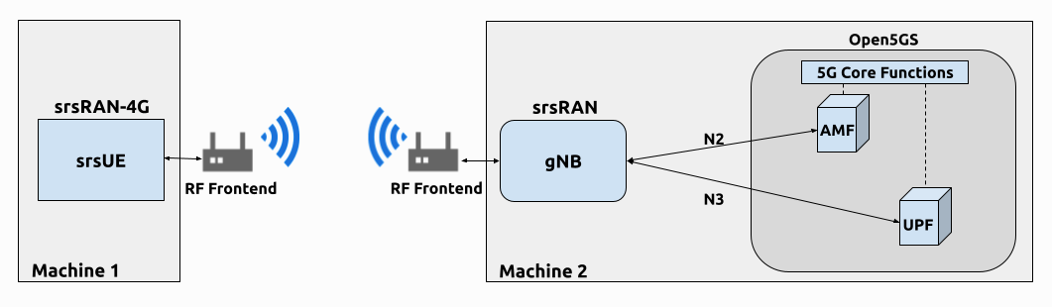
srsRAN gNB with srsUE — srsRAN Project documentation
Open5GS – Introduction
Run the gNB:
sudo ./RAN_Project/build/apps/gnb/gnb –c ./path/to/gnb_rf_b210.yml

Slide 3
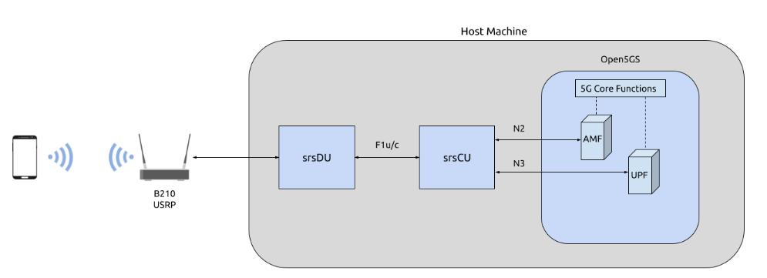
127.0.10.2
127.0.10.1
172.22.1.1
172.22.0.10
127.0.10.2
127.0.10.1

Slide 4
Docker: herlesupreeth/docker_open5gs: Docker files to run open5gs + IMS + eNB + gNB + NR-UE in a docker
nrf: 172.22.0.12, 7777/tcp
scp: 172.22.0.35, 7777/tcp
ausf: 172.22.0.11, 7777/tcp
udr: 172.22.0.14, 7777/tcp
udm: 172.22.0.13, 7777/tcp
smf: 172.22.0.7, 3868/tcp, 3868/sctp, 5868/tcp, 5868/sctp, 8805/udp, 2123/udp, 7777/tcp, 9091/tcp
upf: 172.22.0.8, 2152/udp, 8805/udp, 9091/tcp
amf: 172.22.0.10, 38413/sctp, 7777/tcp, 9091/tcp
pcf: 172.22.0.27, 7777/tcp, 9091/tcp
bsf: 172.22.0.29, 7777/tcp
nssf: 172.22.0.28, 7777/tcp

Slide 5
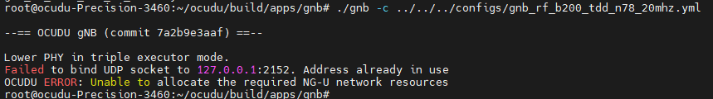
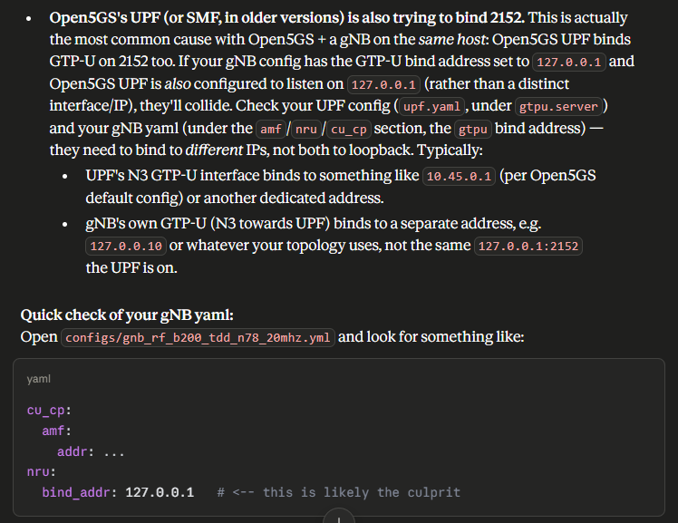
Issues

