Slide 1
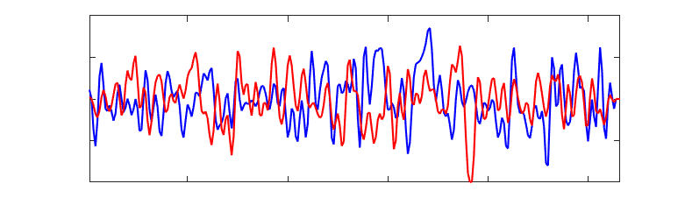
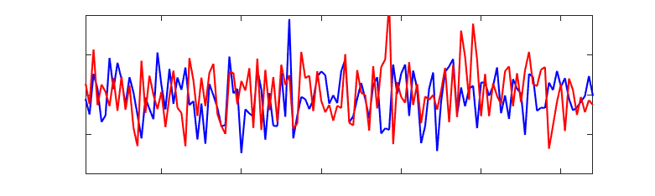
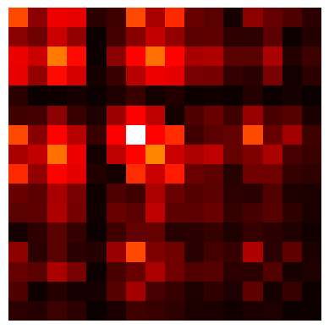

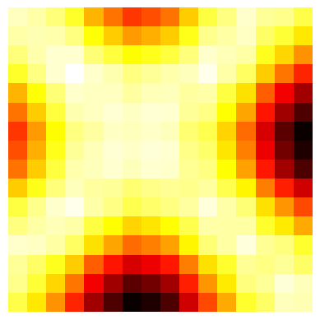
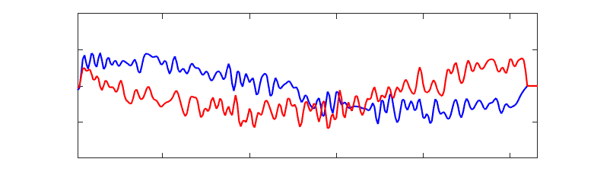
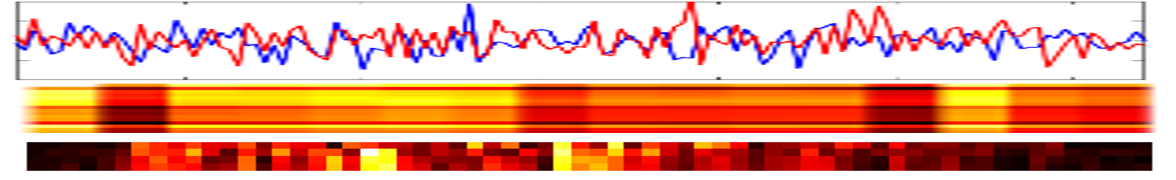
Feature Extraction
Time-Domain
Frequency-Domain
Flatten
Patchify
Linear Projection
Patch/Positional
Embedding
Transformer Encoder
MLP Head
Modulation Class

Slide 2
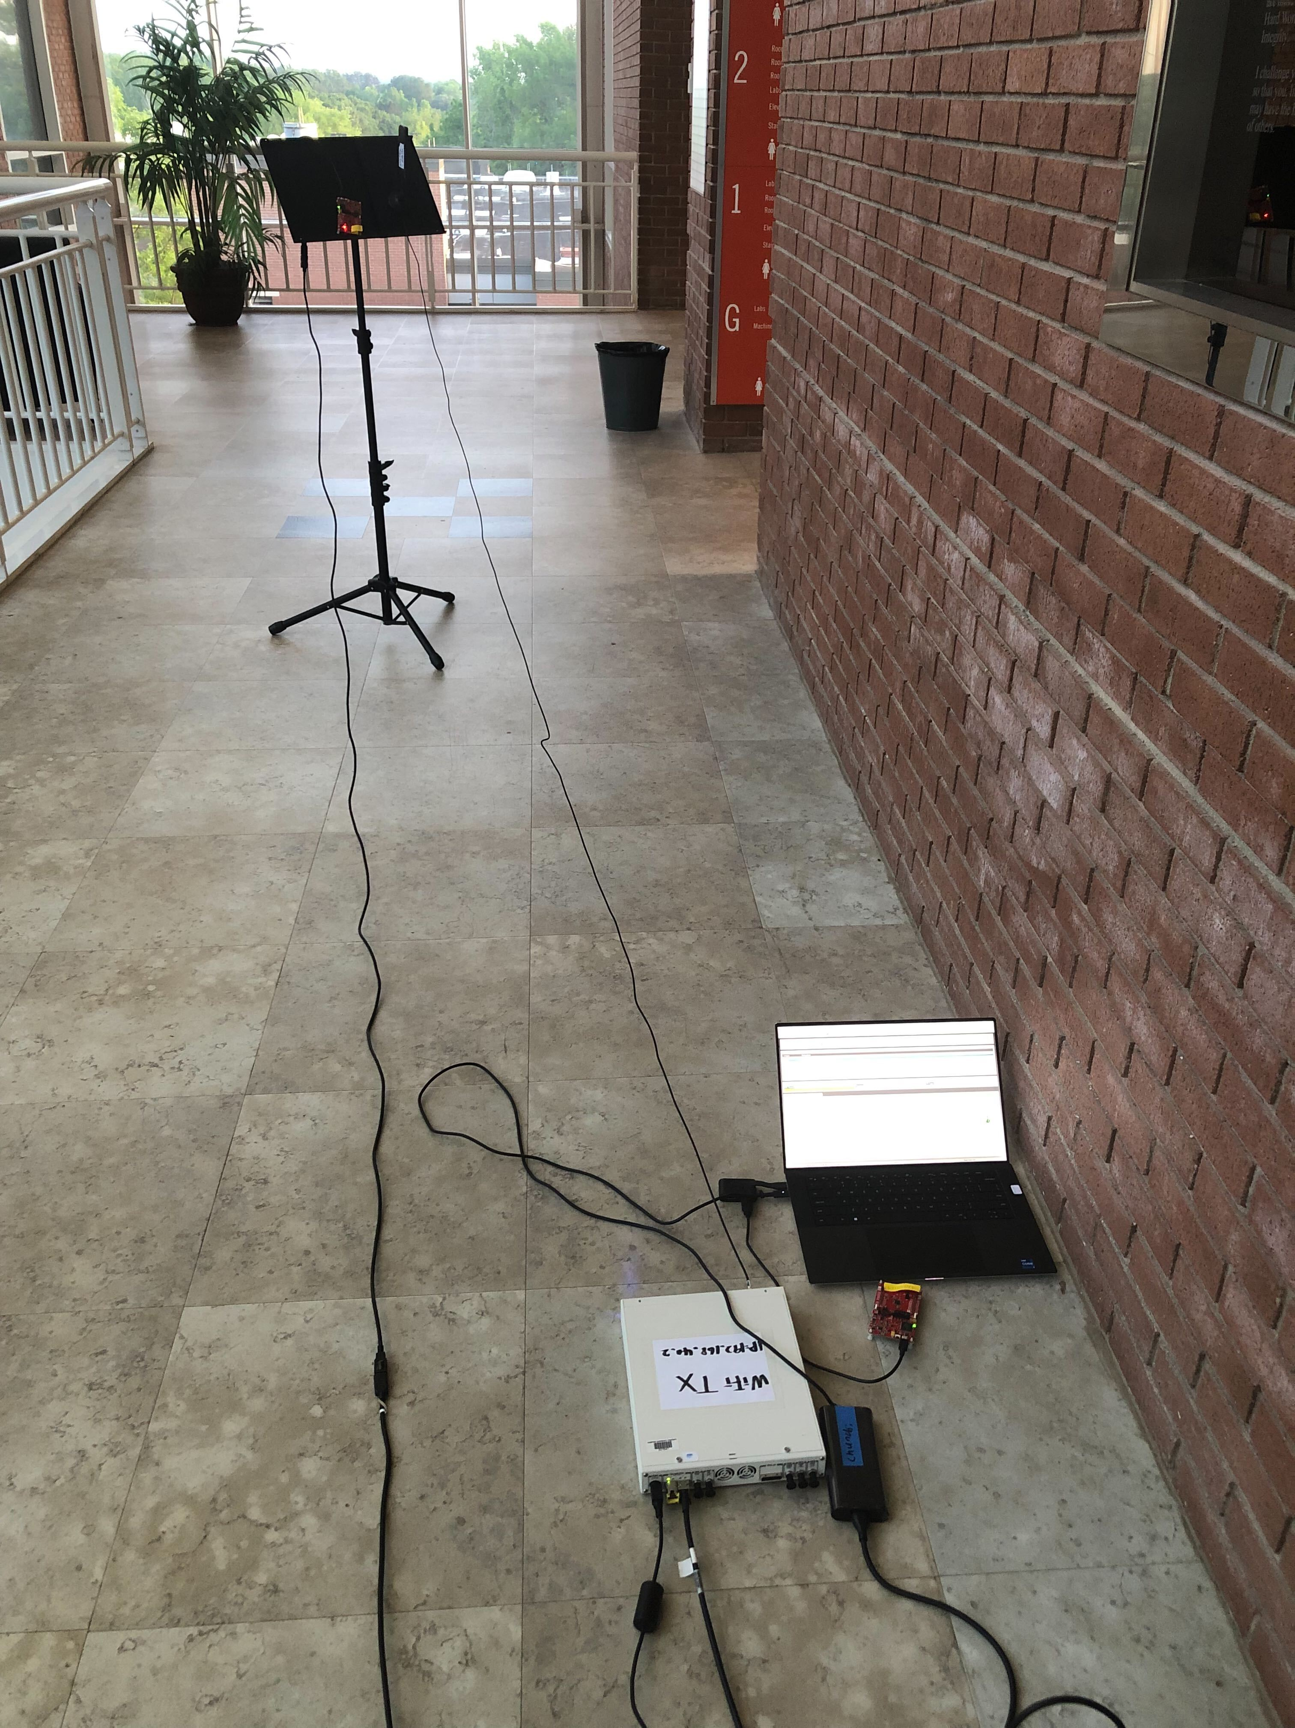
Transmitter
Source
Transmitter
Source
to Indoor Receiver
to Indoor Receiver
3 m
Interference
Source

Slide 3
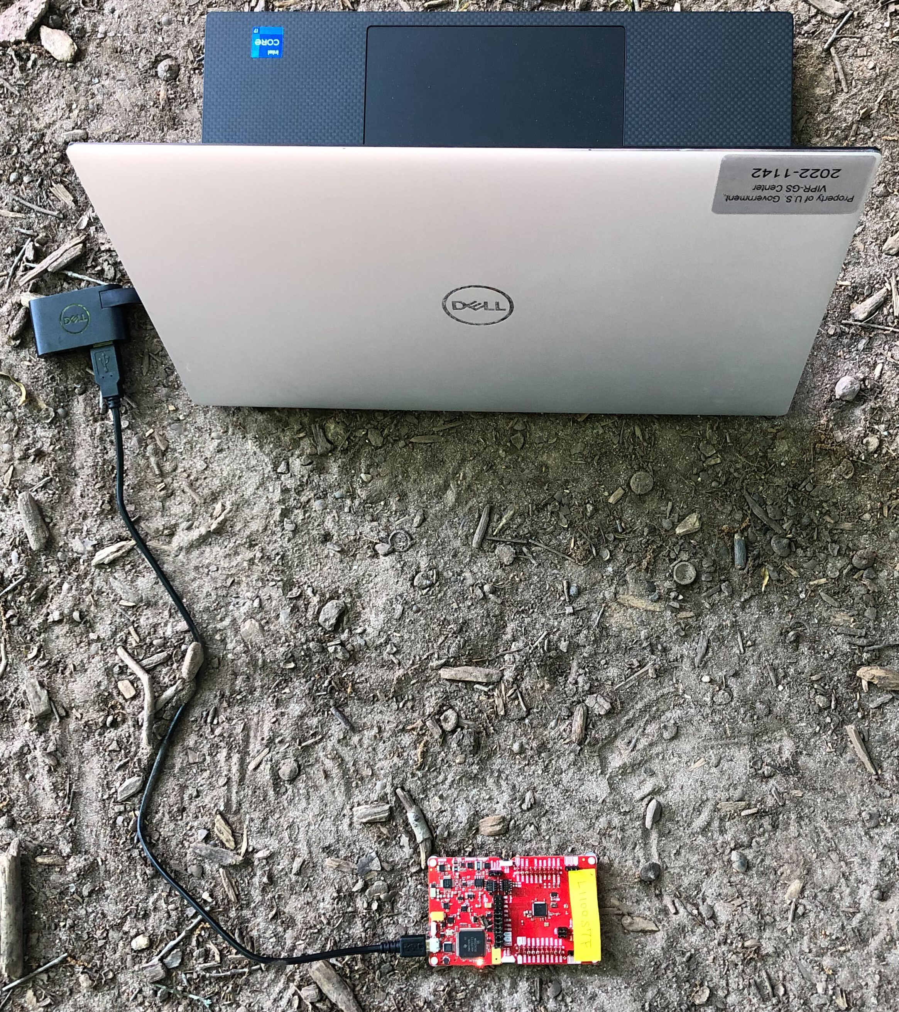
TI CC2652R1F

Slide 4
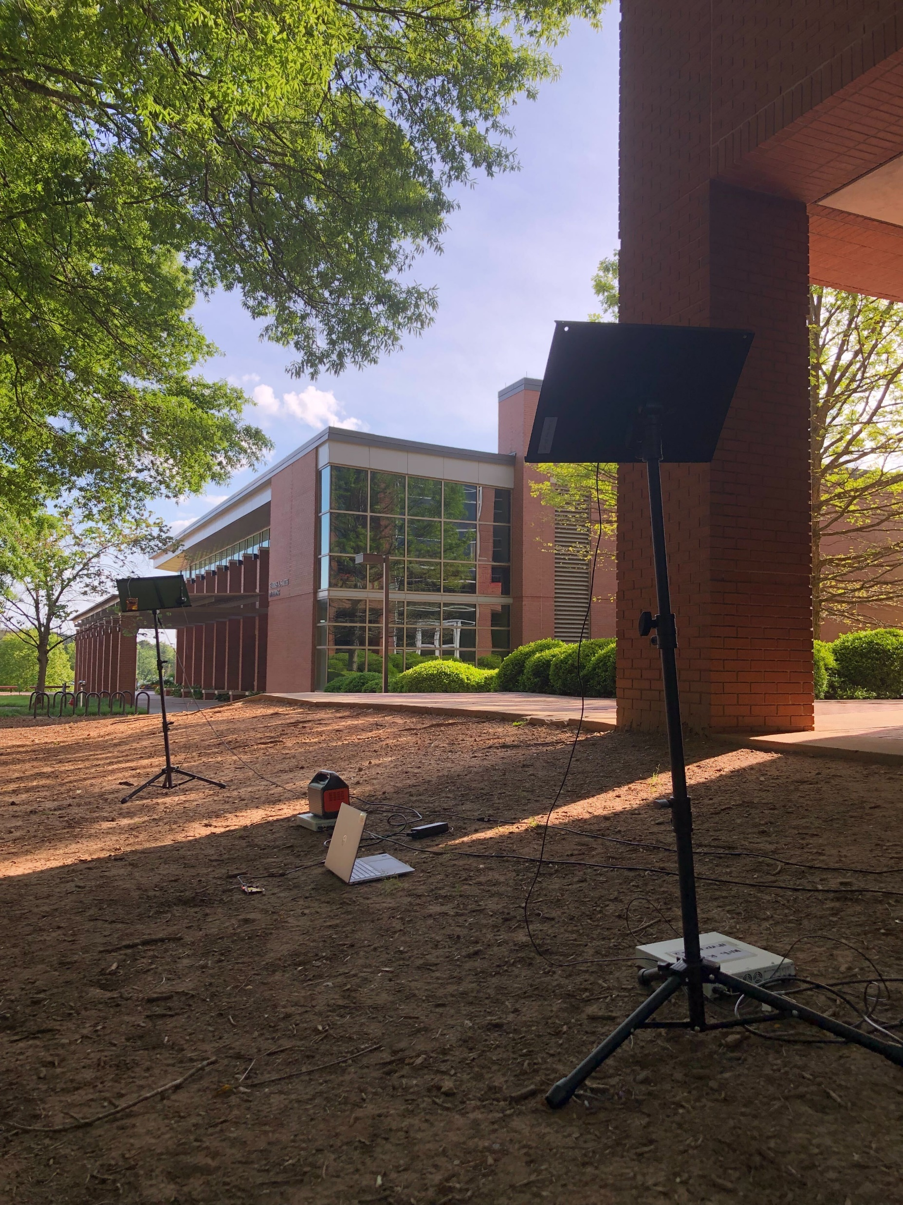

Slide 5
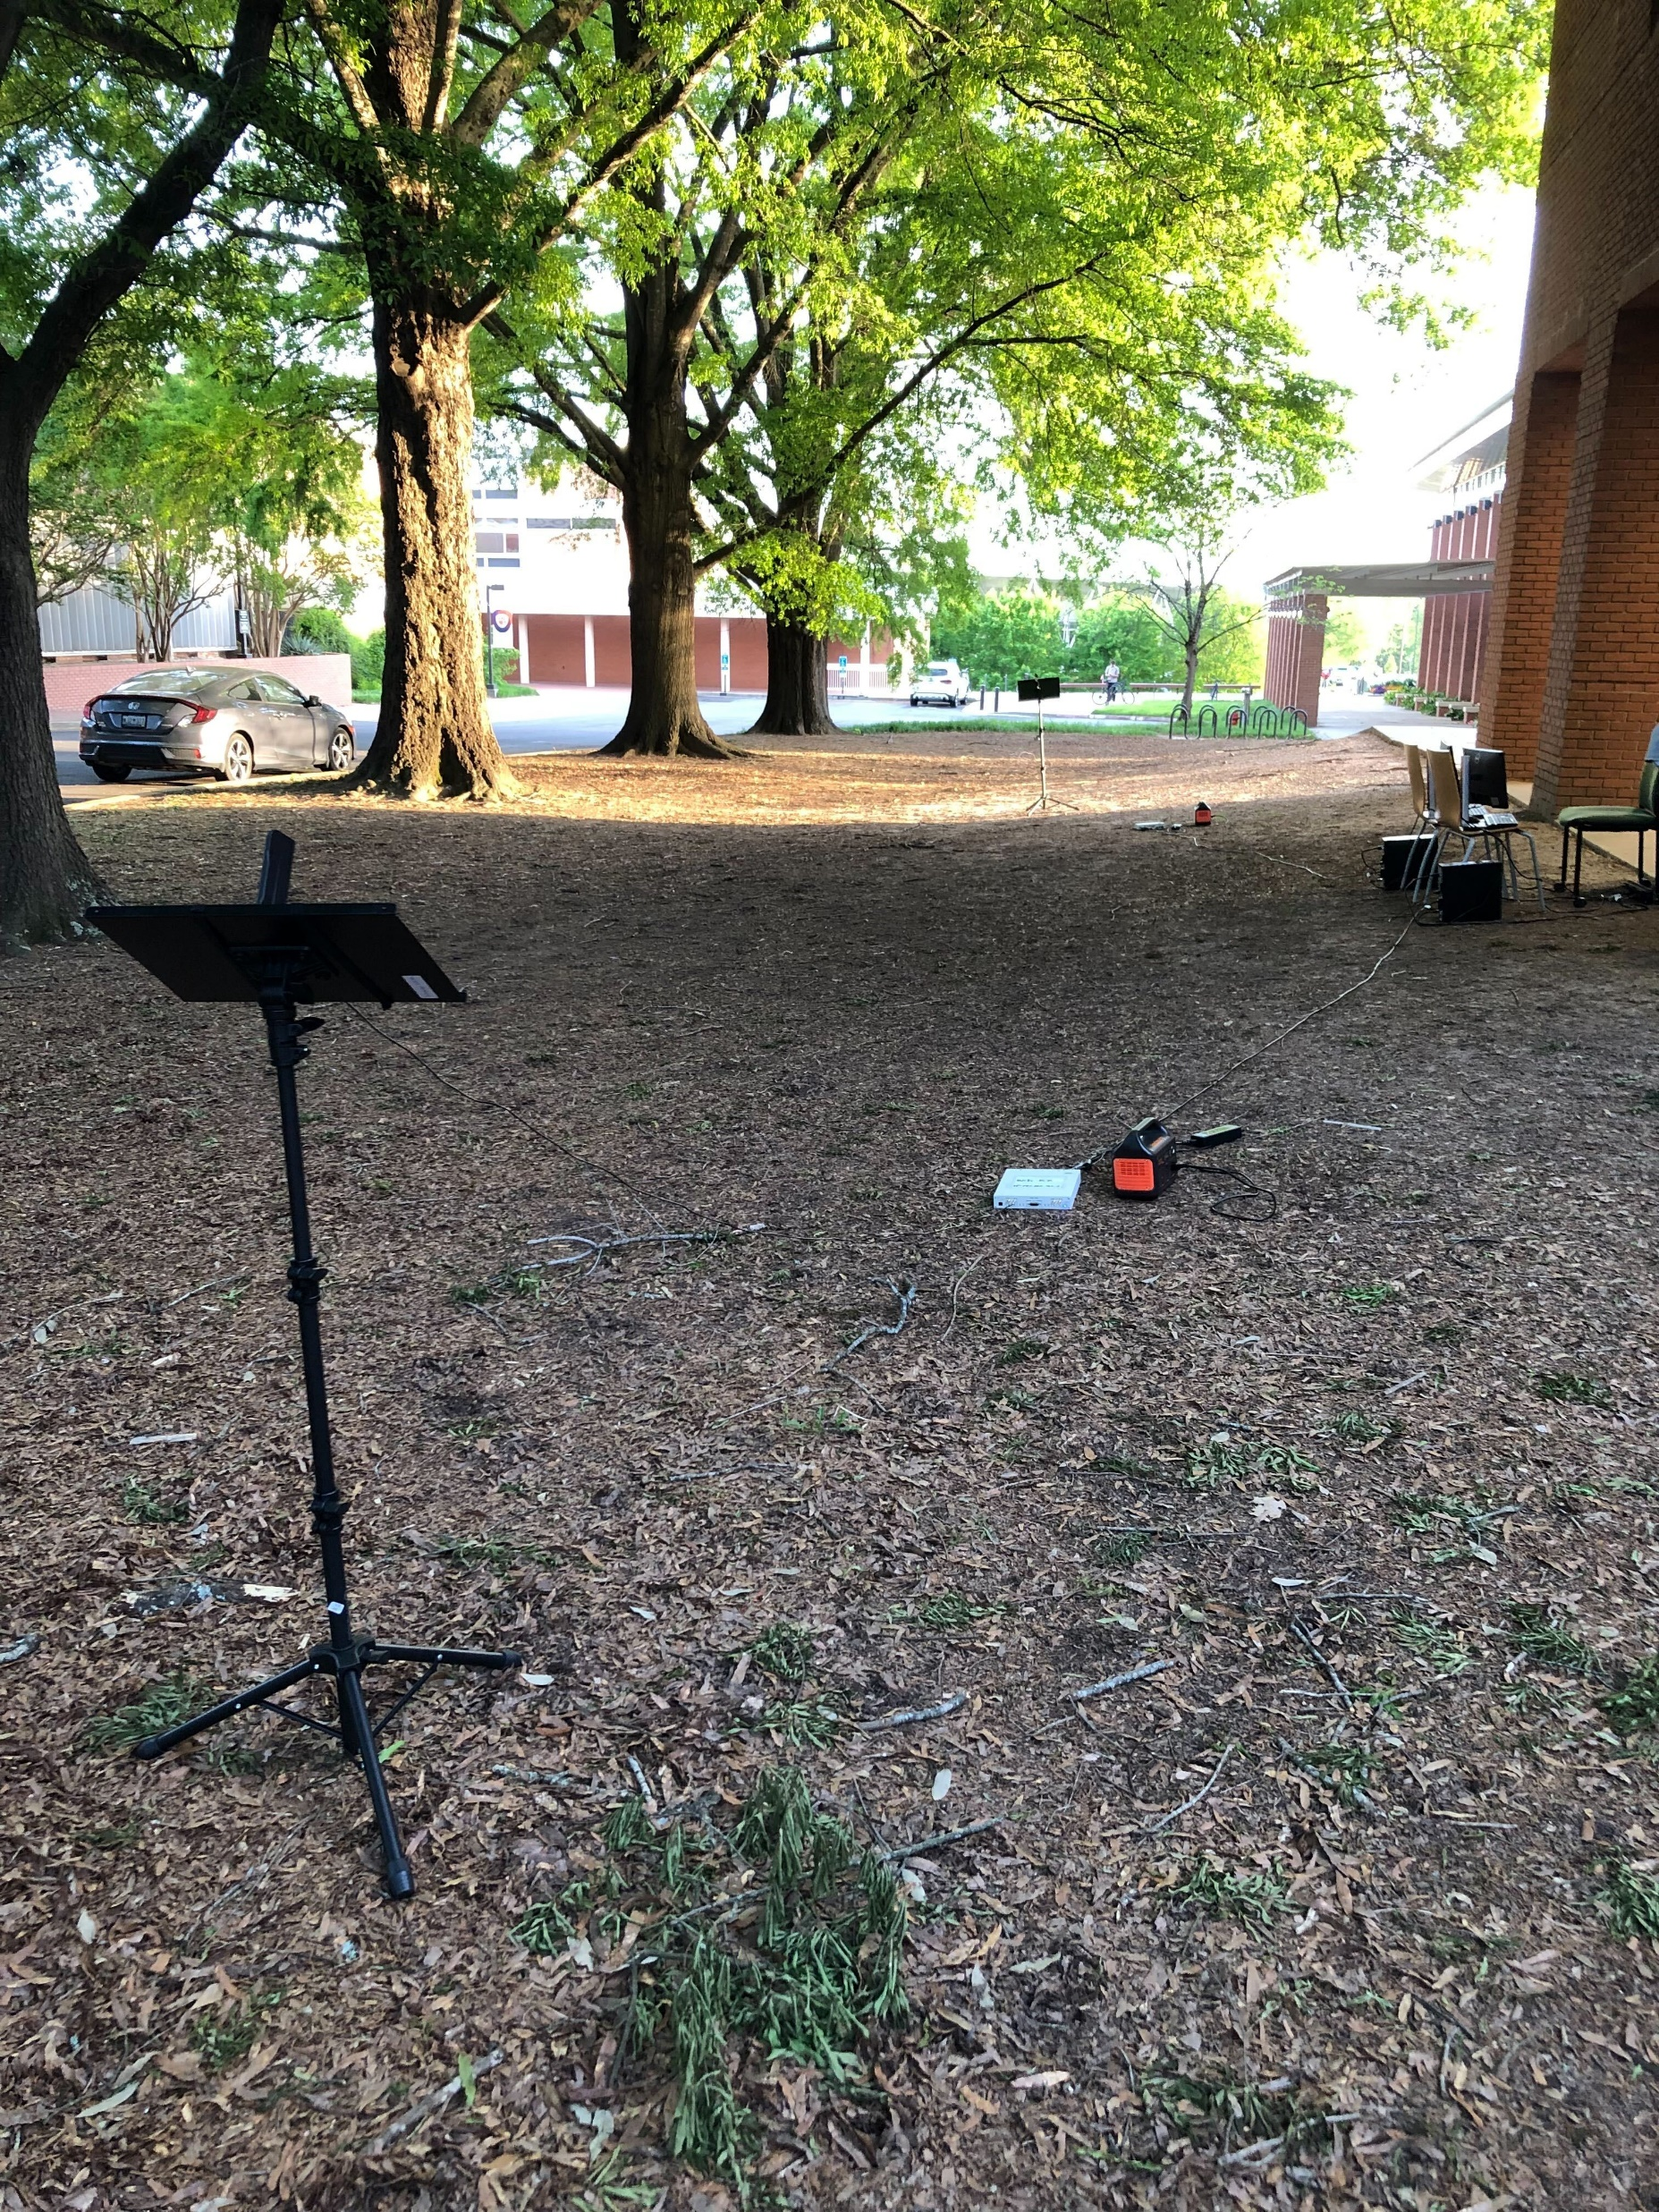
Transmitter
Source
Transmitter
Source
Interference
Source
15 m
15 m
Receiver
Receiver

Slide 6
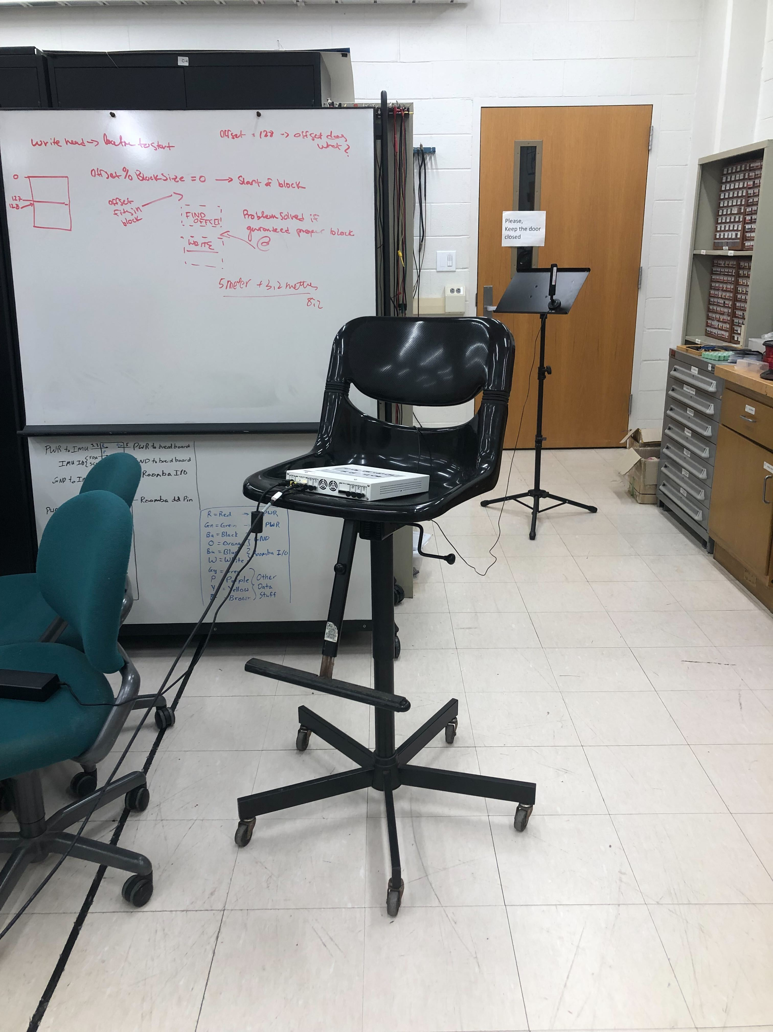

Slide 7
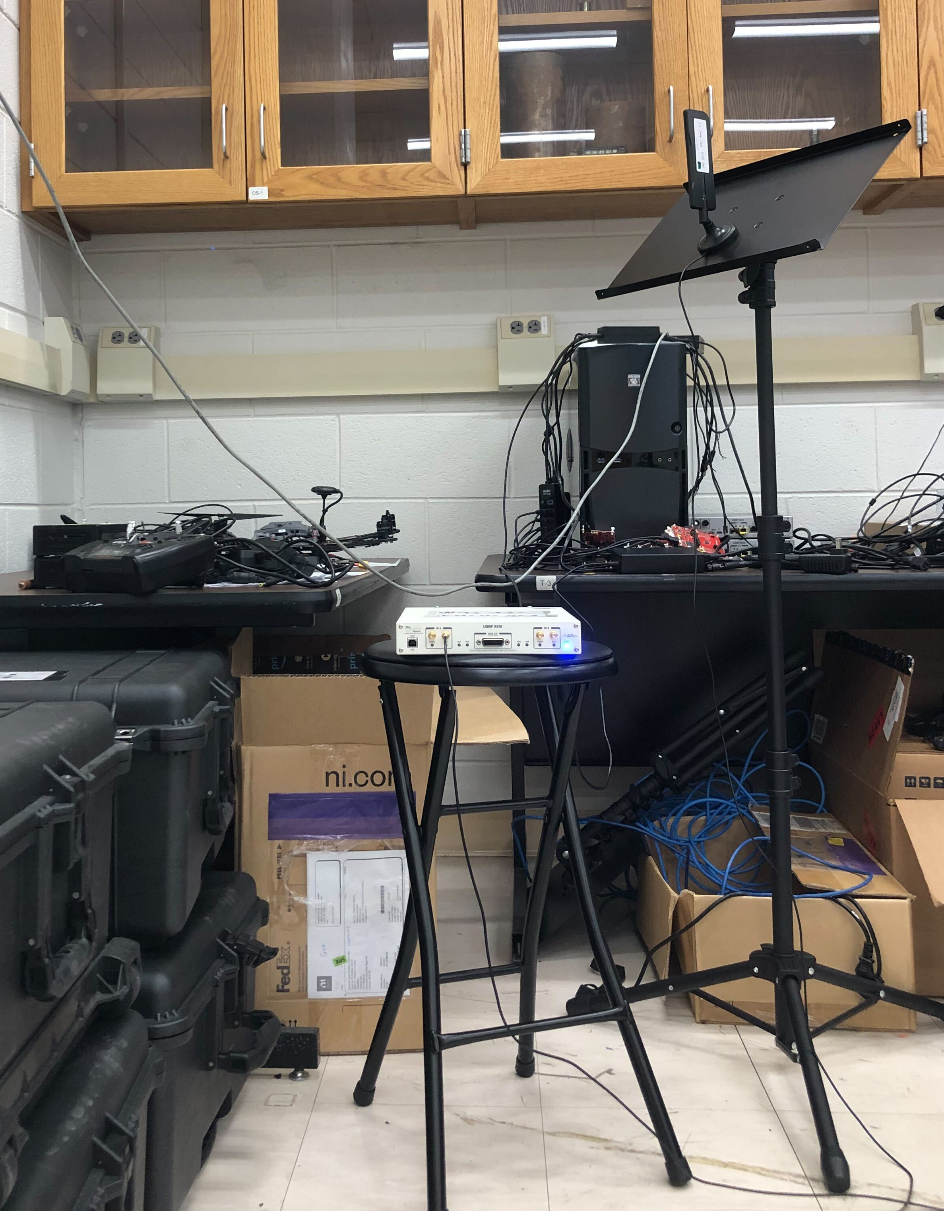
to Hallway
Transmitter

Slide 8
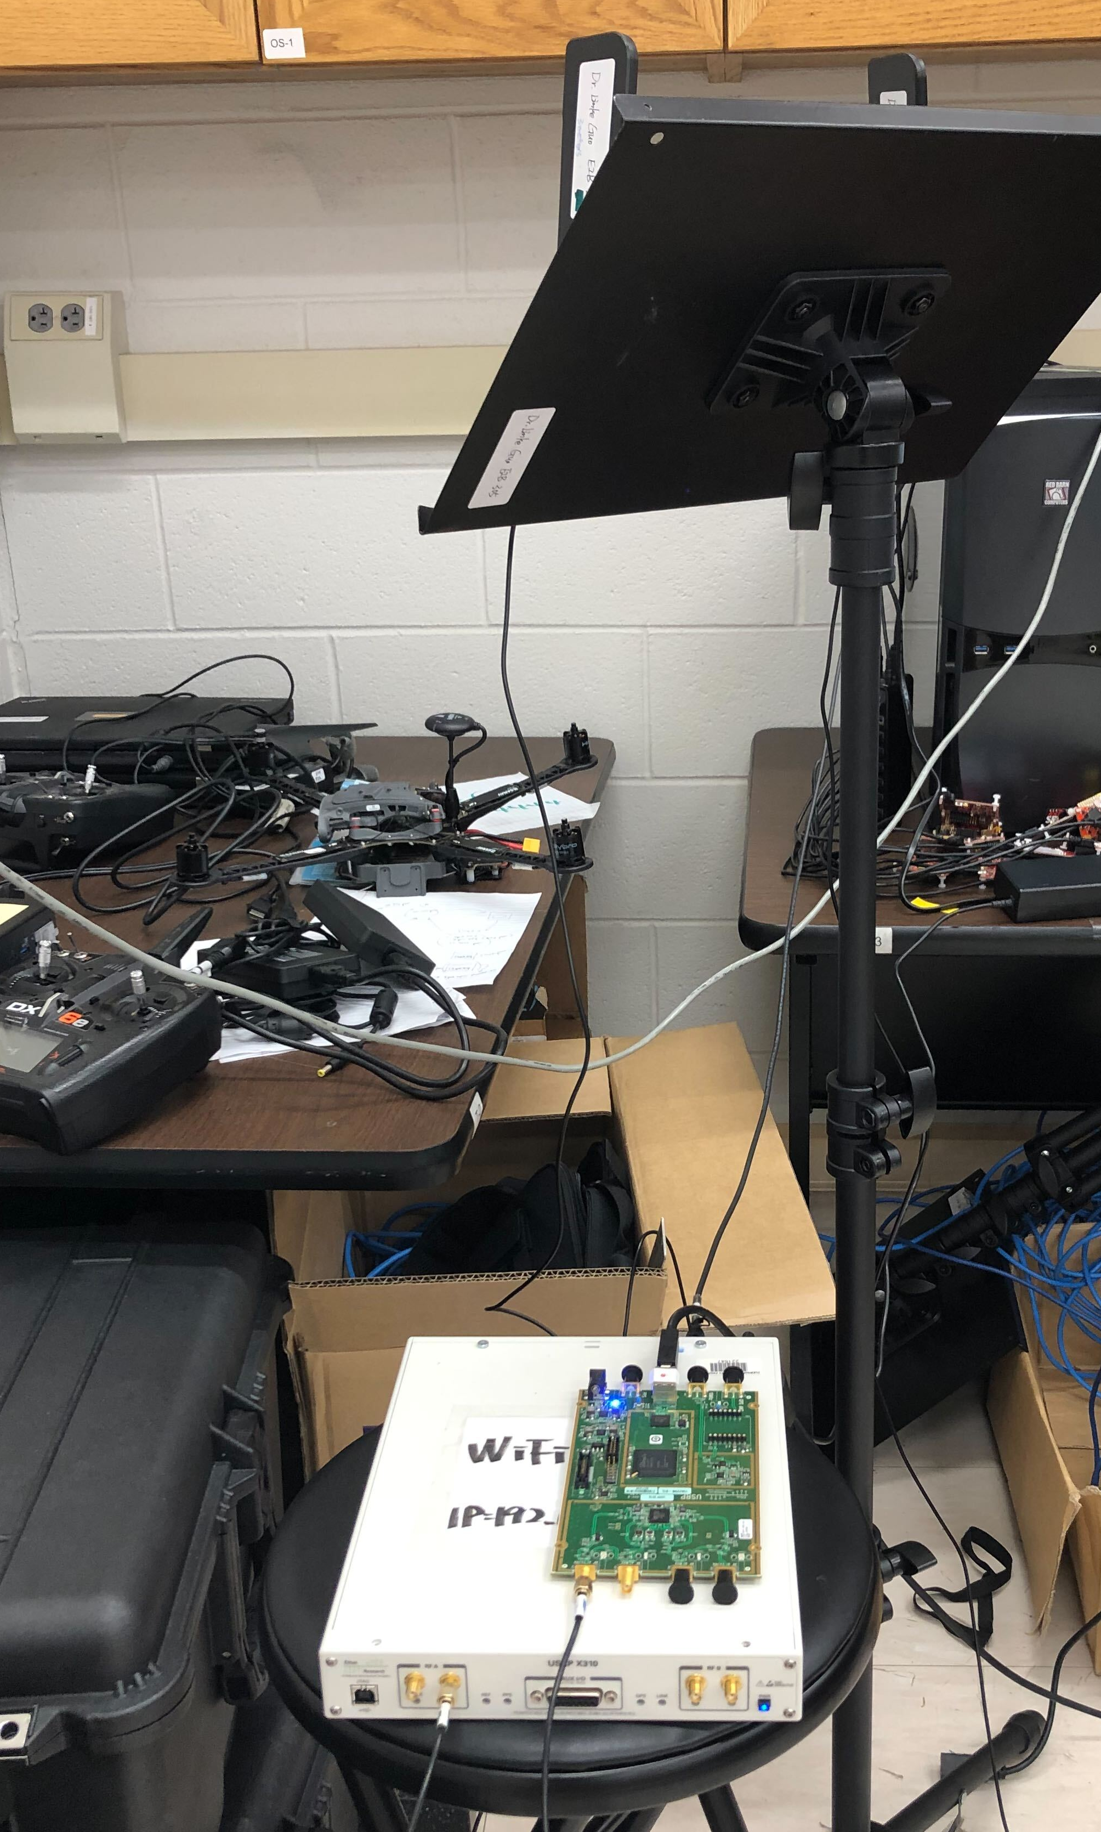
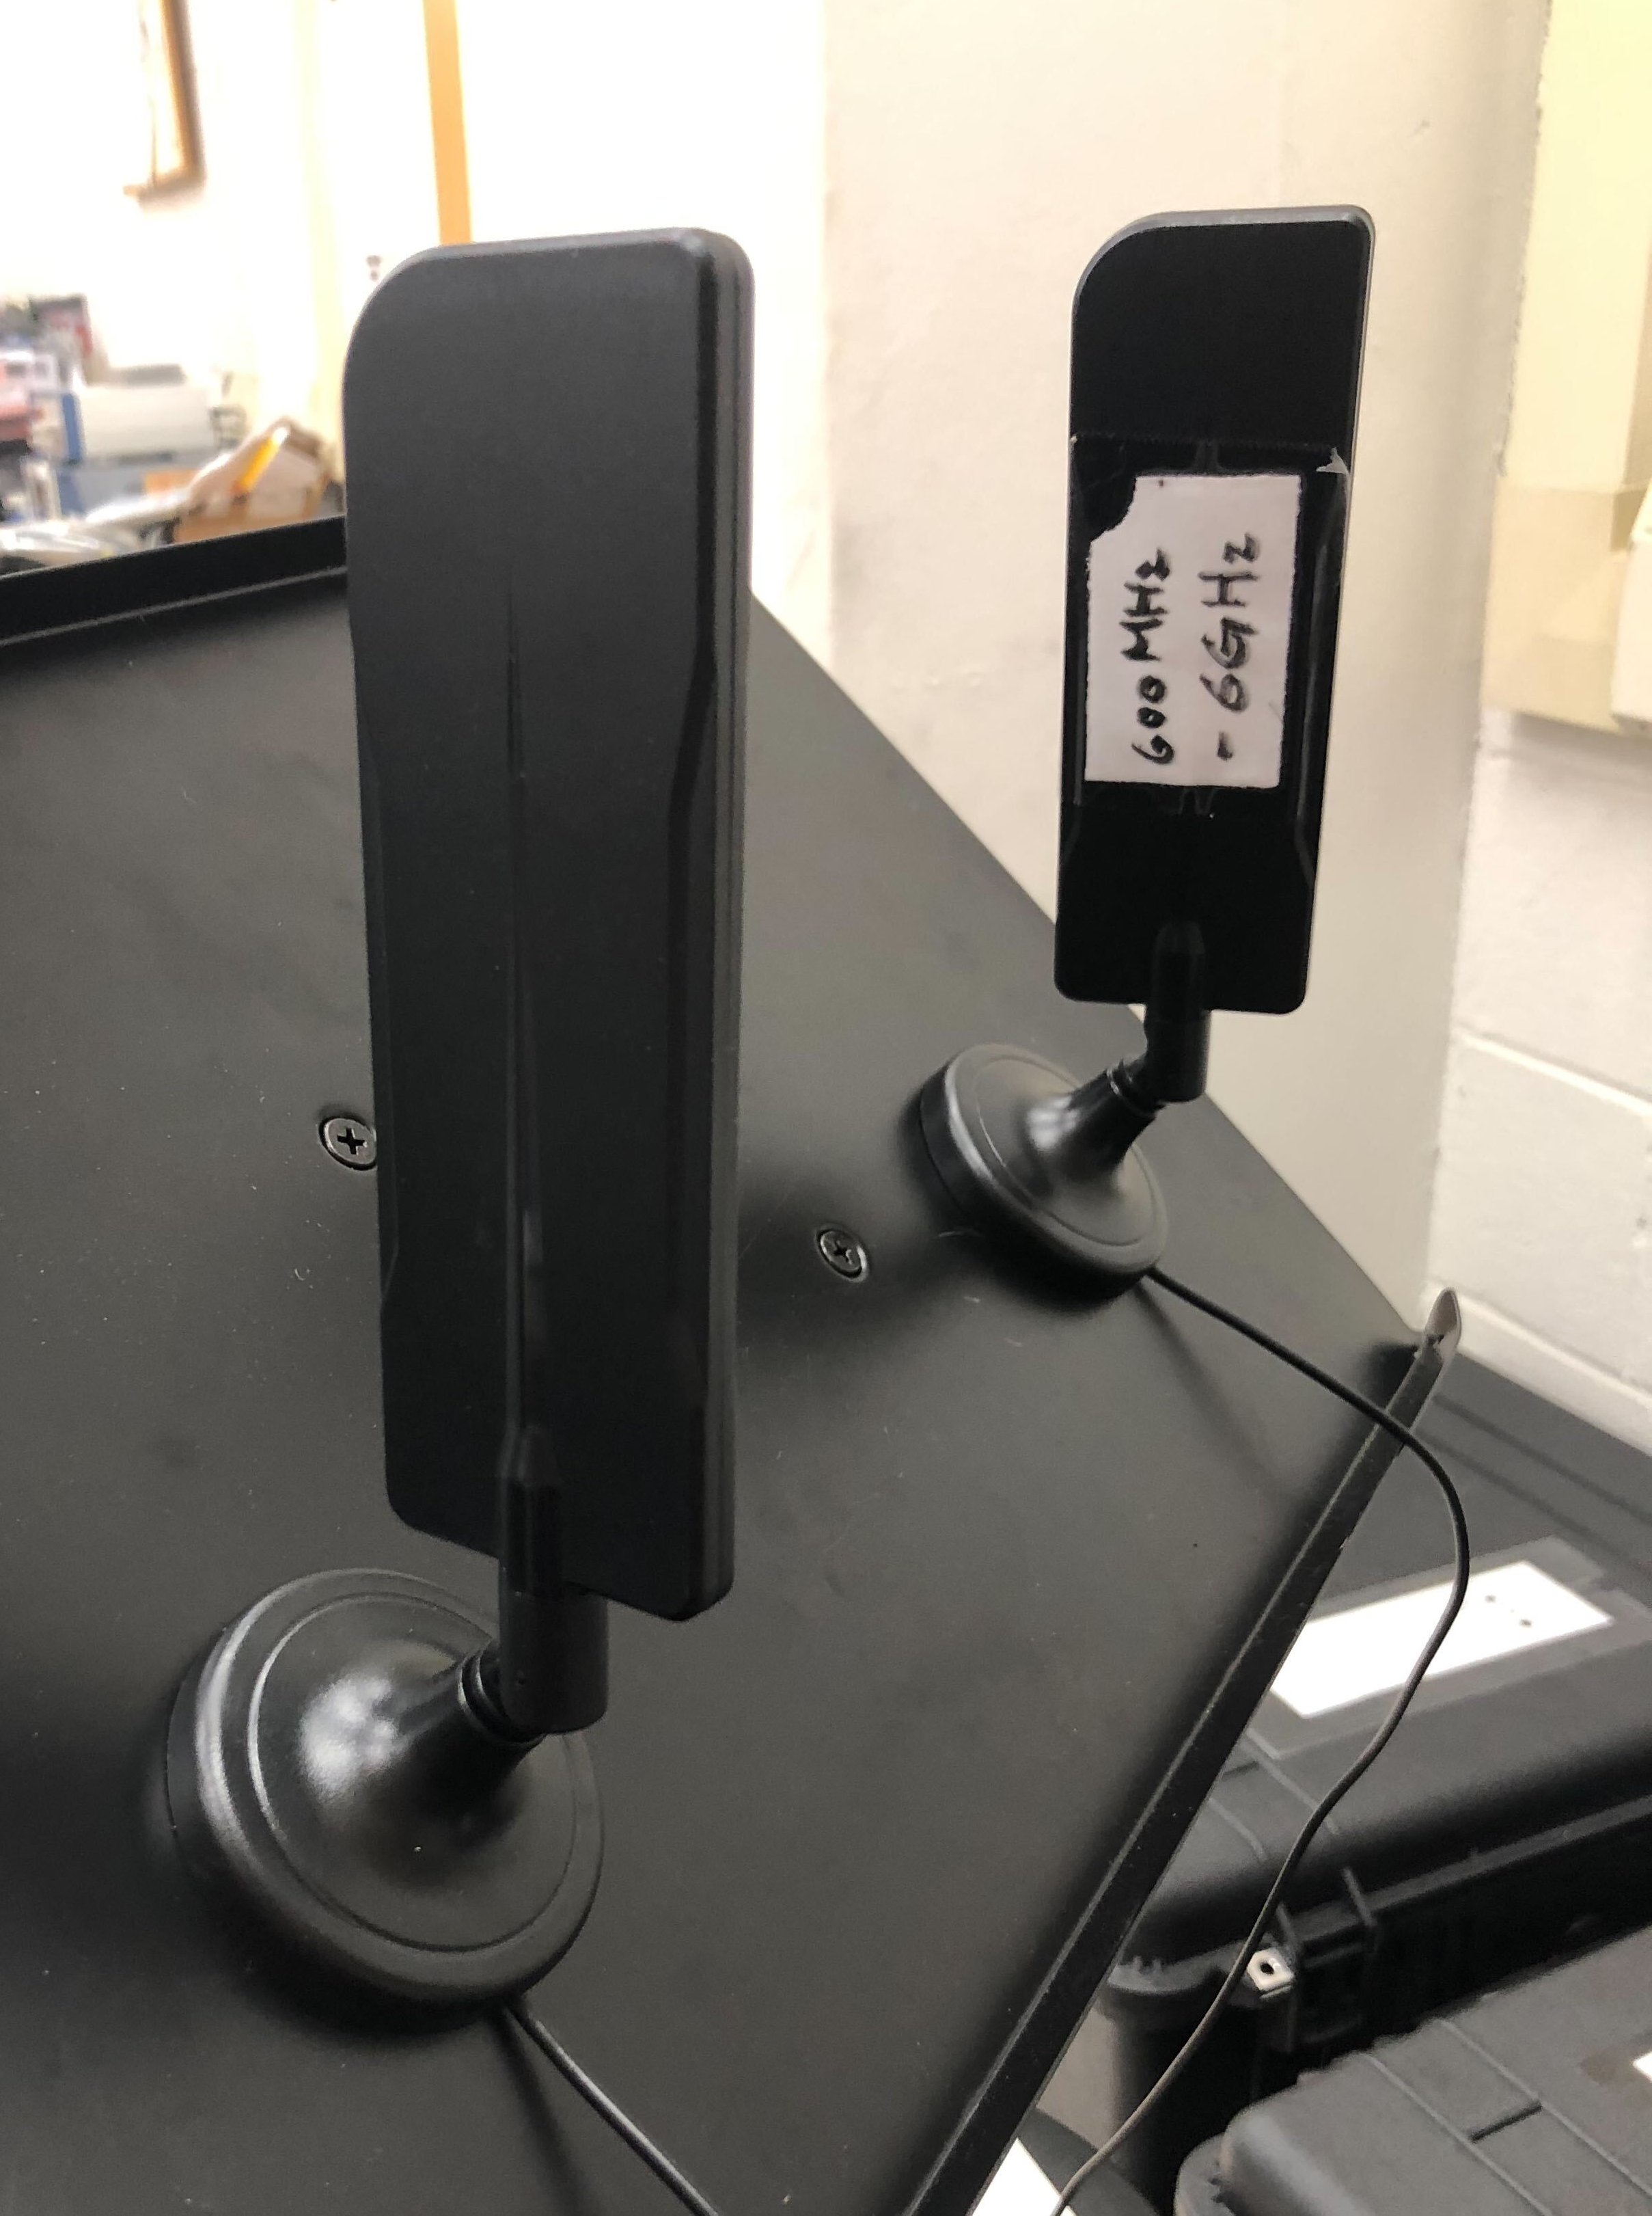
Receiver
Perturbation
Source

Slide 9
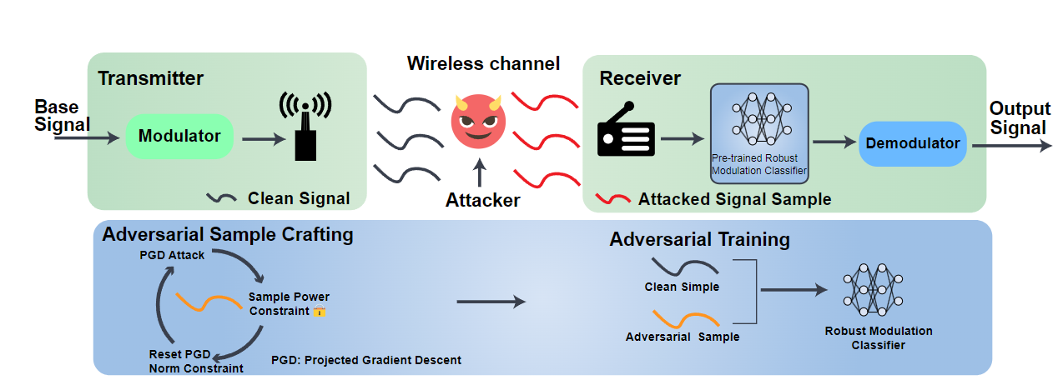
Input
bitstream
Output
bitstream

Slide 10
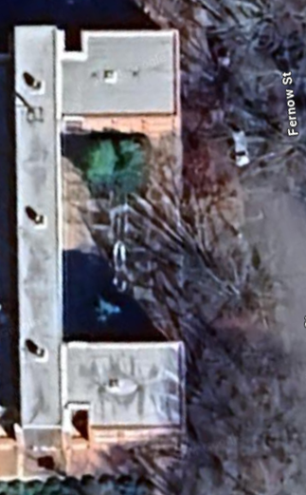

Slide 11
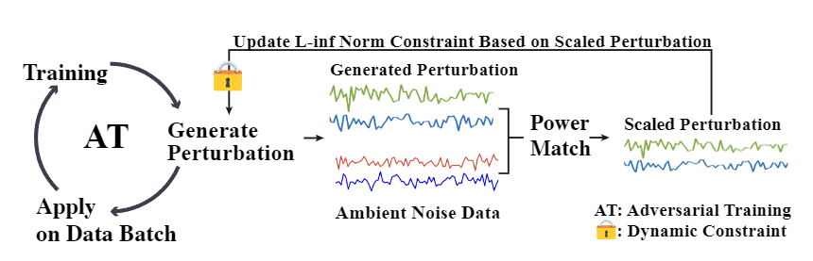
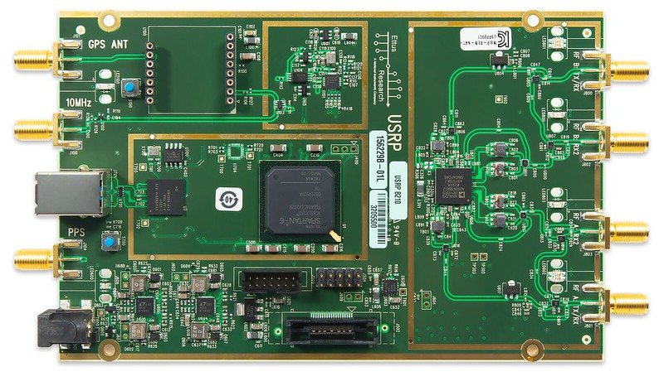


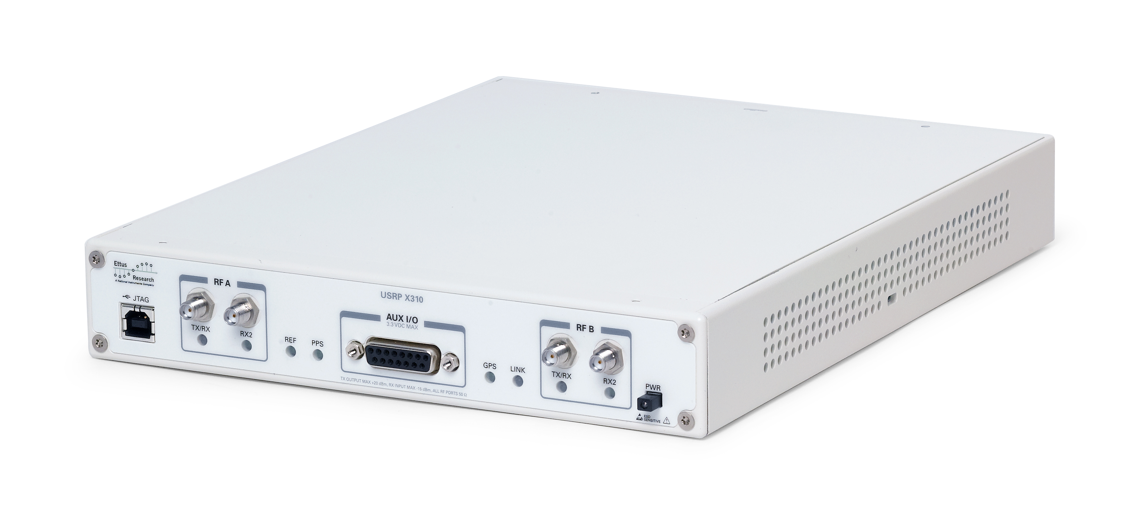

Perturbation for class 1
Trained
AT Model
Perturbation for class 10
class 1
Collected Attacked Signals
class 10

