Slide 1
COMP4433 Data mining and Data Warehousing individual project
Analysis and prediction on Heart Attack Dataset
Leung chun Kit
21018713D

Slide 2
Objective
analysis and prediction dataset
- Analysis the heart attack dataset using PCA, LDA, and association rule.
- Build a model to predict whether the client has heart disease or not by using given information (e.g., age, number of major vessels …)

Slide 3
Data description
There is total of 303 observations and 14 features in the dataset.
Age | Age of patient
Sex | Sex of the patient
cp | Chest Pain type chest pain type Value 1: typical angina Value 2: atypical angina Value 3: non-anginal pain Value 4: asymptomatic
trtbps | resting blood pressure (in mm Hg)
Chol | cholesterol in mg/dl fetched via BMI sensor
fbs | fasting blood sugar > 120 mg/dl (1 = true; 0 = false)
caa | number of major vessels (0-3)
restecg | resting electrocardiographic results Value 0: normal Value 1: having ST-T wave abnormality Value 2: definite left ventricular hypertrophy by Estes' criteria
thalachh | maximum heart rate achieved
exng | exercise induced angina (1 = yes; 0 = no)
oldpeak | Previous peak
slp | Slope of ST
caa | number of major vessels (0-3)
output | Chance of having heart disease(0:low, 1 : high)

Slide 4
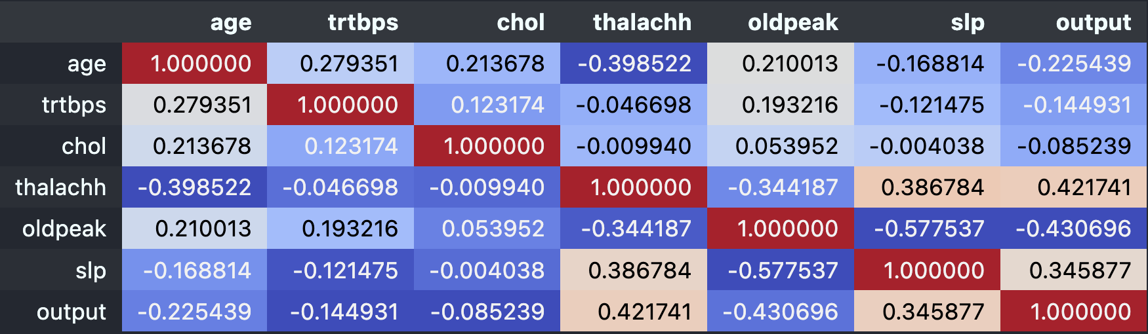
Data analysis - EDA
Correlation matrix for the numeric variable
weak positive linear relationship
maximum heart rate achieved(thalachh)
slope of ST (slp)
weak negative linear relationship
Previous peak (oldpeak )

Slide 5
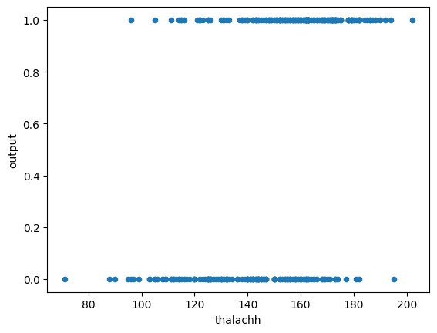
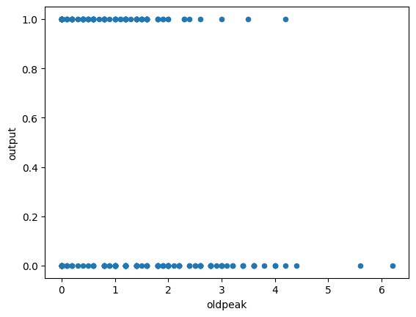
Data analysis - EDA
Scatterplot of thalachh against output
Scatterplot of oldpeak against output
maximum heart rate achieved
Previous peak

Slide 6
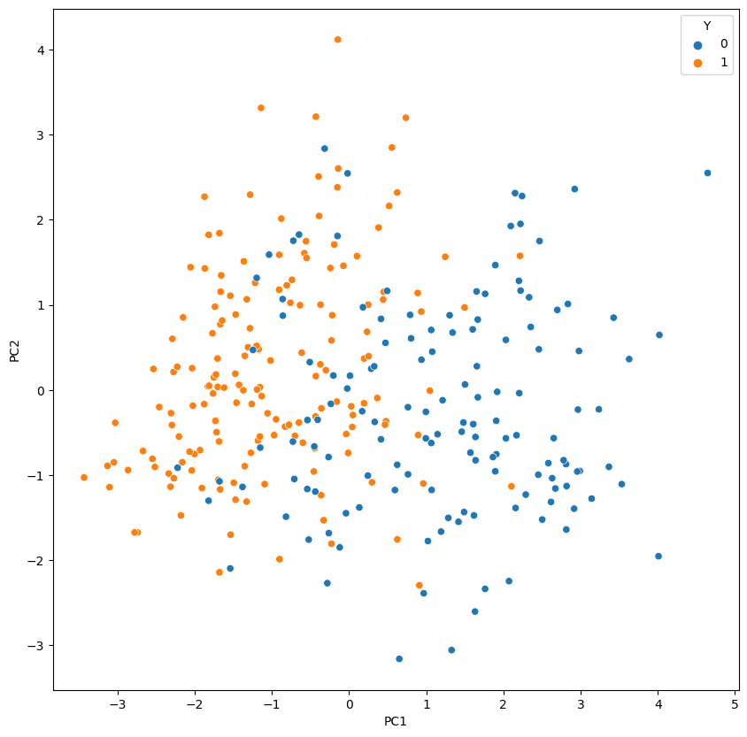
Data analysis - PCA
Principal component analysis (PCA) used to reduce the dimensionality of such datasets, increasing interpretability but at the same time minimizing information loss
The PCA plot with the first two PC explains 33% of the variation in the dataset.
The clients with a higher chance of having heart disease have move to the left side and the clients with a lower chance of having heart disease have move to the right slide. But in the middle part of the graph, there are some overlaps parts with the two types of clients.
We may consider to use more pcs to to analyze the data
(11%)
(22%)

Slide 7
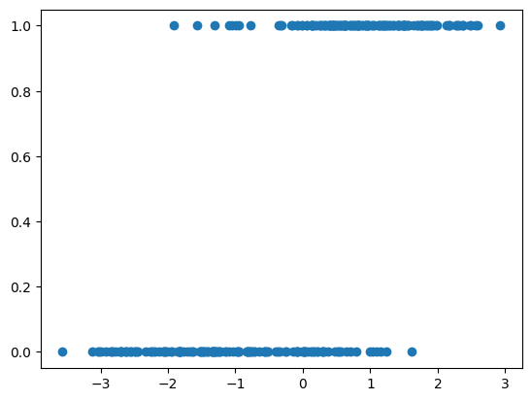
Data analysis - LDA
linear discriminant analysis (LDA) project the features in higher dimension space into a lower dimension space base on their labels .
In the LDA plot, the client with less chance of getting heart disease tends to have a lower value, and the client with a higher chance of getting heart disease tends to have a higher value. But there is some overlap part on the LDA value for both types of clients.

Slide 8
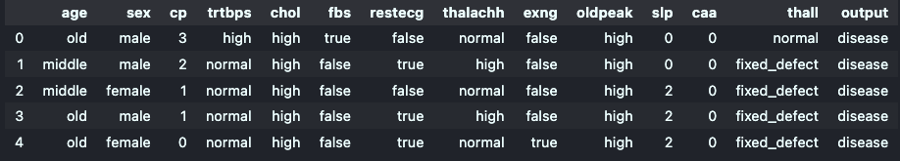
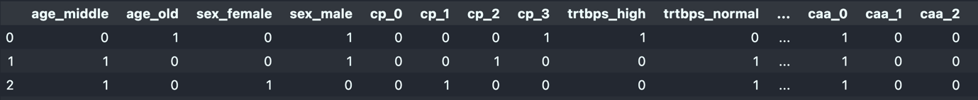
Data analysis – association rule mining
Convert feature to label
Example:
Age <=25 → young
25 < Age <=50 → middle
Age > 50 → old
One hot encoding
Preform one hot encoding using pd.dummies() function

Slide 9
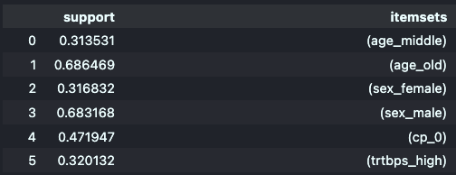
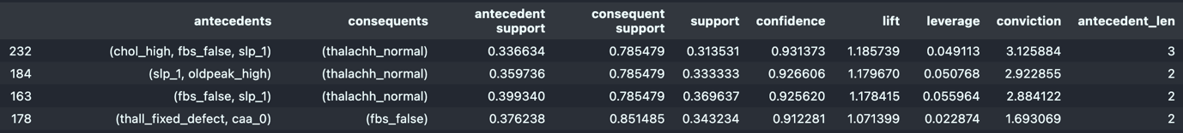
Data analysis – association rule mining
Using Apriori algorithm for finding frequent item set with minimum support of 30%
Find the association rule with minimum confidence of 80%

Slide 10
Data analysis – association rule mining
There are a total of 266 rules mined with confidence greater than 80% and support greater than 30%
Some meaningful rules mined:
Client with false resting electrocardiographic results and age greater than 50 years old tends to have high serum cholesterol levels.
(restecg: false, age: old) -> (chol: high) (support: 0.33, confidence: 0.9)
Clients with a high chance of getting heart disease tend to have high serum cholesterol levels.
(Output: disease)-> (chol: high) (support: 0.44, confidence: 0.81)

Slide 11
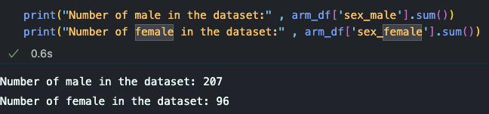
Data analysis – association rule mining
An interesting rule to point out that clients with a low chance of getting heart disease tend to be male. (Output: no disease) -> (sex: male) (support 0.564356, confidence 0.826087)
Before we conclude that people with no heart disease are more likely to be male in general. We need to investigate more on the real condition.
We find out that the number of males and females in the dataset is not equally distributed. There is the more male client in our dataset. Therefore the rule (output: no_disease ) -> (sex: male) is not true in general.

Slide 12
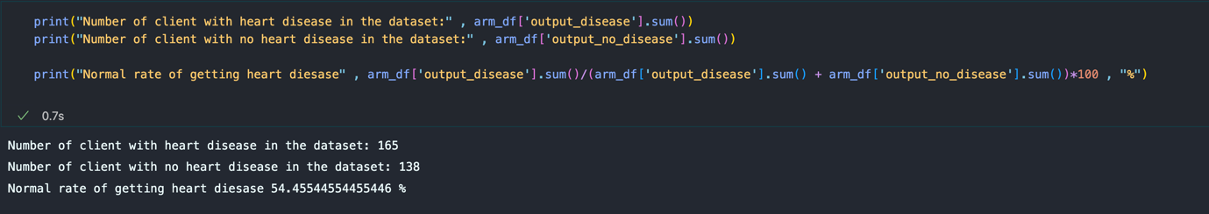
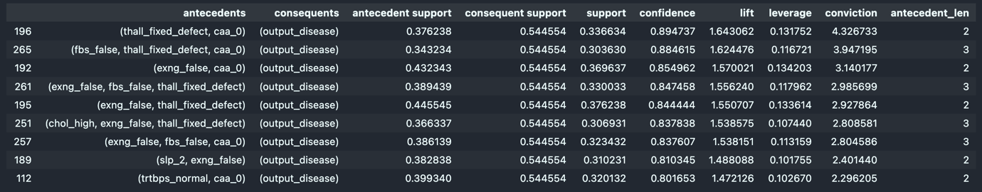
Data analysis – association rule mining
Rules mined related to output: 1 (higher chance of getting heart disease)
We check for the distribution of clients with a high chance of getting heart disease and a low chance of heart disease.
The normal rate of higher chance of getting heart disease is 54%.
But in the following condition, the rate of the client having a high chance of getting heart disease is greater than normal (> 80%).

Slide 13
Model Building – Data model selection
First, we split the raw data into a training dataset and a testing dataset.
The training dataset is used to train the model and the testing data validates the performance of our model chosen when facing unseen data.
We select 30% data as testing data and the remaining 70% data as training data.
70%
30%
The number of observations of training data is 212 and the number of observations of testing data is 91.

Slide 14
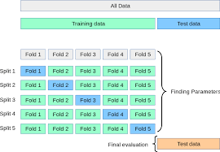
Model Building – Data model selection
I will select the best model from Random forest, logistic regression, LDA classifier, SVM, Decision tree, Naive bayes classifier, KNN, and Multilayer perceptron.
Use 10-fold cross-validation to calculate the mean accuracy rate among difference iterations and choose the models with the highest mean accuracy rate.
For the models with hyperparameters, I will use 10 cross-validations to find out the best parameter, then use the best parameter to build the model.

Slide 15
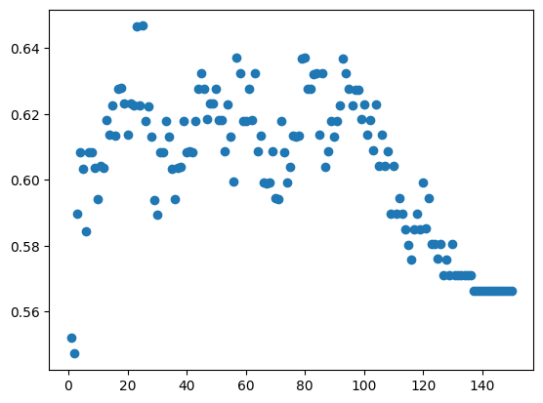
Model Building – Data model selection
Model with hyperparameters example : KNN
Mean Accuracy rate on difference K- value
For the KNN model, we need to choose the parameter K (the number of the neighborhood) to train the model. To find out the K with the best performance. We will perform a 10-fold validation on turning the K parameter.
We will choose the K with the highest accuracy rate in the 10-fold cross-validation.
we can find out that when K =25, the model performs the best in the 10-fold cross-validation. Therefore, we choose k =25 as our parameter for training the KNN model.

Slide 16
Model Building – Data model selection
Model selection criteria
1 . False negative rate
2. Accuracy rate
The rate of our model classify the client’s heart disease risk correctly
The proportion of positives which yield negative test outcomes with the test .
We care about the false negative rate (type II error). Because if we cannot classify the patient, they may not get help on time and worsening the condition of the disease. The cost of getting a false negative result is much larger than getting a false positive result.

Slide 17
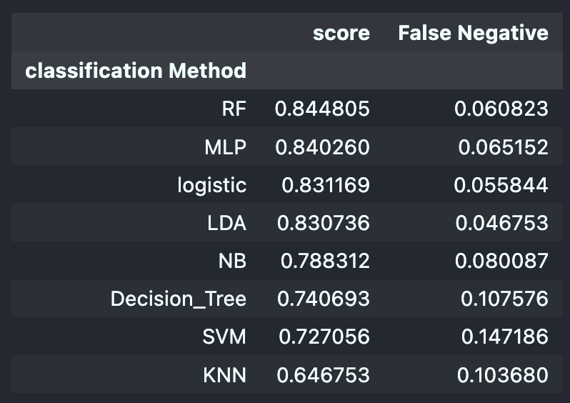
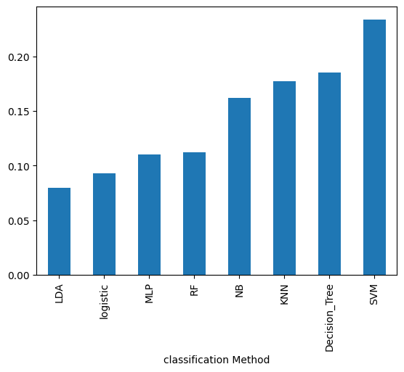
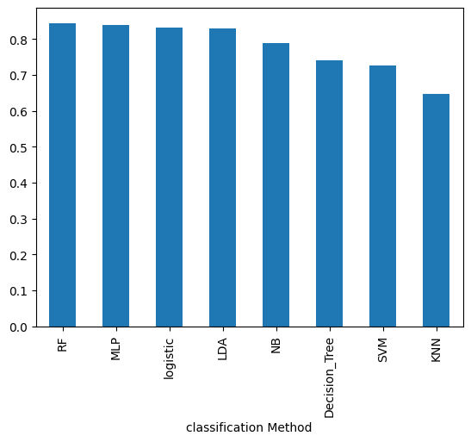
Model Building – Data model selection
Result of different models’ performance on 10-fold cross-validation (training data)
i) score and false negative table
ii) False negative rate of difference models
iii) Accuracy rate of difference models
Since the false Negative rate of LDA is lower than RF, and the accuracy rate is just slightly lower than the Random Forest model, we choose the LDA model to use for predicting client heart disease.

Slide 18
Model performance evaluation
Then we are going to using the test dataset to simulate the unseen client and evaluate the LDA model performance.
We will also with compare the performance of the LDA model and other models to see have we select the best model.

Slide 19
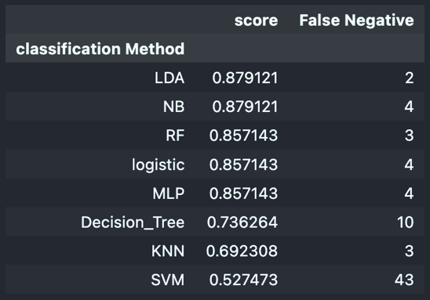
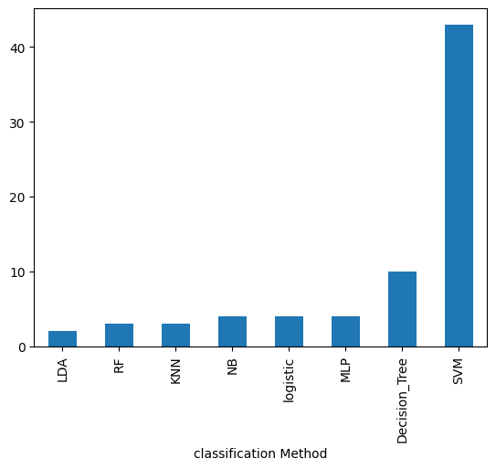
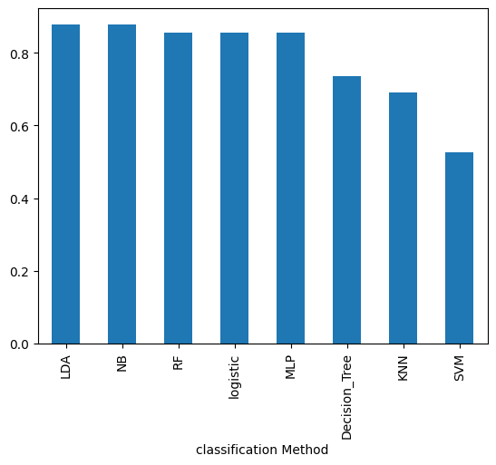
Model performance evaluation ( Test data )
i) score and false negative table
ii) False negative numbers
iii) Accuracy rate of difference models
We find out that the LDA model has the high accuracy rate among all models. And has the lowest false negative rate. Therefore, LDA is the ideal model for predicting a client's chance of getting heart disease.

