Slide 1

Movie Box Office Prediction Based on IMDB Data
Project Luther
Chun Yang

Slide 2
Problem Statement:
Use web scraped IMDB data to predict global movie revenue after opening weekend

Slide 3
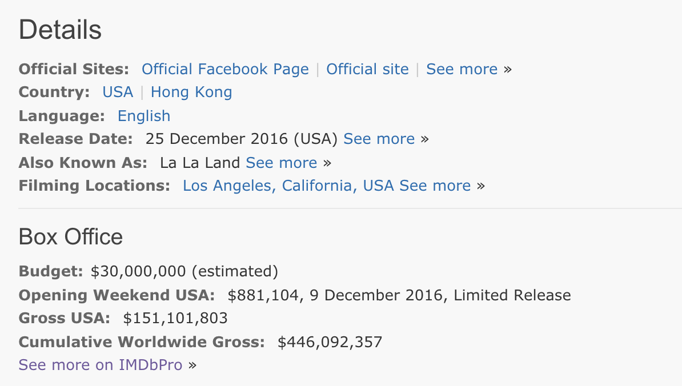
Approach
Data collection from IMDB scraping
Notes:
Predict number different color

Slide 4
Approach
Data cleaning and exploratory data analysis
Scraped about 120,000 movie entries
1200 in training set and 500 in test set

Slide 5
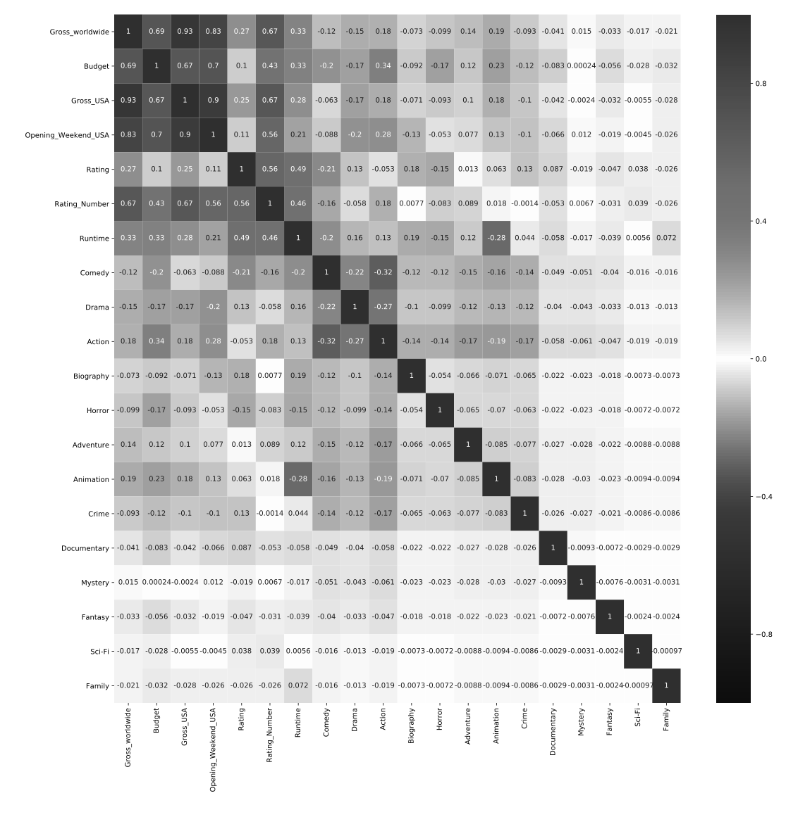
Approach
Preliminary
Exploratory Data Analysis

Slide 6
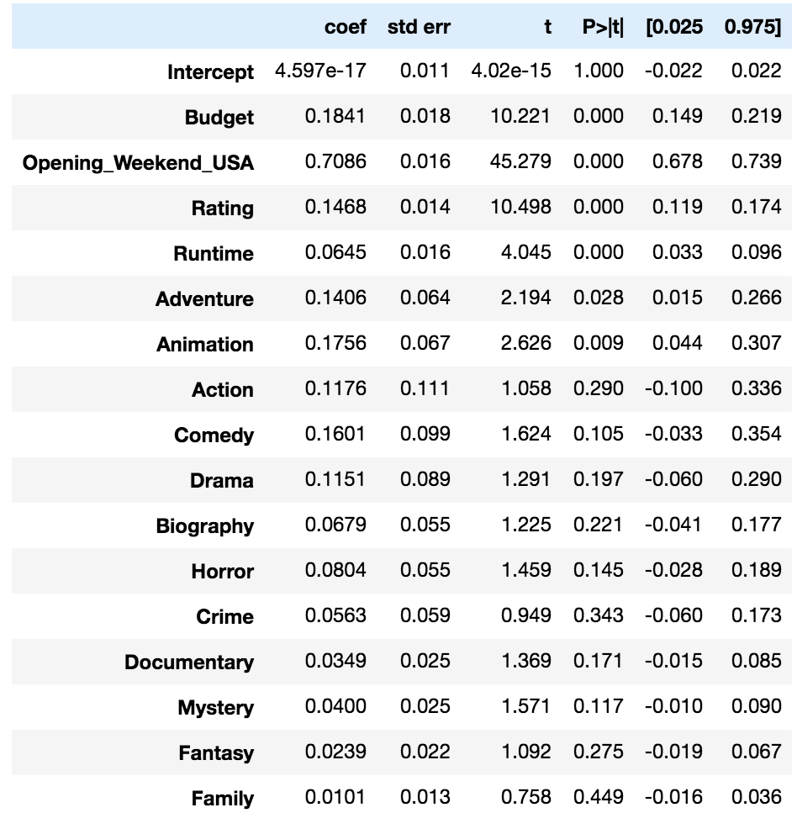
Approach
Feature
selection

Slide 7
Approach
Feature
selection

Slide 8
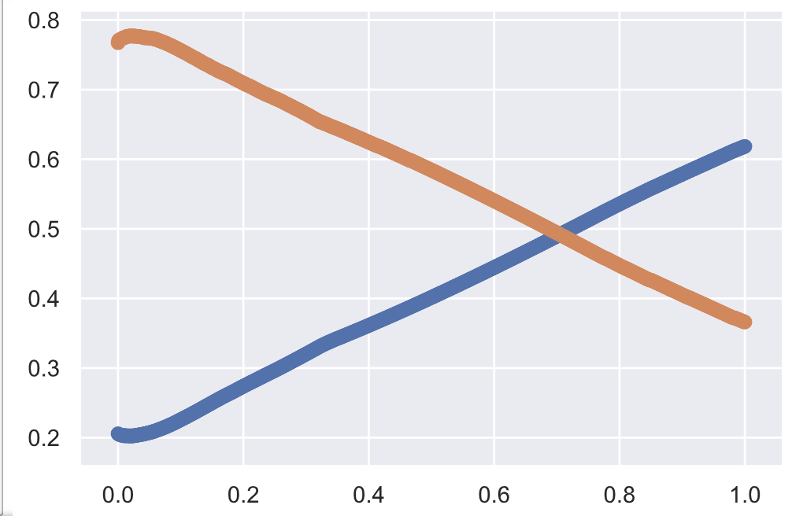
Approach
Hyperparameter optimization by cross validation
Degree = 2 lamda = 0.02
Adjusted R²
MSE
Notes:
Point out the optimized location

Slide 9
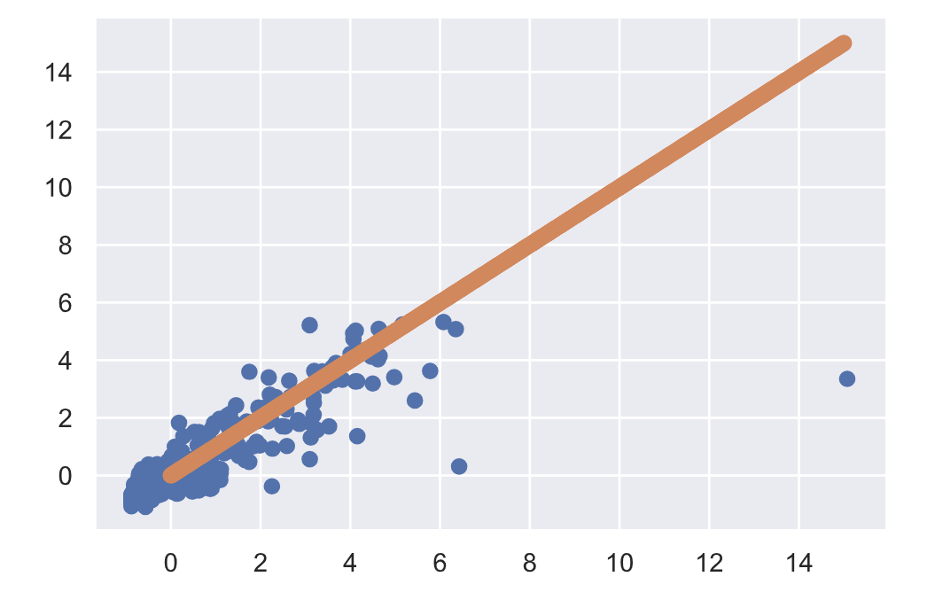
Model Performance
 | R² | Adjusted R² | MSE
Training | 0.810 | 0.807 | 0.189
Test | 0.735 | 0.725 | 0.583
Predicted
Avatar
Frozen
Actual

Slide 10
Future Directions
K nearest neighbors
Kernel approach

Slide 11
Acknowledgement
This would not be possible without your help!
Instructors: Adam, Jonathan
Advisor: Andrew, Stephany
TA: Nick, Jenn
Thanks everyone for being supportive and inspiring!

