Slide 1
Linear Models
Multiple Linear Regression
Explored Initial shortlist of 20 Features
Narrowed list to 5 features
Performed Regression
Ridge/Lasso
Explored Interaction of Features
Expanded Shortlist with Interaction Features

Slide 2
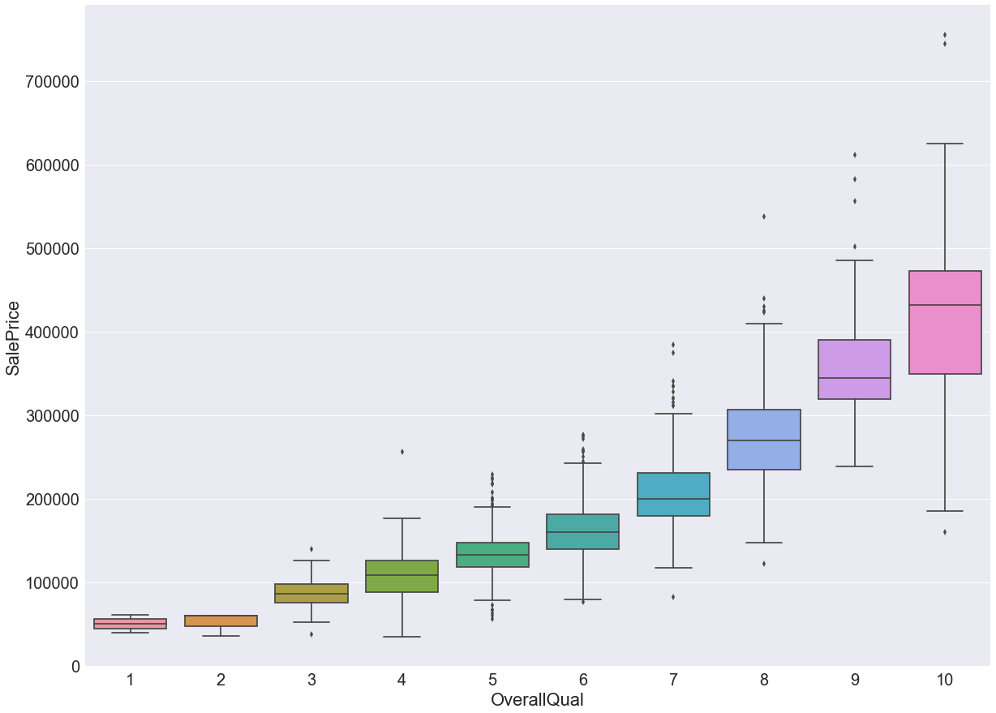
Multiple Linear Regression

Slide 3
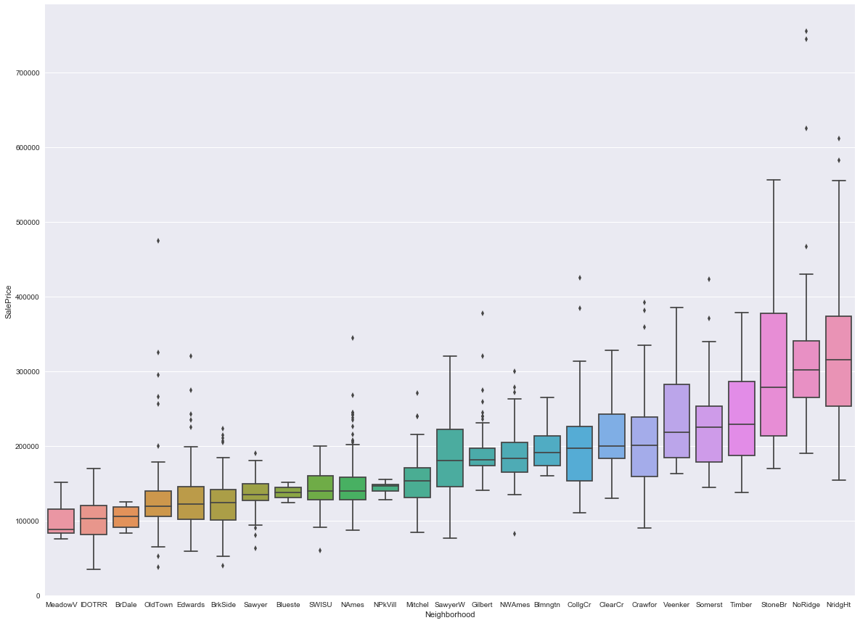
Multiple Linear Regression

Slide 4
Multiple Linear Regression
Shortlist of 20 Features
(Red ones used in Initial Regression)
Location | Style | Condition | Size | Other
Neighborhood | HouseStyle | OverallQual | GrLivArea | SaleCondition
MSZoning | Foundation | OverallCond | 1stFlrSF, 2ndFlrSF | SaleType
 | GarageFinish | YrBuilt | FullBath
 | Paved Drive | ExterQual | TotRms
 |  | BsmtQual | GarageCars
 |  |  | GarageArea

Slide 5
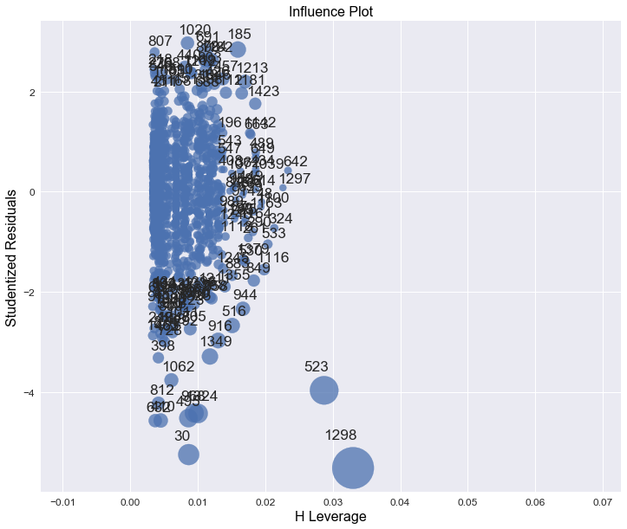
Multiple Linear Regression

Slide 6
Multiple Linear Regression
 | R^2 (Training Set) | RMSE (Training Set)
With Influential Points | 0.800 | 0.178
Without Influential Points | 0.807 | 0.176

Slide 7
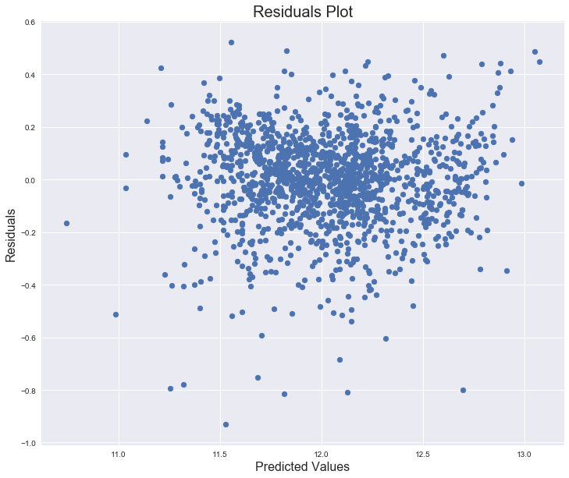
Multiple Linear Regression

Slide 8
Features Interactions

Slide 9
RIDGE/LASSO PROCESS
Split training data 80%/20%
Used grid search to tune hyperparameter
5-fold cross-validation for each parameter value
Tested against remaining 20%
Trained against entire 100% of training set

Slide 10
Ridge Regression
INSERT CROSS-VALIDATION CURVE

Slide 11
Ridge Regression
 | R^2 (Training Set) | RMSE (Training Set)
SUB-TRAINING SET
TEST SET
TOTAL TRAINING SET

Slide 12
Ridge Regression
Top Features | Coefficient Value

Slide 13
Ridge Regression
INSERT RESIDUALS PLOT?

Slide 14
Lasso Regression
 | R^2 (Training Set) | RMSE (Training Set)
SUB-TRAINING SET
TEST SET
TOTAL TRAINING SET

Slide 15
Lasso Regression
Top Features | Coefficient Value

