Slide 2
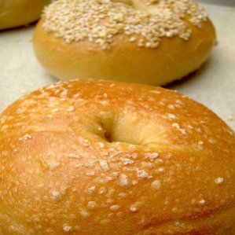


Bagel
Adversarial noise
Grand piano

