Slide 1
Chun-Chi Huang Mar. 19, 2018
Data Modeling
- Basketball

Slide 2
My Favorite Sport - Basketball
Have played for a long time
Played on school teams in HS and college
Have been watching NBA games since 1992
Despite injuries, I never give up
Basketball has been an important part of my life

Slide 3
Introduction of Basketball
Two teams play the game, and each of them has five players in the field.
Center(C), Power Forward(PF), Small Forward(SF), Point Guard(PG), Shooting Guard(SG).
For defensive team, there are five trajectories at the same time.
For offensive team, there are also five trajectories too.

Slide 4
An Interesting Game
My HS team lost to a top team by 30 points.
My team was at a disadvantage in terms of height and skill.
By only changing the defensive strategy, my team beat the same rival team by 30 points.

Slide 5
Data Science in Sports
Moneyball – recognized underestimated players with high performance through advanced statistics analysis.
Different strategies can significantly influence sports such as baseball and basketball.

Slide 6
The Research about Basketball
“The benefits of forcing offensive basketball players to their weak side” (Bartholomew & Collier, 2012)
“Analysis of offensive tactics of basketball games using link prediction” (Zhang, Hu, & Liao, 2013)
“Spatio-temporal learning of basketball offensive strategies” (Chen, Liu, Wang, Chu, Tang, & Liao, 2015)

Slide 7
Forcing to Weak Side
“Defense wins championships”
What benefits come from defensive players forcing offensive players to use their weak sides?
The goal is to fight with the offensive players and make them have lower total points.
Analyzes the relationship among “Weak Side (WS)”, “Strong Side (SS)”, some defensive indicators, and some offensive indicators.

Slide 8
Settings
Uses digital recording software, Gamebreaker, to collect the performance data by player and by team
Data comes from NCAA Division I and II
Players typically depend on their strong sides
Players have higher performance with their strong sides than with their weak sides

Slide 9
Analysis of Correlation (1/3)
The correlations among WS, TOP, FG%, and 3FG% are higher than the correlations among SS, TOP, FG%, and 3FG%.
The correlations among DR, TOP, FG%, and 3FG% are negative.

Slide 10
Analysis of Correlation (2/3)
The correlations among WS, DS, OA, and DR are lower than the correlations among SS, DS, OA, and DR.
The correlation of FTO is higher in WS than SS.

Slide 11
Analysis of Correlation (3/3)
DS plays the most important role in TOP, and DR is the second most valuable factor. In addition, forcing players to their SS has less worth than the previous two defensive indicators but still decreases TPO.
$$TOP=41.1541−0.229118∗WS+0.468505∗SS−1.74644∗DR−2.03136∗DS$$
3rd
2nd
1st

Slide 12
Using Link Prediction in Basketball Games
Focuses on offensive behaviors of the rival team.
Attempts to determine the higher performance of cooperation between different players.
Uses graph-based link prediction method to analyze the game records for basketball teams’ offensive tactics.

Slide 13
Steps of Finding the Critical Links
Constructs a Basketball Analysis Graph (BA graph) from the data of offensive chains collected in the basketball games.
Introduces link prediction into the BA graph to determine the important links.

Slide 14
Offensive Chains

Slide 15
BA Graph of the Offensive Chains
FG failed

Slide 16
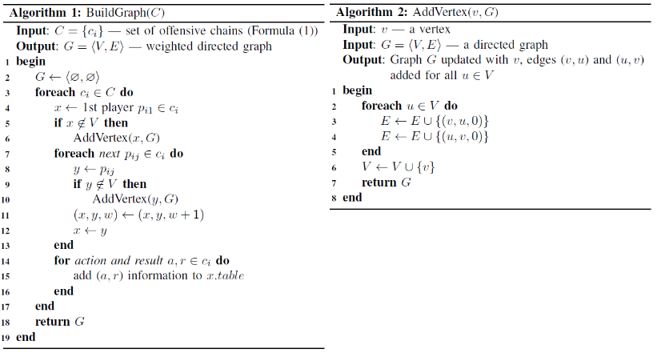
Constructs a Basketball Analysis Graph
“V”: a set of players and their scoring information.
“E” is a set of ball-passing times from one player to another.
“G” is a BA graph with a vertex set “V” and an edge set “E.”

Slide 17
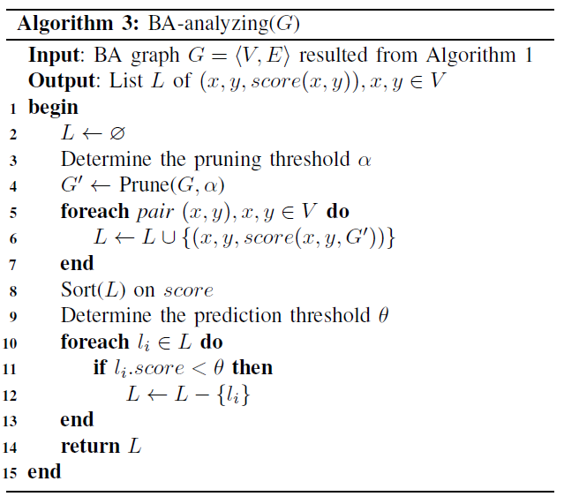
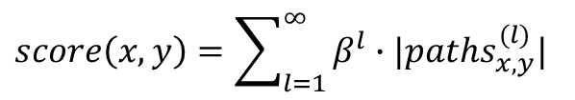
Introduces link prediction (Katz Index)
The higher the score of the Katz index, the more critical pair of players there is.
$score\left(x,y\right)=\sum_{l=1}^{∞}{β^{l}∙|{paths}_{x,y}^{(l)}|}$

Slide 18
Applying to A Real NBA Game

Slide 19
Spatio-temporal learning Mode
Establishes unsupervised modeling for offensive tactics.
Divides basketball training data into clusters.
Helps the defensive team understand the offensive team’s strategies.
The defensive team is able to find out the weaknesses of the offensive team.

Slide 20
Flowchart of Learning Mode

Slide 21
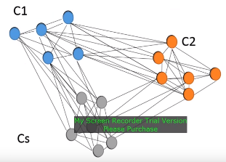
Relationships among Different Clusters

Slide 22
Result of this Learning Model
Collects 134 video clips from NBA games.
Includes ten different types of basketball offensive strategies.
80% for training and 20% for testing.
For testing, this model obtains an average classification rate of 89.1%.

Slide 23
Conclusion
Correlation analysis can reflect the performance on weak sides vs. strong sides.
Link prediction can prove that pairs of players with higher Katz scores have better performance than others.
Spatio-temporal learning mode can precisely identify rival teams’ offensive strategies with 89.1% accuracy.

Slide 24
References
Bartholomew, J. T., & Collier D. A. (2012). The benefits of forcing offensive basketball Players to their weak side. Journal of Multidisciplinary Research, Vol. 4, No. 2, Summer, pp. 19-27.
Chen, C. H., Liu, T. L., Wang, Y. S, Chu, H. K., Tang, N. C., & Liao, H. Y. M. (2015). Spatio-temporal learning of basketball offensive strategies. MM '15 Proceedings of the 23rd ACM international conference on Multimedia, pp. 1123-1126.
Chen, C. H. (2015). Spatio-Temporal Learning of Basketball Offensive Strategies. https://www.youtube.com/watch?v=DGrzEleeL-c.
Zhang, T., Hu, G., & Liao, Q. (2013). Analysis of offensive tactics of basketball games using link prediction. IEEE/ACIS 12th International Conference on Computer and Information Science (ICIS), pp. 207-212.

Slide 25
Question?

Slide 26
Thanks for Your Attention

