Slide 1
Maher Aboul Hosn Chun-Chi Huang Jorge Pena
HOLIS
Nullpointers
SEGR 5230 01 18WQ SW Architecture and Design I

Slide 2
Problem Statement
Slowing no growth in the company’s core professional theater marketplaces
This dilemma has affects on the company, its employees, and its shareholders.
The result of which, is unacceptable business performance and lack of meaningful opportunities for growth in revenue and profitability.

Slide 3
Benefits
The benefits of new products and a potential new marketplace for the company include:
Revitalize the company and its employees
Increase loyalty and retain the company’s distributors
Create higher revenue growth and profitability
Upturn in the company’s stock price

Slide 4
Requirements
High-end residential lighting system
Automated control for patio, garden, garage and home lights
Control for programmable devices
Support of soft key switches
Programming HOLIS from a remote center through internet or Wifi
A simple push-button interface
An emergency contact and support

Slide 5
Initial phase – The Vision of HOLIS
Homeowner
Integrator/Programmer/System Admin
Field Engineer
Emergency Contact Service
Lights, Bell, Alarms, Garage Door, etc.

Slide 6
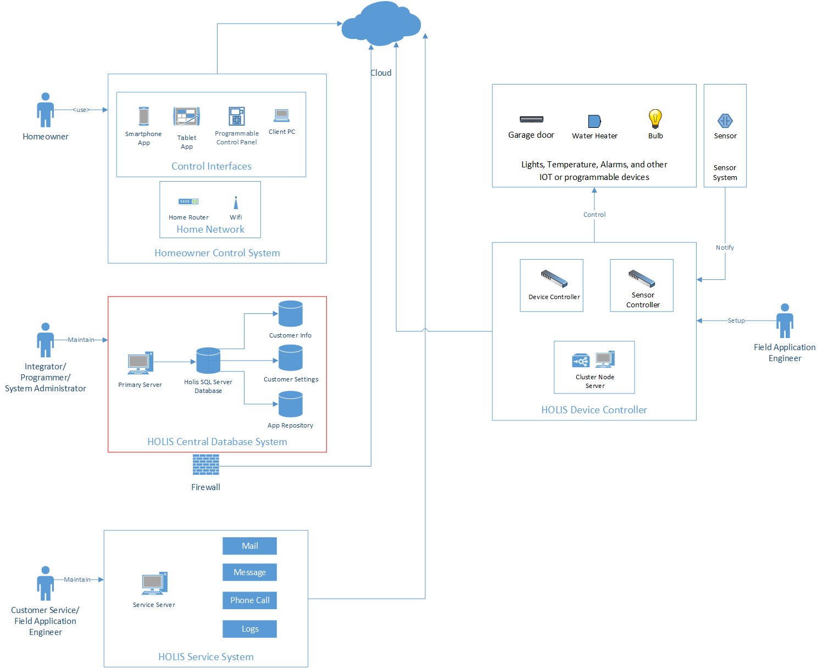
Initial phase – The Vision of HOLIS

Slide 7
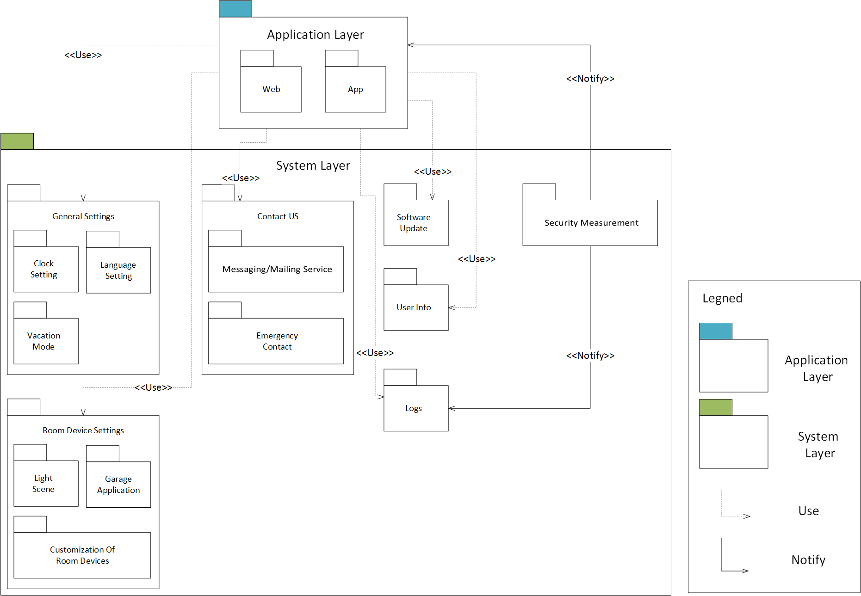
Module View (Decomposition & Uses)

Slide 8
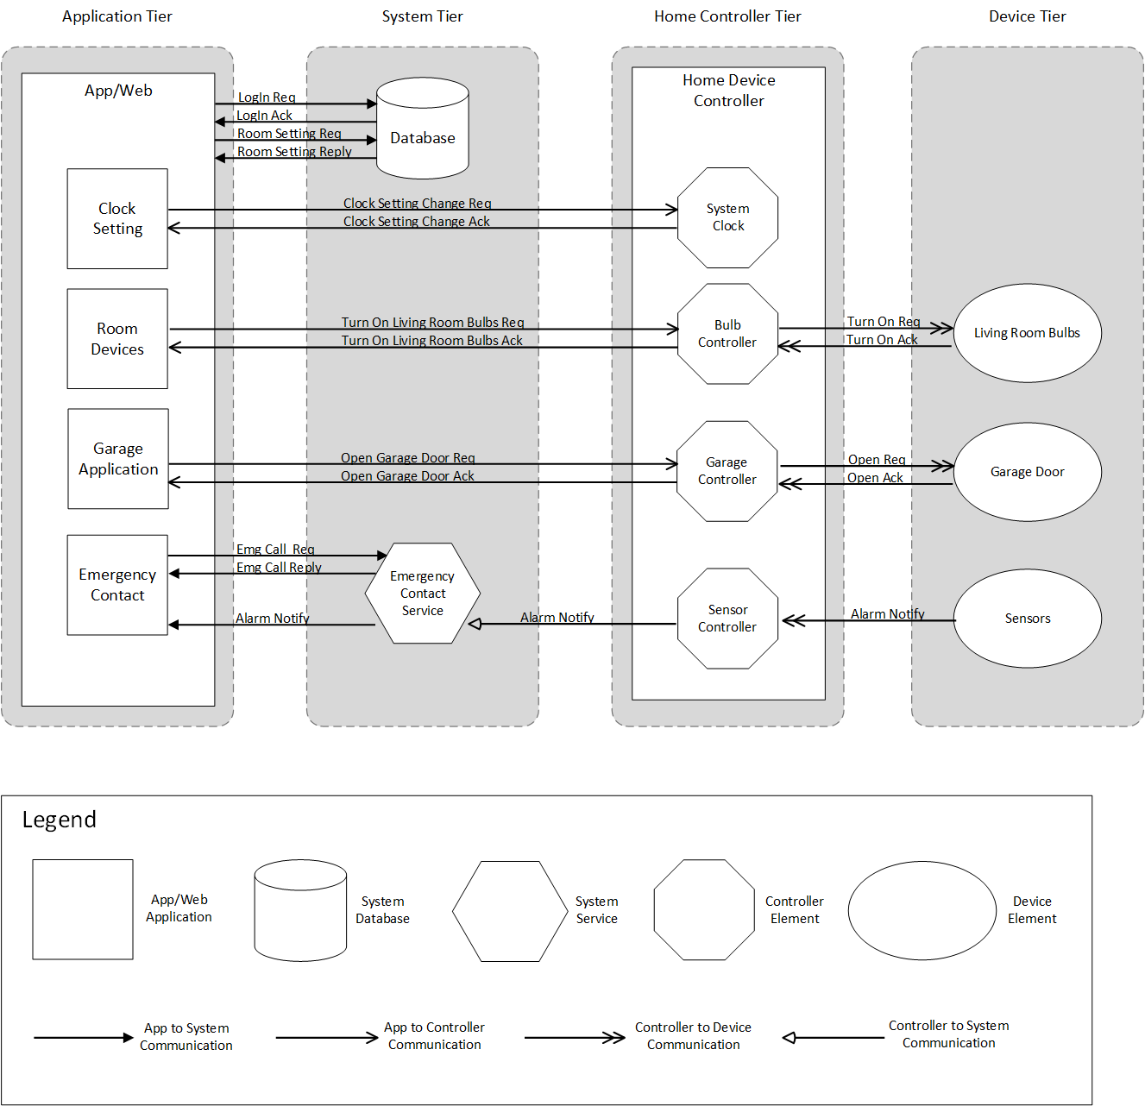
Component & Connector View (Multi-tier)

Slide 9
Component Description
Element | Description
Clock Settings | This is a feature setting in the application that allows the user to set the time. Time can be set automatically or manually. The user also has the option to set an alarm using the clock settings.
Room Devices | This feature allows the user to add, delete or edit an electronic device to a room in the house. The user can turn on or off the device using this feature.
Garage Door | The application allows the end user to program the garage door controls on HOLIS. The user will be able to open and close the garage door using this application.
Emergency Contact | An emergency contact button is an option found in the HOLIS application. It allows the user to contact 911 immediately by clicking the button.
Database | Contains all the data about the subscriber's profile and personalized configuration of the HOLIS application.
Emergency Contact Service | Is the service feature that connects the users to the 911 department. If the Emergency contact button is pushed, this service is triggered and notifies 911.

Slide 10
Component Description
Element | Description
System Clock | The system clock can capture the date and time of the user's location. If a user sets automatic time in the clock settings, the system clock will set the time based on his/her geographic location.
Bulb Controller | The bulb controller detects and controls light bulbs in the house. The controller can dim and undim the lights based on the user's input or specification.
Garage Controller | Detects the garage door, as well as the electronic devices added in the garage.
Sensor Controller | Can detect all the sensors placed around the house. The Sensor controller is triggered if one of the sensors in the house was triggered. The Sensor controller will notify the emergency contact service in case one of the sensors goes off. (This is useful in case of fire, flooding and or burglary)
Living Room Bulb | A living room light bulb is just one of the lights that can be controlled by the system. The system can sense if the lightbulb is on or off and change its state based on the user's input.
Garage Door | Represents the garage door. The system can sense if the garage door is open or closed and change its state based on the user's input.
Sensors | Sensors can detect smoke, water and open door or window. The sensors notify the system in case of an emergency.

Slide 11
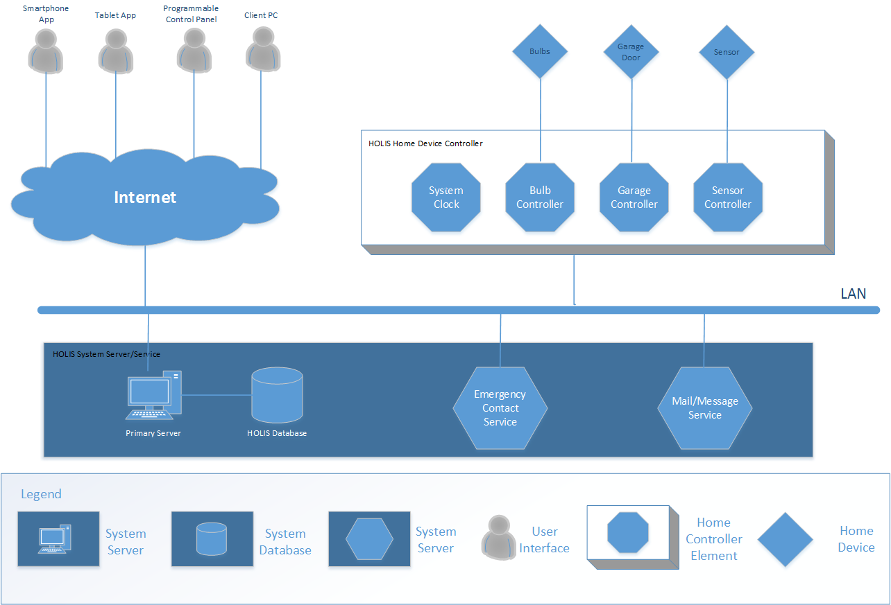
Allocation View (Deployment)

Slide 12
Sensitivity Point
Intruder tries to hack the HOLIS database in attempts to analyze the timestamp for which to determine the specific days and hours of the week the homeowner is not home. The system must comply to secure customer OAuth2 authentication to avoid intruders from accessing control points. Also secure customer home automation product API keys.

Slide 13
Trade-off
Modifiability (+) vs. Performance (-) – separating the architecture into layers adds an overhead for exchanging information between layers which affects the performance.
Scalability (+) vs. Security (-) – The more devices we are able to connect with HOLIS provides ideal scalability. However, it is difficult to provide software updates to every different type of IOT device in the market today. Depending on the number of bugs reported, each device will be upgraded on a needs basis.

