Slide 1
THOUGHT QUANTA
Chun-Chi Huang
Feb. 28th , 2018
SEGR-5230 - THOUGHT QUANTA

Slide 2
DILEMMA
Trade-off Quality Attributes
  Performance Vs Affordability - Chip Selection
  Performance Vs Sensitivity - Strategy for Testing
  Performance Vs Functionality – Business Goals
SEGR-5230 - THOUGHT QUANTA

Slide 3
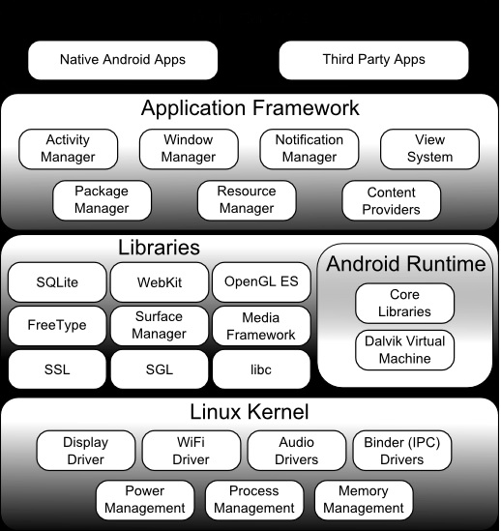
FIREOS ARCHITECTURE (LAYERED)
Application
Display
IC
BT-WiFi
IC
Audio
IC
ROM
Hardware
PMIC
CPU
RAM
SEGR-5230 - THOUGHT QUANTA

Slide 4

MISSION: HANDS-FREE ALEXA FEATURE IN TABLET
Alexa
- An intelligent personal assistant
- Controlled by sound
Hands-Free (Always-on)
Longer Battery Life or Alexa Always-On?
SEGR-5230 - THOUGHT QUANTA

Slide 5
APPROACHES
Minimize the power consumption of Alexa feature
  Choose the audio IC with stand-alone feature
  Only always turn on audio IC to receive the specific voice command
  Receive the specific command to wake up system
  Pass the entire voice command to Amazon Alexa Server
  Response to the end user
  Modify the user scenario
    - Only always-on Alexa while charging
SEGR-5230 - THOUGHT QUANTA

Slide 6
CONCLUSION
Determine what the most important thing is
Modifying the user scenario also can achieve the goal
SEGR-5230 - THOUGHT QUANTA

Slide 7
REFERENCES
http://www.techotopia.com/index.php/An_Overview_of_the_Kindle_Fire_Android_Architecture
https://www.amazon.com/dp/B01J6RPGKG/ref=fs_ods_tab_sz
SEGR-5230 - THOUGHT QUANTA

