Slide 1
Cascading Style Sheets- CSS “Add style to your web pages”
Devendra Shukla Senior web designer Singsys Pte Ltd

Slide 2
Definition of CSS
CSS stands for Cascading Style Sheets
Styles - define how to display HTML elements
Styles are normally stored in Style Sheets
Definition:
Cascading Style Sheets (CSS) – is a style sheet language used for describing the look and formatting of a document written in a markup language. You write CSS rules in elements, and modify properties of those elements such as color, background color, width, border, font etc.
lay
out

Slide 3
CSS
Cascading Style Sheets, or CSS, is a style sheet language used on the Web
CSS specifications are maintained by the World Wide Web Consortium (W3C)
Three versions of CSS exist: CSS1, CSS2, and CSS3

Slide 4
CSS1
The first CSS specification to become an official W3C Recommendation is CSS level 1, published in December 1996. Among its capabilities are support for-
Font properties such as typeface and emphasis
Color of text, backgrounds, and other elements
Text attributes such as spacing between words, letters, and lines of text
Alignment of text, images, tables and other elements
Margin, border, padding, and positioning for most elements
The W3C no longer maintains the CSS 1 Recommendation.

Slide 5
CSS2
CSS level 2 specification was developed by the W3C and published as a recommendation in May 1998. A superset of CSS 1, CSS 2 includes a number of new capabilities like-
Positioning
Visual Formatting
Media Types
Interfaces
z-index
and new font properties such as shadows.

Slide 6
CSS3
Work on CSS level 3 started around the time of publication of the original CSS 2 recommendation. The earliest CSS 3 drafts were published in June 1999
User Interfaces
Accessibility
Columnar layout
Mobile Devices
Scalable Vector Graphics

Slide 7
Advantages
Separation of content from presentation
CSS facilitates publication of content in multiple presentation formats based on nominal parameters. Nominal parameters include explicit user preferences, different web browsers, the type of device being used to view the content (a desktop computer or mobile Internet device), the geographic location of the user and many other variables.
Bandwidth
A stylesheet, internal or external, specifies the style once for a range of HTML elements selected by class, type or relationship to others. This is much more efficient than repeating style information inline for each occurrence of the element. An external stylesheet is usually stored in the browser cache, and can therefore be used on multiple pages without being reloaded, further reducing data transfer over a network.

Slide 8
Advantages
Site-wide consistency
When CSS is used effectively, in terms of inheritance and "cascading," a global style sheet can be used to affect and style elements site-wide. If the situation arises that the styling of the elements should need to be
changed or adjusted, these changes can be made by editing rules in the global style sheet. Before CSS, this sort of maintenance was more difficult, expensive and time-consuming.
CSS Saves a Lot of Work!
CSS defines HOW HTML elements are to be displayed.
Styles are normally saved in external .css files. External style sheets enable you to change the appearance and layout of all the pages in a Web site, just by editing one single file!

Slide 9
Syntax of CSS
The CSS syntax is made up of 5 parts:
Selector
Property/value
Declaration
Declaration block
Curly braces

Slide 10
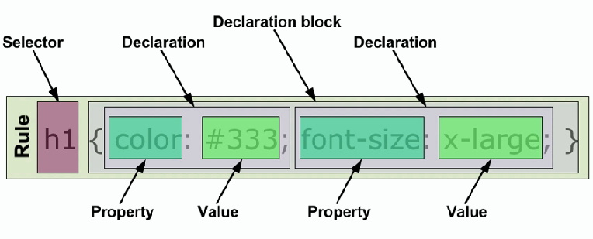
Syntax of CSS

Slide 11
Selector
Selectors are used to declare which part of the markup a style applies to, a kind of match expression.
3 types of selectors
Tag selectors (body, p, div, a)
ID selectors (#wrapper, #sidebar)
Class selectors (.content, .menu)
*The selector is normally the HTML element you want to style
*Selectors should never start with a number, nor should they have spaces in them

Slide 12
ID Selector
The id selector is used to specify a style for a single, unique element.
The id selector uses the id attribute of the HTML element, and is defined with a "#".
The style rule below will be applied to the element with id="wrapper":
#wrapper
{
text-align:center;
border:1px solid red;
Width: 200px;
Height: 100px
}
For example, to identify a paragraph as “head”, use the code:
<div id=“wrapper”>… </div>
*Do NOT start an ID name with a number!

Slide 13
Class Selector
The class selector is used to specify a style for a group of elements. Unlike the id selector, the class selector is most often used on several elements.
This allows you to set a particular style for many HTML elements with the same class.
The class selector uses the HTML class attribute, and is defined with a "."
In the example below, all HTML elements with class="center" will be center-aligned:
.center {text-align:center;}
<h1 class="center">Center-aligned heading</h1>
<p class="center">Center-aligned paragraph.</p>
p.center {text-align:left;}
<p class="left">Center-aligned paragraph.</p>
*Do NOT start an ID name with a number!

Slide 14
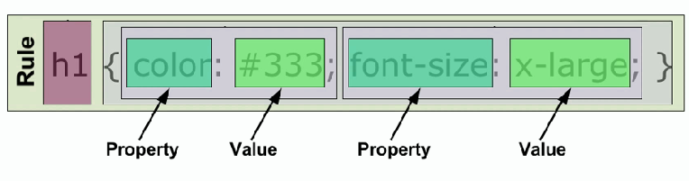
Property & Value
*Properties are separated from their respective values by colons :
*Pairs are separated from each other by semicolons ;
The property is the style attribute you want to change. Each property has a value

Slide 15
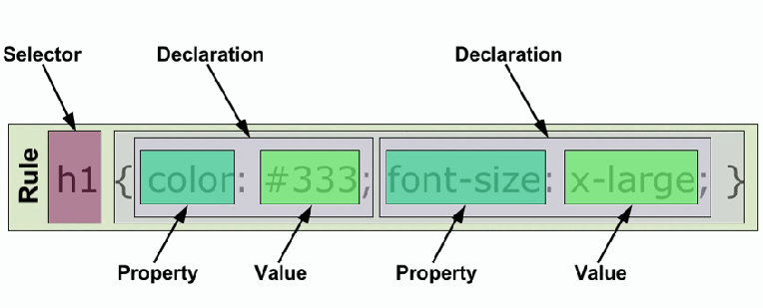
Declaration
*Each declaration consists of a property and a value
Definition: Each CSS line that includes property and value

Slide 16
Declaration Block
A declaration block consists of a list of declarations in braces. Each declaration itself consists of a property and a value. If there are multiple declarations in a block.

Slide 17
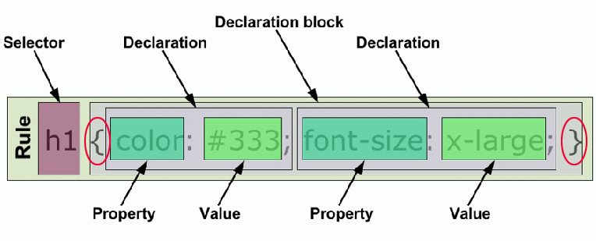
Curly Braces
The curly braces contain the properties of the element you want to manipulate, and the values that you want to change them to. The curly braces plus their content is called a declaration block.

Slide 18
How CSS is Applied to A Web Page
There are three ways of inserting a style sheet:
Inline style
Internal style sheet
External style sheet

Slide 19
Inline style
An inline style loses many of the advantages of style sheets by mixing content with presentation. Use this method sparingly!
To use inline styles you use the style attribute in the relevant tag. The style attribute can contain any CSS property. The example shows how to change the color and the left margin of a paragraph
<p style=“text-align: center; font- weight: bold; color: yellow;”>This is a paragraph.</p>

Slide 20
Internal style sheet
An internal style sheet should be used when a single document has a unique style. You define internal styles in the head section of an HTML page, by using the <style> tag, like this:
<head>
<style type=“text/css”>
hr {color:sienna;}
p {margin-left:20px;}
body {background-image:url("images/back40.gif");}
</style>
</head>

Slide 21
External style sheet
Link to a separate
css file
An external style sheet is ideal when the style is applied to many pages. With an external style sheet, you can change the look of an entire Web site by changing one file. Each page must link to the style sheet using the <link> tag. The <link> tag goes inside the head section:
<head>
<link rel="stylesheet" type="text/css" href="style.css">
<link rel="stylesheet" type="text/css" href="mystyle.css">
</head>

Slide 22
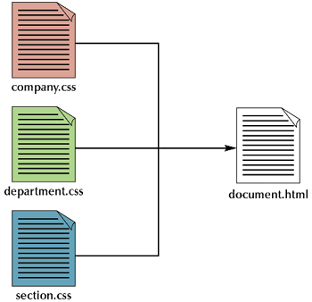
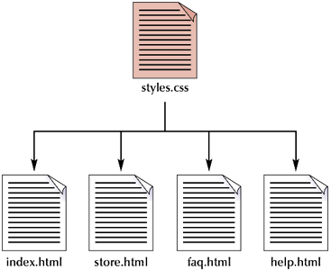
Multiple Style Sheets
You can link a single style sheet to multiple documents in your Web site by using the link element or the @import element
You can also link a single document to several style sheets
@import "container.css";
@import "header.css";
@import "content.css";
@import "footer.css";

Slide 23
Multiple Style Sheets
If some properties have been set for the same selector in different style sheets, the values will be inherited from the more specific style sheet.
For example, an external style sheet has these properties for the h3 selector:
h3{
color:red;
text-align:left;
font-size:8pt;
}

Slide 24
Multiple Style Sheets
And an internal style sheet has these properties for the h3 selector:
h3
{
text-align:right;
font-size:20pt;
}

Slide 25
Multiple Style Sheets
If the page with the internal style sheet also links to the external style sheet the properties for h3 will be:
color:red;
text-align:right;
font-size:20pt;

Slide 26
Cascading order
What style will be used when there is more than one style specified for an HTML element?
Generally speaking we can say that all the styles will "cascade" into a new “virtual" style sheet by the following rules, where number four has the highest priority:
Browser default
External style sheet
Internal style sheet (in the head section)
Inline style (inside an HTML element)
So, an inline style (inside an HTML element) has the highest priority, which means that it will override a style defined inside the <head> tag, or in an external style sheet, or in a browser (a default value).

Slide 27
CSS Box Model
All HTML elements can be considered as boxes. In CSS, the term "box model" is used when talking about design and layout.
The CSS box model is essentially a box that wraps around HTML elements, and it consists of: margins, borders, padding, and the actual content.
The box model allows us to place a border around elements and space elements in relation to other elements.

Slide 28
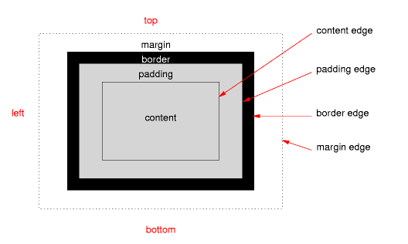
CSS Box Model

Slide 29
Margin, Padding, Border and Content
Explanation of the different parts:
Margin - Clears an area around the border. The margin does not have a background color, it is completely transparent
Border - A border that goes around the padding and content. The border is inherited from the color property of the box
Padding - Clears an area around the content. The padding is affected by the background color of the box
Content - The content of the box, where text and images appear

Slide 30
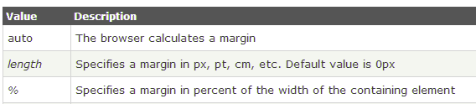
Margin
The CSS margin properties define the space around elements.
The top, right, bottom, and left margin can be changed independently using separate properties. A shorthand margin property can also be used, to change all margins at once.
Possible Values

Slide 31
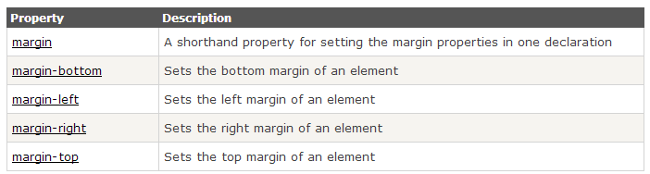
Margin - Individual sides
In CSS, it is possible to specify different margins for different sides:
margin-top:100px;
margin-bottom:100px;
margin-right:50px;
margin-left:50px;
All CSS Margin Properties

Slide 32
Margin - Shorthand property
To shorten the code, it is possible to specify all the margin properties in one property. This is called a shorthand property.
The shorthand property for all the margin properties is "margin":
margin:25px
All Four Side
margin:25px 75px;
Top & bottom - left & right
margin:25px 50px 75px;
Top – right & left - bottom
margin:25px 50px 75px 100px;
Top right bottom & left

Slide 33

Padding
The padding clears an area around the content (inside the border) of an element. The padding is affected by the background color of the element.
The top, right, bottom, and left padding can be changed independently using separate properties.
Possible Values

Slide 34
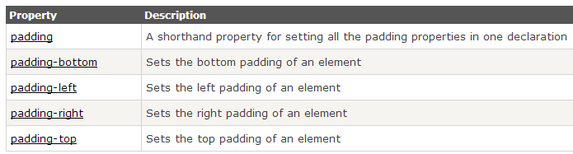
Padding - Individual sides
In CSS, it is possible to specify different margins for different sides:
padding-top:100px;
padding-bottom:100px;
padding-right:50px;
padding-left:50px;
All CSS Padding Properties

Slide 35
Padding - Shorthand property
To shorten the code, it is possible to specify all the padding properties in one property. This is called a shorthand property.
The shorthand property for all the padding properties is "padding":
padding:25px
All Four Side
padding:25px 75px;
Top & bottom - left & right
padding:25px 50px 75px;
Top – right & left - bottom
padding:25px 50px 75px 100px;
Top right bottom & left

Slide 36
Border
The CSS border properties allow you to specify the style and color of an element's border.
Borders fall between the padding and margin and provide an outline around an element. Every border needs three values, a width, style, and color. Shorthand values fall in the order of width, style and color. Longhand, these three values can be broken up into the border-width, border-style, and border-color properties.
Most commonly you will see one sized, solid, single colored borders. Borders do however have the capability to come in numerous sizes, shapes, and colors.

Slide 37
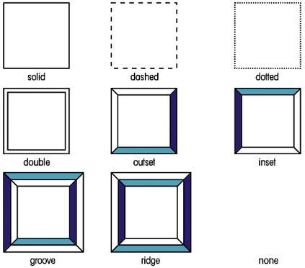
Border Style
The border-style property specifies what kind of border to display.

Slide 38
Border Width
The border-width property is used to set the width of the border.
The width is set in pixels, or by using one of the three pre-defined values: thin, medium, or thick.
The "border-width" property does not work if it is used alone. Use the "border-style" property to set the borders first.

Slide 39



Border Width
.one-box
{
border-style:solid;
border-width:5px;
}
.two-box
{
border-style:solid;
border-width:medium;
}
.three-box
{
border-style:solid;
border-width:1px;
}

Slide 40
Border Color
The border-color property is used to set the color of the border. The color can be set by:
name - specify a color name, like "red"
RGB - specify a RGB value, like "rgb(255,0,0)"
Hex - specify a hex value, like "#ff0000"
You can also set the border color to "transparent".
p.one
{
border-style:solid;
border-color:red;
}
p.two
{
border-style:solid;
border-color:#98bf21;
}

Slide 41
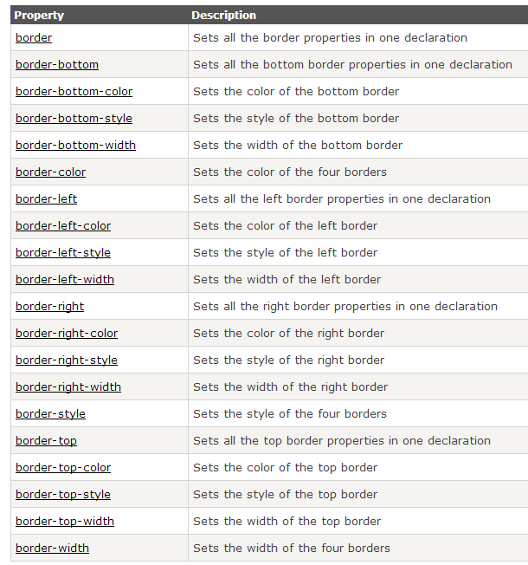
All CSS Border Properties

Slide 42
CSS Box Model
This is commonly called the Box Model. In order to set the width and height of an element correctly in all browsers, you need to know how the box model works.
Here is a way to visualize it...

Slide 43
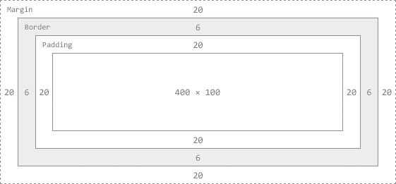
Width and Height of an Element
When you set the width and height properties of an element with CSS, you just set the width and height of the content area. To calculate the full size of an element, you must also add the padding, borders and margins.
The total width of the element in the example below is

Slide 44
Width and Height of an Element
div {
background: #fff;
border: 6px solid #ccc;
height: 100px;
margin: 20px;
padding: 20px;
width: 400px;
}
To break down the total width of an element, including the box model, use the formula:
margin-right + border-right + padding-right + width + padding-left + border-left + margin-left
In comparison, the total height of an element, including the box model, can be found using the formula:
margin-top + border-top + padding-top + height + padding-bottom + border-bottom + margin-bottom

Slide 45
Width and Height of an Element
div {
background: #fff;
border: 6px solid #ccc;
height: 100px;
margin: 20px;
padding: 20px;
width: 400px;
}
Using the formulas and box context above we can find the total height and width of our example.
Width: 492px = 20px + 6px + 20px + 400px + 20px + 6px + 20px
Height: 192px = 20px + 6px + 20px + 100px + 20px + 6px + 20px

Slide 46
Thank You!
Devendra Shukla Senior web designer Singsys Pte Ltd

Slide 47




