Slide 1

ONLINE BIKE RENTAL SYSTEM
Md Noorullah Khan

Slide 2
INTRODUCTION
Simple and easy bike rental
Easy browsing, Booking and renting of bikes.
Authentication & Authorization

Slide 3
Problem statement
Bike rental services available in many countries.
Absence of a comprehensive system in Nepal.
Motorcycles are expensive products.
Rental services make riding accessible to a wider audience.

Slide 4
OBJECTIVE
To develop a web-based system to reserve bike online.
To provide customers platform for easy browsing, booking, and renting of bike.

Slide 5
Scope and limitation
SCOPE
User-friendly environment.
Users can easily view book details in their dashboard.
Unauthorized users cannot access the system.
Users of any experience can easily browse through the website.
User can easily view the availability status
LIMITATION
No online payment available, only cash on site is preferred.
Since it is online based, internet is required. The location of vehicles or customers who booked the vehicles cannot be tracked.

Slide 6
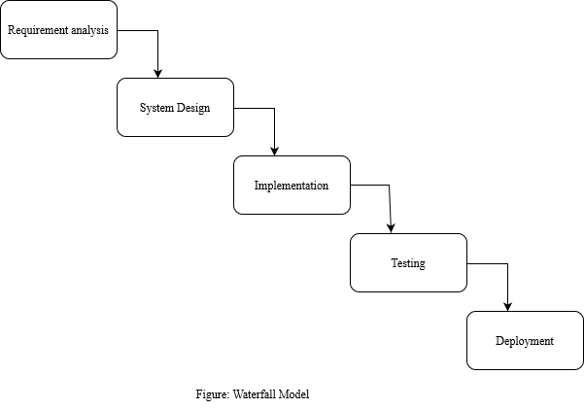
System analysis and design
Waterfall Model:

Slide 7
Requirement analysis
NON-FUNCTIONAL REQUIREMENT:
Usability
Security
Reliability
FUNCTIONAL REQUIREMENT:
Customer Login/Registration Module
Customer Dashboard
Admin Dashboard
Bike Selection
Availability Status
Rental Management

Slide 8
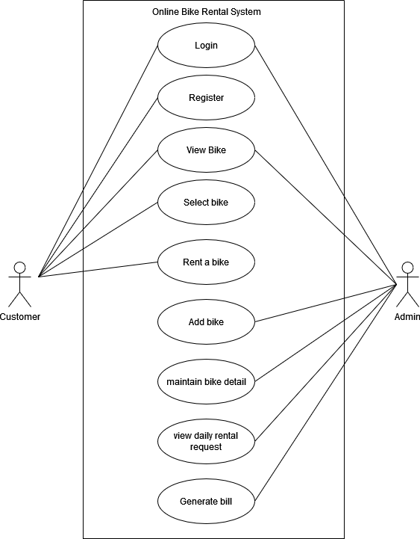
USE CASE DIAGRAM

Slide 9
FEASIBILITY STUDY
Technical Feasibility
Operational Feasibility
Economic Feasibility
Schedule

Slide 10
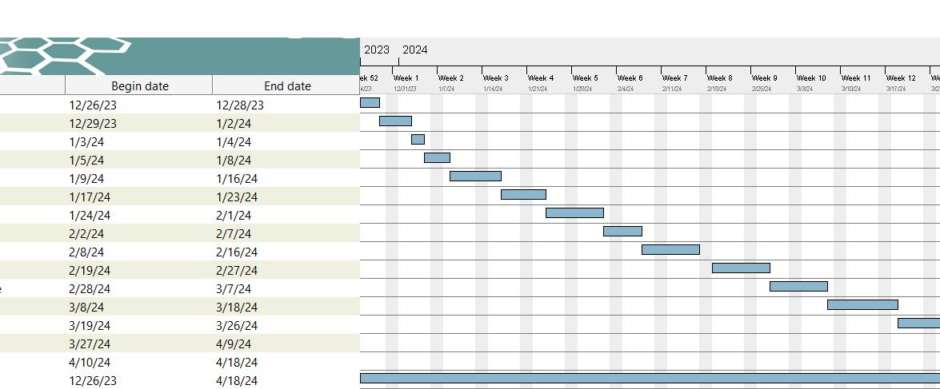
Gant chart

Slide 11
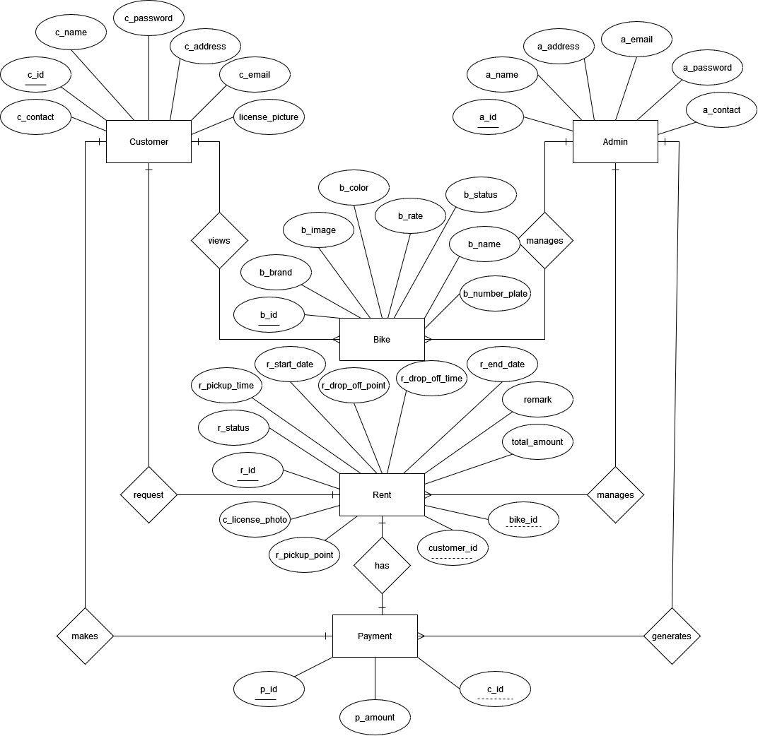

Slide 12
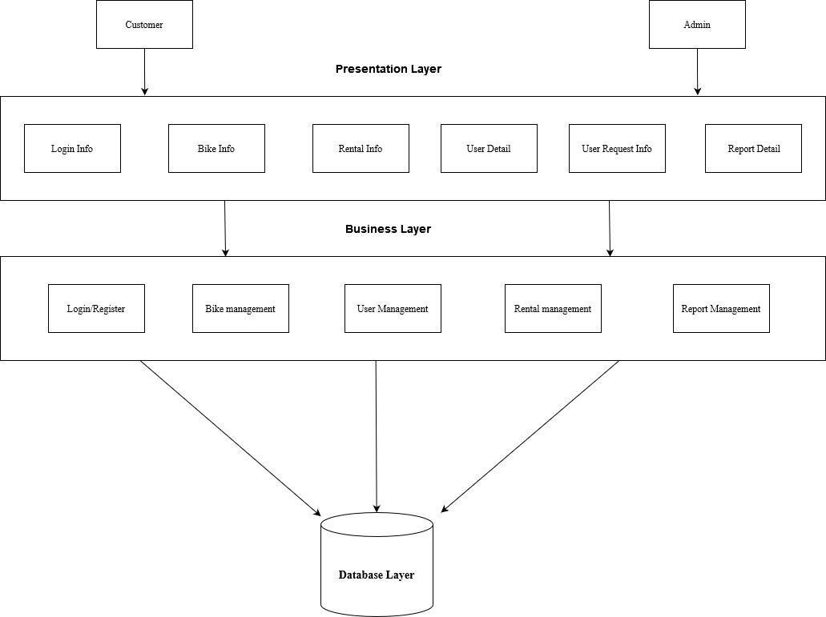
3-Tier Architecture

Slide 13
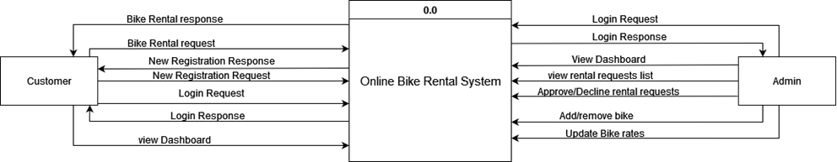
DFD LEVEL 0

Slide 14
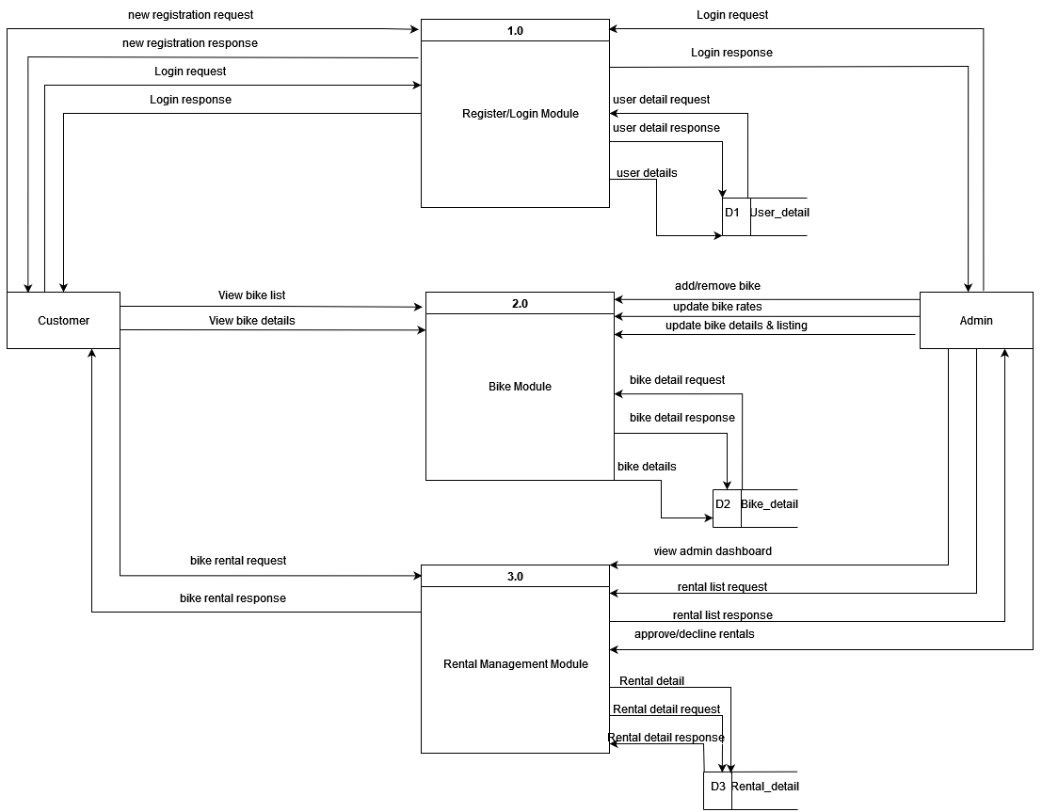
LEVEL 1 DFD

Slide 15
implementation
TOOLS USED:
Draw.io
Gantt Project
PHP
MySQL
Java script
Xampp
VS code
Figma

Slide 16
Lesson Learnt
Learned about HTML, CSS, PHP, JavaScript and MySQL.
Learned about how to connect all the modules.
Learned about research and literature review of system.
Learned to solve problems while testing.
Learned to implement a CRUD operation in a system.

Slide 17
CONCLUSION
Development of a web-based Online Bike Rental System.
Successful implementation of all essential modules.
Customers can perform bike rental transactions conveniently through the web application.
Fulfillment of project objectives.
Overall aim of the system is to offer reliable bike booking and rental services to customers anytime, anywhere.

Slide 18
FUTURE RECOMMENDATION
Accessing the online payment method.
GPS Bike Tracking.
Implementation of graph report of rental history for admin dashboard.

Slide 19
REFERENCES
[1] | "selfdrivenepal," [Online]. Available: https://selfdrivenepal.com/. [Accessed 26 12 2023].
[2] | "Maharjan Bikes Rental," [Online]. Available: https://maharjanbikesrental.com/. [Accessed 27 12 2023].
[3] | R. Mall, Fundamentals of Software Engineering, Delhi, 2014.
[4] | J. R. G. a. P. N. Weinberg, The complete Reference SQL, 2007.
[5] | D. Flanagan, JavaScript: The Definitive Guide, O' Reilly Media, 2011.

Slide 20
THANK YOU

