Slide 1
Lab Instructions for TA
Before starting the lab, run the script file Lab6DB.sql.
Use slides 2-8 to explain PL/SQL basics and 14 and 18 to briefly explain cursors. (I have already briefly explained all this in the lectures.)
Slides 10-13, 15-17, 19-28 are hidden in PowerPoint Presentation mode.
In SQL Developer, demonstrate how to do the following:
in the Connections tab, create the procedure CourseEnrollmentReport under the Procedures node.
replace all the code in the procedure CourseEnrollmentReport with the code in the CourseEnrollmentReport.txt file in the Lab6ExerciseSolutions folder.
compile the procedure for debug (see slide 30 if using the HKUST VPN).
set a breakpoint.
run the procedure in debug mode.
inspect the values of variables.
Answer any questions students might have about the lab notes.
Explain what the students need to do in the lab exercise and help any students who are having problems doing the exercise.

Slide 2
Database Management Systems
Lab 6
Oracle PL/SQL and Stored Procedures

Slide 3
Lab Topics
Oracle PL/SQL basics.
Using cursors in Oracle PL/SQL procedures/functions.
Creating Oracle PL/SQL stored procedures/functions.
PL/SQL = Procedural Language/SQL, 即过程化SQL语言
2

Slide 4
Oracle PL/SQL (1)
http://docs.oracle.com/cd/A97630_01/appdev.920/a96624/02_funds.htm
Oracle PL/SQL (Procedural Language/SQL) allows SQL statements to be embedded into a procedural programming language.
Oracle PL/SQL extends the capabilities of SQL by adding functionality that is supported by procedural programming languages.
An Oracle PL/SQL can be
a procedure, which does not return a value.
a function, which returns a value using the return keyword.

Slide 5
Oracle PL/SQL (2)
Oracle PL/SQL statements:
are case insensitive.
use C style comments /*…*/.
use := operator to assign values to a variable.
use = operator for comparison.
A block is the basic processing unit in Oracle PL/SQL and is delimited by begin…end.
ALLOWED SQL statements: select, insert, update and delete (i.e., DML statements)
NOT ALLOWED SQL statements: create, drop, alter, rename (i.e., DDL statements).

Slide 6
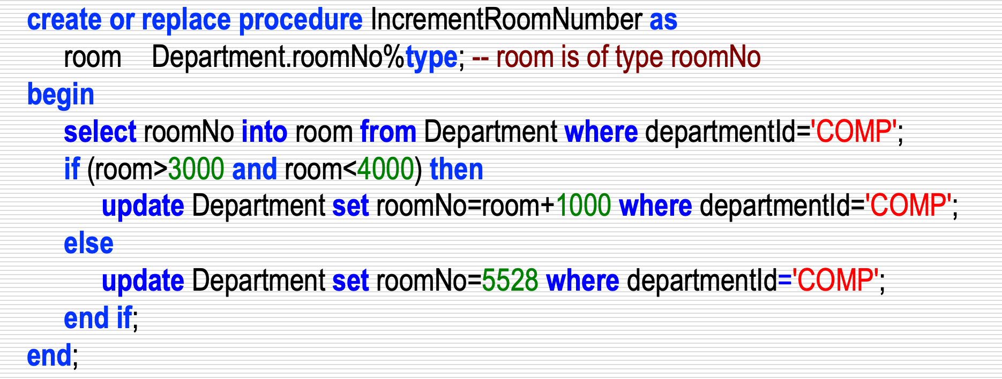
Oracle PL/SQL Basic Structure
create or replace procedure procedure_name [ as | is ]
Declarative section: declaration of variables, types, and local subprograms go here.
begin Executable section: procedural and SQL statements go here. This is the only required section of the block.
exception Exception handling section: error handling statements go here.
end;
Example:

Slide 7
Declaring Variables
http://docs.oracle.com/cd/A97630_01/appdev.920/a96624/02_funds.htm#27307
A variable’s data type can be either
an SQL basic type (i.e., number, int, char, varchar2, date, etc.) or
the same type as a table attribute (table_name.attribute_name%type) or a table row (table_name%rowtype).
Examples
Declare count to be a variable of basic type number.
count number;
Declare projectors to be a variable with the same type as the numberProjectors attribute in the Facility table.
projectors Facility.numberProjectors%type;
Declare facilityRecord to be a variable that is the same type as a row (tuple).
facilityRecord Facility%rowtype;

Slide 8
Select-Into Statement
The select-into statement must retrieve at most one record from only one table (i.e., cannot do a join with the select-into statement).
Example: Extract data of the Math department from the Department table into a table called MathDept.
create or replace procedure ExtractMathRecords as
-- deptName is the same type as departmentName in the Department table
deptName Department.departmentName%type;
-- deptRoom is the same type as roomNo in the Department table
deptRoom Department.roomNo%type;
begin
select departmentName, roomNo into deptName, deptRoom from Department where departmentId='MATH';
insert into MathDept values (deptName, deptRoom);
end;
The value of the attributes departmentName and roomNo in the Department table are assigned to, respectively, the PL/SQL variables deptName and deptRoom by the select statement.
Must fetch at most one record

Slide 9
Flow of Control Statements
http://docs.oracle.com/cd/A97630_01/appdev.920/a96624/04_struc.htm
Sequential control
goto
Branch to a label unconditionally.
null
Pass control to the next statement.
return
Return control to the calling block and possibly return a value (for a function).
Conditional control
if-then, if-then-else, if-then-elsif
Conditional processing.
case
Selects one sequence of statements to execute.
Iterative control
loop statements end loop;
while condition loop statements end loop;
Executes the loop while condition is true.
for index in [reverse] lower_bound..upper_bound loop statements end loop;
Iterates over a range of integers starting either from lower_bound to upper_bound or in reverse order.
exit / exit when condition
Exits current loop completely either unconditionally or when condition is true.
continue / continue when condition
Exits current loop iteration and continues with the next iteration either unconditionally or when condition is true.

Slide 10
If-Then-Else Example (1)
create or replace procedure IncrementRoomNumber as
room Department.roomNo%type; -- room is of type roomNo
begin
select roomNo into room from Department where departmentId='COMP';
if (room>3000 and room<4000) then
update Department set roomNo=room+1000 where departmentId='COMP';
else
update Department set roomNo=5528 where departmentId='COMP';
end if;
end;
This procedure adds 1000 to the room number of the COMP department if the room starts with 3. The room number is set to 5528 if the room number does not start with 3.

Slide 11
If-Then-Else Example (2)
create or replace procedure IncrementRoomNumber as
room Department.roomNo%type; -- room is of type roomNo
begin
-- Incorrect use of select statement
room := select roomNo from Department where departmentId='COMP';
if (room>3000 and room<4000) then
update Department set roomNo=room+1000 where departmentId='COMP';
else
update Department set roomNo=5528 where departmentId='COMP';
end if;
end;
⇒
Cannot assign the result of a select statement to a variable as in the highlighted line since the result of a select statement is always a table even if the table contains only one value.

Slide 12
Loop Example
Insert values 1 to 10 into table Testloop.
create or replace procedure LoopTest as
i Testloop.testValue%type := 1; -- i is of type testValue and is initialized to 1
begin
loop
insert into Testloop values (i);
i := i + 1;
exit when i > 10;
end loop;
end;
Note: A loop can be terminated by the exit or exit when keywords.
11

Slide 13
Loop Label Example
A loop label appears at the beginning of a loop statement enclosed by double angle brackets.
create or replace procedure LoopTest as
i Testloop.testValue%type := 1; -- i is of type testValue and is initialized to 1
begin
«myLoop»
loop
insert into Testloop values (i);
i := i + 1;
exit myLoop when i > 10;
end loop;
end;
Note: Several levels of nested loops can be terminated using a loop label.
12

Slide 14
For-Loop Example
Increase the number of projectors in a department based on a loop counter i.
create or replace procedure IncrementProjectors as
i number(2) := 1;
begin
for var in (select * from Facility order by departmentId) loop
update Facility set numberComputers = numberComputers + 1
where departmentId=var.departmentId;
i := i + 1;
end loop;
end;
Note: In this example the for-loop acts like a for-each-loop where var is assigned the next record in the result of the select statement in each iteration of the for-loop.
13

Slide 15
Cursors(光标)
http://www.techonthenet.com/oracle/cursors/
If a select statement returns more than one record, a cursor is needed to process the result records one-at-a-time.
A cursor is like a pointer that points to a single record in the result of a select statement.
When used with the for-loop statement, the cursor iterates over the result records one-at-a-time allowing the values in a record to be accessed and manipulated.
A cursor is declared in the declare section using the syntax:
cursor cursor_name is select_statement;
Example: Declare a cursor that retrieves all the Facility table records.
cursor facilityCursor is select * from Facility;
14

Slide 16
How to Use Cursors
Explicit cursor
Is activated by the open command.
Fetches records one-at-a-time using the fetch command.
The status %notfound returns true when all the records are fetched.
Needs to be closed with the close command so as to free up resources.
Implicit cursor
Is activated using the for-loop statement.
The cursor_name replaces the range limit so the loop ranges from the first record of the cursor to the last record of the cursor.
15

Slide 17
Cursor Status
The possible values of a cursor status are:
Determine whether the previous fetch failed.
cursor_name%notfound
Determine whether the previous fetch succeeded.
cursor_name%found
Determine the number of records fetched so far.
cursor_name%rowcount
Determine whether the cursor is still open.
cursor_name%isopen
Cursor status can only be used with an explicit cursor.
16

Slide 18
Explicit Cursor Example
create or replace procedure InsertExample as
varDeptId Facility.departmentId%type;
varComputers Facility.numberComputers%type;
cursor facilityCursor is select departmentId, numberComputers from Facility;
begin
open facilityCursor;
loop
fetch facilityCursor into varDeptId, varComputers;
exit when facilityCursor%notfound;
insert into ResultTable values (varDeptId, varComputers);
end loop;
close facilityCursor;
end;
The facilityCursor retrieves records from the Facility table and inserts the values one-by-one into another table called ResultTable.

Slide 19
Implicit (For-Loop) Cursor Example (1)
create or replace procedure InsertExample as
varDeptId Facility.departmentId%type;
varComputers Facility.numberComputers%type;
cursor facilityCursor is select departmentId, numberComputers from Facility;
begin
for record in facilityCursor loop
varDeptId := record.departmentId;
varComputers := record.numberComputers;
insert into ResultTable values (varDeptId, varComputers);
end loop;
end;
facilityCursor defines what data should be retrieved when the select statement is executed.
Each time through the for-loop, the variable record is assigned the next record from the cursor faciltyCursor which contains the result of the select statement.
This is the same example as on the previous slide, but using a for-loop, which automatically opens the cursor, exits the loop when there are no more records in the cursor and closes the cursor.

Slide 20
Implicit (For-Loop) Cursor Example (2)
The FacilityCursor on the previous slide is automatically opened by the for-loop.
The variable record is of data type rowtype, but there is no need to declare it.
Code inside the for-loop is executed once for each row of the cursor, and each time the two attributes departmentId, and departmentName are copied into record.
The data in record can be accessed directly (as shown in the code).
The for-loop terminates automatically once all the records in the cursor are fetched.
The cursor is then closed automatically.
19

Slide 21
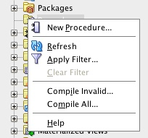
Creating A Procedure/Function (1)
In the Connections navigator pane,
right-click the Procedures or Functions node;
select New Procedure… or New Function… in the context menu as shown to the right.
In the Create Procedure dialog, shown on the next slide,
enter a name for the procedure (e.g., CourseEnrollmentReport);
specify any parameters by clicking the + symbol to add a parameter and specifying a name, mode, datatype and possibly a default value for the parameter;
click the OK button.

Slide 22
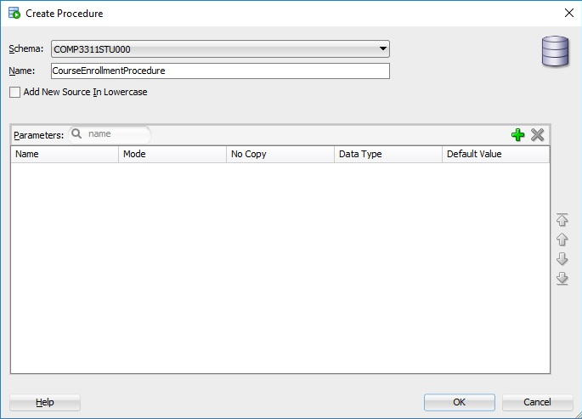
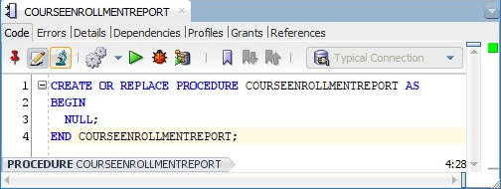
Creating A Procedure/Function (2)
An outline of the procedure with a NULL executable section is created as shown in the figure at the bottom right.
Add any declarations before the BEGIN statement and executable code between the BEGIN and END statements as shown on the next slide.

Slide 23
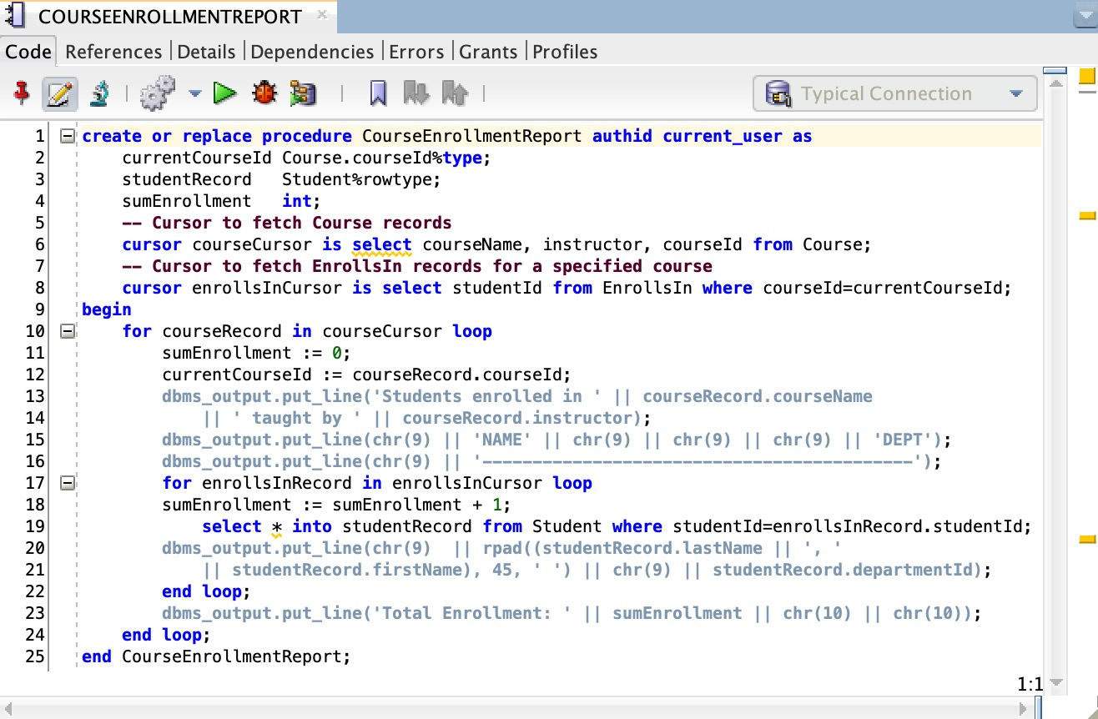
Creating A Procedure/Function (3)
IMPORTANT
The name of the procedure must match exactly the name on the final END statement.

Slide 24
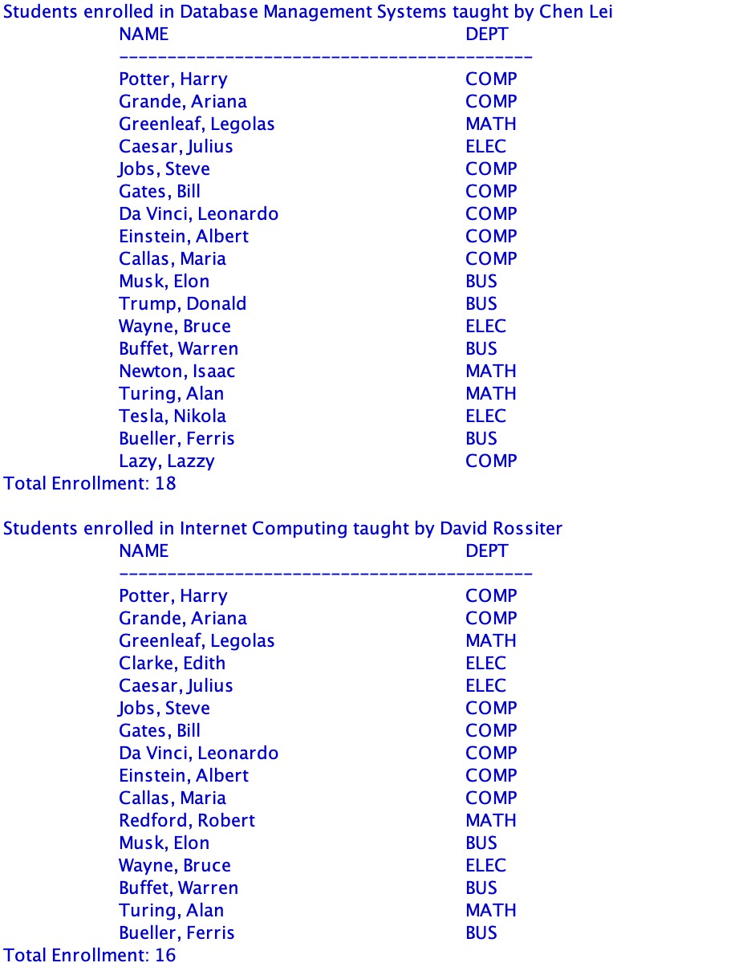
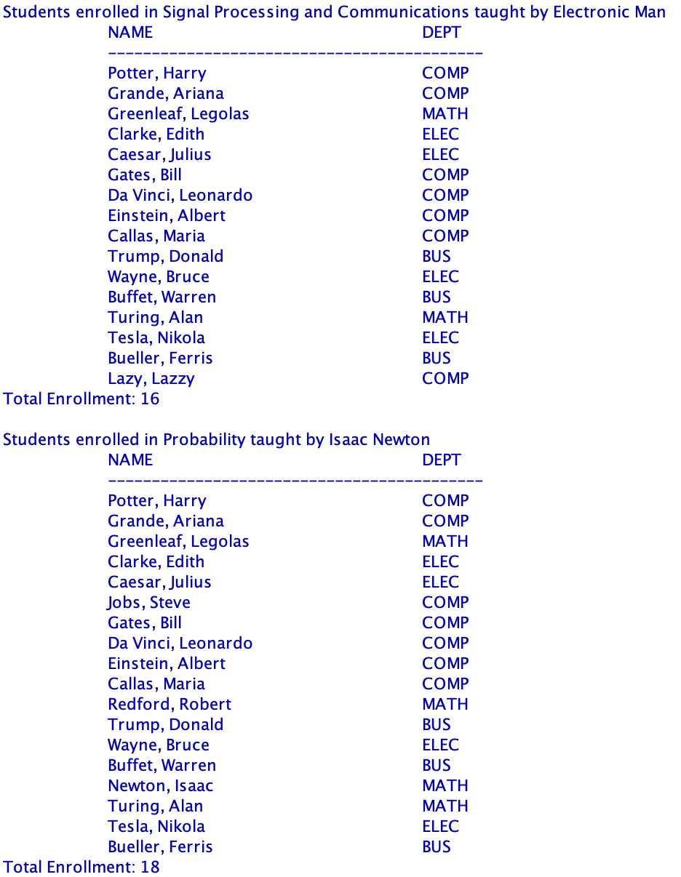
Creating A Procedure/Function (4)
Sample output of the CourseEnrollmentReport procedure.

Slide 25

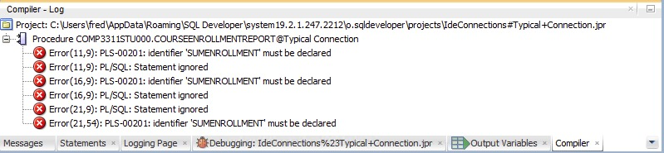
Code Editor Toolbar
The PL/SQL Code Editor toolbar contains the following buttons (among others).
Compile compiles the procedure/function possibly for debugging. A procedure/function is also automatically compiled whenever it is saved. Any compile errors are displayed in the log of the Compiler tab shown below.
Run invokes the Run PL/SQL dialog allowing selection of the procedure/function to run and displaying a list of parameters for the selected procedure/function.
Debug runs the procedure/function in debug mode.

Slide 26
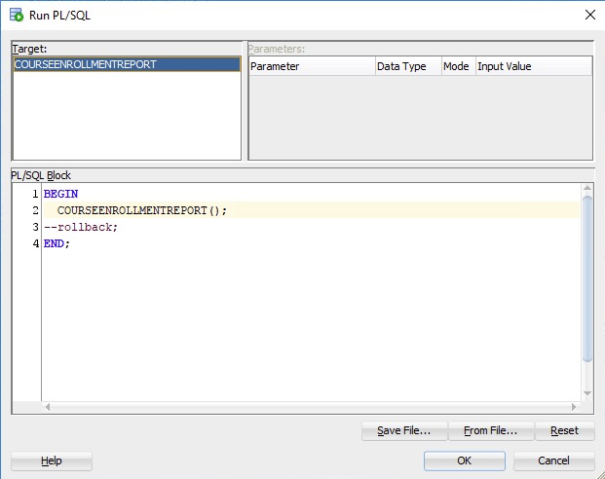
Running A Procedure/Function
To run a procedure/ function, click the (Run) button or the (Debug) button. Note that a procedure/function must be compiled as Compile for Debug to be run in debug mode.
The Run PL/SQL dialog appears as shown on the right where the values of any required parameters can be provided.
Click the OK button to run the procedure.

Slide 27
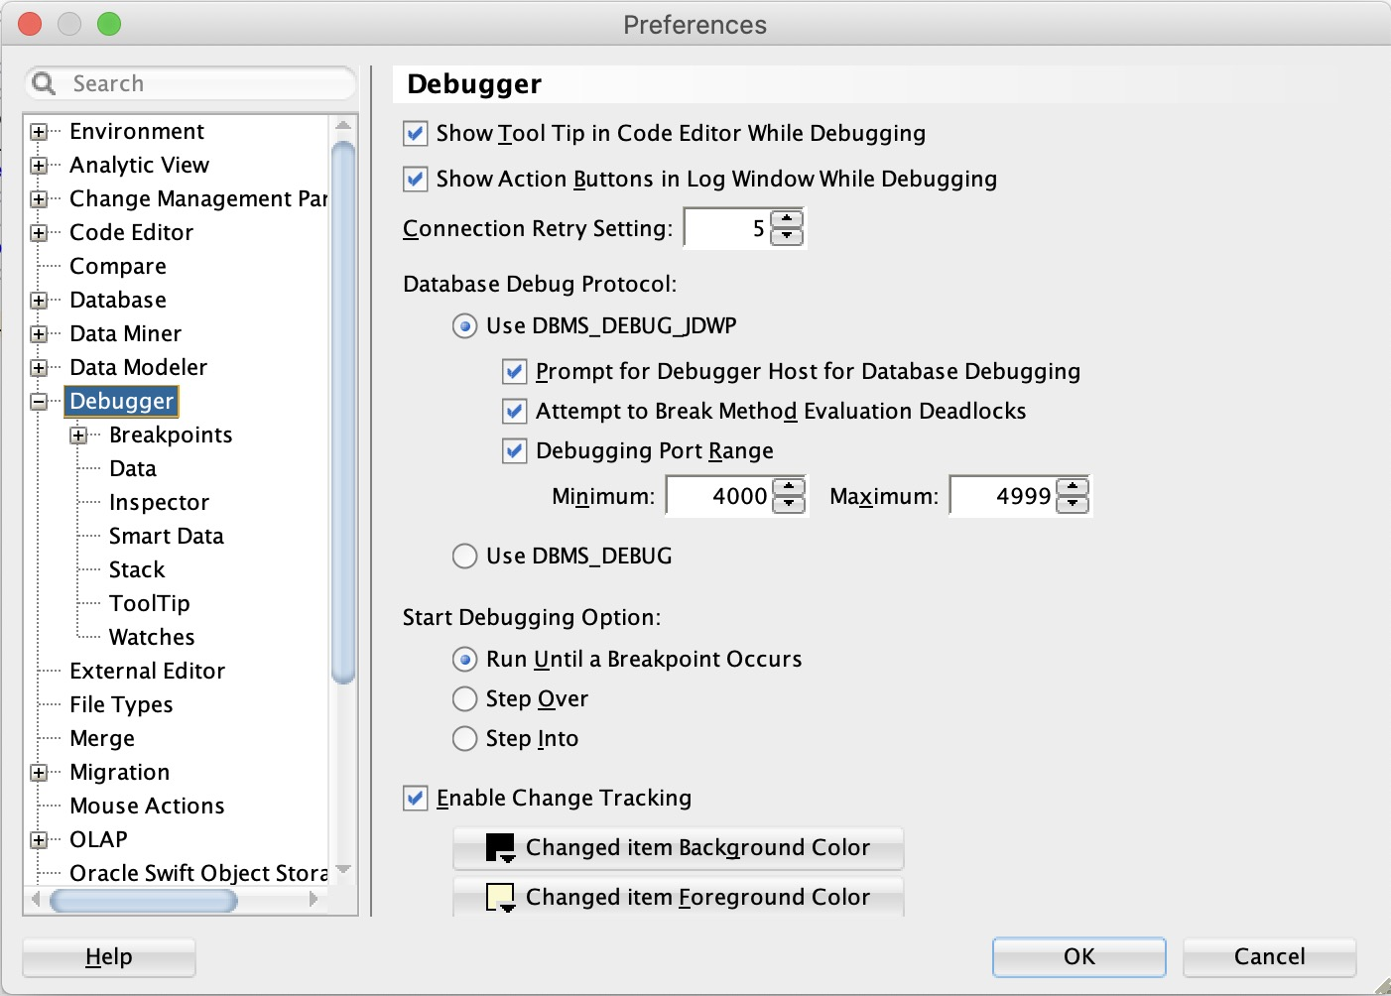
Enabling Debugging
To enable debugging:
open the Preferences dialog.
select the Debugger tab.
select the checkbox Debugging Port Range.
click OK.
Check this if you are accessing Oracle Database through the HKUST VPN.
IMPORTANT
It is also necessary to configure your computer’s firewall to allow incoming connections from SQL Developer.

Slide 28
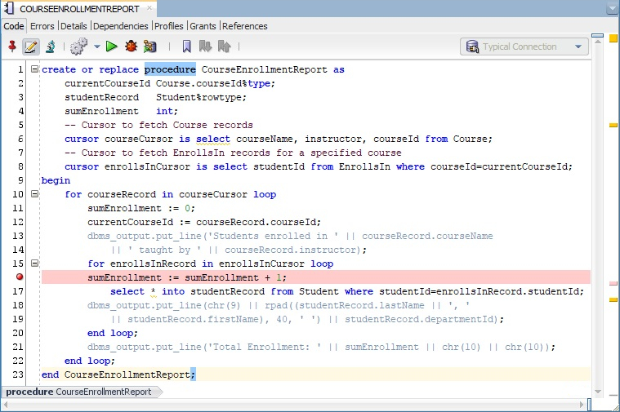
Debugging With Breakpoints (1)
To set a breakpoint for debugging, in the line gutter, select the line number of the statement where you want to pause execution as shown in the figure.
Click the (Debug) button to run the procedure/ function in debug mode.

Slide 29
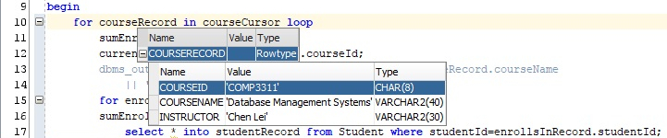
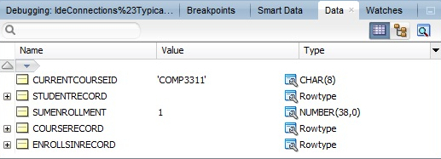
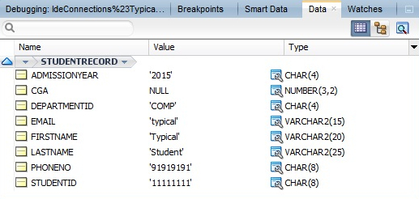
Debugging With Breakpoints (2)
When execution pauses at a breakpoint, the values of variables, including cursors, can be inspected either by hovering the mouse pointer over the variable (figure (a)) or by inspecting the Data tab (figure (b)) or Smart Data tab¹.
(a) inspecting variable values by hovering the mouse cursor over the variable.
(b) inspecting variable values in the Data tab.
1. The Smart Data tab shows only the values of the variables, while the Data tab shows all the data manipulated in the procedure.

Slide 30
Debugging With Breakpoints (3)
In the Debugging toolbar, the following buttons are available.
Terminate stops the debugging session.
Find Execution Point moves the cursor to where the execution has stopped.
Step Over moves to the next line in the code.
Step Into steps into the line of code selected, causing the debugger to continue inside the method or function of the current line of code.
Step Out steps out of the current method or function and returns to the level above.
Step To End Of Method goes to the end of the method.
Resume continues execution until another error or breakpoint is reached.
Pause pauses the debugger at its current statement.
Suspend All Breakpoints turns off all breakpoints in the current procedure/ function.

Slide 31
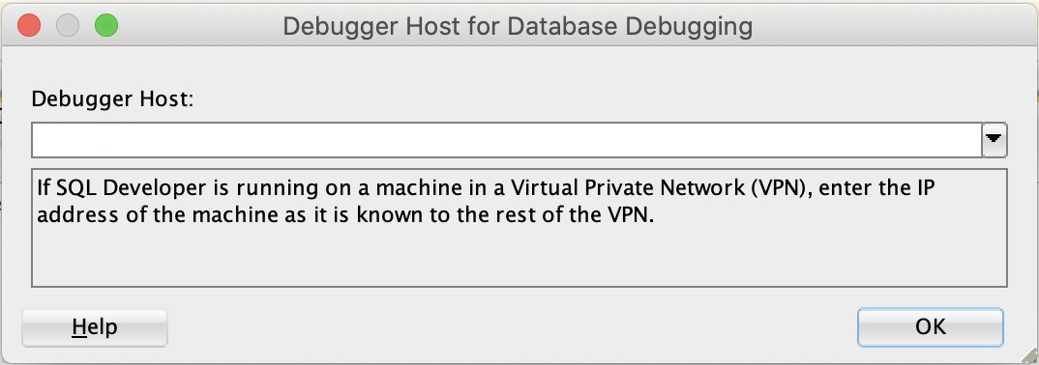
Debugging With Breakpoints (4)
To allow debugging when connecting to Oracle Database through the HKUST VPN, you need to check Prompt for Debugger Host for Database Debugging in the Debugger tab of the Preferences dialog as shown on slide 26.
Then, when selecting Debug, you will be prompted to input your HKUST VPN IP address as shown in the dialog on the right.
To obtain your HKUST VPN IP address, open Pulse Secure.
In the Pulse Secure menu select File→Connections→Advanced Connection Details…..
Copy the Assigned IPV4 address.
Paste the Assigned IPV4 address into the Debugger Host field of the Debugger Host for Database Debugging dialog shown above.

