Slide 1
Lab Instructions for TA
Use slides 3-5 to explain when an index is used in Oracle Database and how to manage it.
Use slides 6-10 to explain how to use exceptions in PL/SQL.
Before the lab, create the procedure OverallAverageGradeReport and demonstrate how to use the Exception section to handle a divide by zero exception and a user-defined exception.
Answer any questions students might have about the lab notes.
Explain what the students need to do in the lab exercise and help any students who are having problems doing the exercise.

Slide 2
Database Management Systems
Lab 7
Oracle Indexing
and Oracle PL/SQL Exceptions

Slide 3
Lab Topics
How to manage an index for a table in Oracle Database.
PL/SQL exceptions and exception handling.
在一些ppt页面上方，我们给出了相关内容详细介绍的网址。

Slide 4
Managing Indexes
Create index
create [unique] index index_name on table_name (attribute_name1, attribute_name2, …);
Example: Create an index on admissionYear of the Student table.
create index AdmissionYearIndex on Student (admissionYear);
Example: Create an index on courseName of the Course table.
create unique index CourseNameIndex on Course (courseName);
The unique keyword specifies that the attribute courseName must have unique values.
Drop index
drop index index_name;
Display information about an index
select index_name from user_indexes;

Slide 5
RECALL: Oracle PL/SQL Basic Structure
create or replace procedure procedure_name [ as | is ]
Declarative section: declaration of variables, types, and local subprograms go here.
begin Executable section: procedural and SQL statements go here. This is the only required section of the block.
exception Exception handling section: error handling statements go here.
end;

Slide 6
Oracle PL/SQL Exceptions
http://docs.oracle.com/cd/B10501_01/appdev.920/a96624/07_errs.htm
Predefined exceptions are raised implicitly by Oracle PL/SQL if the exception occurs. 系统定义的异常类型，用户不需要指定异常触发条件，会自动报错。
User-defined exceptions are raised explicitly by the command. 用户自定义异常类型，需要用户自己指定异常出发条件，并且手动触发异常如下：
raise exception_name;
Predefined Exceptions
ACCESS_INTO_NULL ORA-06530
CASE_NOT_FOUND ORA-06592
COLLECTION_IS_NULL ORA-06531
CURSOR_ALREADY_OPEN ORA-06511
DUP_VAL_ON_INDEX ORA-00001
INVALID_CURSOR ORA-01001
INVALID_NUMBER ORA-01722
LOGIN_DENIED ORA-01017
NO_DATA_FOUND ORA-01403
NOT_LOGGED_ON ORA-01012
PROGRAM_ERROR ORA-06501
ROWTYPE_MISMATCH ORA-06504
SELF_IS_NULL ORA-30625
STORAGE_ERROR ORA-06500
SUBSCRIPT_BEYOND_COUNT ORA-06533
SUBSCRIPT_OUTSIDE_LIMIT ORA-06532
SYS_INVALID_ROWID ORA-01410
TIMEOUT_ON_RESOURCE ORA-00051
TOO_MANY_ROWS ORA-01422
VALUE_ERROR ORA-06502
ZERO_DIVIDE ORA-01476

Slide 7
User-defined Exceptions
Declare the exception in the declaration section.
myException exception;
Raise it within a begin…end block.
if condition then
raise myException;
end if;
Define the exception-handling code in the exception section within the begin…end block.
exception
when myException then
.
.
.
/* DECLARATION SECTION */
myException exception;
.
.
.
begin
.
.
.
begin
.
.
.
if condition then
raise myException;
endif;
.
.
.
exception
when myException then
/* Code to handle exception */
.
.
.
end;
.
.
.
end;

Slide 8
Continuing After An Exception (1)
/* DECLARATION SECTION */
.
.
.
begin
.
.
.
begin
.
.
.
exception
when invalid_cursor then
/* Code to handle exception */
.
.
.
when value_error then
/* Code to handle exception */
.
.
.
end;
.
.
.
end;
如果程序发生异常，则程序运行跳转到异常处理语句。
异常处理完毕后，跳转到exception block后面的语句。
7

Slide 9
Continuing After An Exception (2)
declare
peRatio number(3,1);
begin
delete from stats where symbol = 'xyz';
begin -- sub-block begins
-- The select statement will throw an exception if nvl(earnings, 0) is zero
select price / nvl(earnings, 0) into peRatio from stocks where symbol = 'xyz';
exception
when zero_divide then
peRatio := 0;
end; -- sub-block ends
insert into stats (symbol, ratio) values ('xyz', peRatio);
exception
when others then
.
.
.
end;
nvl（表达式1，表达式2）:如果表达式1为空值，nvl返回值为表达式2的值，否则返回表达式1的值。
After the zero_divide exception is handled, execution continues with the insert statement, which is outside the inner begin...end block.
Note: others指代其他异常类型
8

Slide 10
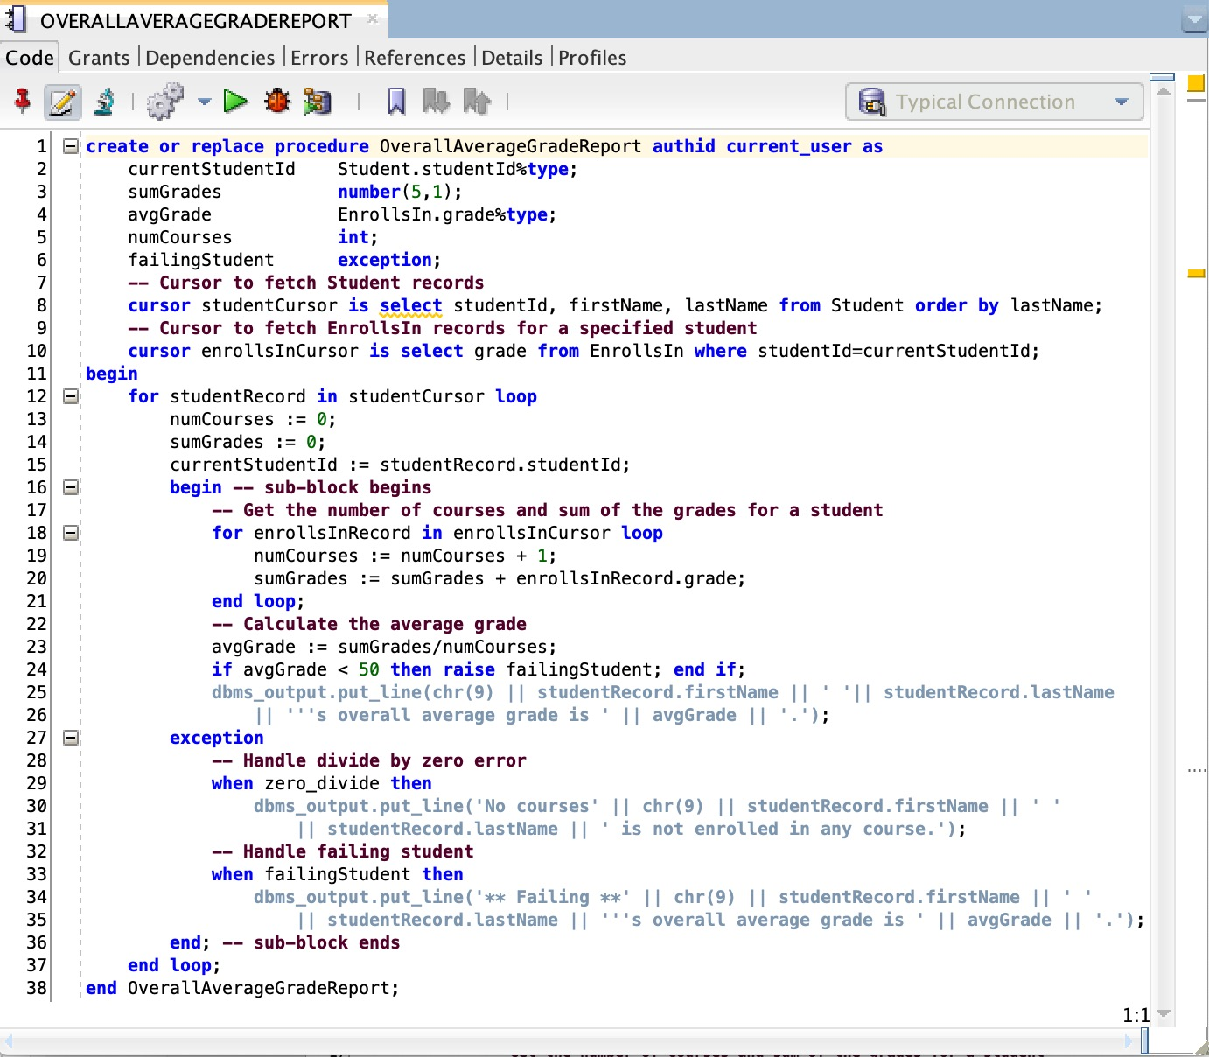
Exception Handling Examples
Declaring a user-defined exception
Checking for the user-defined exception
Handling an implicit exception
Handling the user-defined exception

