Slide 1
Lab Instructions for TA
Use slides 2 and 3 to explain the objective of the lab and what is Oracle Data Modeler.
Start SQL Developer and illustrate how to access Oracle Data Modeler from within SQL Developer.
Demonstrate how to create the entity types—Person, Patient and Doctor—and how to relate them.
Demonstrate how to add an attribute to one of the entity types.
Let students complete the remainder of the exercise and provide help as needed.
Note that slides 4-29 demonstrate how to create entity types, add attributes to them and how to relate them; these slides are hidden in PowerPoint Presentation mode.

Slide 2
Database Management Systems
Lab 1
Oracle Data Modeler

Slide 3
Lab Topics
How to construct an E-R diagram using Oracle Data Modeler.

Slide 4
Oracle Data Modeler
Oracle Data Modeler is a database design tool that allows you to:
create, browse and edit E-R diagrams;
reduce an E-R diagram to a relational schema.
Oracle Data Modeler is included with Oracle SQL Developer, which can be downloaded from
https://www.oracle.com/tools/downloads/sqldev-downloads.html
Requires registration/login; Windows, Mac, Linux available. Latest version is 20.2 (requires JDK 8 or 11).
(There is also a standalone version of Oracle Data Modeler.)
For Windows you should download the 64-bit version that includes JDK 8.

Slide 5
Oracle SQL Developer (1)
Run the program “sqldeveloper”.
Double click the app.
SQL Developer opens in the Start Page as shown on the next slide.

Slide 6
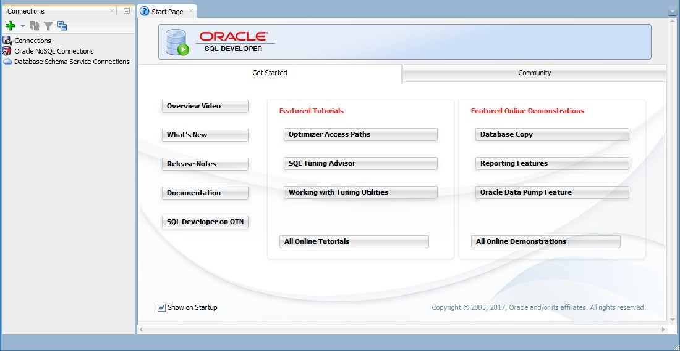
Oracle SQL Developer (2)
Close the Connections and the Start Page tabs; you will use the Connections tab in the next lab.

Slide 7
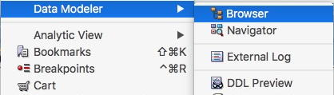
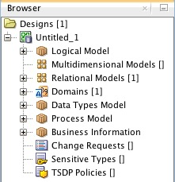
Create A Database Design
To create a database design:
select View in the Oracle SQL Developer menu and then select Data Modeler→Browser as shown in the figure;
right-click on the Logical Model node in the Browser tab and select Show from the popup menu to open the design surface.
As shown in the figure on the right, the Browser tab contains a default template called Unititled_1 for creating a database design.
This template will be renamed when you save your design as explained on the next slide.

Slide 8
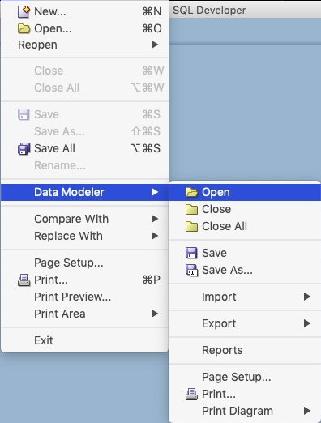

Save, Open, Print A Database Design
To save a design (see figure):
select File in the Oracle SQL Developer menu;
select Data Modeler→Save or Data Modeler→Save As….
To open a saved design (see figure):
select File in the Oracle SQL Developer menu;
select Data Modeler→Open;
navigate to the folder containing the design and select its .dmd file.
To print a design:
right-click in the design surface;
select Print Diagram from the popup menu.
select one of the options shown in the figure.

Slide 9
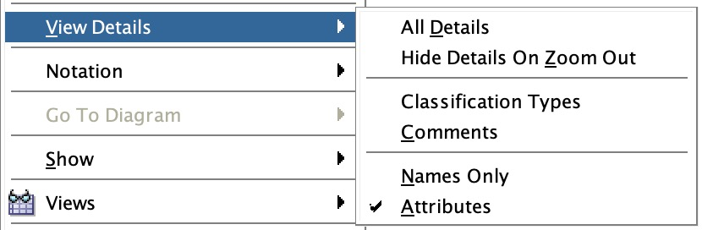

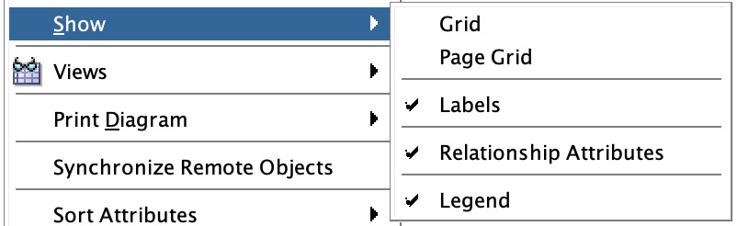
Oracle Data Modeler Design Settings
Right-click in the design surface of the Logical tab and make the following selections from the popup menu.
View Details: check only Attributes
Notation: check Information Engineering Notation; uncheck Box-in-Box Presentation
Show: check Labels, Relationship Attributes, Legend
Note
If options other than Attributes is selected in View Details, Oracle Data Modeler will show many additional details about entities that are not relevant for the purpose of constructing only an E-R diagram.

Slide 10
Oracle Data Modeler Toolbar
The Oracle Data Modeler toolbar contains buttons for the following operations (among others):
Select allows selection of diagram elements.
New Entity creates a new entity type.
New N:M Relation creates a new N:M relationship type.
New 1:N Relation creates a new 1:N relationship type.
New 1:N Relation Identifying creates a new 1:N relationship type for a weak entity.
New 1:1 Relation creates a new 1:1 relationship type.
New Arc creates an XOR (exclusive or) constraint.
New Note creates a new note.

Slide 11
Create An Entity Type (1)
Select the New Entity button and click anywhere in the design surface.
In the Entity Properties dialog, shown on the next slide:
Enter a name for the entity type in the Name field.
Click the OK button.
An entity appears on the design surface like those shown on slide 12.
Note: Until another toolbar button is selected, several entities can be created sequentially by simply clicking in the design surface.

Slide 12
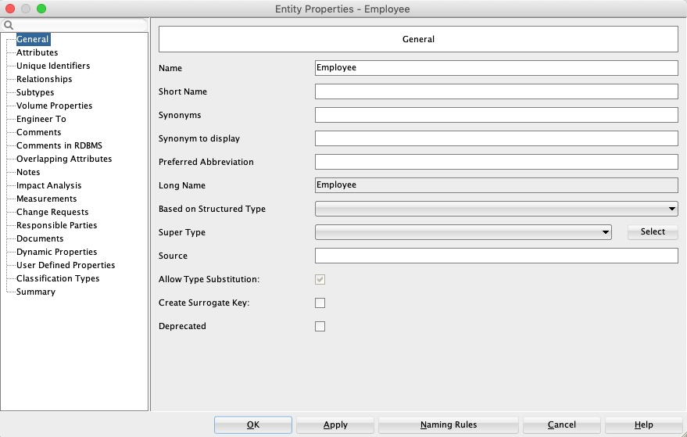
Create An Entity Type (2)

Slide 13
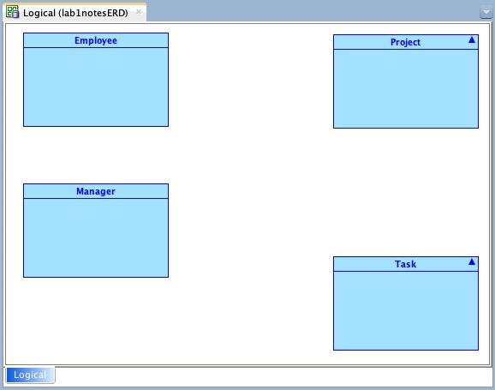
Create An Entity Type (3)
Reposition an entity type by selecting it and dragging it to the desired position.
Resize an entity type by selecting it and dragging one of its handles.
To better help align entities you can select Layout→Snap to Grid in the design surface.

Slide 14
Create A Weak Entity Type
On the previous slide, Task is a weak entity.
However, Oracle Data Modeler cannot draw a double line around a weak entity.
Instead, Oracle Data Modeler indicates that an entity is weak by using only identifying relationships (solid relationship lines) as shown for the Has relationship on slide 16.

Slide 15

Create A Relationship Type (1)
Select one of the Relation buttons and click inside one entity and then inside the other entity.
In the Relation Properties dialog shown on the next slide:
Enter a name for the relationship type in the Name field.
Edit the cardinality and participation constraints, if necessary.
Click the OK button.
A relationship appears on the design surface like those shown on slide 15.
Note: Until another toolbar button is selected, several relationships can be created sequentially by selecting the source and target entities.

Slide 16
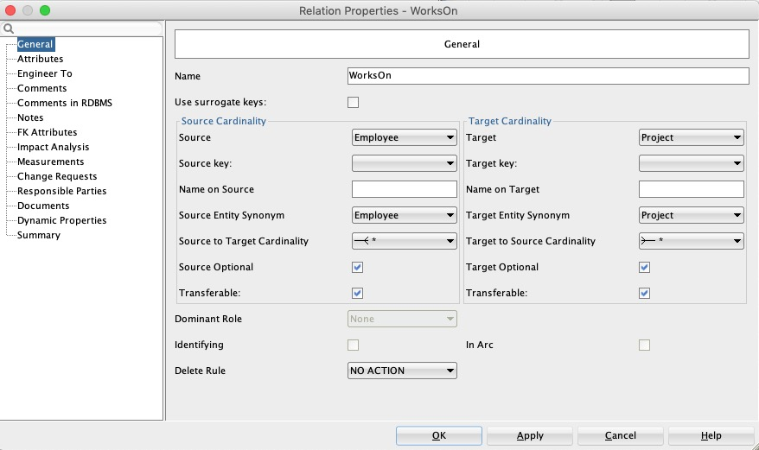
Create A Relationship Type (2)

Slide 17
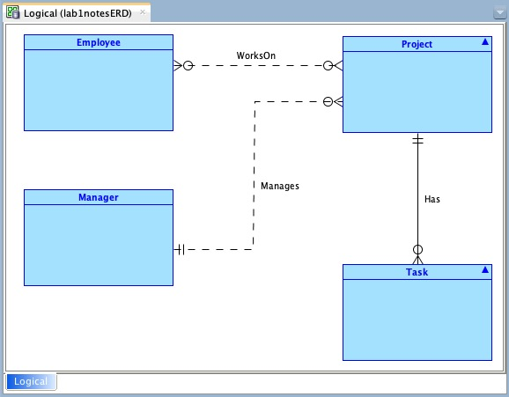
Create A Relationship Type (3)
Reposition a relationship type by selecting it and dragging its endpoints to the desired positions.
Add elbows to a relationship type by right-clicking on it, selecting Add Elbow from the popup menu and dragging the elbow to the desired position.

Slide 18
Create A Relationship Type (4)
Due to a bug in Oracle Data Modeler, relationship names do not display.
A work around is to add relationship names manually via a Note element as shown in slide 15.
To remove the background colour and border of a note, right-click it, select Format from the popup menu and
unselect Use Default Format.
set the Background Color and Border Color to white.
Note: It is advisable to add relationship names only after completing the diagram to avoid having to move them as relationships are moved.

Slide 19
Add Entity Attributes (1)
Open the Properties dialog for an entity (shown on the next slide) either by double clicking it or right-clicking it and selecting Properties from the popup menu and do the following.
Select the Attributes tab in the left column.
Select + to add a new attribute.
Enter a name for the attribute in the Name field.
Check the Primary UID checkbox if the attribute is a primary key.
The attributes that have been defined for an entity can be displayed inside the entity box as shown on slide 20.

Slide 20
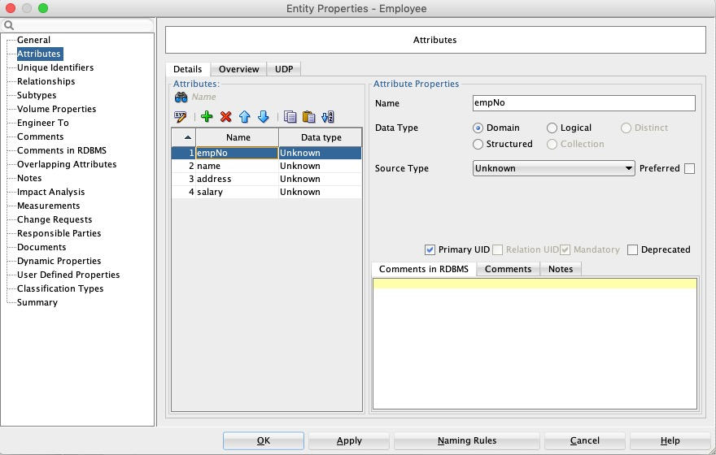
Add Entity Attributes (2)

Slide 21
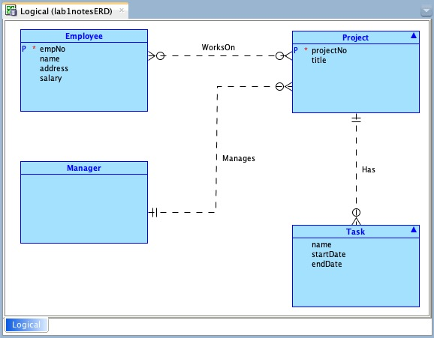
Add Entity Attributes (3)

Slide 22
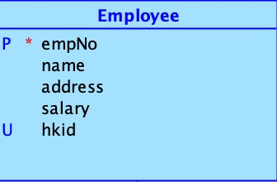
Specify Unique Attributes
To indicate that an attribute's values are unique, but not a primary key, do the following in the entity's Properties dialog.
Select the Unique Identifiers tab.
Select + to add a new attribute.
Double-click the newly added attribute.
In the General tab of the Key Properties dialog, edit the Name field to that of the unique attribute.
In the Attributes and Relations tab of the Key Properties dialog, select the unique attribute in the left pane and move it to the right pane.
Select the OK button in the Key Properties dialog and in the Properties dialog.
The attribute is displayed with a U as shown in the figure.

Slide 23
Add Relationship Attributes (1)
Open the Properties dialog for a relationship (see slide 14) either by double clicking it or right-clicking it and selecting Properties from the popup menu and:
Select the Attributes tab in the left column.
Click + to add a new attribute.
Enter a name for the attribute in the Name field.
Click OK.
Resize the attribute box as desired.
The next slide shows an attribute defined for the WorksOn relationship.

Slide 24
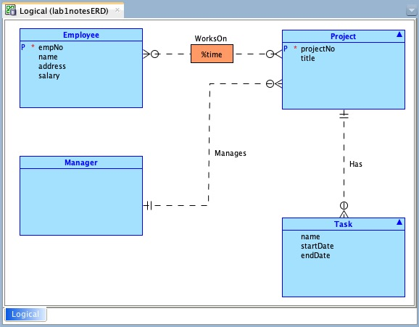
Add Relationship Attributes (2)

Slide 25
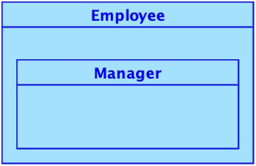
Create A Generalization Relationship (1)
Open the Properties dialog for the subclass entity (e.g., Manager) and do the following.
Select the superclass in the Super Type dropdown list (e.g., Employee as shown on the next slide).
Click OK.
Note: If Box-In-Box Presentation has not been unchecked in the Notation setting (see slide 8), then the supertype/subtype relationship will display as shown in the figure on the right. To display it as shown in slide 26, uncheck Box-In-Box Presentation in the Notation setting.
Slide 26 shows a generalization relationship example.

Slide 26
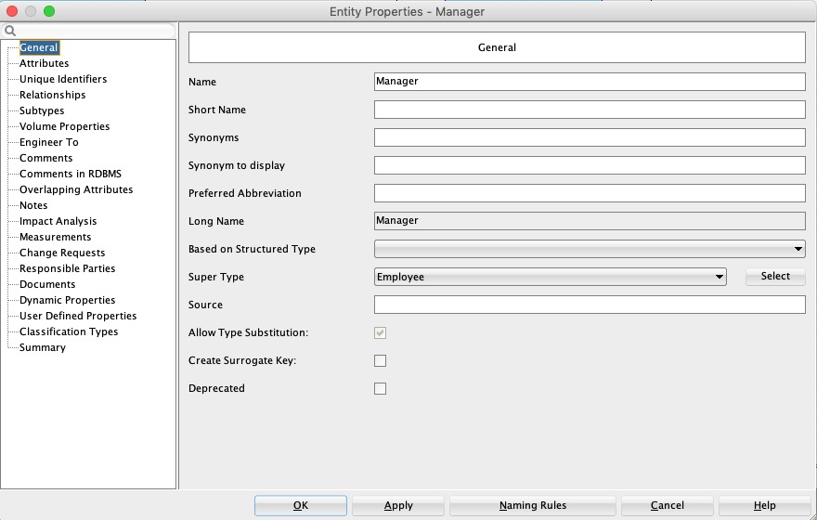
Create A Generalization Relationship (2)

Slide 27
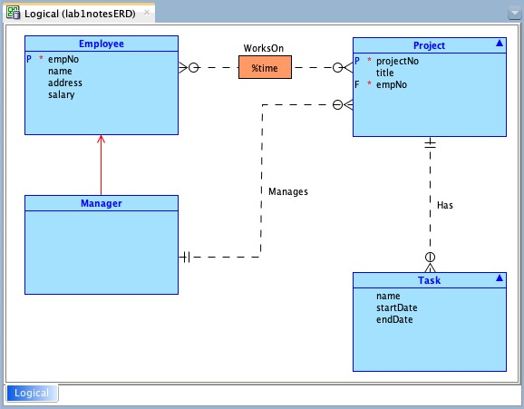
Create A Generalization Relationship (3)
Reposition a generalization relationship by selecting it and dragging its endpoints to the desired positions.
Add elbows to a generalization relationship by right-clicking on it, selecting Add Elbow from the popup menu and dragging the elbow to the desired position.

Slide 28
Create An XOR Constraint (Arc Relationship) (1)
To create an XOR constraint (Arc relationship):
Select the entity type that should participate in only one of the relationship types (e.g., Task).
Select all relationships to be included (hold down the Shift key and click each relationship).
Click the New Arc button in the toolbar.
An example of an XOR constraint (Arc relationship) is shown on the next slide.

Slide 29
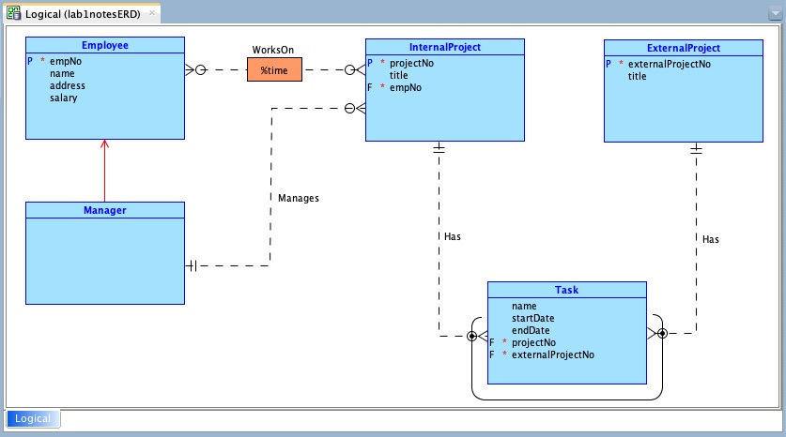
Create An XOR Constraint (Arc Relationship) (2)

Slide 30
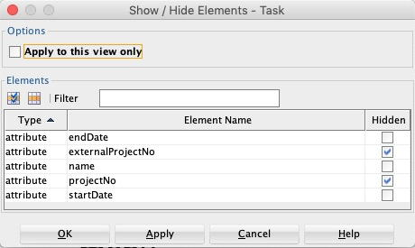
Showing/Hiding Design Elements (1)
To hide elements, such as foreign keys, within an entity:
right-click on the entity and select Show / Hide Elements from the popup menu.
Select the elements to hide and select OK.
Slide 30 shows an example of hiding some entity elements (compare with the previous slide).
When entity elements are hidden, a triangle appears in the upper right corner as shown on slide 29.

Slide 31
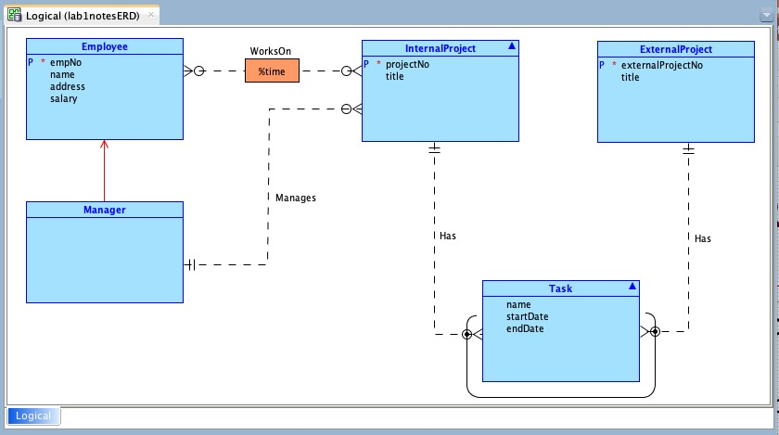
Showing/Hiding Design Elements (2)

