Slide 1


Lecture-03
Lecture Notes: Data Structures and Algorithms
Chapter 3 Linear List (Sequential List)
Dr. Gao Xiang

Slide 2
Table of Contents
Arrays and ADTs of Array
  1D array
  ADT of array
  2D and high dimensional arrays
Sequential List
  ADT of sequential list
  Applications
Polynomial ADT and Representation
  Polynomial ADT
  Sequential Representation of PolyN
  Addition of Polynomial

Slide 3
Sparse Matrix
  Sparse Matrix ADT
  Transpose Sparse Matrix
String
string ADT
Pattern matching

Slide 4
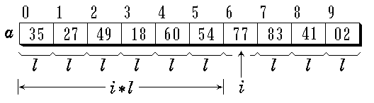
3.1 Arrays and ADTs
One dimensional array
  An example

Slide 5
Arrays and ADTs
一维数组的特点
除了第一个元素以外，所有元素都有一个直接前驱
除了最后一个元素以外，所有元素都有一个直接后继
存储在连续的空间里，每个元素的数据类型相同占据同样大小的存储空间
First
element
Last
element

Slide 6
Arrays and ADTs
Definition and Initialization of array in C++
#include <iostream.h>
class szcl {
int e; // Element of the array
public:
// Constructor without parameter (The initialization of the array is not necessary)
szcl ( ) { e = 0; }
// Constructor with parameter (The array should be initialized)
szcl ( int value ) { e = value; }
int get_value ( ) { return e; } // get value from array
}

Slide 7
int main ( ) {
// A static array a1 and a dynamic array elem
szcl a1[3] = { 3, 5, 7 }, *elem;
// Output static array
for ( int i = 0; i < 3; i++ )
cout << a1[ i ].get_value ( ) << “\n”;
elem = a1;
// Output dynamic array
for ( int i = 0; i < 3; i++ ) {
cout << elem→get_value( ) << “\n”;
elem++;
}
return 0;
}

Slide 8
ADT of 1D Array (Class Definition)
#include <iostream.h>
#include <stdlib.h>
template <class Type>
class Array {
private:
Type *elements; // Space to store array
int ArraySize; // Length of array
void getArray ( ); // Initialization of storage for array
public:
Array( int Size=DefaultSize ); // Constructor
Array( const Array<Type>& x ); // Constructor (copy)

Slide 9
~Array( ) { delete [ ]elements;} //Deconstructor
Array <Type> & operator = // Array duplication
( const Array <Type> & A );
Type& operator [ ] ( int i ); // Get the element of the array
Type* operator* ( ) const // Conversion of the pointers
{ return elements; }
int Length ( ) const // Get the length of array
{ return ArraySize; }
void ReSize ( int sz ); // change the size of the array
}

Slide 10
Implementation of Methods for 1D Array
template <class Type>
void Array <Type>::getArray ( ) {
// Private Function: Allocate the space for the array
elements = new Type[ArraySize];
if ( elements == 0 ) {
arraySize = 0;
cerr << "Memory Allocation Error" << endl;
return;
}
}

Slide 11
Implementation of Methods for 1D Array
template <class Type>
Array <Type>::Array ( int sz ) {
// Constructor Function of Array ADT
if ( sz <= 0 ) {
arraySize = 0;
cerr << “Invalid size of array!” << endl;
return;
}
ArraySize = sz;
getArray ( );
}

Slide 12
Implementation of 1D Array
template <class Type>
Array<Type>:: Array ( const Array<Type> & x ) {
// Constructor Function (with copy) of Array ADT
int n = ArraySize = x.ArraySize;
elements = new Type[n];
if ( elements == 0 ) {
arraySize = 0;
cerr << “Error of Memory Allocation” << endl;
return;
}
Type *srcptr = x.elements; //源数组首地址
Type *destptr = elements; //目标数组首地址
while ( n-- ) * destptr++ = * srcptr++;
}

Slide 13
Implementation of Methods for 1D Array
template <class Type>
Type & Array<Type>::operator [ ] ( int i ) {
// Get the i-th element of array of Array ADT
if ( i < 0 || i > ArraySize-1 ) {
cerr << “The i is exceed the bound of the array” << endl;
return NULL;
}
return element[i];
}

Slide 14
template <class Type>
void Array<Type>::Resize (int sz) {
if ( sz >= 0 && sz != ArraySize ) {
Type * newarray = new Type[sz];
if ( newarray == 0 ) {
cerr << “Error of Memory Allocation” << endl;
return;
}
int n = ( sz <= ArraySize ) ? sz : ArraySize;
Type *srcptr = elements;
Type *destptr = newarray;
while ( n-- ) * destptr++ = * srcptr++;
delete [ ] elements;
elements = newarray;
ArraySize = sz;
}
}

Slide 15
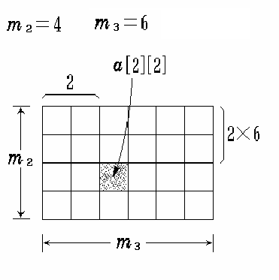
2D Array
Row subscript i, Column subscript j

Slide 16
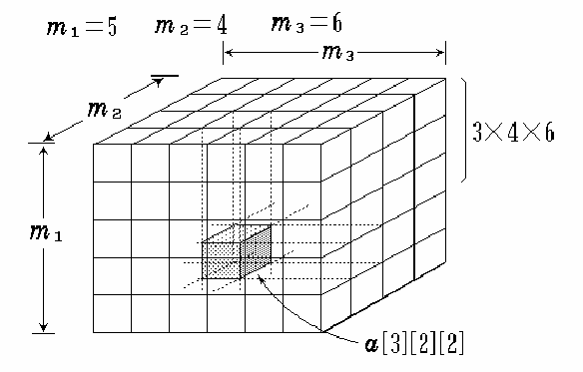
3D Array

Slide 17
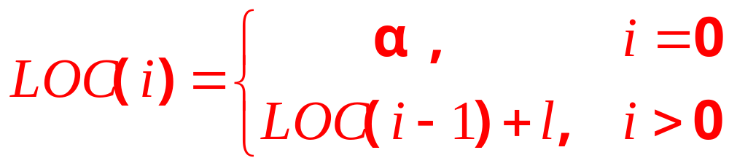
Sequential Storage of Arrays
1D array
LOC ( i ) = LOC ( i -1 ) + l =α+ i*l

Slide 18
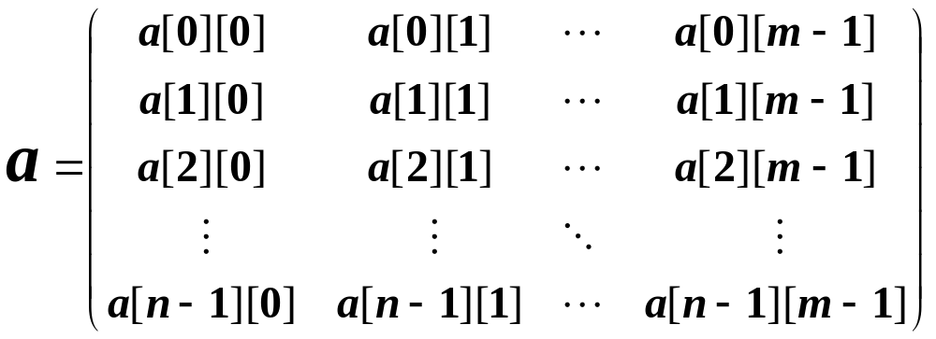
Sequential Storage of Arrays
2D array
行优先:
LOC ( j, k ) = LOC(j,0)+k
=LOC(j-1,0)+m+k
=…
=a + ( j * m + k ) * l

Slide 19
Sequential Storage of Arrays
3D array
页优先:
在3维数组a[m₁][m₂][m₃]中的元素a[i][j][k]的位置为：
LOC (i, j, k ) =a+(i*m₂*m₃+ j*m₃+k) * l

Slide 20
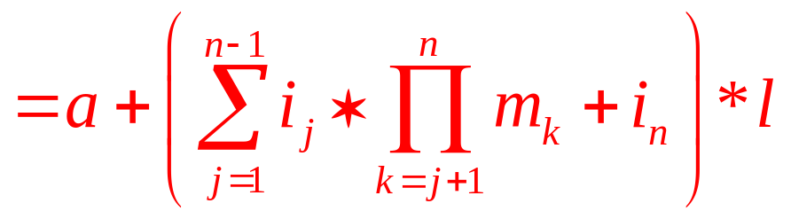
Sequential Storage of Arrays
N-D array
  The dimensions are m₁, m₂, m₃, …, m_{n}
  The element with subscripts (i₁, i₂, i₃, …, i_{n}) is in the space
LOC ( i₁, i₂, …, i_{n} ) = a +
( i₁*m₂*m₃*…*m_{n} + i₂*m₃*m₄*…*m_{n}+
+ ……+ i_{n-1}*m_{n} + i_{n} ) * l

Slide 21
3.2 Sequential List (Sequence)
Definition and Property of Sequential List
  Definition: A list is a finite, ordered sequence of data items
  （a₁, a₂, …, a_{n}）
    where a₁ is the item or element of list , n is the length of the list
  Property: sequential access (put and get)
  Important concept: List element has a position.
  Traversal:
    from the first to the last
    from the last to the first
    from the intermediate position to the head or the end

Slide 22
ADT of Sequential List (Class Definition)
template <class Type> class SeqList {
private:
Type *data; // Array to store the sequential list
int MaxSize; // Maximize the size of list
int last; // Length of the list
public:
SeqList ( int MaxSize = defaultSize );
~SeqList ( ) { delete [ ] data; }
int Length ( ) const { return last+1; }
int Find ( Type & x ) const;

Slide 23
ADT of Sequential List (Class Definition)
int IsIn ( Type & x );
int Insert ( Type & x, int i );
int Remove ( Type & x );
int Next ( Type & x ) ;
int Prior ( Type & x ) ;
int IsEmpty ( ) { return last ==-1; }
int IsFull ( ) { return last == MaxSize-1; }
Type Get ( int i ) {
return i < 0 || i > last？NULL : data[i];
}
}

Slide 24
Implementation of Methods for Sequential List
template <class Type>
SeqList<Type> :: SeqList ( int sz ) {
// Constructor Function
if ( sz > 0 ) {
MaxSize = sz; last = -1;
data = new Type[MaxSize];
if ( data == NULL ) {
MaxSize = 0; last = -1;
return;
}
}
}

Slide 25
template <class type>
int SeqList<Type>::IsIn(type & x){
//判断是否在表中
int i=0, found=0;
while(i<=last&&!found)
if(data[i]!=x) i++;
else found=1;
return found;
}

Slide 26
Implementation of Methods for Sequential List
template <class Type>
int SeqList<Type>::Find ( Type & x ) const {
// Searching Function: try to find out the position of x
int i = 0;
while ( i <= last && data[i] != x )
i++;
if ( i > last ) return -1;
else return i;
}

Slide 27
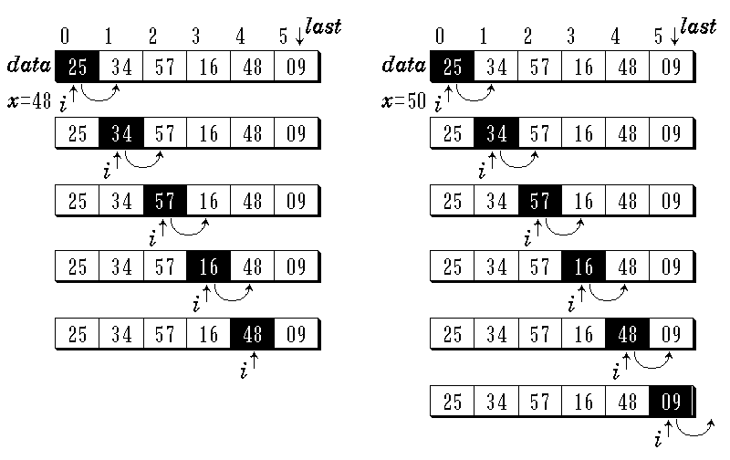
Implementation of Methods for Sequential List (find)

Slide 28
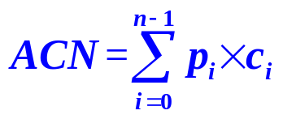
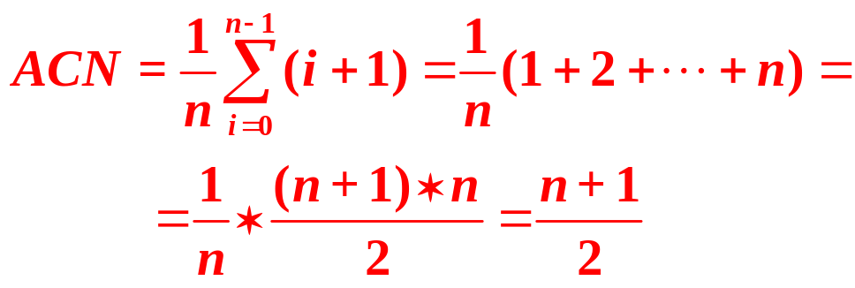
Complexity Analysis of Searching
If success
Average Comparison Number (ACN) is
If fail to search x,
Actual comparison number is n

Slide 29
template <class type>
int SeqList<Type>::Next(type & x){
//寻找x的后继
int i=Find(x);
if(i>=0&&i<last) return i+1;//x的后继存在
else return -1;
}
template <class type>
int SeqList<Type>::Prior(type & x){
//寻找x的前驱
int i=Find(x);
if(i>0&&i<=last) return i-1;//x的前驱位置
else return -1;
}

Slide 30
Insert an item into the List
template <class Type>
int SeqList<Type>::Insert ( Type & x, int i ){
// Insert a new item with (x) before pos i in the list
if ( i < 0 || i > last+1 || last == MaxSize-1 )
return 0; // Fail to insert
else {
last++;
for ( int j = last; j > i; j-- ) // Move elements
data[j] = data[j -1];
data[i] = x;
return 1; // Success to insert
}
}

Slide 31
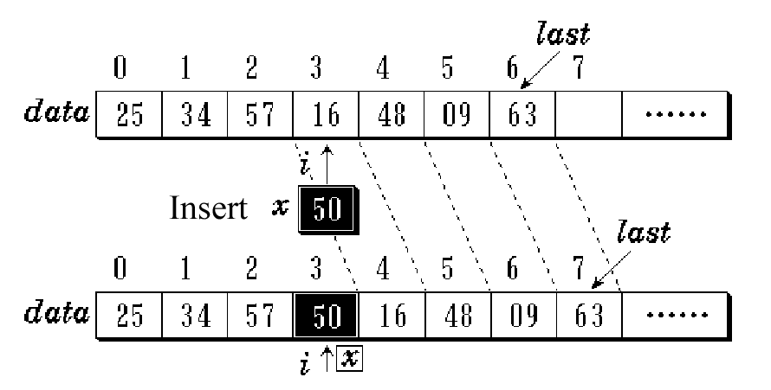
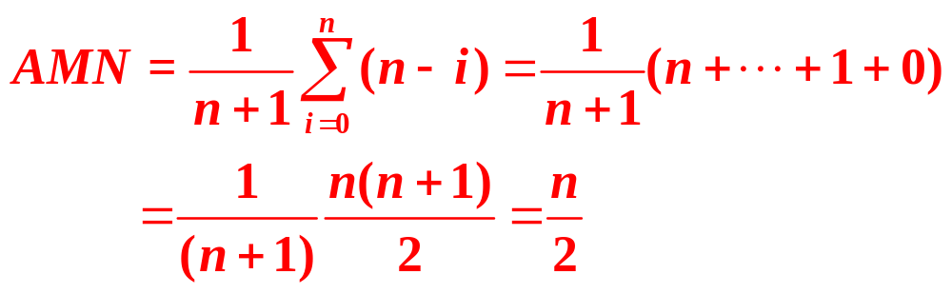
Insert an item into the List
Average Move Number (AMN) is
Notes:
n个元素有n+1个空隙,移动i到n-1的元素

Slide 32
Remove an item from the List
template <class Type>
int SeqList<Type>::Remove ( Type & x ) {
// Remove existed item x from the list
int i = Find (x); // Search x in the list
if ( i >= 0 ) {
last-- ;
for ( int j = i; j <= last; j++ )
data[j] = data[j+1]; // Move elements
return 1; // Success to remove x
}
return 0; // No removal if no item x
}

Slide 33
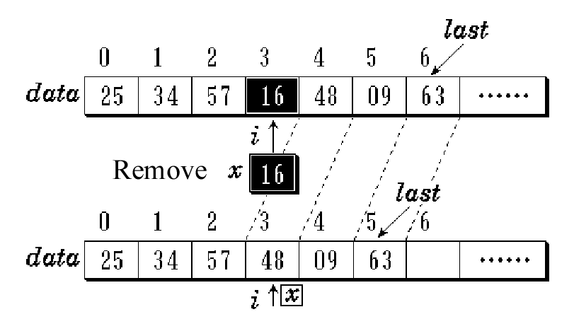
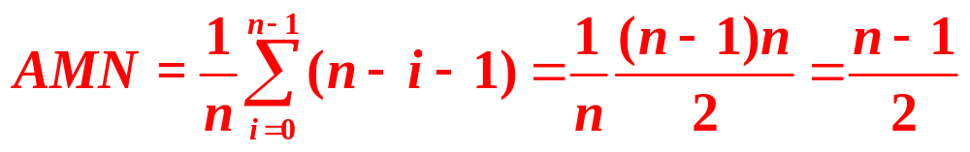
Remove an item from the List
Average Move Number (AMN) is

Slide 34

Application of Sequential List（1）
Union of two sets
a₂
a₁
b₂
b₁
a_{i}
a_{n}
b_{i}
b_{m}
a_{1,} a₂, …,a_{i}… a_{n},
b_{1,} b₂, …, b_{i}… b_{m},
N
Insert
Get an item
b_{i}
Get another item

Slide 35
Application of Sequential List（1）
Union of two sets
template <class Type>
void Union ( SeqList<Type> & LA,
SeqList<Type> & LB ) {
int n = LA.Length ( );
int m = LB.Length ( );
for ( int i = 0; i < m; i++ ) {
Type x = LB.Get(i); // Get an item x from Set LB
int k = LA.Find (x); // Search x in Set LA
if ( k == -1 ) // if not found, insert x into LA
{ LA.Insert (n+1, x); n++; }
}
}

Slide 36

Application of Sequential List (2)
Intersection of two sets
b₂
a₂
b₁
a₁
b_{i}
b_{m}
a_{i}
a_{n}
Remove from A
a₁, a₂, …,a_{i}… a_{n},
N
Get an item
a_{i}
Get another item
Y

Slide 37
Application of Sequential List (2)
Intersection of two sets
template <class Type>
void Intersection ( SeqList<Type> & LA,
SeqList<Type> & LB ) {
int n = LA.Length ( );
int m = LB.Length ( ); int i = 0;
while ( i < n ) {
Type x = LA.Get (i); // Get an item x from LA
int k = LB.Find (x); // Search x in Set LB
if ( k == -1 ) { LA.Remove (i); n--; }
// if not found, remove x from LA
else i++;
}
}

Slide 38
Application of Sequential List (3)
Merge two sorted lists into a new list and the new one is also sorted as before.
i
LA= (3, 5, 8, 11)
LB= (2, 6, 8, 9, 11, 15, 20)
j
LC= (2, 3, 5, 6, 8, 8, 9, 11, 11, 15, 20)
Merge
k

Slide 39
Application of Sequential List (3)
template <class Type>
SeqList &Merge_List ( SeqList <Type> & LA,
SeqList <Type> & LB ) {
int n = LA.Length ( );
int m = LB.Length ( );
SeqList LC(m+n);
int i=j=k=0;
while ( i < n && j<m) {
Type x = LA.Get (i); // Get an item x from LA
Type y = LB.Get (j); // Get an item y from LB

Slide 40
Application of Sequential List (3)
if (x <= y )
{ LC.Insert (k, x); i++; k++;} // Insert x into LC
else
{ LC.Insert (k, y); j++; k++;}
}//end while
while ( i < n) { // Insert the remains of LA into LC
Type x = LA.Get (i); LC.Insert (k, x); i++; k++;
}
while (j<m) { // Insert the remains of LB into LC
Type y = LB.Get (j); LC.Insert (k, y); j++; k++;
}
return LC;
}
Notes:
I++,,j++调集下一个元素进行比较

Slide 41
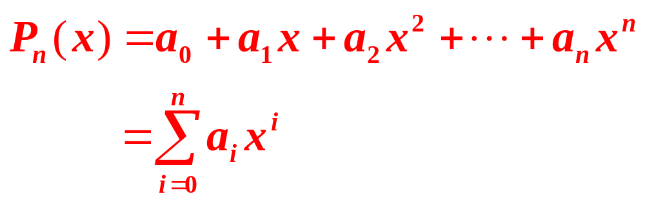
3.3 Polynomial
N-order polynomial P_{n}(x) has n+1 items。
  Coefficients: a₀, a₁, a₂, …, a_{n}
  Exponentials: 0, 1, 2, …, n。 ascending

Slide 42
ADT of Polynomial
class Polynomial {
public:
Polynomial ( ); //Constructor
int operator ! ( );
//若*this是零多项式，则返回1，否则返回0
float Coef ( int e);
//返回多项式*this中指数e的系数
int LeadExp ( ); //返回多项式*this中最大的指数
Polynomial Add (Polynomial poly);
Polynomial Mult (Polynomial poly);
float Eval ( float x);
//计算多项式*this在变量为x时的值
}

Slide 43
To computer the power of x, (Power Class)
#include <iostream.h>
class power {
double x;
int e;
double mul; //The value of x^{e}
public:
power (double val, int exp); //constructor
double get_power ( ) { return mul; } //Get x^{e}
};
Notes:
当调用一个成员函数时，有一个指向请求这个调用的对象的指针作为一个参数将自动的传递给这个函数，这个指针就是this。

Slide 44
power::power (double val, int exp) {
//Computer the power of val x^{e}
x = val; e = exp; mul = 1.0;
if ( exp == 0 ) return;
for ( ; exp>0; exp--) mul = mul * x;
}
main ( ) {
power pwr ( 1.5, 2 );
cout << pwr.get_power ( ) << “\n”;
}
®
Notes:
X=val等同于this->x=val;
友元函数不是类的成员，不会传递给它this指针，静态成员函数也不能得到传送的this指针

Slide 45
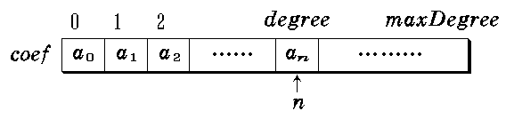
Representation of Polynomial (storage)
1st method：
private:
int degree;
float coef [maxDegree+1];
P_{n}(x): pl.degree = n
pl.coef[i] = a_{i}, 0 ≤ i ≤ n

Slide 46
2nd method：
private:
int degree;
float * coef;
Polynomial::Polynomial (int sz) {
degree = sz;
coef = new float [degree + 1];
}
The 1st and 2nd storages are NOT suitable for the following case
P₁₀₁(x) = 3 + 5x⁵⁰ - 14x¹⁰¹

Slide 47
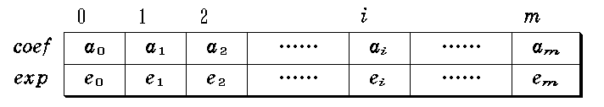
3rd method:
class Polynomial;
class term { //item definition
friend Polynomial;
//PN class is the friend class of item class
private:
float coef; //coefficient
int exp; //exponential
};
®
Notes:
友元函数是能够访问类中的私有成员的非成员函数。友元函数从语法上看，它与普通函数一样，即在定义上和调用上与普通函数一样。
友元关系不具对称性。即 A 是 B 的友元，但 B 不一定是 A 的友元。 友元关系不具传递性。即 B 是 A 的友元，C 是 B 的友元，但是 C 不一定是 A 的友元。
作用及特点
友元提供了不同类的成员函数之间、类的成员函数与一般函数之间进行数据共享的机制。通过友元，另一个类中的成员函数可以访问类中的私有成员和保护成员。c++中的友元为封装隐藏这堵不透明的墙开了一个小孔，外界可以通过这个小孔窥视内部的秘密。

Slide 48
class Polynomial { //Polynomial class
public:
……
private:
static term termArray[MaxTerms]; //items
static int free; //pos of current free space
// term Polynomial::termArray[MaxTerms];
// int Polynomial::free = 0;
int start, finish; //start and finish pos of the items of //Polynomial
}
®

Slide 49
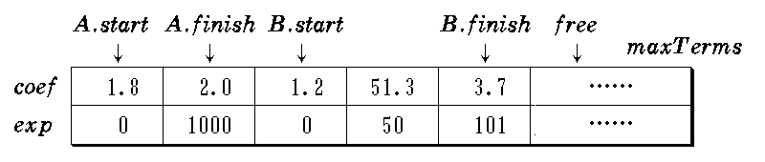
Examples:
Two polynomials are stored in termArray
A(x) = 2.0x¹⁰⁰⁰+1.8
B(x) = 1.2 + 51.3x⁵⁰ + 3.7x¹⁰¹

Slide 50
Addition of Polynomials
Requirement
  The summarization polynomial is an new one
Method
  To traverse two polynomials (A and B) until one of them has been traversed;
  If the exps are equal, add two coefs.
    If the addition of coefs are not equal to 0, new a item and append it into C, otherwise continue to traverse.
  If the exps are not equal, add the item whose exp is lower into C.
  If one of A and B has been traversed completely, it is easy to duplicate the remains of another one into C

Slide 51
Polynomial Polynomial::Add (Polynomial B) {
// 返回两个多项式A(x){在*this中}与B(x)的和
Polynomial C;
int a = start; int b = B.start; C.start = free;
float c;
while ( a <= finish && b <= B.finish )
Switch ( compare ( termArray[a].exp,
termArray[b].exp) ) { //compare
case ‘=’ : //exps are equal
c = termArray[a].coef + //coef
termArray[b].coef;
if ( c ) NewTerm ( c, termArray[a].exp );
a++; b++; break;

Slide 52
case ‘>’ : // new item with item b in C
NewTerm ( termArray[b].coef, termArray[b].exp );
b++; break;
case '<': // new item with item a in C
NewTerm ( termArray[a].coef, termArray[a].exp );
a++;
}
for ( ; a <= finish; a++ ) //A has remains
NewTerm ( termArray[a].coef, termArray[a].exp );
for ( ; b <= B.finish; b++ ) //B has remains
NewTerm ( termArray[b].coef, termArray[b].exp );
C.finish = free-1;
return C;
}

Slide 53
Add a new item in the polynomial
void Polynomial::NewTerm ( float c, int e ) {
// Add a new item into polynomial
if ( free >= maxTerms ) {
cout << "Too many terms in polynomials”
<< endl;
return;
}
termArray[free].coef = c;
termArray[free].exp = e;
free++;
}

Slide 54
Addition of Polynomials
整个算法的时间复杂度为O(m+n)
用数组表示多项式，主要的缺点是数组的长度不能增加，一旦放满后就不能加入，否则会溢出。
一种解决方法是存储压缩的方法，扫描数组中有哪些属于已经作废的多项式，对它们做无用标记，然后把有用的项向数组的前端压缩，腾出数组后部形成的一个连续的空闲空间，这种方法需要大量的数据移动，操作复杂，费时费力。
另一种是采用动态数组
第三种是利用链表
®

Slide 55
3.4 稀疏矩阵
0 0 0 22 0 0 15
0 11 0 0 0 17 0
0 0 0 -6 0 0 0
0 0 0 0 0 39 0
91 0 0 0 0 0 0
0 0 28 0 0 0 0
A_{6*7}=
(a) 稀疏矩阵
0 0 0 0 91 0
0 11 0 0 0 0
0 0 0 0 0 28
22 0 -6 0 0 0
0 0 0 0 0 0
0 17 0 39 0 0
15 0 0 0 0 0
B_{7*6}=
(b) 转置矩阵

Slide 56
稀疏矩阵的抽象数据类型
Template<class type> class SparseMatrix{
//对象：三元组<row,col,value>的集合，row和col是整数记忆元素所在的行号和列号，value是元素的值。
private: int row, col, terms;
//分别代表稀疏矩阵的行数，列数和非0元素个数
Trituple<type> smarray[MaxTerms];//三元组数组
public:
SparseMatrix(int MaxRow, int MaxCol);
//构造函数，建立一个MaxRow行 MaxCol列的稀疏矩阵
SparseMatrix<type> Transpose();//转置运算
SparseMatrix<type>Add(SparseMatrix<type> b);
//加法运算
SparseMatrix<type> Multiply(SparseMatrix<type> b);
//乘法运算
}

Slide 57
稀疏矩阵的压缩表示
template<class type> class SparseMatrix<type>;
template <class type> class Trituple{
//三元组类
friend class SparseMatrix<type>
private :
int row, col;//非0元素的行号，列号
type value;//非0元素的值
}

Slide 58
稀疏矩阵的转置
 | row | col | value
[0] | 0 | 3 | 22
[1] | 0 | 6 | 15
[2] | 1 | 1 | 11
[3] | 1 | 5 | 17
[4] | 2 | 3 | -6
[5] | 3 | 5 | 39
[6] | 4 | 0 | 91
[7] | 5 | 2 | 28
 | row | col | value
[0] | 0 | 4 | 91
[1] | 1 | 1 | 11
[2] | 2 | 5 | 28
[3] | 3 | 0 | 22
[4] | 3 | 2 | -6
[5] | 5 | 1 | 17
[6] | 5 | 3 | 39
[7] | 6 | 0 | 15
a.Smarray a.row=6,a.col=7,a.Terms=8
b.Smarray b.row=7,b.col=6,b.Terms=8

Slide 59
稀疏矩阵的转置方法
最简单的方法是将(a)中给出的三元组表中的row和col内容互换，然后再按新的row中的行号对三元组从小到大重新排序，得到(b)中给出的三元组表。
假设稀疏矩阵A有n列，相应的针对它的三元组表中的col列进行n次扫描，第k次扫描是在数组的col列中查找列号为k的三元组，若找到，则意味着这个三元组所表示的矩阵元素在稀疏矩阵的第k列，把它存放到转置矩阵的第k行，具体做法是：取出这个三元组，交换其row和col，连同value的值作为新的三元组存放到转置矩阵的三元组表中，n趟扫描完毕，算法结束。

Slide 60
template<class type> SparseMatrix<type> SparseMatrix<type>::transpose(){
//将稀疏矩阵a转置，结果存放在稀疏矩阵b中
SparseMatrix<type> b(cols,rows);
b.rows=cols;//矩阵b的行数=a的列数
b.cols=rows;//矩阵b的列数=a的行数
b.terms=terms;//矩阵b的非0元素数=a的非0元素数
if(terms>0){ int currentB=0;//初始化位置指针
for(int k=0; k<cols; k++)//按列号做col趟扫描
for(int i=0; i<terms; i++)//在数组中查找列号为k的三元组
if(smarray[i].col==k){
b.smarray[currentB].row=k;
b.smarray[currentB].col=smarray[i].row;
b.smarray[currentB].value=smarray[i].value;
currentB++;}
}
return b;}

Slide 61
转置算法的时间复杂度
O( cols * terms )
如果非0元素个数terms和矩阵行，列数的乘积rows*cols等数量级，则算法复杂度为O( rows*cols² )
®

Slide 62
快速转置算法
引入两个辅助数组
rowSize[] 用它存放事先统计出来的稀疏矩阵各列的非零元素个数，转置以后就是转置矩阵各行的非零个数。
for(int i=0; i<Cols; i++) rowSize[i]=0;
for(i=0; i<Terms; i++) rowSize[smArray[i].col]++;

Slide 63
rowStart[] 用它存放事先计算出来的稀疏矩阵各行非零元素在转置矩阵的三元组表中应存放的位置。具体做法是先定转置矩阵的第0行从对应三元组表的0号位置开始存放；然后令循环变量i=1,2,…,Cols,逐个计算第1行、第2行、…第Cols行在对应三元组表中的开始存放位置。
rowStart[0]=0;
for(i=1; i<Cols; i++) rowStart[i]=rowStart[i-1]+rowSize[i-1];

Slide 64
 | [0] | [1] | [2] | [3] | [4] | [5] | [6]
rowSize | 1 | 1 | 1 | 2 | 0 | 2 | 1
rowStart | 0 | 1 | 2 | 3 | 5 | 5 | 7

Slide 65
算法主要思想：事先统计好转置后各行非零元素在转置矩阵的三元组表中应存放的位置，然后对稀疏矩阵的三元组表进行一趟扫描，依次检测各三元组。每检测到一个三元组，就交换其行号与列号，连同它的值，构成一个新的三元组，按辅助数组rowStart[row]所指示的位置，直接存放到转置矩阵的三元组中。

Slide 66
3.5 字符串
字符串是n (n>=0)个字符的一个有限序列，通常记为
S=“a₀ a₁ a₂ …a_{n-1}”
a_{i}是串中的字符，n是串中的字符个数，也叫作串的长度，它不包括分界的引号，和串结束符”/0”,长度为0的串叫做空串，除串结束符外，不包含任何其他字符。
若一个字符串不为空，从这个字符串中连续取出若干个字符组成的串叫做原串的子串，空串是任何字符串的子串，任一串是它自身的子串。

Slide 67
字符串的抽象数据类型
const int maxlen=128;
class string{
private: int curlen;
char * ch;
public:
string(const string &ob);//拷贝构造函数
string(const char*init);//构造函数
string();//构造函数
~string(){delete []ch;}//析构函数
int length() const{return curlen;}//返回串的长度
string &operator()(int pos, int len);
//从pos开始取len个字符组成字符串返回
int operator==(const string&ob) const{return strcmp(ch, ob.ch)==0;}
//串是否相等，是返回1，否返回0
int operator!=(const string &ob) const{return strcmp(ch, ob.ch)!=0;}
//串是否不等，是返回1，否返回0

Slide 68
字符串的抽象数据类型
int operator!() const {return curlen==0;}
//判是否串空，是返回1，否返回0
string &operator=(const string&ob);//将ob赋值给当前串
string &operator+=(const string&ob)//把ob接在当前串后面
char &operator[](int i);//取当前串的第i个字符
int find(sting &pat) const;
//若串pat和当前串中的某个子串匹配，返回第一次匹配
//时子串在当前串中的位置，若pat为空或没有找到匹配
//子串，则返回-1
}

Slide 69
string::string(const string &ob){//拷贝构造函数
ch=new char[maxlen+1];//创建字符串数组
if(!ch){cerr<<"error"; exti(1);}
curlen=ob.curlen;//串长度
strcpy(ch, ob.ch);//串复制
}
string::string(const char * init){//构造函数
ch=new char[maxlen+1];//创建字符串数组
if(!ch){cerr<<"error"; exti(1);}
curlen=strlen(init);//串长度
strcpy(ch,init);//串复制
}

Slide 70
string::string(){//构造函数
ch=new char[maxlen+1];//创建字符串数组
if(!ch){cerr<<"error"; exti(1);}
curlen=0;//串长度
ch[0]='/0';//空串
}
string&string::operator=(const string&ob){//串赋值
if(ob!=this){//若两个串相等为自我赋值
delete[] ch;//删除当前串
ch= new char[maxlen+1];//创建字符串数组
if(!ch){cerr<<"error"; exti(1);}
curlen=ob.curlen;//串长度
strcpy(ch, ob.ch);//串复制
}
else cout<<"assignment error";
return *this;
}

Slide 71
string &string::operator+=(const string &ob){//串连接
char *temp=ch;
curlen+=ob.curlen;
ch=new char[maxlen+1];//创建字符串数组
if(!ch){cerr<<"error"; exti(1);}
strcpy(ch,temp);//串复制
strcat(ch, ob.ch);
delete[] temp; return *this;
}
char &string::operator[](int i){//取*this的第i个字符
if(i<0&&i>=curlen){cout<<"out of boundary"; exit(1);}
return ch[i];}

Slide 72
string &string::operator(int pos, int len){//求子串
string *temp=new string;//创建一个空串
if( pos<0||pos+len-1>=maxlen||len<0 ){
temp->curlen=0; temp->ch[0]=‘\0’;}
//参数不合理，不取子串
else{
if ( pos+len-1>=curlen) len=curlen-pos;
//子串字符数不够取一部分
temp.curlen=len;
for (int i=0, j=pos; i<len; i++, j++) temp.ch[i]=ch[j];
temp.ch[len]=‘\0’;}
reurn * temp;}

Slide 73
pos=2, len=3,curlen=8
i | n | f | i | n | i | t | y
f | i | n
(a) pos+len-1<=curlen-1的情形
pos=5, len=4
i | n | f | i | n | i | t | y
超出
i | t | y
len=3
(b) pos+len-1>=curlen的情形
len=curlen-pos

Slide 74
字符串的模式匹配
第一趟
T a b b a b a
设有两个字符串T和pat，在串T中查找是否有与串pat相等的子串，则称串T为目标，pat为模式，查找模式在目标中的匹配位置的运算为模式匹配。
pat a b a
第二趟
T a b b a b a
pat a b a
第三趟
T a b b a b a
pat a b a
第四趟
T a b b a b a
pat a b a

Slide 75
int string::find(string &pat) const{
//若在当前串中找不到与串pat匹配的子串，则返
//回-1，否则返回pat在*this中第一次匹配的位置
char *p=pat.ch, *s=ch; int i=0;//i是开始位置
if(*p&&*s)//两个串均不空
while(i<=curlen-pat.curlen)
if(*p++==*s++){
if(!*p) return i;//串pat扫描完，*p=0
}//匹配成功
else {i++; s=ch+i; p=pat.ch;}//不匹配
//s指针进1,p指针回到开始位置做下一趟比较
return -1;}//pat为空或在s中找不到
}

Slide 76
匹配算法的算法复杂度
最坏情况下，最多比较n-m+1趟，每趟比较都在最后出现不匹配，则要做m次比较，总比较次数为(n-m+1)*m，多数情况下m远小于n，算法复杂度为O (n*m)

Slide 77

Implementation
Implementation of Sequential List using STL

Slide 78
Contents
String
Array
STL sequence containers
  Vector
  Deque

Slide 79
Using the Standard string Class
C-style Strings
Advanced String Operations

Slide 80

C-style Strings
  string类表示字符串提供了支持
  string类提供了c语言的字符串中所不具备的安全方便的操作

Slide 81
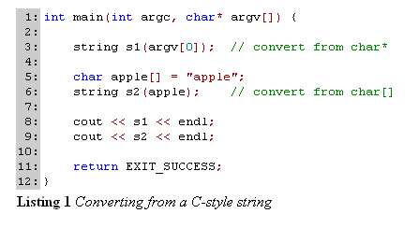
C-style Strings
string类的构造函数可以将c语言的字符串转化为string对象

Slide 82
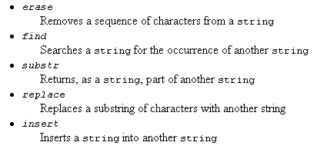
Advanced String Operations
®

Slide 83
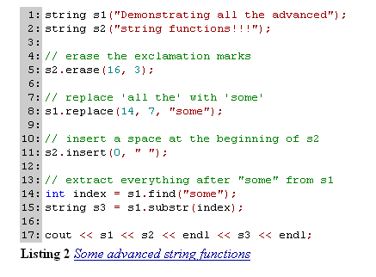
Advanced String Operations
Notes:
Demonstrating some advanced string functions
some advanced

Slide 84
int main(int argc, char* argv[]) {
string s1(argv[1]);
s1.erase(6,3);
s1.replace(3,3,"xxx");
s1.insert(0,"!!");
string s2=s1.substr(5,2);
string s3= s1.substr(5);
int i=s1.find("23");
cout << s1 << endl;
cout << s2 <<endl;
cout << s3 <<endl;
cout << i <<endl;
return EXIT_SUCCESS;
}

Slide 85
Advanced String Operations
输入:
123456789
输出：
!!123xxx
xx
xxx
3

Slide 86
Using the STL vector Container
Vector as an Array Class
Vector as an STL Container

Slide 87
Vector as an Array Class
  More safer than array
  Templates supported
®

Slide 88
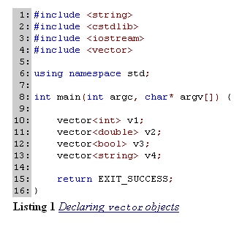
Vector as an Array Class

Slide 89

Vector as an Array Class
可以声明一个由vector对象组成的vector，这就为2维的数据结构，例如矩阵提供了实现方法

Slide 90
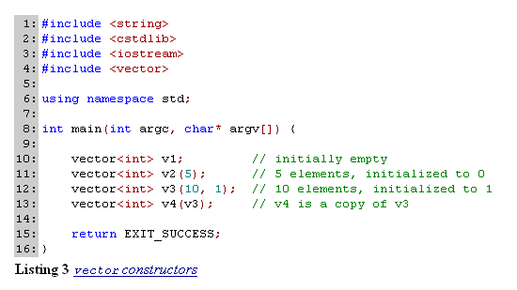
Vector as an Array Class
Constructor

Slide 91
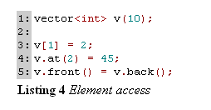
Vector as an Array Class
Element access
当需要边界检查的时候，我们必须使用at()方法,该方法返回指定位置元素的引用，如果该位置是无效的则抛出out_of_range异常 。 front()和back()分别返回vector的第一个元素和最后一个元素。
®

Slide 92
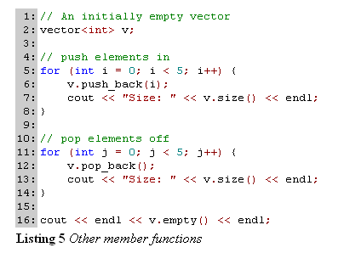
Vector as an Array Class
Other member functions

Slide 93
Vector as an STL Container
游标的使用
vector<int> v;
for (int i = 0; i < 10; i++)
{ v.push_back(i); }
// Iterate though elements
vector<int>::iterator it;
for (it = v.begin(); it != v.end(); it++)
{ cout << *it << endl; }
®

Slide 94
Vector as an STL Container
begin方法返回了指向vector中的第一个元素的游标，end返回指向vector中最后一个元素再往后一个位置的游标

Slide 95
Vector as an STL Container
vector<int> v;
for (int i = 0; i < 10; i++)
{ v.push_back(i); }
// Iterate though elements
vector<int>::reverse_iterator rev_it; for(rev_it=v1.rbegin();rev_it!=v1.rend();rev_it++)
{
cout<<*rev_it<<endl;
}

Slide 96
Vector as an STL Container
rbegin返回vector中指向最后一个元素的反游标, rend方法返回了指向vector中的第一个元素前一个位置的反游标。

Slide 97
Vector as an STL Container
Insert and erase functions
Vector还提供了在vector中的任意位置插入和删除元素的方法，方法insert和erase分别提供这些功能，这些方法用游标作为参数，通过游标指明插入的位置和删除的元素。

Slide 98
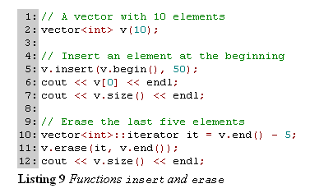
Vector as an STL Container
Notes:
Erase可以是一个参数，也可以是2个参数，一个参数就是删除一个元素，2个参数是删除一个区间中的元素。

Slide 99




Vector as an STL Container
图1
图2
图3
图4
Size和capacity是vector的两个属性，在图1中vector的size为3，因为它存储了3个元素，vector还另外占用4个内存空间来支持新元素的加入，所以capacity是7
®

Slide 100
Using the STL deque Container
Double-ended Queue
Interface
  can store and provide access to a linear sequence of elements
Implementation

Slide 101
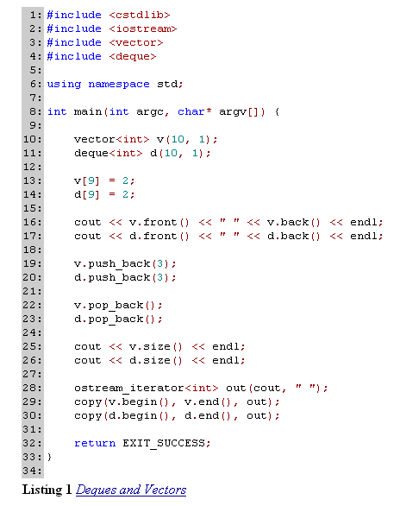

Slide 102
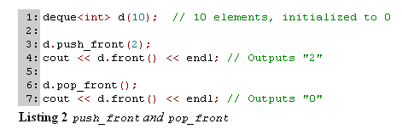
Interface
push_front() and pop_front()
Notes:
vector并不支持push_front和pop_front操作,可以采用insert和erase来代替 .

Slide 103
Interface
Count() and count_if()
count方法在一定范围的元素中计数某个特定值的个数。该方法返回的是在特定范围内等于该值的元素的数量。
count_if方法用来确定在指定的范围内一些特定条件的元素的发生次数。
注意使用count，count_if时要包含头文件 #include <algorithm>

Slide 104
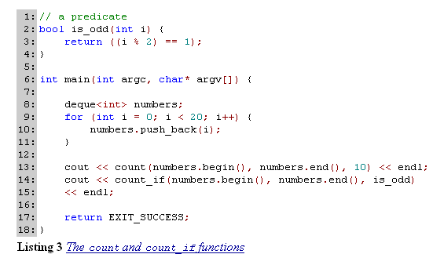
Interface
®
Notes:
1,10

Slide 105


Implementation
Difference between vector and deque
Storage strategies
  Vectors reserve memory only at the back of stored elements
  Deques reserve memory locations at both the front and back of their stored elements

Slide 106
Implementation
Operations
  The same ones
    push_back
    pop_back
  For deque only
    push_front
    pop_front
  For vector
    Alternative method: insert or erase the first element

Slide 107
Implementation
Implementation of Linked List using STL

Slide 108
Linked Lists
A Linked Structure
A C++ Implementation
Using the STL list Container

Slide 109
A Linked Structure
链表用于存储一系列有序的元素。使用链表及其操作，可以建立，操作，维护一系列有序的元素。
Linked List和vector的差异
存储方式
效率

Slide 110

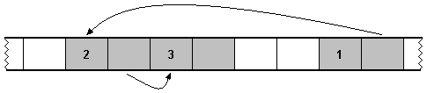
A Linked Structure
Vector在内存中的存储
Linked List在内存中的存储

Slide 111

A Linked Structure
非连续空间的存储也有自己的优缺点:
优点是在移出和添加一个元素的时候只需要简单的改变连接。
缺点是在链表中随机的访问并不像在vector中那么高效，为了访问链表中的特定元素，由于无法通过计算得出该元素存储的位置，所以必须从头开始遍历元素直到找到想要查找的元素为止。
Linked list移出操作

Slide 112

A Linked Structure
在内存中仅仅储存数据元素是无法维护链表的，每个元素必须指出下一个元素的位置，链表是通过指针来组织的。
链表模型

Slide 113

A Linked Structure
双向链表可以支持从前往后和从后往前两个方向遍历表中的数据元素
双向链表模型

Slide 114
template <class T> // Public interface of class LinkedList
class LinkedList {
public:
LinkedList(); // Default constructor
LinkedList(const LinkedList<T>& src); // Copy constructor
~LinkedList(); // Destructor
T& front(); // Element access for front of list
T& back(); // Element access for back of list
int size(); // count of elements in list
bool empty(); // Size > 0
void push_front(const T&); // Insert element at beginning
void push_back(const T&); // Insert element at end
void pop_front(); // Remove element from beginning
void pop_back(); // Remove element from end
void dump(); // Output contents of list
};

Slide 115
Implementation
节点
template <class T>
class LinkedList {
private:
class Node {
T data;
Node* next; };
public: // rest of public members ...

Slide 116
All the private data members
template <class T>
class LinkedList {
private:
class Node {
friend class LinkedList<T>;
private:
T data;
Node* next;
public:
Node(T d, Node* n = NULL) : data(d), next(n) {}} ;
Node* head; // Beginning of list
Node* tail; // End of list
int count; // Number of nodes in list

Slide 117
// Default constructor
LinkedList(void) : head(NULL), tail(NULL), count(0) {}
// Returns a reference to first element
T& front(void) {
assert (head != NULL);
return head->data;
}
// Returns a reference to last element
T& back(void) {
assert (tail != NULL);
return tail->data;
}
// Returns count of elements of list
int size(void) {
return count;
}
// Returns whether or not list contains any elements
bool empty(void) {
return count == 0;
}

Slide 118
Implementation
在开始处插入元素主要包含以下步骤 ：
产生一个新节点
将新节点链接到表的开始处
将head指针移到列表的新开始处
count值加1

Slide 119


Implementation
插入时的特殊情况

Slide 120
// Insert an element at the beginning
template <class T>
void LinkedList<T>::push_front(T d) {
Node* new_head = new Node(d, head);
if (this->empty()) {
head = new_head;
tail = new_head;
}
else {
head = new_head;
}
count++;
}
Method push_front

Slide 121
// Remove an element from the beginning
template <class T>
void LinkedList<T>::pop_front(void) {
assert(head != NULL);
Node* old_head = head;
if (this->size() == 1) {
head = NULL;
tail = NULL;
}//no element
else {
head = head->next;
}
delete old_head;
count--;
}
Method pop_front

Slide 122
// Insert an element at the end
template <class T>
void LinkedList<T>::push_back(T d) {
Node* new_tail = new Node(d, NULL);
if (this->empty()) {
head = new_tail;
}
else {
tail->next = new_tail;
}
tail = new_tail;
count++;
}
Method push_back

Slide 123
Implementation
Pop_back需要执行以下操作作步骤：
将tail指针指向前一个节点
释放最后一个节点的内存

Slide 124
// Remove an element from the end
template <class T>
void LinkedList<T>::pop_back(void) {
assert(tail != NULL);
Node* old_tail = tail;
if (this->size() == 1) {
head = NULL;
tail = NULL;
}
else {
// Traverse the list to node just before tail
Node* current = head;
while (current->next != tail) {
current = current->next;
}
// Unlink and reposition
current->next = NULL;
tail = current;
}
delete old_tail;
count--;
} Method pop_back

Slide 125
// Destructor
template <class T>
LinkedList<T>::~LinkedList(void) {
while (! this->empty()) {
this->pop_front();
}
}
The destructor

Slide 126
// Copy constructor
template <class T>
LinkedList<T>::LinkedList(const LinkedList<T>& src) :
count(0), head(NULL), tail(NULL) {
Node* current = src.head;
while (current != NULL) {
this->push_back(current->data);
current = current->next;
}
}
Copy constructor

Slide 127
// Display the contents of the list
template <class T>
void LinkedList<T>::dump(void) {
cout << "(";
Node* current = head;
if (current != NULL) {
while (current->next != NULL) {
cout << current->data << ", ";
current = current->next;
}
cout << current->data;
}
cout << ")" << endl;
}
Method dump

Slide 128
Using the STL list Container
在list类中成员函数push_front，pop_front，push_back和pop_back支持元素在两端的插入和移出，。List类还通过front和back方法提供了对第一个元素和最后一个元素的访问，size方法返回了列表中元素的个数，empty返回了列表是否为空的布尔值。

Slide 129
#include <iostream>
#include <string>
#include <cstdlib>
#include <list>
using namespace std;
int main(int argc, char* argv[]) {
list<int> l1;
l1.push_front(10);
cout << l1.size() << endl; // count of 1
list<string> l2(10);
cout << l2.size() << endl; // count of 10
list<double> l3(1, 2.3); // initial value of 2.3
cout << l3.back() << endl;
l3.pop_back();
cout << l3.empty() << endl;
return EXIT_SUCCESS;
}
Notes:
1 10 2.3 1

Slide 130
Using the STL list Container
Traversing a List
// Populate
list<int> l;
for (int i = 1; i <= 10; i++) {
l.push_back(i);
}
// Traverse
list<int>::iterator it;
for (it = l.begin(); it != l.end(); it++) {
cout << *it << endl;
}

Slide 131
// Populate
list<int> l;
for (int i = 1; i <= 10; i++) {
l.push_back(i);
}
// Reverse Traverse
list<int>::iterator it;
it = l.end();
do {
--it;
cout << *it << endl;
}
while (it != l.begin());

Slide 132
// Populate
list<int> l;
for (int i = 1; i <= 10; i++) {
l.push_back(i);
}
// Reverse Traverse
list<int>::reverse_iterator it;
for (it = l.rbegin(); it != l.rend(); it++) {
cout << *it << endl;
}
Reverse iterators

Slide 133
Using the STL list Container
Inserting and Removing Elements
// Erase the second element from a list
list<int> l(10);
list<int>::iterator second = l.begin();
second++;
l.erase(second);
Using function erase
Notes:
erase用一个参数指明移出的元素，用两个参数指明移出指定范围内的元素。

Slide 134
Using the STL list Container
// Insert an element after the first element
list<int> l(10);
list<int>::iterator it = l.begin();
it++;
l.insert(it, 5);
Function insert

Slide 135
Using the STL list Container
// Insert a range of elements
list<double> l1(10, 2.14);
list<double> l2(5, 0.0);
list<double>::iterator it = l1.begin();
it++;
l1.insert(it, l2.begin(), l2.end());
cout << l1.size() << endl;
Inserting a range of elements
Notes:
15

