Slide 1


Lecture-04
Lecture Notes: Data Structures and Algorithms
Lecture 4 Linked List and STL

Slide 2
Chapter 4 Linked List
Table of Contents
  Singly Linked List
    Structure of singly linked list
    ListNode Class and List Class definition
    Implementation of functions
    Iterator Class
  Circular List
  Linked representation of Polynomial
  Doubly Linked List
  Summary

Slide 3


4-1.1 Singly Linked List
Characteristics
  Node (item) representation
  Linear structure
  Nodes stored in non-contiguous space
  Extensible
®

Slide 4
Class definition of S-Linked List
A linked list consists of:
  ListNode Class
  List Class
  Iterator Class
Definition
  Compound definition
  Embedded definition

Slide 5
class List; //Compound Class
class ListNode { //ListNode Class
friend class List; //List class is its friend
private:
int data; //Node type, int
ListNode *link; //Pointer
};
class List { //List Class
public:
//Public methods of Linked List
………
private:
ListNode *first, *last; //head and tail pointer
};

Slide 6
class List { //List Class (Embedded definition)
public:
//Operations
………
private:
class ListNode { //Embedded ListNode Class
public:
int data;
ListNode *link;
};
ListNode *first, *last; //Head and Tail pointer
};
Insert (Three cases)

Slide 7
Insert an item into S-Linked List
Three cases considered
  First case:
Insert a node before the first node of List.
newnode→link = first ;
first = newnode;
first
first
Before insertion
After insertion

Slide 8
Insert an item into S-Linked List
  Second case:
  Insert a node within the list (before the last node)
  newnode→link = p→link;
p→link = newnode；
newnode
p
p
Before insertion
After insertion

Slide 9
Insert an item into S-Linked List
  Third case:
  Insert a node after the last node of List.
  newnode→link = p→link;
p→link = last = newnode；
newnode
newnode
p
p
last
last
Before insertion
After insertion

Slide 10
int List::Insert ( const int x, const int i ) {
//Insert a new element x before i-th node of the list
ListNode *p = first; int k = 0;
while ( p != NULL && k < i -1 )
{ p = p→link; k++; } //Find out i-1-th node
if ( p == NULL && first != NULL ) {
cout << “Invalid pos for insertion!\n”;
return 0;
} //no i-1th node
ListNode *newnode= new ListNode(x, NULL);
//New a node whose data is x and pointer is 0

Slide 11
if ( first == NULL || i == 0 ) { //First case
newnode→link = first; //i=0
if ( first == NULL ) last = newnode;
first = newnode;
}
else { //Second and third cases
newnode→link = p→link;
if ( p→link == NULL ) last = newnode;
p→link = newnode;
}
return 1;
}
Remove

Slide 12
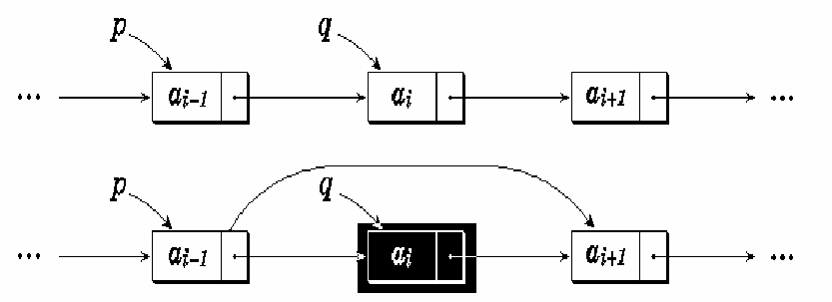
Remove a node from List
Two cases
  First case: Remove the first node of list;
  Second case: Remove the node within the list or the last node.
Before removal
After removal

Slide 13
int List::Remove ( int i ) {
//Remove i-th node of the list
Node *p = first, *q; int k = 0;
while ( p != NULL && k< i-1 )
{ p = p→link; k++; } //Find out i-1-th node
if ( p == NULL || p→link == NULL ) {
cout << “Invalid pos for removal!\n”;
return 0;
}
if ( i == 0 ) { //First case
q = first;
p = first = first→link; //Modify first pointer
}

Slide 14
else { //Second case
q = p→link;
p→link = q→link;
}
if ( q == last ) last = p; //Modify last pointer
k = q→data;
delete q; //Release q
return k;
}
S-List Dummy node

Slide 15
S-Linked List with Dummy Node
Dummy node (DN)
  at the beginning of the list
  without specific meaning, just a indicator
The aim of dummy node
  Unify the operations of Linked list, whether it is a Empty list or Non-empty list;
  Simplify the operations of list
first
a₁
a_{n}
0
first
0
last
last
General Non-Empty List
Empty List

Slide 16
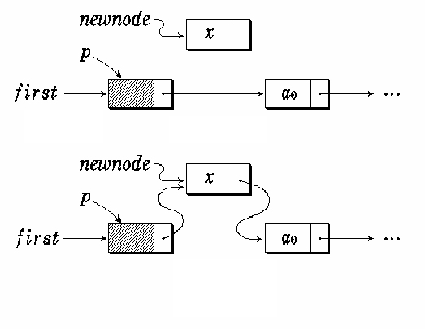
Details of Insertion for List with DN
Non-Empty list
Before insertion
After insertion

Slide 17
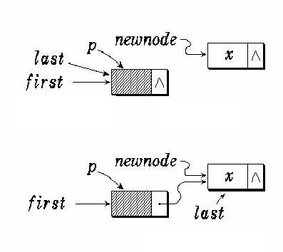
Empty list
Before insertion
After insertion
newnode→link = p→link;
if ( p→link == NULL ) last = newnode;
p→link = newnode;

Slide 18
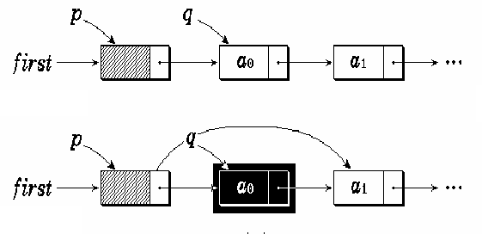
Details of Removal for List with DN
Non-Empty list
Before
Removal
After
Removal

Slide 19
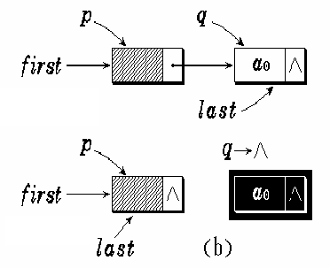
Empty list
Before
Removal
After
Removal
q = p→link;
p→link = q→link;
delete q;
if ( p→link == NULL ) last = p;
Class
S-List Dummy node

Slide 20
Class of S-Linked List with DN
template <class Type> class List;
template <class Type> class ListNode {
friend class List<Type>;
Type data;
ListNode<Type> *link;
public:
ListNode ( );
ListNode ( const Type& item );
//Get the address of next node (successor)
ListNode<Type> *NextNode ( ) { return link; }

Slide 21
//New a node with (item, next)
ListNode<Type> *GetNode ( const Type&
item, ListNode<Type> *next );
//Insert p-node after the current node
void InsertAfter ( ListNode<Type> *p );
//Remove the current node
ListNode<Type> *RemoveAfter ( );
};
template <class Type> class List {
ListNode<Type> *first, *last;
public:

Slide 22
List ( const Type & value ) {
last =first = new ListNode<Type>( value );
} //constructor
~List ( );
void MakeEmpty ( );
int Length ( ) const;
ListNode<Type> *Find ( Type value );
ListNode<Type> *Find ( int i );
int Insert ( Type value, int i );
Type *Remove ( int i );
Type *Get ( int i );//get i-th element
};

Slide 23
Implementation of functions
ListNode Class
//Constructor 1
template <class Type>
ListNode<Type> :: ListNode ( ) : link (NULL)
{ }
//Constructor 2
template <class Type>
ListNode<Type>::
ListNode( const Type & item ) :data (item), link (NULL)
{ }

Slide 24
ListNode Class
//New node
template <class Type>
ListNode<Type> * ListNode<Type>::
GetNode ( const Type & item,
ListNode<Type> *next = NULL ) {
ListNode<Type> *newnode =
new ListNode<Type> ( item );
newnode →link = next;
return newnode;
}

Slide 25
ListNode Class
//Insert a node p after current node
template <class Type>
void ListNode <Type>::
InsertAfter ( ListNode<Type> *p ) {
p→link = link; link = p;
}

Slide 26
ListNode Class
//Remove the current node in the list
template <class Type>
ListNode<Type>* ListNode<Type>::RemoveAfter ( ) {
ListNode<Type> *tempptr = link;
if ( link == NULL ) return NULL;
link = tempptr→link;
return tempptr;
}
List Class

Slide 27
List Class
//Constructor (defined in the class declaration)
template <class Type>
List<Type> :: List ( const Type & value ) {
last =first = new ListNode<Type>( value );
}
//Deconstructor
template <class Type>
List<Type> :: ~List ( ) {
MakeEmpty ( ); delete first;
}

Slide 28
List Class
//Release the linked list
template <class Type>
void List<Type> :: MakeEmpty ( ) {
ListNode<Type> *q;
while ( first→link != NULL ) {
q = first→link; first→link = q→link;
delete q;
}
last = first;
}

Slide 29
List Class
//Get the number of the nodes
template <class Type>
int List<Type>::Length ( ) const {
ListNode<Type> *p = first→link;
int count = 0;
while ( p != NULL ) {
p = p→link; count++;
}
return count;
}

Slide 30
List Class
//Search a value in the list
template <class Type>
ListNode<Type>*List <Type>:: Find ( Type value ) {
ListNode<Type> *p = first→link;
while ( p != NULL && p→data != value )
p = p→link;
return p;
}

Slide 31
List Class
//Find out the i-th node, return it’s address
template <class Type>
ListNode<Type> *List<Type> :: Find ( int i ) {
if ( i < -1 ) return NULL;
if ( i == -1 ) return first;
ListNode<Type> *p = first→link;
int j = 0;
while ( p != NULL && j < i )
{ p = p→link; j = j++; }
return p;
}

Slide 32
//Insert a new node (value) before the i-th node in
//the list List Class
template <class Type>
int List<Type> :: Insert ( Type value, int i ) {
ListNode<Type> *p = Find ( i-1 );
if ( p == NULL ) return 0;
ListNode<Type> *newnode =
GetNode ( value, p→link );
if ( p→link == NULL ) last = newnode;
p→link = newnode;
return 1;
}

Slide 33
//Remove the i-th node in the list (List Class)
template <class Type>
Type *List<Type>::Remove ( int i ) {
ListNode<Type> *p = Find (i-1), *q;
if ( p == NULL || p→link == NULL )
return NULL;
q = p→link; p→link = q→link;
Type* value = new Type ( q→data );
if ( q == last ) last = p;
delete q;
return value;
}

Slide 34
List Class
//Find out the i-th node, return it’s value
template <class Type>
Type *List<Type>::Get ( int i ) {
ListNode<Type> *p = Find ( i );
if ( p == NULL || p == first )
return NULL;
else
return p→data;
}
Iterator Class

Slide 35
Iterator Class of Linked List
The objective of iterator class
  To search in the singly linked list
Principal of iterator class
  Friend class of ListNode and List classes
  Iterator object can refer existing CList object
  Variable: current position
    Keep the position of the current node in the list
  Provide several methods for testing and searching
®

Slide 36
Template description of three Classes of Linked list (without DN)
enum Boolean { False, True };
template <class Type> class List;
template <class Type> class ListIterator;
template <class Type> class ListNode {
friend class List <Type>;
friend class ListIterator <Type>;
public:
………

Slide 37
private:
Type data;
ListNode<Type> *link;
};
template <class Type> class List {
public:
………
private:
ListNode<Type> *first, *last;
};

Slide 38
template <class Type> class ListIterator {
public:
ListIterator ( const List<Type> & l )
: list ( l ), current ( l.first ) { }
Boolean NotNull ( );
Boolean NextNotNull ( );
ListNode <Type> *First ( );
ListNode <Type> *Next ( );
private:
const List<Type> & list;
ListNode<Type> *current;
}

Slide 39
Implementation of methods of Iterator Class
//Check whether the current node is NULL or not template <class Type>
Boolean ListIterator<Type> :: NotNull ( ) {
if ( current != NULL ) return True;
else return False;
}
current
current
case 1 return True case 2 return False

Slide 40
//Check whether the next node of the current
//node is NULL or not
template <class Type>
Boolean ListIterator<Type>::NextNotNull ( ) {
if ( current != NULL &&
current→link != NULL ) return True;
else return False;
}
current
current
case 1 return True case 2 return False

Slide 41
//return the address of the first node
template <class Type>
ListNode<Type>* ListIterator<Type> :: First ( ) {
if ( list.first→link != NULL ){
current = list.first;
return &current→data;
}
else { current = NULL; return NULL; }
}
list.first
current
Without dummy node

Slide 42
//return the address the next node of the current
//node in the list
template <class Type>
ListNode<Type>* ListIterator<Type> :: Next ( ) {
if ( current != NULL
&& current→link != NULL ) {
current = current→link;
return current;
}
else { current = NULL; return NULL; }
}
current
current

Slide 43
Example: compute the sum of elements of the list using iterator class
int sum ( const List<int> &l )
{
ListIterator<int> li ( l );
if ( ! li.NotNull ( ) ) return 0;
int retval = li.First( )->data;
while ( li.nextNotNull ( ) )
retval += li.Next( )->data;
return retval;
}

Slide 44
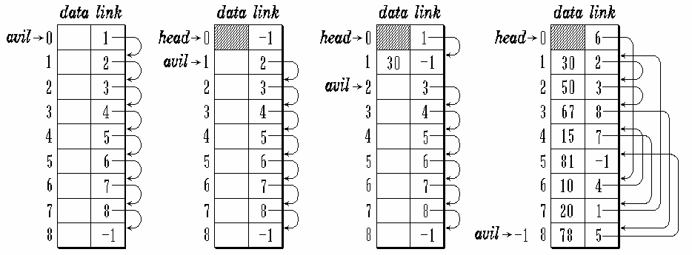
Linked List in array
New node： j = avil; avil = A[avil].link;
Release ： A[i].link = avil; avil = i;
®

Slide 45
4-1.2 Circular List
Circular list is an advanced singly linked list
  The link field of the last node of the list is not 0 yet, pointing to the head of list;
  If we know the position of arbitrary node of the circular list, we could access all the nodes one by one.
Circular list has two kinds of representation
  Without Dummy node
  With dummy node

Slide 46

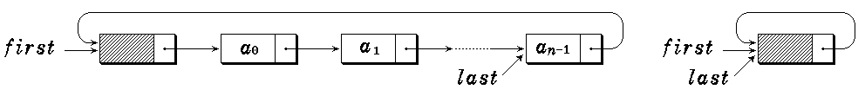
Example
An example of circular list
Circular list with DN

Slide 47
Class of circular list
template <class Type> class CircList;
template <class Type> class CircListNode {
friend class CircList;
public:
CircListNode ( Type d = 0,
CircListNode<Type> *next = NULL ) :
data ( d ), link ( next ) { }
private:
Type data;
CircListNode<Type> *link;
}

Slide 48
template <class Type> class CircList {
public:
CircList ( Type value );
~CircList ( );
int Length ( ) const;
Boolean IsEmpty ( )
{ return first→link == first; }
Boolean Find ( const Type & value );
Type getData ( ) const;
void Firster ( ) { current = first; }
Boolean First ( );
Boolean Next ( );

Slide 49
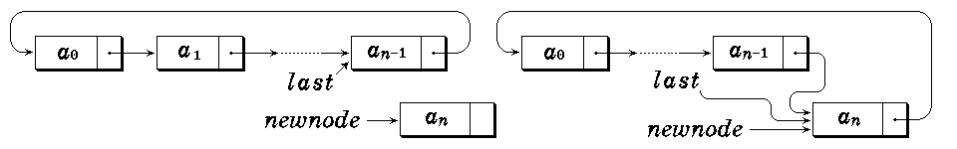
Boolean Prior ( );
void Insert ( const Type & value );
void Remove ( );
private:
CircListNode<Type> *first, *current, *last;
};
Insertion
®

Slide 50
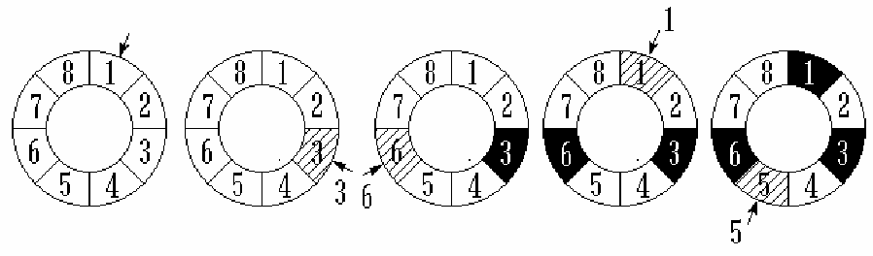
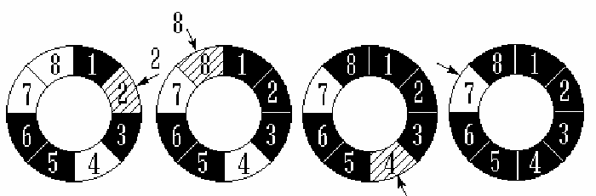
Application– Joseph Problem
Joseph Problem: m=3, n=8
Finished
Implementation

Slide 51
#include <iostream.h>
#include “CircList.h”
Template<Type>
void CircList<Type>:: Josephus ( int n, int m ) {
Firster ( );
for ( int i = 0; i < n-1; i++ ) {
for ( int j = 0; j < m-1; j++ ) Next ( );
cout << “The out one is” << getData ( )
<< endl;
Remove ( );
}
}

Slide 52
void main ( ) {
CircList<int> clist;
int n, m;
cout << “Input the number of people and the interval”;
cin >> n >> m;
for ( int i = 1; i <= n; i++ ) clist.insert (i);
//Construct Joseph circle
clist.Josephus (n, m);
//Call Joseph function
}

Slide 53
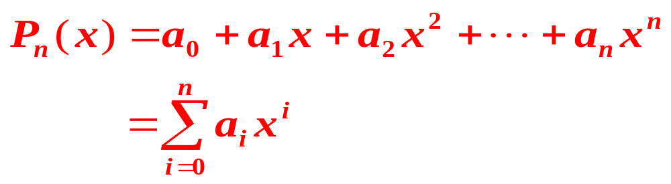

4-1.3 Linked list for Polynomial
Polynomial
Node:
®

Slide 54
Class description of PN using S-LL
struct Term {
int coef;
int exp;
Term* link;
Term ( int c, int e ) { coef = c; exp = e; }
};
class Polynomial {
List<Term> poly;
friend Polynomial & operator +
( Polynomial &, Polynomial &);
};

Slide 55
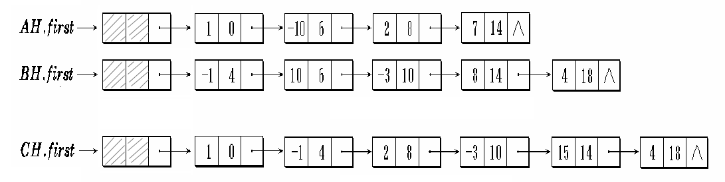
Polynomial Addition
AH = 1 - 10x⁶ + 2x⁸ +7x¹⁴
BH = - x⁴ + 10x⁶ - 3x¹⁰ + 8x¹⁴ +4x¹⁸
CH=AH+BH
= 1- x⁴ + 2x⁶ - 3x¹⁰ + 15x¹⁴ +4x¹⁸
pc
pa
pb

Slide 56
Case 1：pa->expn<pb->expn
Key steps：
pc
pa
1
0
8
6
pb
-1
4
pc
pa
1
0
8
6
pb
-1
4

Slide 57
Case 2：pa->expn>pb->expn
Key steps：
pc
pa
1
0
8
6
pb
-1
4
-10
6
pa
1
0
8
6
pc
pb
-1
4
-10
6

Slide 58
Case 3a：pa->expn=pb->expn
pa->coef+pb->coef !=0
Key steps：
pa
1
0
8
6
2
8
pc
pb
-1
4
-10
6
-3
10
pc
pa
1
0
-2
6
2
8
pb
-1
4
-10
6
-3
10

Slide 59
Case 3b：pa->expn=pb->expn
pa->coef+pb->coef ==0
Key steps：
pa
1
0
10
6
2
8
pc
pb
-1
4
-10
6
-3
10
pa
1
0
10
6
2
8
pc
pb
-1
4
-10
6
-3
10

Slide 60
Result
la
1
0
-10
6
2
8
7
14
lb
-1
4
10
6
-3
10
8
14
4
18
la
1
0
-10
6
2
8
15
14
lb
-1
4
10
6
-3
10
8
14
4
18

Slide 61
Polynomial & operator + ( Polynomial & ah,
Polynomial & bh )
{
ListNode<Term> *pa, *pb, *pc, *p;
//Aiter、Biter
ListIterator<Term> Aiter ( ah.poly );
ListIterator<Term> Biter ( bh.poly );
// pa, pb
pa = pc = Aiter.First ( ); // ah
pb = p = Biter.First ( ); // bh
pa = Aiter.Next ( ); pb = Biter.Next ( );
delete p;//释放多项式pb的头结点

Slide 62
while ( Aiter.NotNull ( ) && Biter.NotNull ( ) )
switch ( compare ( pa→exp, pb→exp ) ) {
case ‘=’ :
pa→coef = pa→coef + pb→coef;
p = pb; pb = Biter.Next ( ); delete p;
if ( !pa→coef ) {
p = pa; pa = Aiter.Next ( );
delete p;
}
else {
pc→link = pa; pc = pa;
pa = Aiter.Next ( );
}

Slide 63
break;
case ‘>’ : // pa→exp> pb→exp
pc→link = pb; pc = pb;
pb = Biter.Next ( ); break;
case ‘<’ : // pa→exp< pb→exp
pc→link = pa; pc = pa;
pa = Aiter.Next ( );
}
if ( Aiter.NotNull ( ) ) pc→link = pa;
else pc→link = pb;
}

Slide 64
4-1.4 Doubly Linked List (DblList)
Drawback of singly linked list
  Can’t visit the predecessor of the current node
Improved criteria
  Besides the existed successor linked pointer, add another pointer which used to point to the predecessor node
lLink
(left link pointer)
data
rLink
(right link pointer)

Slide 65

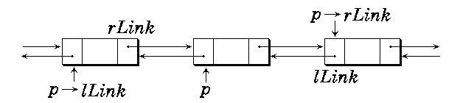
Non-empty list Empty list
Relations between the predecessor, current node and successor
  p == p→lLink→rLink == p→rLink→lLink
DblList Class

Slide 66
Class of DblList
template <class Type> class DblList;
//DblNode class
template <class Type> class DblNode {
friend class DblList<Type>;
private:
Type data; //data
DblNode<Type> *lLink, *rLink; //pointer

Slide 67
DblNode ( Type value,
DblNode<Type> *left,
DblNode<Type> *right ) :
data (value), lLink (left), rLink (right)
{ }
DblNode ( Type value ) : data (value),
lLink (NULL), rLink (NULL)
{ }
};

Slide 68
//DblList class
template <class Type> class DblList {
public:
DblLIst ( Type uniqueVal );
~DblList ( );
int Length ( ) const;
int IsEmpty ( ) { return first→rlink == first; }
int Find ( const Type & target );
Type getData ( ) const;
void Firster ( ) { current = first; }
int First ( );

Slide 69
int Next ( );
int Prior ( );
int operator ! ( )
{ return current != NULL; }
void Insert ( const Type & value );
void Remove ( );
private:
DblNode<Type> *first, *current;
};

Slide 70
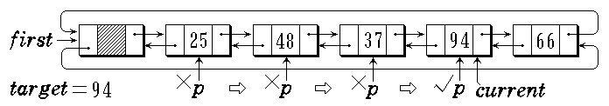
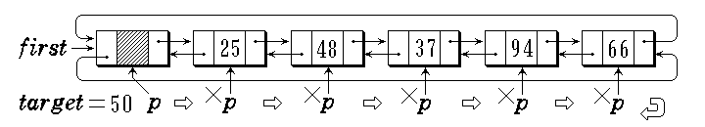
Searching in DblList
Success
Failure

Slide 71
//Find out the target in the DbL-List
template <class Type>
int DblList<Type>::Find ( const Type & target ) {
//Return 1 if success, otherwise return 0
DblNode<Type> *p = first→rLink;
while ( p != first && p→data != target )
p = p→rLink;
if ( p != first ) { current = p; return 1; }
return 0;
}

Slide 72
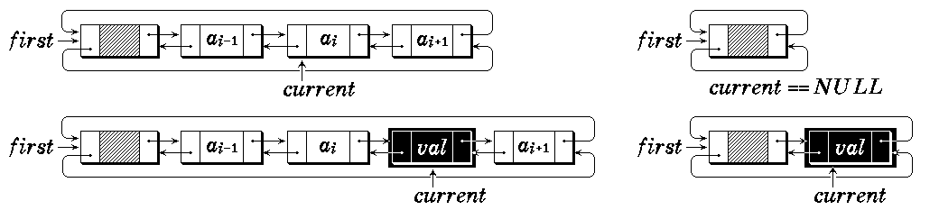
Insertion after current node in DblList
p→lLink = current;
p→rLink =current→rLink;
current→rLink = p;
current = current→rLink;
current→rLink→lLink = current;
p
p
val
val
Insertion in a non-empty list In an empty list

Slide 73
//Insert a node (value) after the current node
template <class Type>
void DblList<Type>::Insert ( const Type & value ) {
if ( current == NULL )
current = first→rLink =
new DblNode ( value, first, first );
else {
current→rLink =new DblNode
( value, current, current→rLink );
current = current→rLink;
}
current→rLink→lLink = current;
}

Slide 74
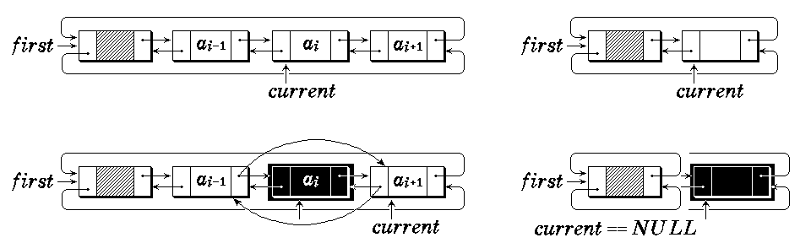
Node removal in DblList
current→rLink→lLink = current→lLink; current→lLink→rLink = current→rLink;
current = current→rLink;

Slide 75
//Remove the current node
template <class Type>
void DblList<Type>::Remove ( ) {
if ( current != NULL ) {
DblNode *temp = current;
current = current→rLink;
current→lLink = temp→lLink;
temp→lLink→rLink = current;
delete temp;
if ( current == first )
if ( IsEmpty ( ) ) current = NULL;
else current = current→rLink;
}
}

Slide 76
//Constructor
template <class Type>
DblList<Type>::DblLIst ( Type uniqueVal ) {
first = new DblNode<Type> ( uniqueVal );
first→rLink = first→lLink = first;
current = NULL;
}

Slide 77
//Get the number of the nodes in the DbL List
template <class Type>
int DblList<Type>::Length ( ) const {
DblNode<Type> * p = first→rLink;
int count = 0;
while ( p != first )
{ p = p→rLink; count++; }
return count;
}

Slide 78
//Move the current pointer to the first node
template <class Type>
int DblList<Type>::First ( ) {
if ( !IsEmpty ( ) )
{ current = first→rLink; return 1; }
current = NULL; return 0;
}

Slide 79
//Move the current pointer to the next node
template <class Type>
int DblList<Type>::Next ( ) {
if ( current→rLink == first )
{ current = NULL; return 0; }
current = current→rLink; return 1;
}

Slide 80
//Move the current pointer to the prior node
template <class Type>
int DblList<Type>::Prior ( ) {
if ( current→lLink == first )
{ current = NULL; return 0; }
current = current→lLink; return 1;
}

Slide 81
Question (1)?
For a large number, how to represent it and implement the +, -, *, / operations?
For example:
123456789123456789123456789.123456789
27
123
4567
8912
3456
7891
2345
6789
1234
5678
9
-1234.567890123456789012345678901234
-4
1234
5678
9012
3456
7890
1234
5678
9012
34

Slide 82
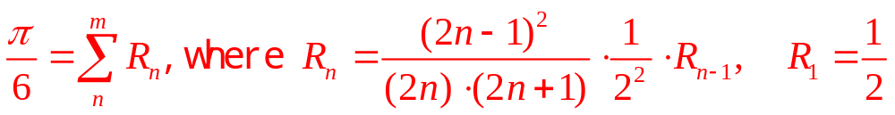
Question (2)?
How to calculate PI?
If x=1/2，arcsinx=π/6
PI
Demo

Slide 83
Summary (1)
Singly Linked List
  Structure and class description
  Implementation of membership functions
  Linked list with dummy node
  Template class definition and implementation
Circular Linked List
  Basic structure
  Application

Slide 84
Summary (2)
Polynomial and its linked list representation
  Polynomial class
  Operations of polynomial
Doubly Linked List
  DblList Class
  Implementation of membership functions

Slide 85
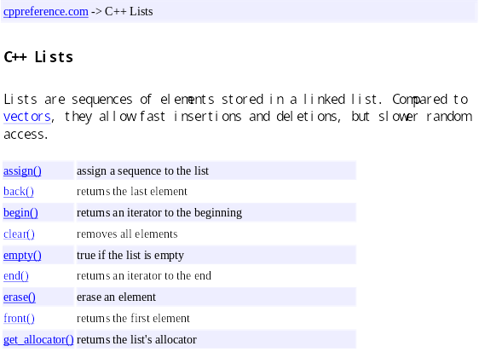
STL Lists

Slide 86
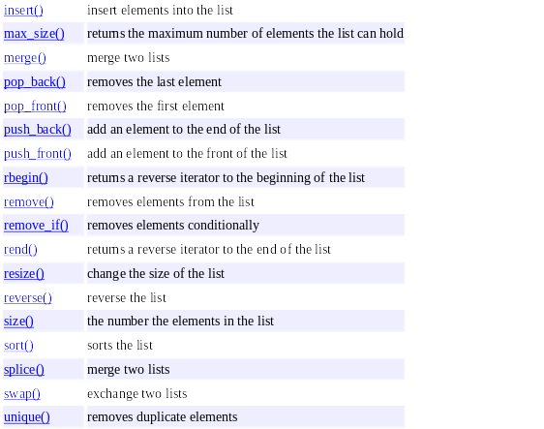
STL Lists

Slide 87
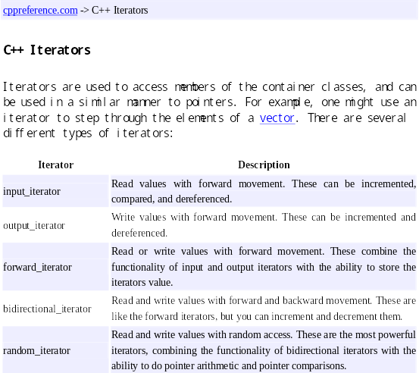
STL Iterator

Slide 88
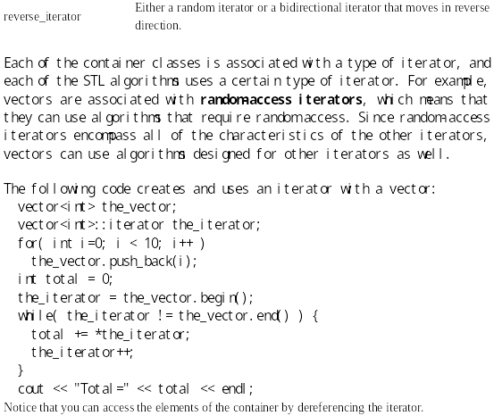
STL Iterator

Slide 89
Quiz
Comparison between sequential list and linked list.
Quiz1
Quiz2

