Slide 1


堆栈&队列
Lecture Notes: Data Structures and Algorithms
Lecture 5 Stack and Queue
Dr.Gao Xiang

Slide 2
Chapter 5-1 Stacks
Table of Contents
  Stack Specifications
  ADT Stacks and Their Implementations
  Application 1: Bracket Matching
  Application 2: A Calculator
  Application 3: Infix Expression to Postfix
  Summary

Slide 3
5-1.1 Stacks
Definition
  A stack is a kind of special linear list.
  A stack is a data structure in which all insertions and removals of entries are made at one end, called the top of the stack.
  LIFO structure: The last entry which was inserted is the first one that will be removed.
  (Last in first out)

Slide 4
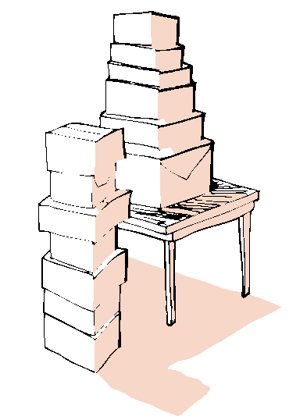
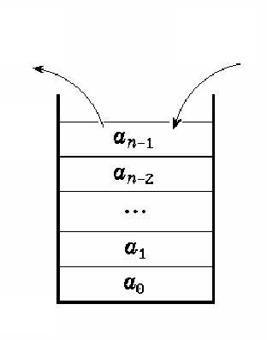
Example

Slide 5
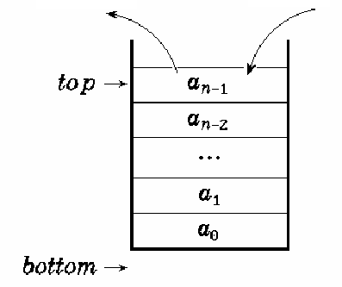
Concepts
Removal
(Pop)
Insertion
(Push)
Top
  The specific end of linear list at which elements can inserted and removed.
Bottom
  Another end of the stack.

Slide 6
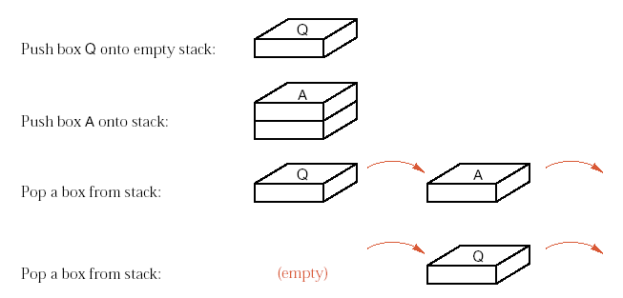

Examples of Push and Pop

Slide 7
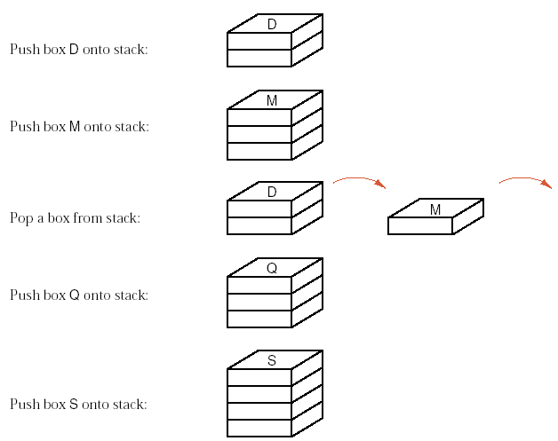

Slide 8
5-1.2 ADT of Stacks
template <class Type> class Stack {
public:
Stack ( int=10 );
void Push ( const Type & item);
Type Pop ( );
Type GetTop ( );
void MakeEmpty ( );
int IsEmpty ( ) const;
int IsFull ( ) const;
}

Slide 9
Sequential Stack Implementation
#include <assert.h>
template <class Type> class Stack {
public:
Stack ( int=10 );
~Stack ( ) { delete [ ] elements; }
void Push ( const Type & item );
Type Pop ( );
Type GetTop ( );
void MakeEmpty ( ) { top = -1; }
int IsEmpty ( ) const { return top == -1; }
int IsFull ( ) const { return top == maxSize-1; }

Slide 10
private:
int top;
Type *elements;
int maxSize;
}
template <class Type> Stack<Type>::
Stack ( int s ) : top (-1), maxSize (s) {
elements = new Type[maxSize];
assert ( elements != 0 );
}
®
Notes:
通常采用一维数组作为栈的存储表示和实现，这种方式实现的栈称为顺序栈，栈的存储结构封装在类的私有部分，栈数组的头指针为*elements，该数组最大允许存放的元素个数为maxSize，当前栈顶位置由数组下标top指示，如果栈不空时element[0]是栈中的第一个元素。

Slide 11
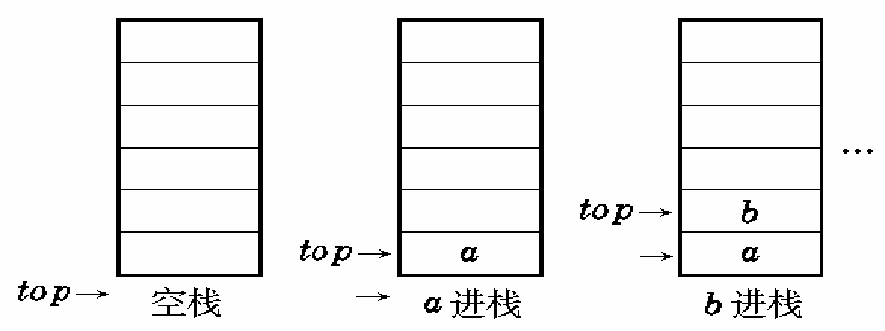
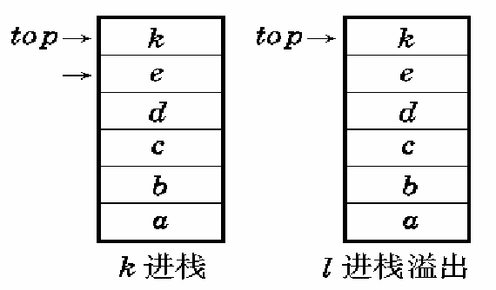
Push Demo

Slide 12
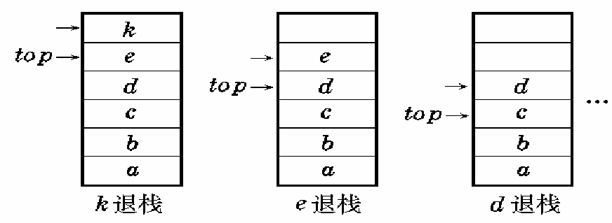
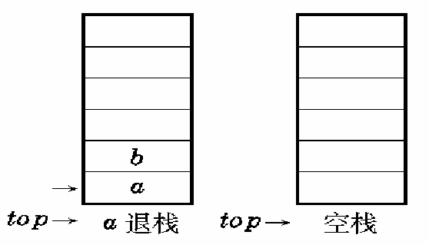
Pop Demo

Slide 13
template <class Type> void Stack<Type>::
Push ( const Type & item ) {
assert ( !IsFull ( ) );
elements[++top] = item;
}
template <class Type> Type Stack<Type>::
Pop ( ) {
assert ( !IsEmpty ( ) );
return elements[top--];
}
template <class Type> Type stack<Type>::
GetTop ( ) {
assert ( !IsEmpty ( ) );
return elements[top];
}

Slide 14
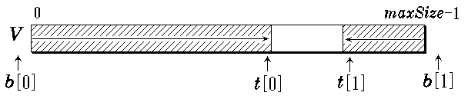
Question?
Two stacks shared in the same array.
  Initialization.
  Push entry into stack 1 or stack 2.
  Pop entry from stacks.
  Critical conditions
    Empty
    Full
    Overflow
Stack 1
Stack 2
®
Notes:
栈满时将发生溢出，为避免这种情况需要为栈设立足够大的空间，如果空间过大，而栈中元素较少就会造成浪费，此外当程序中有多个栈时，一出问题就会变得复杂。
程序需要两个栈的时候，可以定义一个足够大的空间，该空间的两端分别设为两个栈的栈底，两个栈都向伸展，直到栈顶相遇才会发生溢出。
当程序中需要多个栈的时候，就应该采用链式栈。

Slide 15
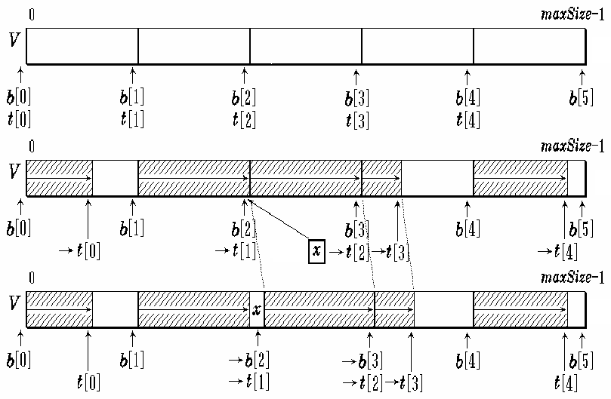
Question?
n stacks in the same array
Initialization
Push x onto stack 2
After pushing x onto stack 2
®

Slide 16

Linked Stack Implementation
template <class Type> class Stack;
template <class Type> class StackNode {
friend class Stack<Type>;
private:
Type data;
StackNode<Type> *link;
StackNode ( Type d = 0, StackNode<Type>
*l = NULL ) : data ( d ), link ( l ) { }
};
®
Notes:
采用链接方法表示的栈称之为链式栈，链式栈的栈顶在链表的表头，新节点的插入和栈顶节点的删除都在链表的表头进行。

Slide 17
template <class Type> class Stack {
public:
Stack ( ) : top ( NULL ) { }
~Stack ( );
void Push ( const Type & item);
Type Pop ( );
Type GetTop ( );
void MakeEmpty ( );
int IsEmpty ( ) const
{ return top == NULL; }
private:
StackNode<Type> *top;
}

Slide 18
template <class Type> Stack<Type>::
~Stack ( ) {
StackNode<Type> *p;
while ( top != NULL )
{ p = top; top = top→link; delete p; }
}
template <class Type> void Stack<Type>::
Push ( const Type &item ) {
top = new StackNode<Type> ( item, top );
}

Slide 19
template <class Type> Type Stack<Type>::
Pop ( ) {
assert ( !IsEmpty ( ) );
StackNode<Type> *p = top;
Type retvalue = p→data;
top = top→link;
delete p; return retvalue;
}
template <class Type> Type Stack<Type>::
GetTop ( ) {
assert ( !IsEmpty ( ) );
return top→data;
}

Slide 20
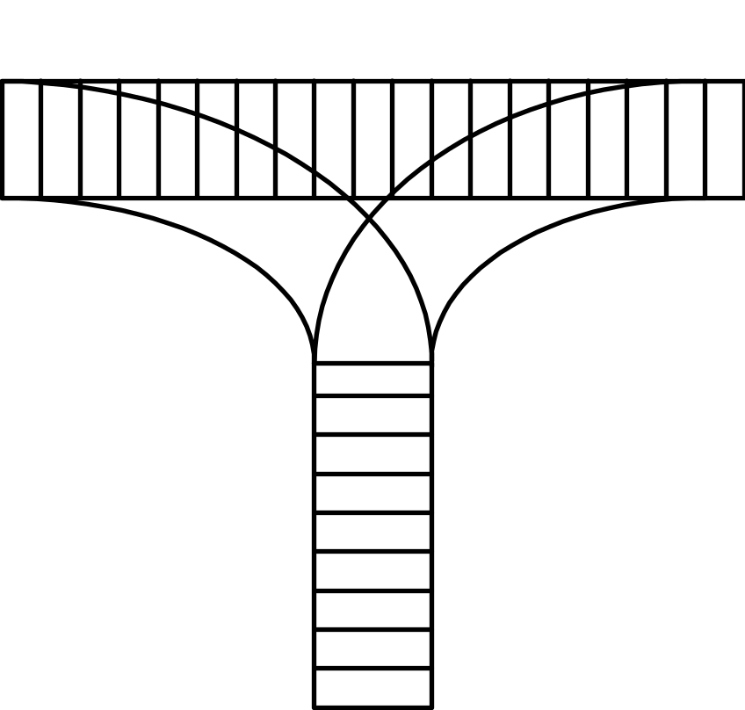
Quiz
How to arrange the carriages?
435612
123456
325641
154623
135426
Notes:
435612 154623不行

Slide 21
5-1.3 Application 1: Bracket Matching
Requirement
  Develop a program to check that brackets are correctly matched in an input text file.
  The brackets are limited in {, }, (, ), [, and ].
Methods
  Read a single line of characters and ignore all input other than bracket characters.
  Our program need only loop over the input characters, until either a bracketing error is detected or the input file ends.

Slide 22
Algorithm:
  Read the file character by character. Each opening bracket (, [, or { that is encountered is considered as unmatched and is stored until a matching bracket can be found. Any closing bracket ), ], or } must correspond, in bracket style, to the last unmatched opening bracket, which should now be retrieved and removed from storage. Finally, at the end of the program, we must check that no unmatched opening brackets are left over.

Slide 23
Bracket Matching Program
int main() {
Stack openings;
char symbol;
bool is_matched = true;
while (is_matched && (symbol = cin.get()) != '\n') {
if (symbol == '{' || symbol == '(' || symbol == '[')
openings.push(symbol);
if (symbol == '}' || symbol == ')' || symbol == ']') {
if (openings.empty()) {
cout << "Unmatched closing bracket " << symbol
<< " detected." << endl;
is_matched = false;
}//扫描到右括号，但栈为空

Slide 24
else {
char match;
match=openings.top();
openings.pop();
is_matched = (symbol == '}' && match == '{')
|| (symbol == ')' && match == '(')
|| (symbol == ']' && match == '[');
if (!is_matched)
cout << "Bad match " << match << symbol << endl;
}//括号不匹配
}
}//end while
if (!openings.empty())
cout << "Unmatched opening bracket(s) detected." << endl;
}//扫描完后栈不空

Slide 25
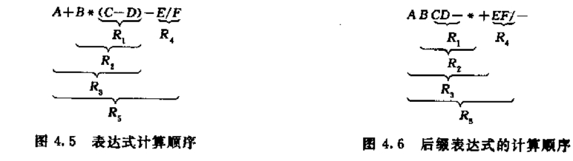
栈的应用——表达式的计算
表达式
  中缀: a+b*(c-d)-e/f
  后缀: abcd-*+ef/-
  操作数: a, b, c, d, e, f
  操作符: +, -, *, /,
  分隔符: (, ), #
®

Slide 26
后缀表达式 ABCD-*+EF/- 的计算过程为：
步 扫描项 项类型 动作 栈中内容
1 置空栈
2 A 操作数 进栈 A
3 B 操作数 进栈 AB
4 C 操作数 进栈 ABC
5 D 操作数 进栈 ABCD
6 — 操作符 D、C退栈，计算C-D,结果R1进栈 ABR1
7 ＊ 操作符 R1、B退栈，计算R2=B＊R1，R2进栈 AR2
8 ＋ 操作符 R2、A退栈，R3=A＋R2 ，R3进栈 R3
9 E 操作数 进栈 R3E
10 F 操作数 进栈 R3EF
11 / 操作符 F、E退栈，R4=E/F ，R4进栈 R3R4
12 — 操作符 R3、R4退栈 R5=R3-R4 R5进栈 R5
®

Slide 27
Calculator
class Calculator{//对键盘读入的后缀表达式求值
public:
Calculator(int sz):s(sz){}
void Run();
void Clear();
private:
void AddOperand(double value);//操作数进栈
Boolean Get2Operands(double &left, double &right); //从栈中退出两个操作数
void DoOperand(char op);//形成运算指令进行计算
Stack<double> s;}
Notes:
此计算器队从键盘读入的后缀表达式求值

Slide 28
void Calculator::AddOperand(double value){
s.Push(value);
}
bool Calculator::Get2Operands(double &left, double &right){
if(s.IsEmpty()){
cerr<<"missing operand\n"; return false;
}
right=s.Pop();
if(s.IsEmpty()){
cerr<<"missing operand\n"; return false;
}
left=s.Pop();
return true;
}

Slide 29
void Calvulator::DoOperator(char op){
double left, right; bool result;
result=Get2Operands(left,right);
if(result==true)
switch(op){
case'+': s.Push(left+right); break;
case'-': s.Push(left-right); break;
case'*': s.Push(left*right); break;
case'/': if(right==0.0){ cerr<<"divide by 0"; Clear();}
else s.Push(left/right); break;
case'^': s.Push(Power(left,right)); break;
}//end switch
else Clear();
}

Slide 30
Calculator
void Calculator::Run(){
char ch; double newoperand;
while(cin>>ch，ch!='='){
switch(ch){
case‘+’: case‘-’: case‘*’: case‘/’: case‘^’://操作符就进行计算
DoOperator(ch);break;
default: cin.putback(ch);
cin>>newoperand;
AddOperand(newoperand);//操作数就入栈
break;
}//end switch
}//end while
}//end run
Notes:
读字符串并求一个后缀表达式的值，‘=’作为结束，表达式的值存储在栈顶

Slide 31
Calculator
void Calculator::Clear(){
s.MakeEmpty();
}

Slide 32
5-1.5 Application 3: Infix Expression to Postfix
Expression
  Infix: a+b*(c-d)-e/f
  Postfix (Reverse Polish Notation): abcd-*+ef/-
Components
  Operands: a, b, c, d, e, f
  Operators: +, -, *, /,
  Delimiter: (, ), #

Slide 33
#a+b*(c-d)-e/f# abcd-*+ef/-
A specific stack OPTR is used to store temporary operators, such as +, *, and ( in above expression.
isp (in stack priority): the priority of operator at the top of OPTR stack.
icp (incoming priority): the new incoming operator priority.
If isp < icp, push the incoming operator into OPTR
If isp > icp, output and pop the top of OPTR
If isp = icp, scan next item and pop the top of OPTR

Slide 34
Infix Expression to Postfix
操作符 | # | ( | ^ | *, /, % | +, - | )
isp | 0 | 1 | 7 | 5 | 3 | 8
icp | 0 | 8 | 6 | 4 | 2 | 1
®

Slide 35
Infix expression: #a+b*(c-d)-e/f#
Step | Items | Type | Activity | Optr Stack | Output
0 |  |  |  | #
1 | a | operand |  |  | a
2 | + | operator | isp(#) < icp(+) | #+ | a
3 | b | operand |  | #+ | ab
4 | * | operator | isp(+) < icp(*) | #+* | ab
5 | ( | operator | isp(*) < icp(() | #+*( | ab
6 | c | operand |  | #+*( | abc
7 | - | operator | isp(() < icp(-) | #+*(- | abc
8 | d | operand |  | #+*(- | abcd
9 | ) | operator | isp(-) > icp()) | #+*( | abcd-
 |  |  | isp(()==icp()) | #+* | abcd-

Slide 36
10 | - | operator | isp(*) > icp(-) | #+ | abcd-*
 |  |  | isp(+) > icp(-) | # | abcd-*+
 |  |  | isp(#) < icp(-) | #- | abcd-*+
11 | e | operand |  | #- | abcd-*+e
12 | / | Operator | isp(-) < icp(/) | #-/ | abcd-*+e
13 | f | Operand |  | #-/ | abcd-*+ef
14 | # | Operator | isp(/) > icp(#) | #- | abcd-*+ef/
 |  |  | isp(-) > icp(#) | # | abcd-*+ef/-
 |  |  | isp(#) == icp(#), end
Infix expression: #a+b*(c-d)-e/f#

Slide 37
void postfix (expression e) {
Stack <char> OPTR; char ch, y;
OPTR.clear(); OPTR.push(‘#’);
while (cin.get(ch)){
if (isdigit(ch)) cout <<ch;//操作数直接输出
else {
OPTR.top(y);
switch(y, ch) {
case <: OPTR.push(ch); break;
case >: cout << y; OPTR.pop(); break;
case =: OPTR.pop();
}
}
}

Slide 38
STL stack adapter
#include <iostream>
#include <string>
#include <cstdlib>
#include <stack>
using namespace std;
int main(int argc, char* argv[]) {
stack<int> s; // push and pop
s.push(1);
s.pop(); // top
s.push(10);
s.push(11);
cout << s.top() << endl; // size and empty
cout << s.size() << endl;
cout << s.empty() << endl;
return EXIT_SUCCESS;}
Notes:
11 2 0

Slide 39
STL stack adapter
在stack adapter中只有6个成员方法，push和pop分别执行元素的插入和移出操作，top方法返回栈顶存储元素的引用，size返回栈中存储元素的数量，empty在栈为空时返回真否则就返回假，在使用stack adapter的时候必须包含头文件<stack>。

Slide 40
Chapter 5-2 Queues
Table of Contents
  Queues
  ADT Queues and Linear Implementation
  Circular Implementations of Queues
  Linked Queue Implementation
  Demonstration and Testing
    Application 1: Fibonacci Array
    Application 2: Yangvi Triangle
    Application 3: Car wash Simulation
  Summary

Slide 41
5-2.1 Queues
Definition
  A queue is a special linear list.
  A queue is a list in which all addition to the list are made at one end, and all deletions from the list are made at the other end.
  FIFO structure: The first entry which is added is the first one that will be removed.
  (First in first out)

Slide 42

Example
  A queue is a waiting line, like a people waiting to purchase tickets, where the first person in line is the first person served.

Slide 43

Concepts
front
  The specific end of linear list at which elements can removed.
  The entry in a queue ready to be served, that is, the first entry that will be removed from the queue, is called the front (head) entry of the queue.
rear
  The specific end of linear list at which elements can added or inserted.
  The one most recently added, is called the rear (tail) entry of the queue.

Slide 44
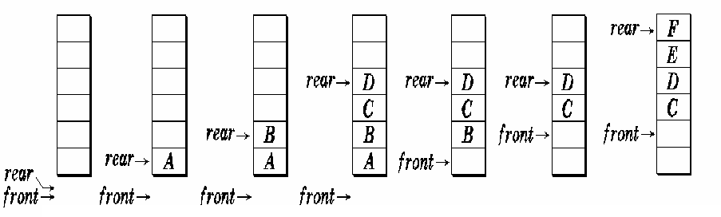
Examples of Addition and Deletion
Empty Queue
Alternative methods
  insert, append, enqueue
  delete, serve, dequeue

Slide 45
5-2.2 ADT of Queues
template <class Type> class Queue {
public:
Queue ( int=10 );
void EnQueue ( const Type & item);
Type DeQueue ( );
Type GetFront ( );
void MakeEmpty ( );
int IsEmpty ( ) const ;
int IsFull ( ) const;
}

Slide 46
Problem of linear implementation in array
当队头指针front==rear时，队列为空；当rear==maxsize-1时，队列为满，如果再加入新元素就会“溢出”。
有时这种溢出并非真正的溢出，在数组前端可能还有空位置，这是一种假溢出。

Slide 47
Problem of linear implementation in array
For example
rear=5, front=1
the actual length of queue is 4
however, no new entry could be appended into queue. Why?
®
Notes:
maxsize为6的队列，当rear==5,front==1时，实际占用的队列长度为4，然而再加入新元素时就溢出了。

Slide 48
Problem of linear implementation in array
Problem
  front and rear indices will move to the high end of the array after several Enqueue and Dequeue operations
Solution
  keep the front index always in the first location of the array — long time taken
  thinking of the array as a circle rather than a straight line
®
Notes:
问题
front和rear指针在执行几次插入和删除的操作后就会位于数组的顶端。
解决方法
必须保证front指针始终位于数组的头部。
为了能够充分的应用数组的存储空间，把数组的前端和后端连接起来，形成一个环形的表，把存储队列元素的表从逻辑上看成一个环，成为循环队列。

Slide 49
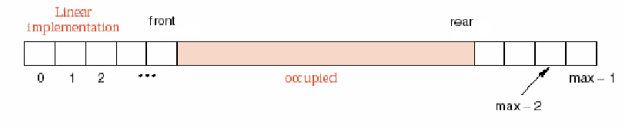
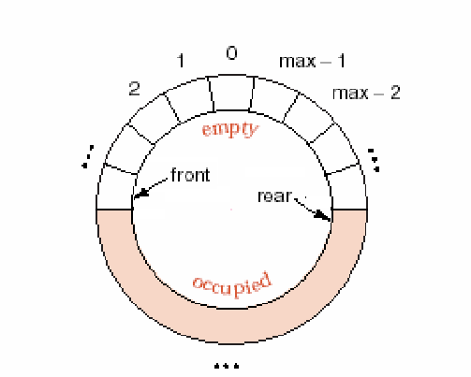

Slide 50
循环队列
循环队列首尾相接，当队头指针front和队尾指针rear进到maxsize-1后，再进一个位置就自动到0，这可以利用除法取余的运算%来实现
队头指针进1：front=(front+1)%maxsize;
队尾指针进1：rear=(rear+1)%maxsize;
当它们进到maxsize-1时并不意味着终结，如果有需要，利用%运算可以前进到数组的前端。

Slide 51
Circular array in C++
Equivalent methods to increment an index i in a circular array:
  i = ((i+1) == max) ? 0 : (i+1);
  if ((i+1) == max) i=0 ; else i=i+1;
  i = (i+1) % max;

Slide 52
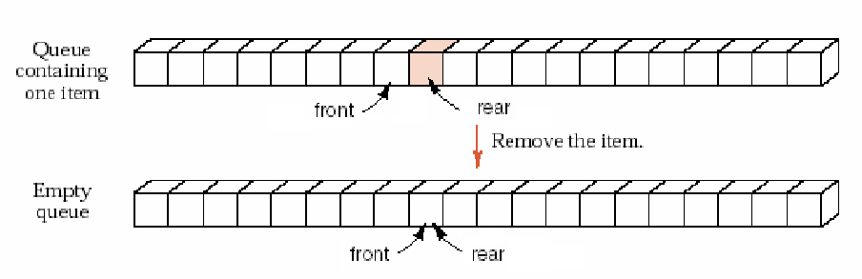
Boundary conditions
Empty
  front == rear;
  due to front++

Slide 53
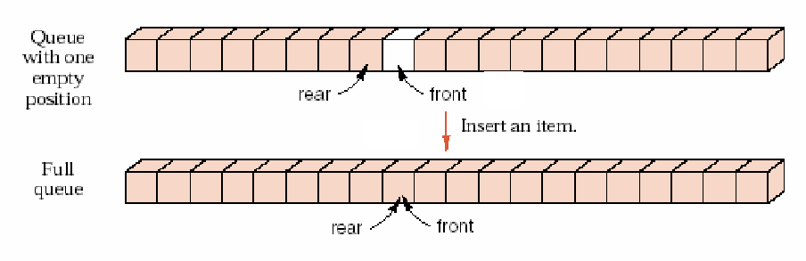
Boundary conditions
Full
  rear == front
  due to rear++

Slide 54
循环队列的边界条件
如果循环队列的读取速度快于存入元素的速度，front很快追上了rear，一旦front==rear，队列就成为了空队列。
如果队列的存入速度高于读取速度，rear很快追上了front，队列满就不能再添加新元素了，为了区别队列空条件，用
（rear+1）%maxsize==front来判断是否队列已满。
Notes:
为了充分利用，可以另设一标志以区别队列的空和满；

Slide 55
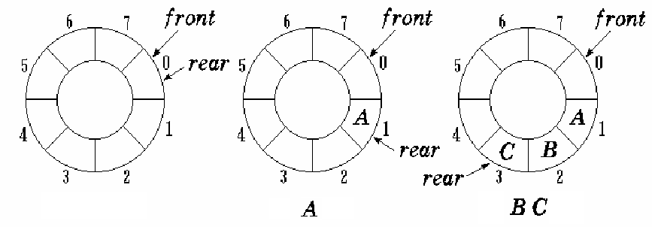
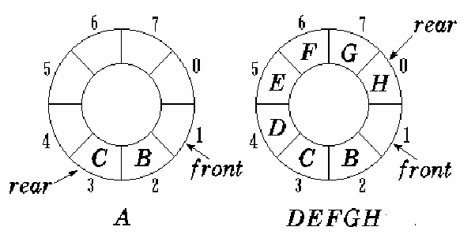
Empty queue
Enqueue
Enqueue
Dequeue
Enqueue
Full queue

Slide 56
5-2.3 Circular Implementations of Queues
Class declaration
#include <assert.h>
template <class Type> class Queue {
public:
Queue ( int=10 );
~Queue ( ) { delete [ ] elements; }
void EnQueue ( const Type & item);
Type DeQueue ( );
Type GetFront ( );
void MakeEmpty ( ) { front = rear = 0; }

Slide 57
int IsEmpty ( ) const
{ return front == rear; }
int IsFull ( ) const
{ return (rear+1) % maxSize == front; }
int Length ( ) const
{ return (rear-front+maxSize) % maxSize;}
private:
int rear, front;
Type *elements;
int maxSize;
}

Slide 58
Implementations of Methods
template <class Type> Queue<Type>::
Queue ( int sz ) : front (0), rear (0), maxSize (sz) {
elements = new Type[maxSize];
assert ( elements != 0 );
}
template <class Type> void Queue<Type>::
EnQueue ( const Type & item ) {
assert ( !IsFull ( ) );
rear = (rear+1) % MaxSize;
elements[rear] = item;
}

Slide 59
Implementations of Methods
template <class Type> Type Queue<Type>::
DeQueue ( ) {
assert ( !IsEmpty ( ) );
front = ( front+1) % MaxSize;
return elements[front];
}
template <class Type> Type Queue<Type>::
GetFront ( ) {
assert ( !IsEmpty ( ) );
return elements[( front+1) % MaxSize];
}

Slide 60

5-2.4 Linked Queue
队列的另一种存储是用单链表的方式来存储队列的元素，队列的队头指针指向单链表的第一个节点，队尾指针指向单链表的最后一个节点。
单链表表示的链式队列适合于数据元素变动较大的情形，而且不存在溢出的情况。假如程序中用到多个队列，最好使用链式列表，这样避免了存储分配不合理的问题。

Slide 61
Linked Queue Class declaration
template <class Type> class Queue;
template <class Type> class QueueNode {
friend class Queue<Type>;
private:
Type data; //Data element
QueueNode<Type> *link; //pointer to next item
QueueNode ( Type d=0, QueueNode
*l=NULL ) : data (d), link (l) { } //constructor
};

Slide 62
Linked Queue Class declaration
template <class Type> class Queue {
public:
Queue ( ) : rear ( NULL ), front ( NULL ) { }
~Queue ( );
void EnQueue ( const Type & item );
Type DeQueue ( );
Type GetFront ( );
void MakeEmpty ( ); //same as function ~Queue( )
int IsEmpty ( ) const { return front == NULL; }
private:
QueueNode<Type> *front, *rear; //Pointer indicators
};

Slide 63
Implementations of Methods
template <class Type> Queue<Type>::
~Queue ( ) {
//Destructor
QueueNode<Type> *p;
while ( front != NULL ) {
//Release every node step by step
p = front; front = front→link; delete p;
}
}

Slide 64
Implementations of Methods
template <class Type> void Queue<Type>::
EnQueue ( const Type & item ) {
//append a new item into Queue
if ( front == NULL ) //NULL Queue
front = rear = new QueueNode <Type> ( item, NULL );
else //Not NULL
rear→link = new QueueNode <Type> ( item, NULL );
rear = rear→link;
}

Slide 65
Implementations of Methods
template <class Type> Type Queue<Type>::
DeQueue ( ) {
//Return the front item and then remove it from Queue
assert ( !IsEmpty ( ) );
QueueNode<Type> *p = front;
Type retvalue = p→data;
front = front→link;
delete p;
return retvalue;
}

Slide 66
Implementations of Methods
template <class Type> Type Queue<Type>::
GetFront ( ) {
assert ( !IsEmpty ( ) );
return front→data;
}

Slide 67
Application 1: Fibonacci Array
F_{n}=F_{n-1}+F_{n-2}, F₁=1, F₂=1
1
1
2
3
5
8
13
21
34
…
…
…
…
Front
1
1
Rear
Front
1
1
2
Rear

Slide 68
Front
1
1
2
3
Rear
Front
1
1
2
3
5
Rear
Front
1
1
2
3
5
8
Front
Rear
1
1
2
3
5
8
13
Rear

Slide 69
#include "queue.h"
void Fibonacci ( int n ) {
Queue q; createQueue ( &q); enQueue (&q, 1); enQueue (&q, 1);
int s,t;
getHead (&q, &s); deQueue (&q);
printf (“%d ”, s );
for ( int i=2; i<=n; i++ ) {
getHead (&q, &t); deQueue (&q);
enQueue (&q, s+t );
s = t;
printf (“%d ”, s );
}
printf (“\n”);
}

Slide 70
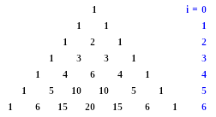
Application 2: Yangvi Triangle
Notes:
分行打印二项式(a+b)^{n}展开的系数

Slide 71
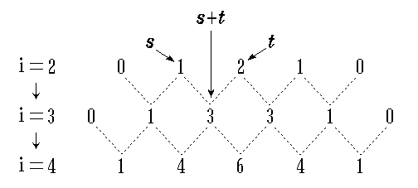
Relation between i-th row and (i+1)-th elements
®

Slide 72
Principle
0 1 1 0
0 1 2 1 0
0 1 3 3 1 0
0 1 4 6 4 1 0
0 1 5 10 10 5 1 0
0 1 6 15 20 15 6 1 0
0 1 7 21 35 35 21 7 1 0

Slide 73
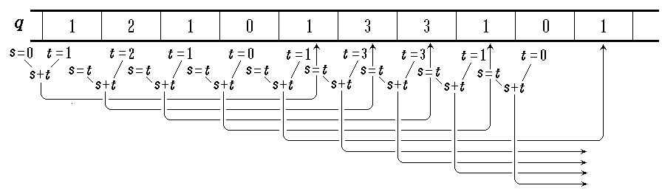
Application 2: Yangvi Triangle
®
Notes:
在数组q中已有第i行的数据，且s=0，则在第i行数据后加一个0，这样第i+1行数据和第i行的数据以0为分界存放。

Slide 74
#include "queue.h"
void YANGHUI ( int n ) {
Queue q; q.MakeEmpty ( );
q.EnQueue (1); q.EnQueue (1);//放入第1行的两个系数
int s = 0;
for ( int i=1; i<=n; i++ ) {
cout << endl;
q.EnQueue(0);//各行间加入一个0
for ( int j=1; j<=i+2; j++ ) {//处理第i行的i+2个系数（包括一个0）
int t=q.DeQueue();//读取一个系数
q.EnQueue(s+t );//计算下一行的系数，并进队列
s = t;
if ( j != i+2 ) cout << s << ‘ ’; //打印一个系数，第i+2个是0
}
}
}

Slide 75
优先级队列
在许多应用中需要另一种队列，每次从队列中取出的应是具有最高优先权的元素，这种队列就是优先级队列。
在相同优先级的情况下则遵照先来先服务的原则。

Slide 76
优先级队列类的声明
template<class Type> class PQueue{
public:
PQueue();//构造函数
~PQueue(){delete[] pqelements;}//析构函数
void PQInsert(const Type&item);//将新元素item插入到队尾
Type PQRemove();//将队头元素删去，并返回
void makeEmpty(){count=0;}//置队列为空
int IsEmpty() const{ return count==0;}//判断队列是否为空

Slide 77
优先级队列类的声明
int IsFull() const{return count==maxPQsize;}//判断队列是否满
int Length() const{return count;}//求队列中元素的个数
private:
Type *pqelements;//优先级队列数组
int count;//当前元素的个数
}

Slide 78
优先级队列的成员方法
template<class Type> PQueue<Type>::PQueue():count(0){
//建立一个最大具有maxPQsize个元素的空优先级队列
pqelements=new Type[maxPQsize];
assert(pqelements!=0);
}
template<class Type> void PQueue<Type>::PQInsert(const Type&item){
//若优先级队列不满，将item插入到该队列的队尾，否则出错处理
assert(!IsFull());
pqelements[count]=item;
count++;
}

Slide 79
template<class Type> Type PQueue<Type>::PQRemove(){
//若优先级队列不空则返回具有最大优先权的值，同时将该元素删除
assert(!IsEmpty());
Type min=pqelements[0];
int minindex=0;
for (int i=1;i<count;i++)
if(pqelements[i]<min){min=pqelements[i]; minindex=i;}
pqelements[minindex]=pqelements[count-1];
//用最后一个元素填补要取走的最小值元素
count--;
return min;
}

Slide 80
Application 3: Simulation of an Car wash
洗车仿真
洗车处有一个洗车台，每个车需洗10分钟，队列中最多可以容纳5辆车等待，平均等待时间是将每辆车的等待时间加起来再除以车的数量。
问题：计算平均等待时间。
关于离开和到达的情况：
如果同一分钟既有到达的又有离开的，先处理离开的车辆；
如果等待队列为空，到达的车就马上开始清洗，不进入队列；
每当一辆车开始清洗，它就离开队列停止等待；

Slide 81
please enter the next arrival time.the end is 999
8
please enter the next arrival time.the end is 999
15
Departure time=11
please enter the next arrival time.the end is 999
999
Departure time=21
Departure time=31
please enter the next arrival time.the end is 999
1
please enter the next arrival time.the end is 999
3
please enter the next arrival time.the end is 999
5
please enter the next arrival time.the end is 999
8

Slide 82
please enter the next arrival time.the end is 999
12
please enter the next arrival time.the end is 999
12
please enter the next arrival time.the end is 999
13
please enter the next arrival time.the end is 999
14
overflow
Departure time=41
Departure time=51
Departure time=61
ave waiting time is 19.333
please enter the next arrival time.the end is 999
5
please enter the next arrival time.the end is 999
5
please enter the next arrival time.the end is 999
7
Notes:
(11-3+21-5+31-8+41-8+51-15)/6=19.33

Slide 83
please enter the next arrival time.the end is 999
18
Departure time=15
please enter the next arrival time.the end is 999
19
Overflow
please enter the next arrival time.the end is 999
25
Departure time=25
please enter the next arrival time.the end is 999
999
Departure time=35
Departure time=45
Departure time=55
Departure time=65
Departure time=75
Departure time=85
ave waiting time is 27.875
Notes:
(15-5+25-7+35-12+35-12+55-13+65-18+75-25)/8=27.875

Slide 84
仿真是事件驱动的，采用carwash类来处理到达事件和离开事件。
接口
carwash();//初始化carwash
void runsimulation();//处理全部到达和离开事件
void printresult();//输出平均等待时间

Slide 85
class car{
public: car();
car(int nextarrivaltime);
int getarrivaltime();
protected: int arrivaltime;
};
car::car(){}
car::car(int nextarrivaltime)
{arrivaltime=nextarrivaltime;}
int car::getarrivaltime()
{return arrivaltime;}

Slide 86
class carwash
{
public:
carwash();
void runsimulation();
void printresult();
protected:
void processarrival(int nextarrivaltime, queue<car>&carqueue);
void processdeparture(queue<car>&carqueue);
const static int INFINITY;
const static int MAX_SIZE;
const static int WASH_TIME;
int currenttime, nextdeparturetime, numberofcars, sumofwaitingtimes;
};

Slide 87
const int carwash::INFINITY=10000;
const int carwash::MAX_SIZE=5;
const int carwash::WASH_TIME=10;
carwash::carwash()
{
currenttime=0;
numberofcars=0;
sumofwaitingtimes=0;
nextdeparturetime=INFINITY;
}

Slide 88
void carwash::runsimulation()
{
const string PROMPT="\n please enter the next arrival time.the end is";
const int end=999;
queue<car>carqueue;
int nextarrivaltime;
cout<<PROMPT<<end<<endl;//输出提示语句
cin>>nextarrivaltime;

Slide 89
while(nextarrivaltime!=end)
{ if(nextarrivaltime<nextdeparturetime)
{processarrival(nextarrivaltime,carqueue);
cout<<PROMPT<<end<<endl;
cin>>nextarrivaltime;
}
else processdeparture(carqueue);
}//end while
while(nextdeparturetime<INFINITY)
processdeparture(carqueue);//处理完队列内剩余的车
}//end runsimulation

Slide 90
void carwash::processarrival(int nextarrivaltime, queue<car>&carqueue)
{ const string overflow="overflow";
currenttime=nextarrivaltime;
if(carqueue.size()==MAX_SIZE)
cout<<overflow<<endl;
else{numberofcars++;
if(nextdeparturetime==INFINITY) //判断洗车台上是否有车
nextdeparturetime=currenttime+WASH_TIME;
else carqueue.push(car(nextarrivaltime)); }
}

Slide 91
void carwash::processdeparture(queue<car>&carqueue)
{ int waitingtime;
cout<<"departure time="<<nextdeparturetime<<endl;
currenttime=nextdeparturetime;
if(!carqueue.empty())
{car car1=carqueue.front();
carqueue.pop();
waitingtime=currenttime-car1.getarrivaltime();
sumofwaitingtimes+=waitingtime;
nextdeparturetime=currenttime+WASH_TIME; }
else nextdeparturetime=INFINITY;}

Slide 92
void carwash::printresult()
{
if (numberofcars==0)
cout<<"no cars"<<endl;
else
cout<<"ave waiting time is"<<((double)sumofwaitingtimes/numberofcars)<<endl;
}

Slide 93
STL queue adapter
STL中queue adapter为队列的数据结构提供了一个可用的接口

Slide 94
#include <iostream>
#include <string>
#include <cstdlib>
#include <queue>
using namespace std;
int main(int argc, char* argv[]) {
queue<int> q; // push and pop
q.push(1);
q.pop(); // front and back
q.push(1);
q.push(2);
cout << q.front() << endl;
cout << q.back() << endl; // size and empty
cout << q.size() << endl;
cout << q.empty() << endl;
return EXIT_SUCCESS;
}
The queue interface
Notes:
1 2 2 0

Slide 95
queue member
deque equivalent
push
push_back
pop
pop_front
front
front
back
back
size
size
empty
empty
queue member functions and their deque equivalents

Slide 96
总结
队列的定义
队列的抽象数据类型
循环队列
链式队列
优先级队列
队列的应用

