Slide 1
MapReduce
Mahmoud Parsian
Ph.D. in Computer Science

Slide 2
Motivation
Process lots of data
Google processed about 24 petabytes of data per day in 2009.
Facebook processed 60 petabytes of data per day in 2020
A single machine cannot serve all the data
You need a distributed system to store and process in parallel
Parallel programming?
Threading is hard!
How do you facilitate communication between nodes?
How do you scale to more machines?
How do you handle machine failures?

Slide 3
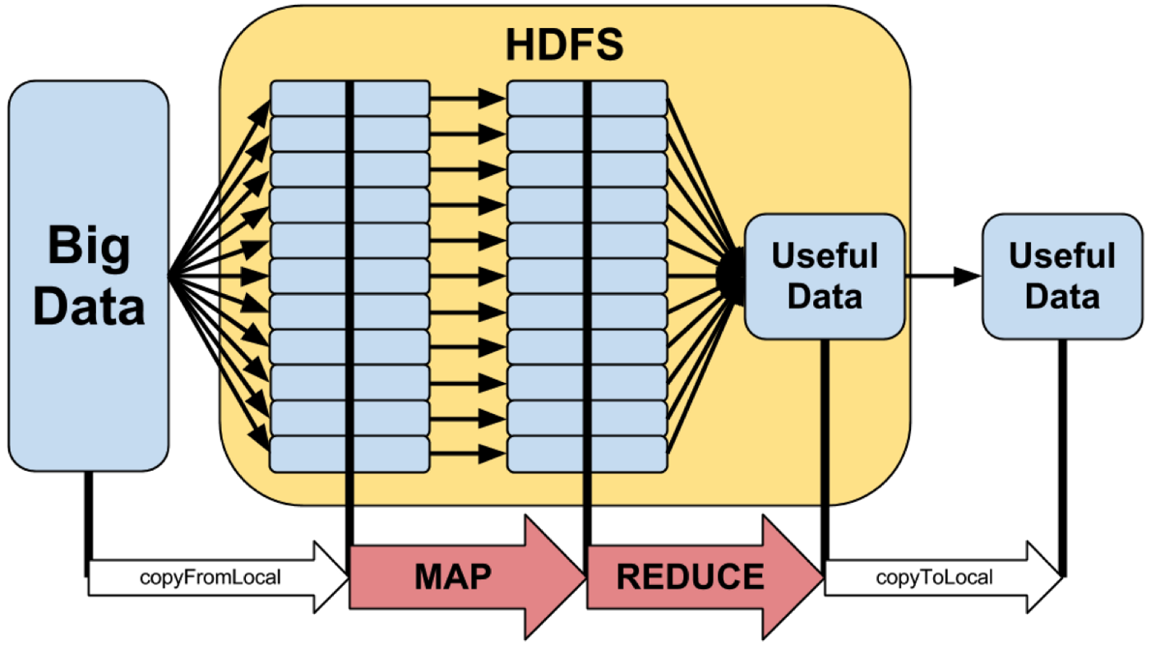
MapReduce Model

Slide 4
MapReduce
MapReduce provides
Automatic parallelization, distribution
I/O scheduling
Load balancing
Network and data transfer optimization
Fault tolerance
Handling of machine failures
Need more power: Scale out, not up!
Large number of commodity servers as opposed to some high end specialized servers
Hadoop:
implementation of MapReduce
Spark superset of MapReduce

Slide 5
Typical problem solved by MapReduce
Read a lot of data
map(): extract something you care about from each record
Shuffle and Sort [done by MapReduce Implementation]
reduce(): aggregate, summarize, filter, or transform
Write the results

Slide 6
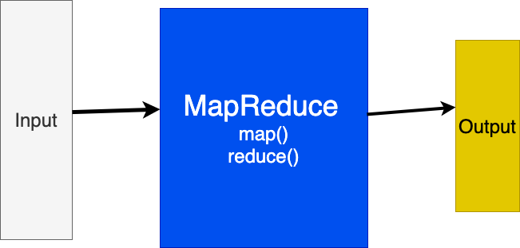
MapReduce model

Slide 7
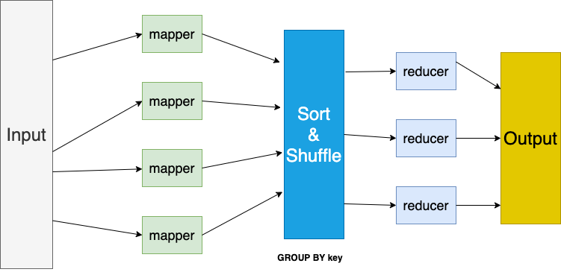
MapReduce model

Slide 8
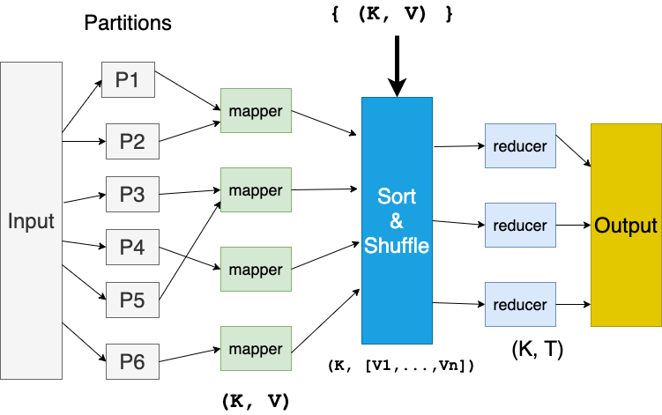
MapReduce model

Slide 9
MapReduce workflow
Input Data
Output Data
Worker
write
Output
File 0
local
write
Worker
Split 1
read
Split 2
Worker
Output
File 1
Split 3
Worker
Split 4
Worker
remote
read,
sort
Map
extract something you care about from each record
Reduce aggregate, summarize, filter, or transform

Slide 10
Mappers and Reducers
Need to handle more data? Just add more Mappers/Reducers!
No need to handle multithreaded code ☺
Mappers and Reducers are typically single threaded and deterministic
Determinism allows for restarting of failed jobs
Mappers/Reducers run entirely independent of each other
They run in separate JVMs

Slide 11
Word Count Problem
Given a set of text documents/files
Find frequencies of each unique word
Input: “gray fox red fox jumped over red gray fox”
Output: dictionary[(word, frequency)]
(gray, 2)
(red, 2),
(fox, 3)
(jumped, 1)
(over, 1)

Slide 12
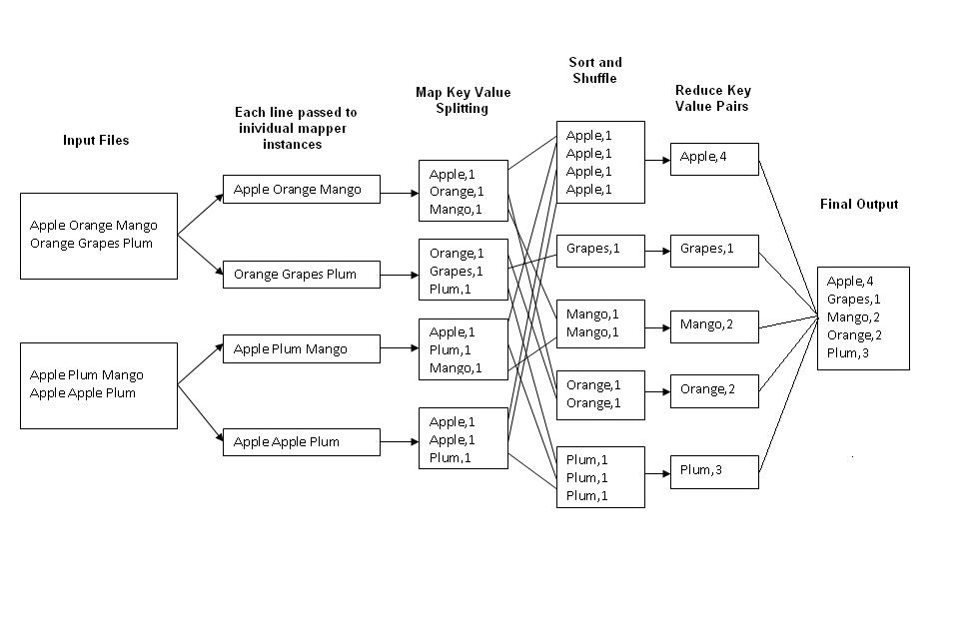
Example: Word Count
http://kickstarthadoop.blogspot.ca/2011/04/word-count-hadoop-map-reduce-example.html

Slide 13
Mapper
Reads in input pair (Key, Value)
Outputs a pair (K’, V’)
Let’s count number of each word in user queries (or Tweets/Blogs)
The input to the mapper will be (queryID, QueryText):
<Q1,“The teacher went to the store. The store was closed; the store opens in the morning. The store opens at 9am.” >
The output would be:
<The, 1> <teacher, 1> <went, 1> <to, 1> <the, 1> <store,1> <the, 1> <store, 1> <was, 1> <closed, 1> <the, 1> <store,1> <opens, 1> <in, 1> <the, 1> <morning, 1> <the 1> <store, 1> <opens, 1> <at, 1> <9am, 1>

Slide 14
Sort & Shuffle: SQL’s GROUP BY
Accepts the Mapper output, and aggregates values on the key
For our example, the mappers output would be:
<The, 1> <teacher, 1> <went, 1> <to, 1> <the, 1> <store, 1> <the, 1> <store, 1> <was, 1> <closed, 1> <the, 1> <store, 1> <opens,1> <in, 1> <the, 1> <morning, 1> <the, 1> <store, 1> <opens, 1> <at, 1> <9am, 1>
The output of Sort & Shuffle would be:
(The, [1, 1, 1, 1, 1, 1])
(store, [1, 1, 1])
…
Notes:
Input is typically sorted, output is output exactly as is
All inputs with the same key must go to the same reducer!

Slide 15
Reducer
Accepts the Sort & Shuffle output, and aggregates values on the key
Input to reducer: (store, [1, 1, 1])
Output: (store, 3)
Input to reducer: (The, [1, 1, 1, 1, 1, 1])
Output: (The, 6)
…
Notes:
Input is typically sorted, output is output exactly as is
All inputs with the same key must go to the same reducer!

Slide 16
MapReduce Job Components
Input path (identify your input files,…)
Output path (where to write output)
map() function
reduce() function
OPTIONAL combine() function
Notes:
Input is typically sorted, output is output exactly as is
All inputs with the same key must go to the same reducer!

Slide 17
MapReduce Job: Input Path
Input path: 3 files will be read
Example: s3://my_bucket/project7
s3://my_bucket/project7/file1
s3://my_bucket/project7/file2
s3://my_bucket/project7/file3
Notes:
Input is typically sorted, output is output exactly as is
All inputs with the same key must go to the same reducer!

Slide 18
MapReduce Job: Output Path
Output path:
Example: s3://my_bucket/output7/
s3://my_bucket/output7/_SUCCESS
s3://my_bucket/output7/part1
s3://my_bucket/output7/part2
s3://my_bucket/output7/part3
s3://my_bucket/output7/part4
Notes:
Input is typically sorted, output is output exactly as is
All inputs with the same key must go to the same reducer!

Slide 19
MapReduce Job: map() function
# key: may be a record number
# value: the entire record such as “fox jumped and jumped”
map(key, value) {
words = value.split(“ “)
for word in words {
emit( word, 1)
}
}
Notes:
Input is typically sorted, output is output exactly as is
All inputs with the same key must go to the same reducer!

Slide 20
MapReduce Job: map() function Ignore words with length of less than 3 Chars.
# key: may be a record number
# value: the entire record such as “fox jumped and jumped”
map(key, value) {
words = value.split(“ “)
for word in words {
# filter non-desired words
if (len(word) > 2) {
emit( word, 1)
}
}
}
Notes:
Input is typically sorted, output is output exactly as is
All inputs with the same key must go to the same reducer!

Slide 21
MapReduce Job: map() function Ignore records with length of less than 80 chars
# key: may be a record number
# value: the entire record such as “fox jumped and jumped”
map(key, value) {
if (len(value) < 80) { return }
words = value.split(“ “)
for word in words {
if (len(word) > 2) {
emit( word, 1) # filter non-desired words
}
}
}
Notes:
Input is typically sorted, output is output exactly as is
All inputs with the same key must go to the same reducer!

Slide 22
MapReduce Job: map() function
# key: may be a record number such as 100 (is ignored)
# value: the entire record such as “fox jumped and jumped”
map() output:
(fox, 1)
(jumped, 1)
(and, 1)
(jumped, 1)
Notes:
Input is typically sorted, output is output exactly as is
All inputs with the same key must go to the same reducer!

Slide 23
MapReduce Job: map() function
# key: may be a record number such as 101 (is ignored)
# value: the entire record such as “fox jumped over fox”
map() output:
(fox, 1)
(jumped, 1)
(over, 1)
(fox, 1)
Notes:
Input is typically sorted, output is output exactly as is
All inputs with the same key must go to the same reducer!

Slide 24
Sort & Shuffle
Sort & Shuffle is the genie of MapReduce
Output of Sort & Shuffle
(key_1, [V1, V2, …])
(Key_2, [T1, T2, …])
…
(key_N, [A1, A2, …])
Notes:
Input is typically sorted, output is output exactly as is
All inputs with the same key must go to the same reducer!

Slide 25
MapReduce Job Components: reduce()
reduce() accepts a
(key, [V1, V2, …, Vn])
And creates any number of new (K’, V’) pairs
Notes:
Input is typically sorted, output is output exactly as is
All inputs with the same key must go to the same reducer!

Slide 26
MapReduce Job: reduce() function
# key: is a unique word
# values: [1, 1, …, 1]
reduce(key, values) {
count = 0
for v in values {
count += v
}
emit(key, count)
}
Notes:
Input is typically sorted, output is output exactly as is
All inputs with the same key must go to the same reducer!

Slide 27
MapReduce Job: reduce() function + what if we want to ignore words with frequencies of less than 5
# key: is a unique word
# values: [1, 1, …, 1]
reduce(key, values) {
count = 0
for v in values {
count += v
}
# filter
if (count >= 5) {
emit(key, count)
}
}
Notes:
Input is typically sorted, output is output exactly as is
All inputs with the same key must go to the same reducer!

Slide 28
MapReduce Job: reduce() function + what if we want to ignore words with frequencies of less than 5
# key: is a unique word
# values: [1, 1, …, 1]
reduce(key, values) {
count = 0
for v in values {
count += v
}
# filter
if (count < 5) {
return
}
else {
emit(key, count)
}
}
Notes:
Input is typically sorted, output is output exactly as is
All inputs with the same key must go to the same reducer!

Slide 29
MapReduce Job: reduce() function + what if we want to ignore words with frequencies of less than 5 Ignore words with length of less than 3 Chars.
# key: is a unique word
# values: [1, 1, …, 1]
reduce(key, values) {
# not a proper filter for reducer (should be done in mapper
if (len(key) <= 2) { return }
count = 0
for v in values {
count += v
}
# filter
if (count < 5) {
return
}
else {
emit(key, count)
}
}
Notes:
Input is typically sorted, output is output exactly as is
All inputs with the same key must go to the same reducer!

Slide 30
MapReduce Job: reduce() function and output length of key
# key: is a unique word
# values: [1, 1, …, 1]
reduce(key, values) {
count = 0
for v in values {
count += v
}
emit(key, (len(key), count))
}
Notes:
Input is typically sorted, output is output exactly as is
All inputs with the same key must go to the same reducer!

Slide 31
MapReduce
Hadoop
Program
fork
fork
fork
Master
assign
map
assign
reduce
Input Data
Output Data
Transfer peta-scale data through network
Worker
write
Output
File 0
local
write
Worker
Split 0
read
Split 1
Worker
Split 2
Output
File 1
Worker
Worker
remote
read,
sort
Map
Reduce

Slide 32
Failure in MapReduce
Failures are norm in commodity hardware
Worker failure
Detect failure via periodic heartbeats
Re-execute in-progress map/reduce tasks
Master failure
Single point of failure; Resume from Execution Log
Robust
Google’s experience: lost 1600 of 1800 machines once!, but finished fine

Slide 33
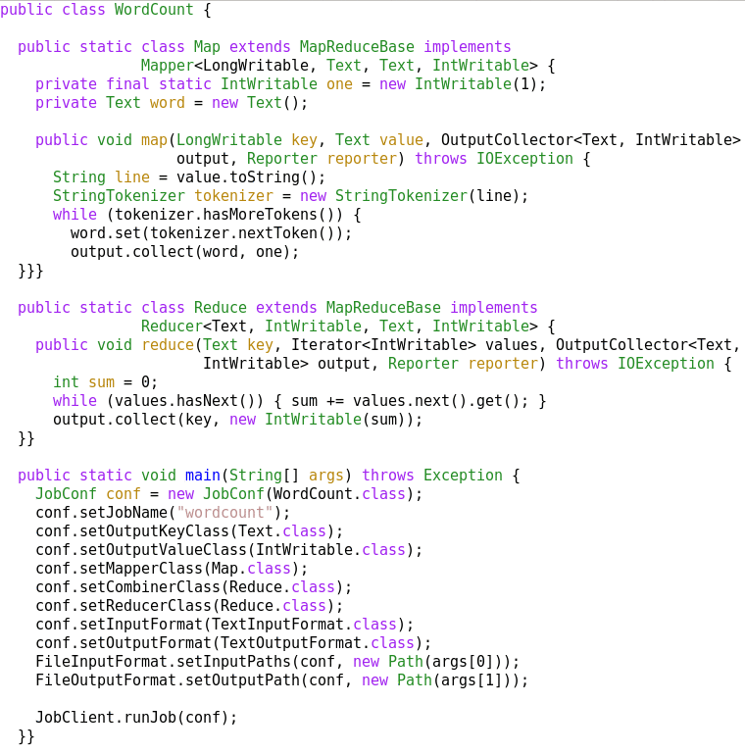
A MapReduce Job
Mapper
Reducer
Run this program as
a MapReduce job

Slide 34
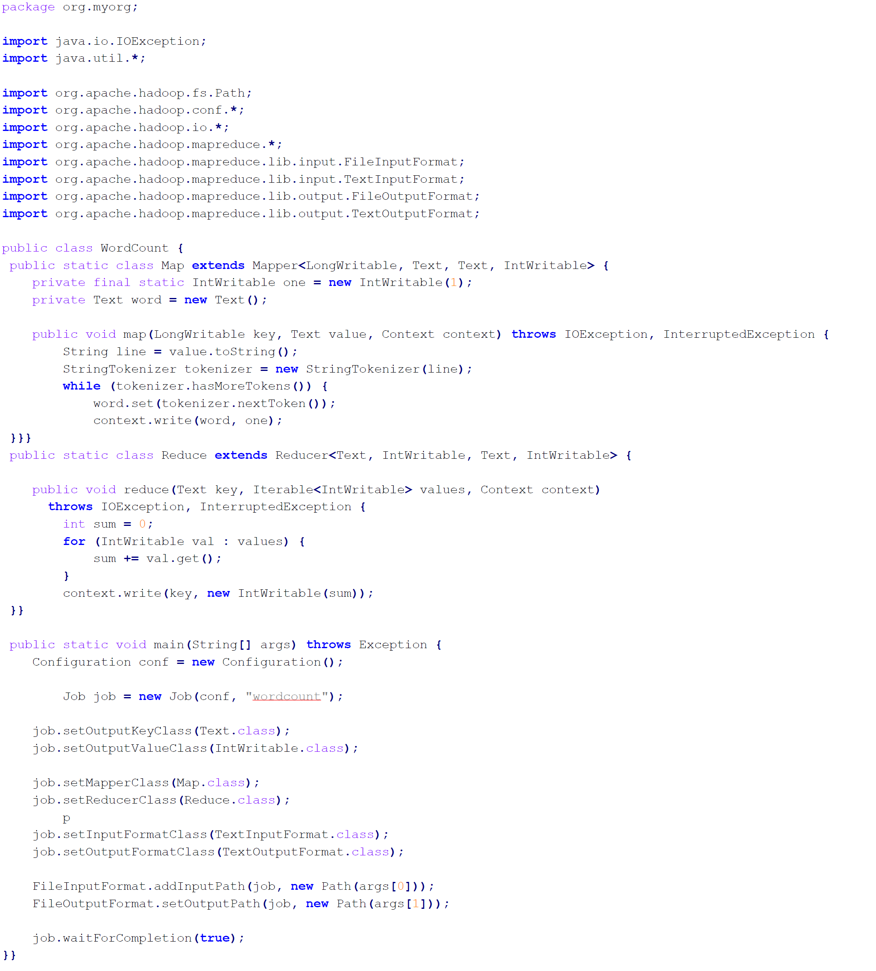
Mapper
Reducer
Run this program as
a MapReduce job

Slide 35
Summary
MapReduce
Programming paradigm for data-intensive computing
Distributed & parallel execution model
Simple to program
The framework automates many tedious tasks (machine selection, failure handling, etc.)

