Slide 1
Introduction to Spark DataFrames
Mahmoud Parsian
Ph.D. in Computer Science

Slide 2
Challenges and Solutions
Challenges
Solutions
Perform ETL to and from various (semi- or unstructured) data sources
Perform advanced analytics
machine learning
graph processing
that are hard to express in relational systems.
ETL = Extract Transfer Load
A DataFrame API that can perform relational operations on both external data sources and Spark’s built-in RDDs.
A highly extensible optimizer, Catalyst, that uses features of Scala to add composable rule, control code gen., and define extensions.

Slide 3
DataFrame
noun – [dey-tuh-freym]
A distributed collection of rows organized into named columns.
An abstraction for selecting, filtering, aggregating and plotting structured data (cf. R, Pandas).

Slide 4
What is Spark DataFrame?
DataFrames are the distributed collections of data, organized into rows and named columns.
DataFrames allow the processing of huge amounts of data (billions of rows)
Each column in a DataFrame has a name and an associated type.
DataFrames are similar to traditional database tables, which are structured and concise.
We can say that DataFrames are relational databases with better optimization techniques.
Spark DataFrames can be created from many data sources:
Hive tables, log tables, external databases, or the existing RDDs.

Slide 5
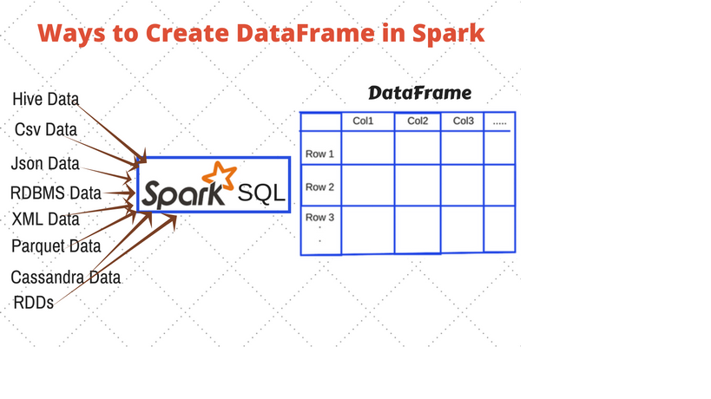
Spark DataFrame: Example

Slide 6
Spark DataFrame: Features
A DataFrame: a table of rows with named columns
Easy to Use
A DataFrame may have billions of rows
Scalable
A DataFrame is immutable (READ-ONLY)
No Synchronization
A DataFrame is PARTITIONED
Parallelism

Slide 7
Spark DataFrame: Features
A DataFrame: a Table of rows with named columns Easy to Use
A DataFrame may have billions of rows Scalable
A DataFrame is immutable (READ-ONLY) No Synchronization
A DataFrame is PARTITIONED:
Number of rows = 800,000,000,000
Number of Partitions = 20,000 Parallelism
Number of rows per partition = 40,000,000
800,000,000,000 = 20,000 x 40,000,000
Any Transformation of this DataFrame can be parallelized by up to 20,000 executors/processes
Can register your DataFrame as a table and then fire SQL queries on the table/DataFrame. Simple Transformations and Usage

Slide 8
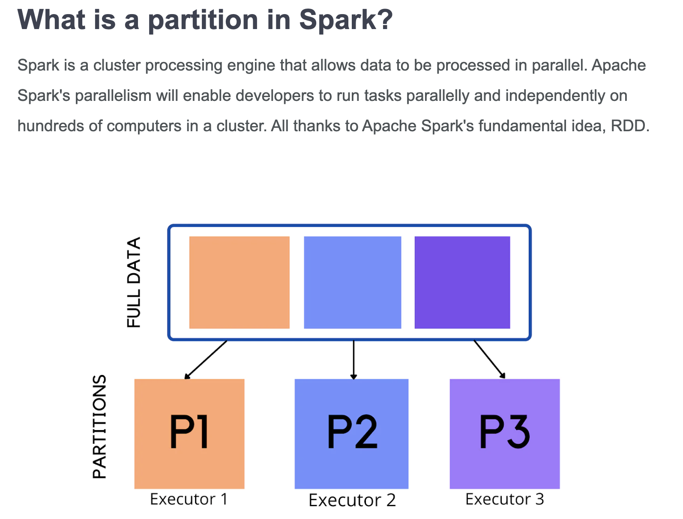

Slide 9
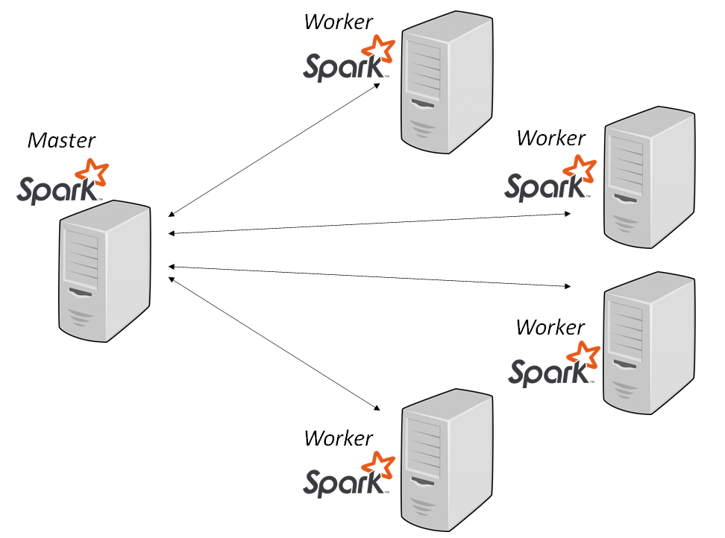
DataFrames Transformations Runs in a Cluster

Slide 10
What is Apache Spark?
Fast and general cluster computing system, interoperable with Hadoop, included in all major distributions
Improves efficiency through:
In-memory computing primitives
General computation graphs
Improves usability through:
Rich APIs in Scala, Java, Python
Interactive shell
Up to 100× faster
(2-10× on disk)
2-5× less code

Slide 11
Spark Model
Write programs in terms of transformations on distributed datasets
Resilient Distributed Datasets (RDDs)
Collections of objects that can be stored in memory or disk across a cluster
Parallel functional transformations (map, filter, …)
Automatically rebuilt on failure
Immutable (READ-ONLY)
Distributed (by partitions)
Enables Parallelism

Slide 12
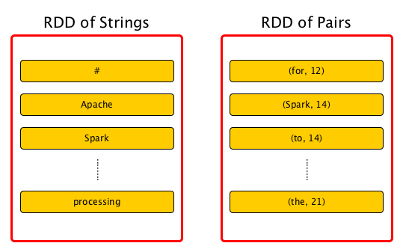
Resilient Distributed Datasets (RDDs)

Slide 13
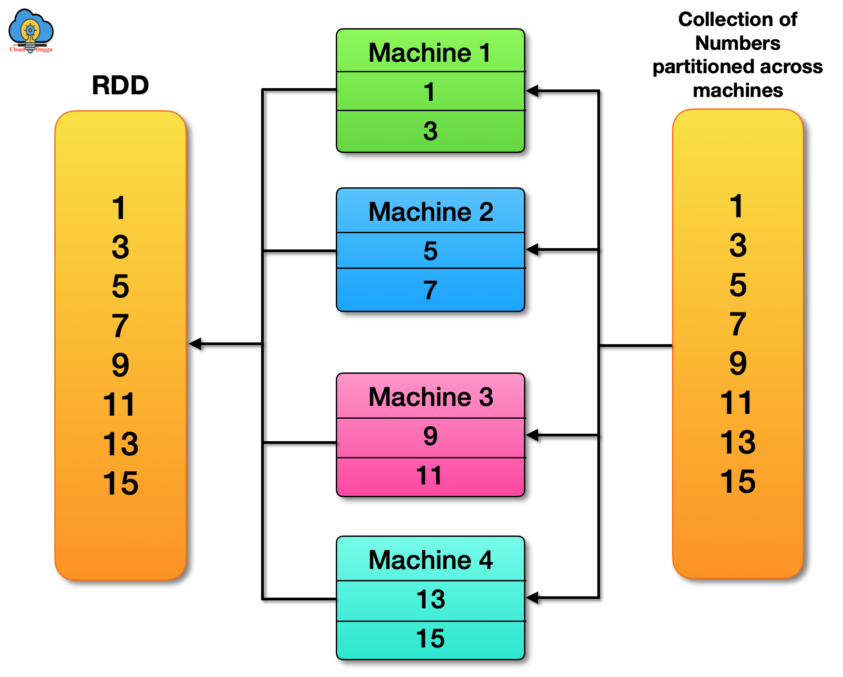
Resilient Distributed Datasets (RDDs): Partitioned

Slide 14


On-Disk Sort Record: Time to sort 100TB
2013 Record: Hadoop
2100 machines
72 minutes
2014 Record: Spark
207 machines
23 minutes
Also sorted 1PB in 4 hours
Source: Daytona GraySort benchmark, sortbenchmark.org

Slide 15
Powerful Stack – Agile Development
Your fancy
SIGMOD technique
here
GraphX
SparkSQL
Streaming

Slide 16

About
SQL
Spark SQL
Part of the core distribution since Spark 1.0 (April 2014)

Slide 17

About
SQL
Spark SQL
Part of the core distribution since Spark 1.0 (April 2014)
Runs SQL / HiveQL queries, optionally alongside or replacing existing Hive deployments
SELECT COUNT(*)
FROM hiveTable
WHERE hive_udf(data)

Slide 18
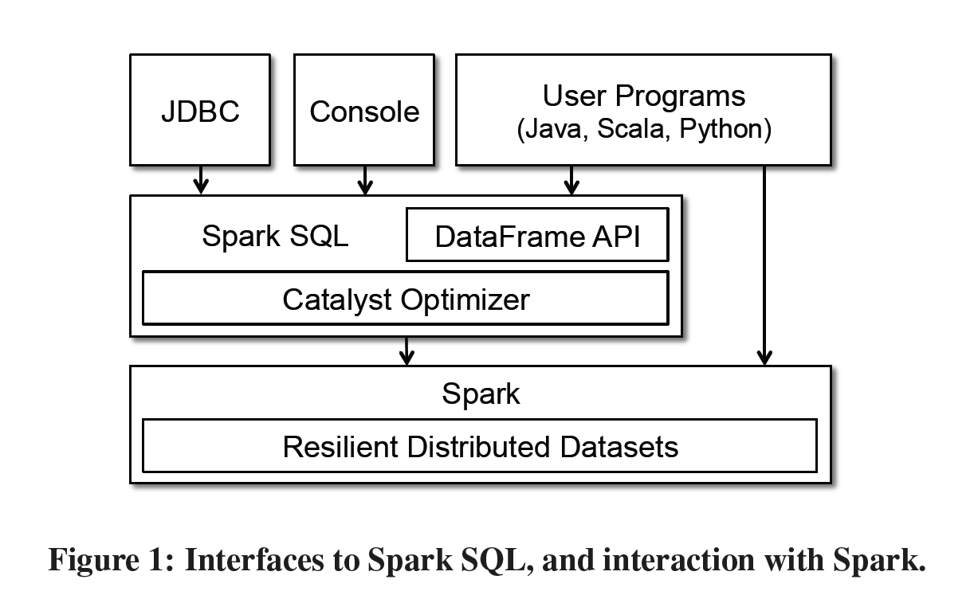
Programming Interface

Slide 19
DataFrame
A distributed collection of rows with the same schema
RDDs suffer from type erasure
Can be constructed from external data sources or RDDs into essentially an RDD of Row objects
Supports relational operators (e.g. where, groupby) as well as Spark operations.
Evaluated lazily → unmaterialized logical plan

Slide 20
DataFrame: Example
# Create a DataFrame(name, age, salary)
# spark : SparkSession
>>> column_names = ['name', 'age', 'salary’]
>>> data = [('alex', 20, 12000), ('jane', 30, 45000)]
>>> df = spark.createDataFrame(data, column_names)
>>> df.show()
+----+---+------+
|name|age|salary|
+----+---+------+
|alex| 20| 12000|
|jane| 30| 45000|
+----+---+------+
>>> df.printSchema()
root
|-- name: string (nullable = true)
|-- age: long (nullable = true)
|-- salary: long (nullable = true)

Slide 21
DataFrame: Example
# df : a DataFrame(name, age, salary)
# spark : SparkSession
# Now, table “people” is the same as df
df.createOrReplaceTempView("people")
query_1 = "select * from people where age < 20"
df_teens = spark.sql(sql_query_1)
query_2 = "select * from people where salary > 200000"
high_salaries = spark.sql(sql_query_2)

Slide 22
: Declarative Big Data Processing
SQL
Let Developers Create and Run Spark Programs Faster:
Write less code
Read less data
Let the optimizer do the hard work

Slide 23
Data Model
Nested data model
Supports both primitive SQL types (boolean, integer, double, decimal, string, data, timestamp) and complex types (structs, arrays, maps, and unions)
First class support for complex data types

Slide 24
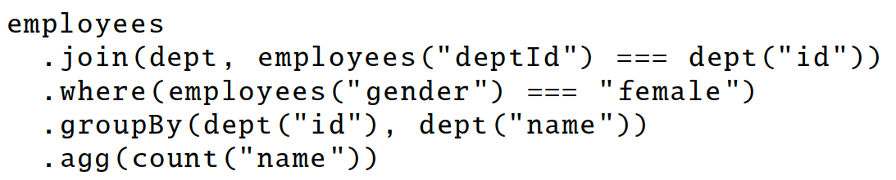
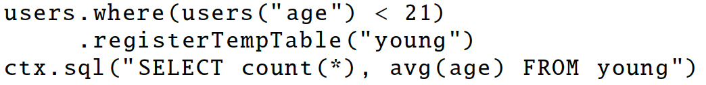
DataFrame Operations & Optimizations
Relational operations (select, where, join, groupBy) via a DSL
Operators take expression objects
Operators build up an abstract syntax tree (AST), which is then optimized by Catalyst.
Alternatively, register as temp SQL table and perform traditional SQL query strings
Notes:
traditional sql convenient for computing multiple things at the same time

Slide 25
Advantages over Relational Query Languages
Provides optimization across functions composed in different languages.
Control structures
if
for
where
groupBy
Logical plan analyzed eagerly → identify code errors associated with data schema issues on the fly.

Slide 26
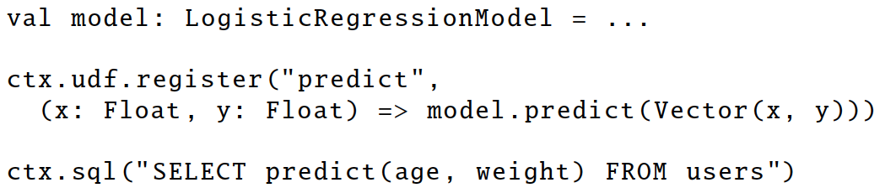
User-Defined Functions (UDFs)
Easy extension of limited operations supported.
Allows inline registration of UDFs
Compare with Pig, which requires the UDF to be written in a Java package that’s loaded into the Pig script.
Can be defined on simple data types or entire tables.
UDFs available to other interfaces after registration

Slide 27
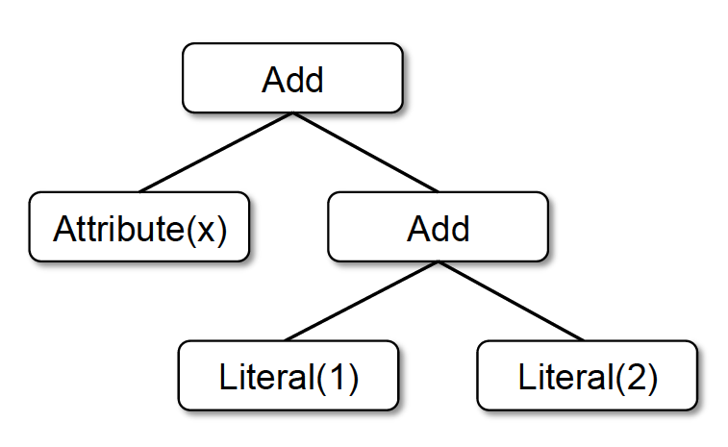
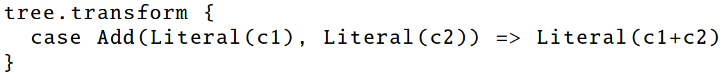
Catalyst
Add
Attribute(x)
Literal(3)
x + (1 + 2)
x + 3
Notes:
Done in Scala because functional programming languages naturally support compiler functions.

Slide 28
Catalyst Rules
Pattern matching functions that transform subtrees into specific structures.
Partial function—skip over subtrees that do not match → no need to modify existing rules when adding new types of operators.
Multiple patterns in the same transform call.
May take multiple batches to reach a fixed point.
transform can contain arbitrary Scala code.

Slide 29
Plan Optimization & Execution
Logical
Optimization
Physical
Planning
Code
Generation
Analysis
SQL AST
Unresolved Logical Plan
Logical Plan
Optimized Logical Plan
Physical Plans
Selected Physical Plan
RDDs
Cost Model
DataFrame
Catalog
DataFrames and SQL share the same optimization/execution pipeline

Slide 30
def add_demographics(events):
u = sqlCtx.table("users") # Load partitioned Hive table
events \
.join(u, events.user_id == u.user_id) \ # Join on user_id
.withColumn("city", zipToCity(df.zip)) # Run udf to add city column
events = add_demographics(sqlCtx.load("/data/events", "parquet"))
training_data = events.where(events.city == "Melbourne").select(events.timestamp).collect()
Physical Plan
Physical Plan
with Predicate Pushdown and Column Pruning
Logical Plan
filter
join
join
join
scan
(events)
filter
optimized
scan
(events)
optimized scan
(users)
events file
users table
scan
(users)

Slide 31
An Example Catalyst Transformation
Find filters on top of projections.
Check that the filter can be evaluated without the result of the project.
If so, switch the operators.

Slide 32
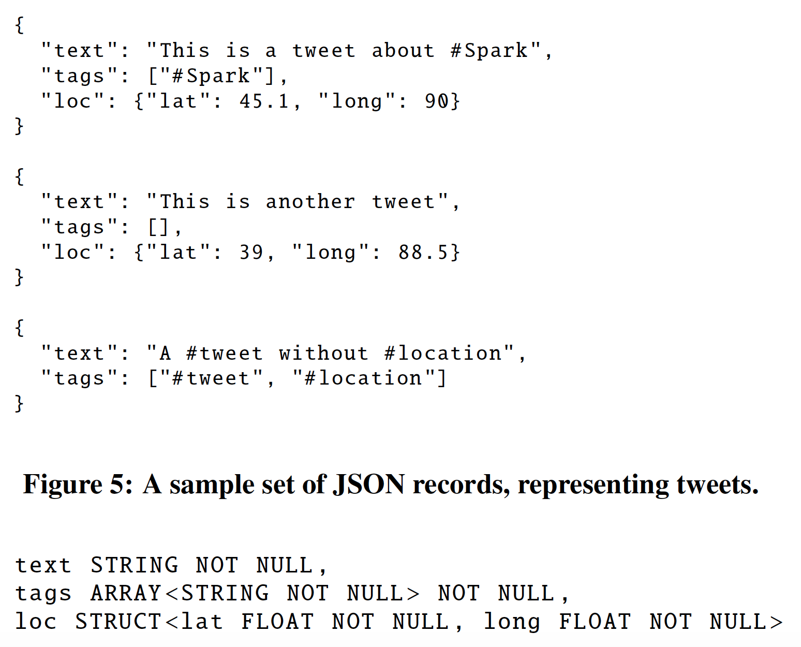
Advanced Analytics Features Schema Inference for Semistructured Data
JSON
Automatically infers schema from a set of records, in one pass or sample
A tree of STRUCT types, each of which may contain atoms, arrays, or other STRUCTs.
Find the most appropriate type for a field based on all data observed in that column. Determine array element types in the same way.
Merge schemata of single records in one reduce operation.
Same trick for Python typing

Slide 33
Spark MLlib Pipelines
tokenizer = Tokenizer(inputCol="text", outputCol="words”)
hashingTF = HashingTF(inputCol="words", outputCol="features”)
lr = LogisticRegression(maxIter=10, regParam=0.01)
pipeline = Pipeline(stages=[tokenizer, hashingTF, lr])
df = sqlCtx.load("/path/to/data")
model = pipeline.fit(df)
lr
ds0
ds1
ds2
ds3
tokenizer
hashingTF
lr.model
Pipeline Model

Slide 34
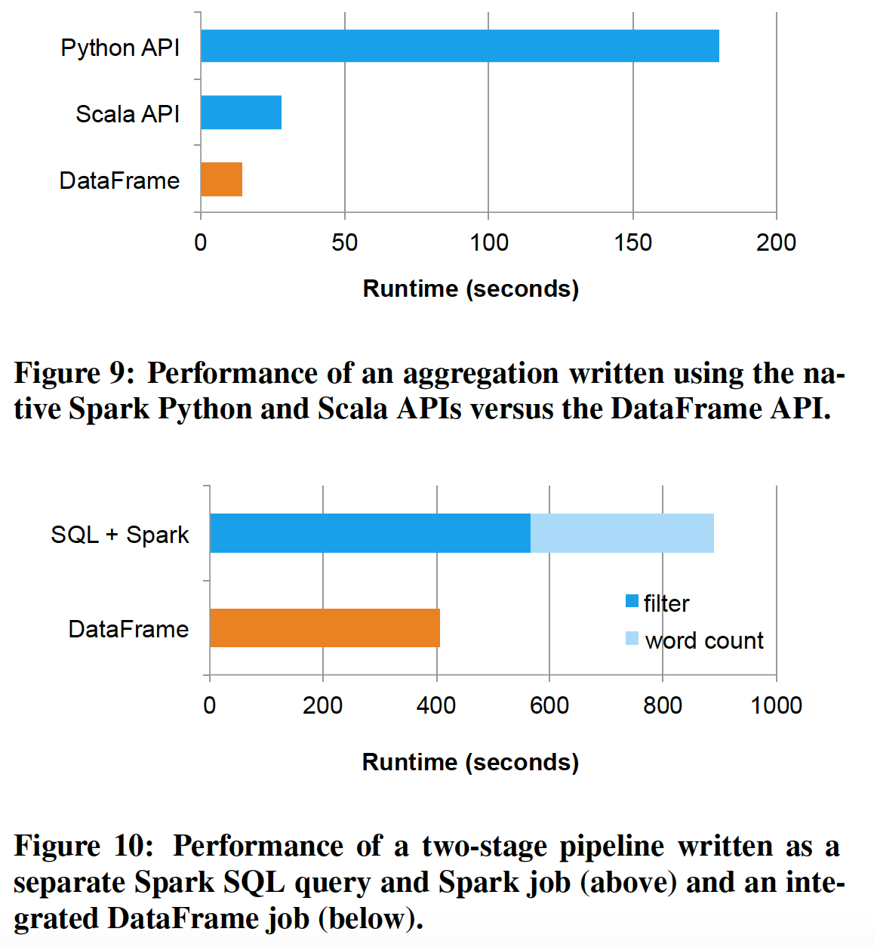

Slide 35

Transformation: Genomics
Recognize range joins and use interval trees.
SELECT * FROM a JOIN b
WHERE a.start < a.end
AND b.start < b.end
AND a.start < b.start
AND b.start < a.end

Slide 36

Write Less Code: Compute an Average
private IntWritable one =
new IntWritable(1)
private IntWritable output =
new IntWritable()
proctected void map(
LongWritable key,
Text value,
Context context) {
String[] fields = value.split("\t")
output.set(Integer.parseInt(fields[1]))
context.write(one, output)
}
IntWritable one = new IntWritable(1)
DoubleWritable average = new DoubleWritable()
protected void reduce(
IntWritable key,
Iterable<IntWritable> values,
Context context) {
int sum = 0
int count = 0
for(IntWritable value : values) {
sum += value.get()
count++
}
average.set(sum / (double) count)
context.Write(key, average)
}
data = sc.textFile(...).split("\t")
data.map(lambda x: (x[0], [x.[1], 1])) \
.reduceByKey(lambda x, y: [x[0] + y[0], x[1] + y[1]]) \
.map(lambda x: [x[0], x[1][0] / x[1][1]]) \
.collect()

Slide 37
Write Less Code: Compute an Average
Using RDDs
data = sc.textFile(...).split("\t")
data.map(lambda x: (x[0], [int(x[1]), 1])) \
.reduceByKey(lambda x, y: [x[0] + y[0], x[1] + y[1]]) \
.map(lambda x: [x[0], x[1][0] / x[1][1]]) \
.collect()
Using SQL
SELECT name, avg(age)
FROM people
GROUP BY name
Using Pig
P = load '/people' as (name, name);
G = group P by name;
R = foreach G generate … AVG(G.age);
Using DataFrames
sqlCtx.table("people") \
.groupBy("name") \
.agg("name", avg("age")) \
.collect()

Slide 38
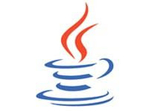





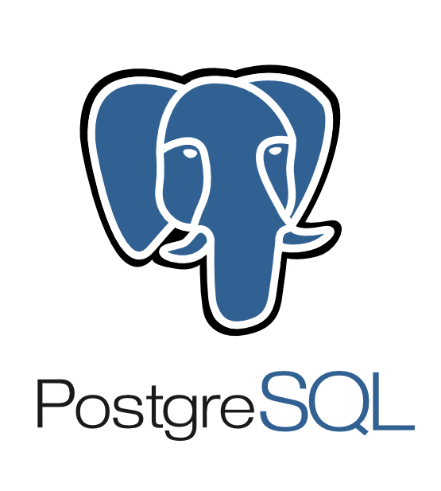







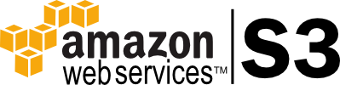

Extensible Input & Output
Spark’s Data Source API allows optimizations like column pruning and filter pushdown into custom data sources.
Built-In
External
{ JSON }
JDBC
and more…

Slide 39
Seamlessly Integrated
Embedding in a full programming language makes UDFs trivial and allows composition using functions.
zipToCity = udf(lambda city: <custom logic here>)
def add_demographics(events):
u = sqlCtx.table("users")
events \
.join(u, events.user_id == u.user_id) \
.withColumn("city", zipToCity(df.zip))
Takes and returns a DataFrame

Slide 40
Spark MLlib Pipelines use DataFrames
tokenizer = Tokenizer(inputCol="text", outputCol="words”)
hashingTF = HashingTF(inputCol="words", outputCol="features”)
lr = LogisticRegression(maxIter=10, regParam=0.01)
pipeline = Pipeline(stages=[tokenizer, hashingTF, lr])
df = sqlCtx.load("/path/to/data")
model = pipeline.fit(df)
lr
ds0
ds1
ds2
ds3
tokenizer
hashingTF
lr.model
Pipeline Model

