Slide 1
Partitioning in Spark
Mahmoud Parsian
Ph.D. in Computer Science

Slide 2
What is Partitioning?
Partitioning is simply defined as dividing into parts (chunks), in a distributed system.
Partitioning means, the division of the large dataset. Also, store them as multiple parts of the cluster.
Partitioning enables to process chunks in parallel.

Slide 3
What is Spark Partitioning?
Spark partitioning is a way to split the data into multiple partitions (called chunks)
Spark executes transformations on multiple partitions in parallel which allows completing the job faster.
You can also write partitioned data into a file system (multiple sub-directories) for faster reads by downstream systems.

Slide 4
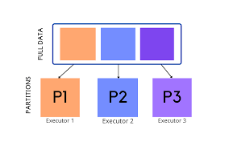
Spark Partitioning Example: 3 Partitions

Slide 5
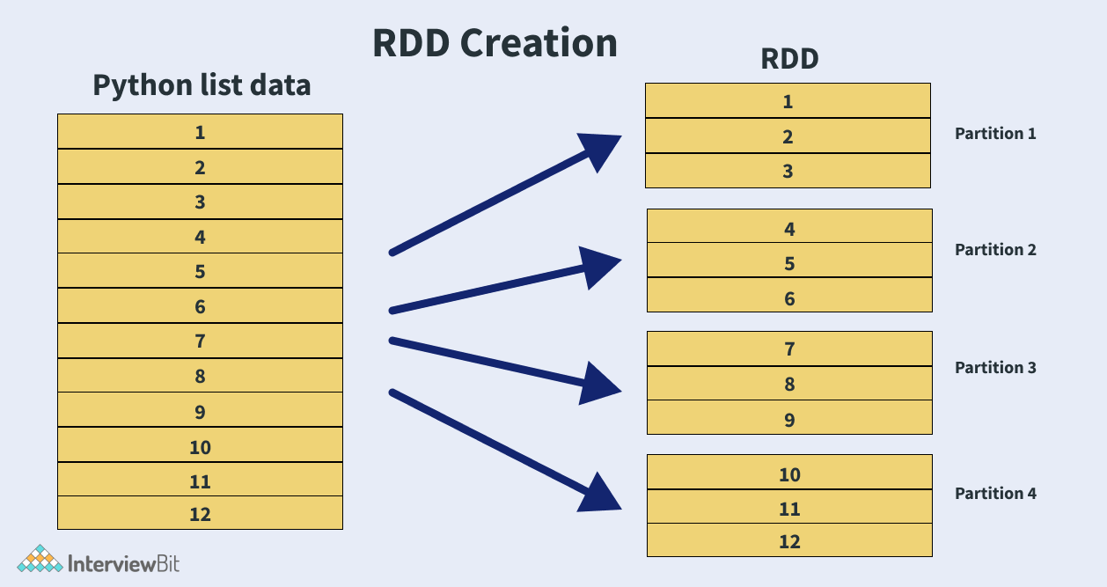
RDD Partitioning Example: 4 Partitions

Slide 6
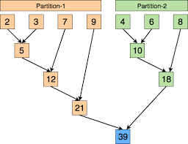
Partitions Enable Parallelism Partitions Run in Parallel

Slide 7
RDD Partitioning Example
Let an RDD to have 800,000,000,000 elements
Let number of partitions to be 40,000
Then each partition have about 20,000,000 elements
40,000 x 20,000,000 = 800,000,000,000
MAXIMUM parallelism is 40,000 tasks at a time

Slide 8
Understanding Basics of Partitioning
Create an RDD and examine the Partitions
>>> rdd = spark.sparkContext.parallelize(range(0,20))
>>> rdd.collect()
[0, 1, 2, 3, 4, 5, 6, 7, 8, 9, 10, 11, 12, 13, 14, 15, 16, 17, 18, 19]
>>> rdd.getNumPartitions()
16

Slide 9
Understanding Basics of Partitioning
Create a function to examine the content of Partition elements
# p denotes a single partition
>>> def debug_partition(p):
>>> print("partition elements=", list(p))
>>> #end-def

Slide 10
Understanding Basics of Partitioning
Examine the content of Partitions
>>> rdd.foreachPartition(debug_partition)
partition elements= [3, 4]
partition elements= [17]
partition elements= [6]
partition elements= [2]
partition elements= [10]
partition elements= [16]
partition elements= [5]
partition elements= [7]
partition elements= [11]
partition elements= [1]
partition elements= [0]
partition elements= [13, 14]
partition elements= [8, 9]
partition elements= [18, 19]
partition elements= [15]
partition elements= [12]

Slide 11
Understanding Basics of Partitioning
RePartition RDD Using RDD.coalesce(numPartitions)
RDD.coalesce(numPartitions):
Return a new RDD that is reduced into numPartitions partitions.
>>> rdd2 = rdd.coalesce(5)
>>> rdd2.getNumPartitions()
5
>>> rdd2.foreachPartition(debug_partition)
partition elements= [11, 12, 13, 14]
partition elements= [15, 16, 17, 18, 19]
partition elements= [0, 1, 2]
partition elements= [3, 4, 5, 6]
partition elements= [7, 8, 9, 10]

Slide 12
Understanding Basics of Partitioning: repartition
RDD.repartition(numPartitions):
Return a new RDD that has exactly numPartitions partitions.
>>> rdd3 = rdd2.repartition(4)
>>> rdd3.foreachPartition(debug_partition)
partition elements= [3, 4, 5, 6]
partition elements= [15, 16, 17, 18, 19]
partition elements= [0, 1, 2]
partition elements= [7, 8, 9, 10, 11, 12, 13, 14]
>>> rdd3.getNumPartitions()
4

Slide 13
References and Further Reading
Spark Partitioning & Partition Understanding
https://sparkbyexamples.com/spark/spark-partitioning-understanding/
Apache Spark Partitioning and Spark Partition
https://techvidvan.com/tutorials/spark-partition/
Data Algorithms with Spark (book)
Author: Mahmoud Parsian

