Slide 1

Introduction to
Mahmoud Parsian
Ph.D. in Computer Science

Slide 2
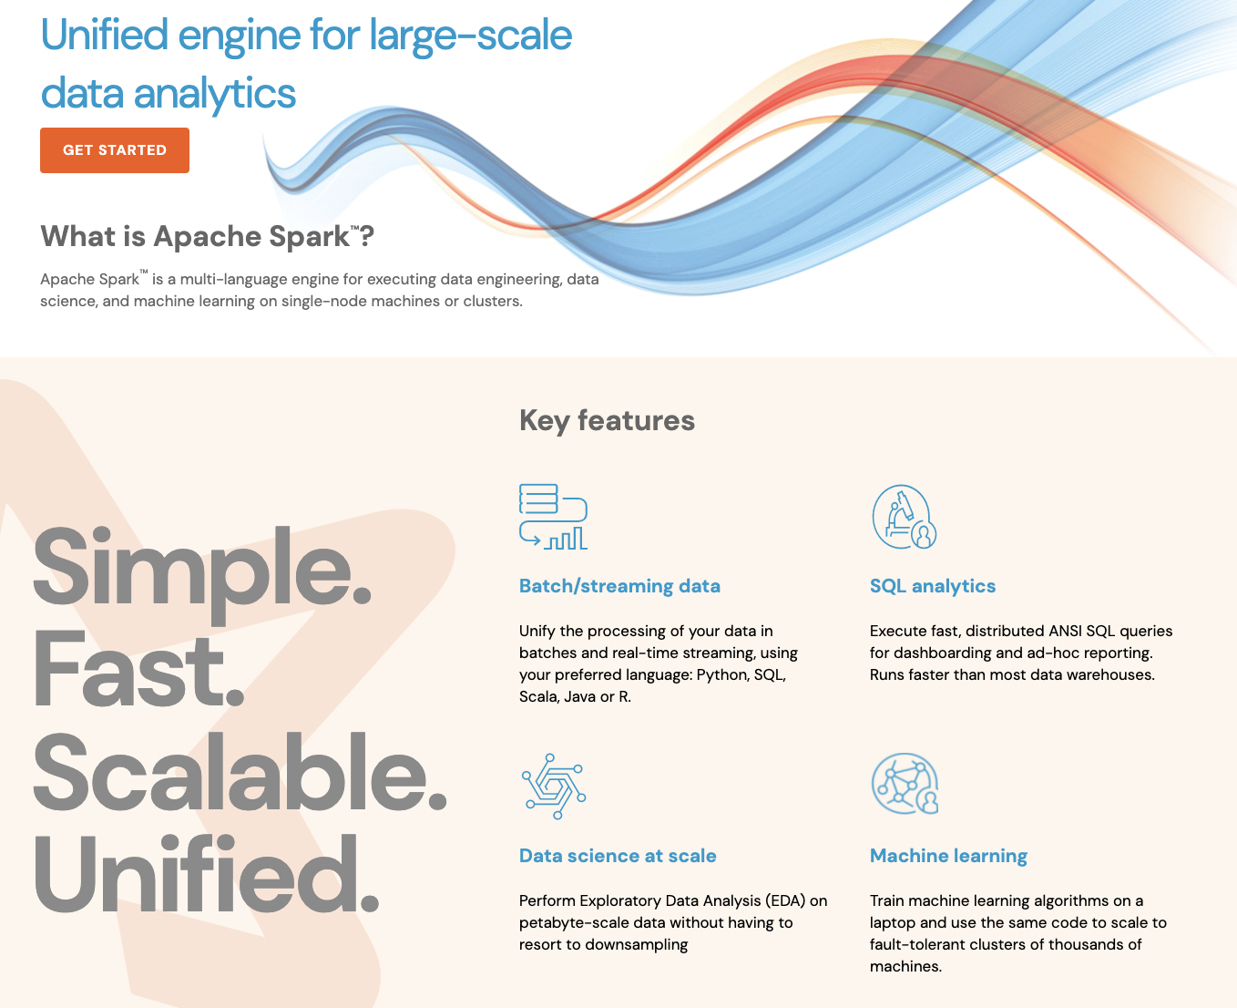
What is

Slide 3
What is
Fast and expressive cluster computing system
Compatible with Hadoop File System
HDFS
S3 (Simple Storage System)
SequenceFile (Binary K-V Files)
Text File
Relational Database Systems

Slide 4
What is
Improves efficiency through in-memory computing:
1 second = 1000 milliseconds
Memory data access: 10 milliseconds
Disk data access: 1000 milliseconds
General computation graphs (DAG)
As much as 100x faster

Slide 5
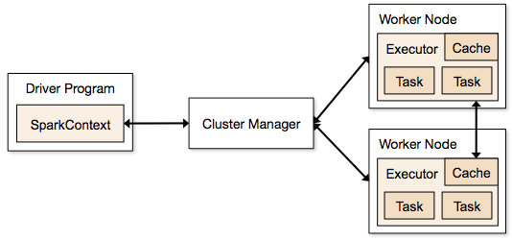
Architecture of

Slide 6
What is
Improves usability by rich API
Scala
Java
Python (simple & expressive API)
PySpark (interactive shell)
SQL
Often 2-10x less code

Slide 7
Language Support
Python
# sc : SparkContext
lines = sc.textFile(...) lines.filter(lambda s: “ERROR” in s).count()
Standalone Programs
Python, Scala, & Java
Interactive Shells
Python & Scala
Performance
Java & Scala are faster due to static typing
…but Python is often fine
Scala
val lines = sc.textFile(...) lines.filter(x => x.contains(“ERROR”)).count()
Java
JavaRDD<String> lines = sc.textFile(...); lines.filter(new Function<String, Boolean>(){ Boolean call(String s) { return s.contains(“ERROR”); } }).count();

Slide 8
Data Abstractions in
RDDs: Resilient Distributed Datasets
Immutable, partitioned collection of objects
Partitioned for distributed and parallel processing
Low-level API
DataFrames
A table of named columns
Partitioned for distributed and parallel processing
High-Level API

Slide 9
Data Abstractions in
RDDs: Resilient Distributed Datasets
Immutable, partitioned collection of objects
Partitioned for distributed and parallel processing
Low-level API
# rdd1 : source RDD
# rdd1 : RDD[String]
# filter() is a transformation
# x refers to an element of rdd1
rdd2 = rdd1.filter(lambda x: len(x) > 80)
# rdd2: target RDD
# rdd2 : RDD[String]

Slide 10
Data Abstractions in
RDDs: Resilient Distributed Datasets
Immutable, partitioned collection of objects
Partitioned for distributed and parallel processing
Low-level API
# rdd1 : RDD[String]
# filter() is a transformation
rdd2 = rdd1.filter(lambda x: len(x) > 80)
# rdd2: target RDD
# rdd2 : RDD[String]
Transformation: source_RDD → target_RDD

Slide 11
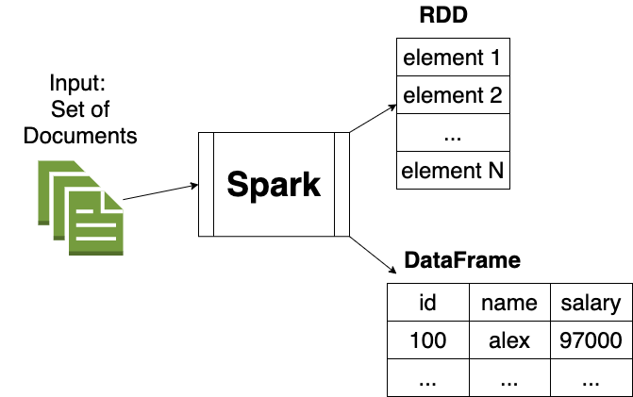
Data Abstractions in

Slide 12
RDDs in
Resilient Distributed Datasets
Immutable, partitioned collection of objects
Basic mechanism for distributed and parallel processing
RDD[String]
RDD[(String, Integer)]
RDD[(String, (Integer, Integer))
RDD[((String, Integer), (Double, Double))]
RDD[(String, String, Integer)]
RDD[(String, Integer, String, Float)]

Slide 13
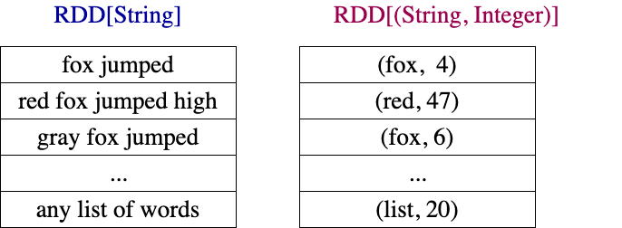
RDDs Examples

Slide 14
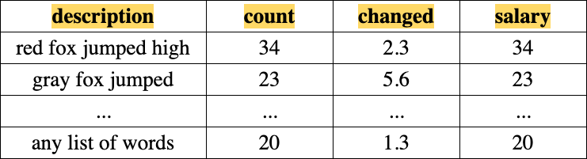
DataFrame Example: with 4 columns and Billions of rows

Slide 15
Operations in
Transformations
map()
flatMap()
mapPartitions()
filter()
reduceByKey()
groupByKey()
T1.join(T2)
…
Actions
count()
collect()
save()
…

Slide 16
Working With RDDs
textFile = sc.textFile(”SomeFile.txt”)
RDD
RDD
Action
RDD
Transformations
RDD
Value
linesWithSpark.count()
74
linesWithSpark.first()
# Apache Spark
linesWithSpark = textFile.filter(lambda line: "Spark” in line)

Slide 17
Key Concepts in Spark
Write programs in terms of transformations on distributed datasets
RDDs & DataFrames
Collections of objects spread across a cluster, stored in RAM or on Disk
Built through parallel transformations
Automatically rebuilt on failure
Operations
Transformations (e.g. map, filter, groupBy)
Actions (e.g. count, collect, save)
Notes:
RDD ➔ Colloquially referred to as RDDs
(e.g. caching in RAM)
Lazy operations to build RDDs from other RDDs
Return a result or write it to storage

Slide 18
DataFrame API
DataFrames evolve Spark’s RDD model, making operations with structured datasets even faster and easier.
# Constructs a DataFrame from a JSON dataset.
users = spark.load("s3n://path/to/users.json", "json")
# Create a new DataFrame that contains “young users” only
young = users.filter(users.age < 21)
# Alternatively, using Pandas-like syntax
young = users[users.age < 21]
# DataFrame's support existing RDD operators
print("Young users: " + young.count())

Slide 19
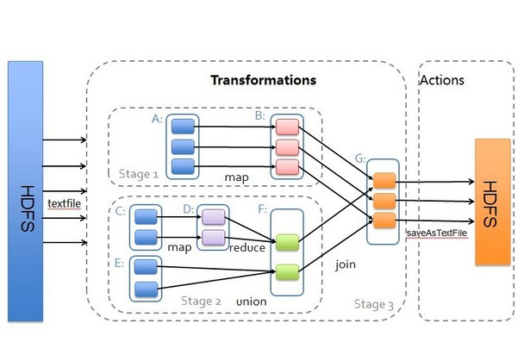
Transformations & Actions

Slide 20

Example: Log Mining
Load error messages from a log into memory, then interactively search for various patterns
Base RDD
Transformed RDD
Cache 1
lines = spark.textFile(“hdfs://...”)
errors = lines.filter(lambda s: s.startswith(“ERROR”))
messages = errors.map(lambda s: s.split(“\t”)[2])
messages.cache()
results
Worker
tasks
Block 1
Driver
Action
messages.filter(lambda s: “mysql” in s).count()
Cache 2
messages.filter(lambda s: “php” in s).count()
Worker
Cache 3
. . .
Full-text search of Wikipedia
60GB on 20 EC2 machine
0.5 sec vs. 20s for on-disk
Worker
Block 2
Block 3
Notes:
Add “variables” to the “functions” in functional programming

Slide 21
Interactive Shell
The Fastest Way to Learn Spark
Available in Python and Scala
Python: PySpark
Scala: Spark-Shell
Runs as an application on an existing Spark Cluster…
OR Can run locally

Slide 22
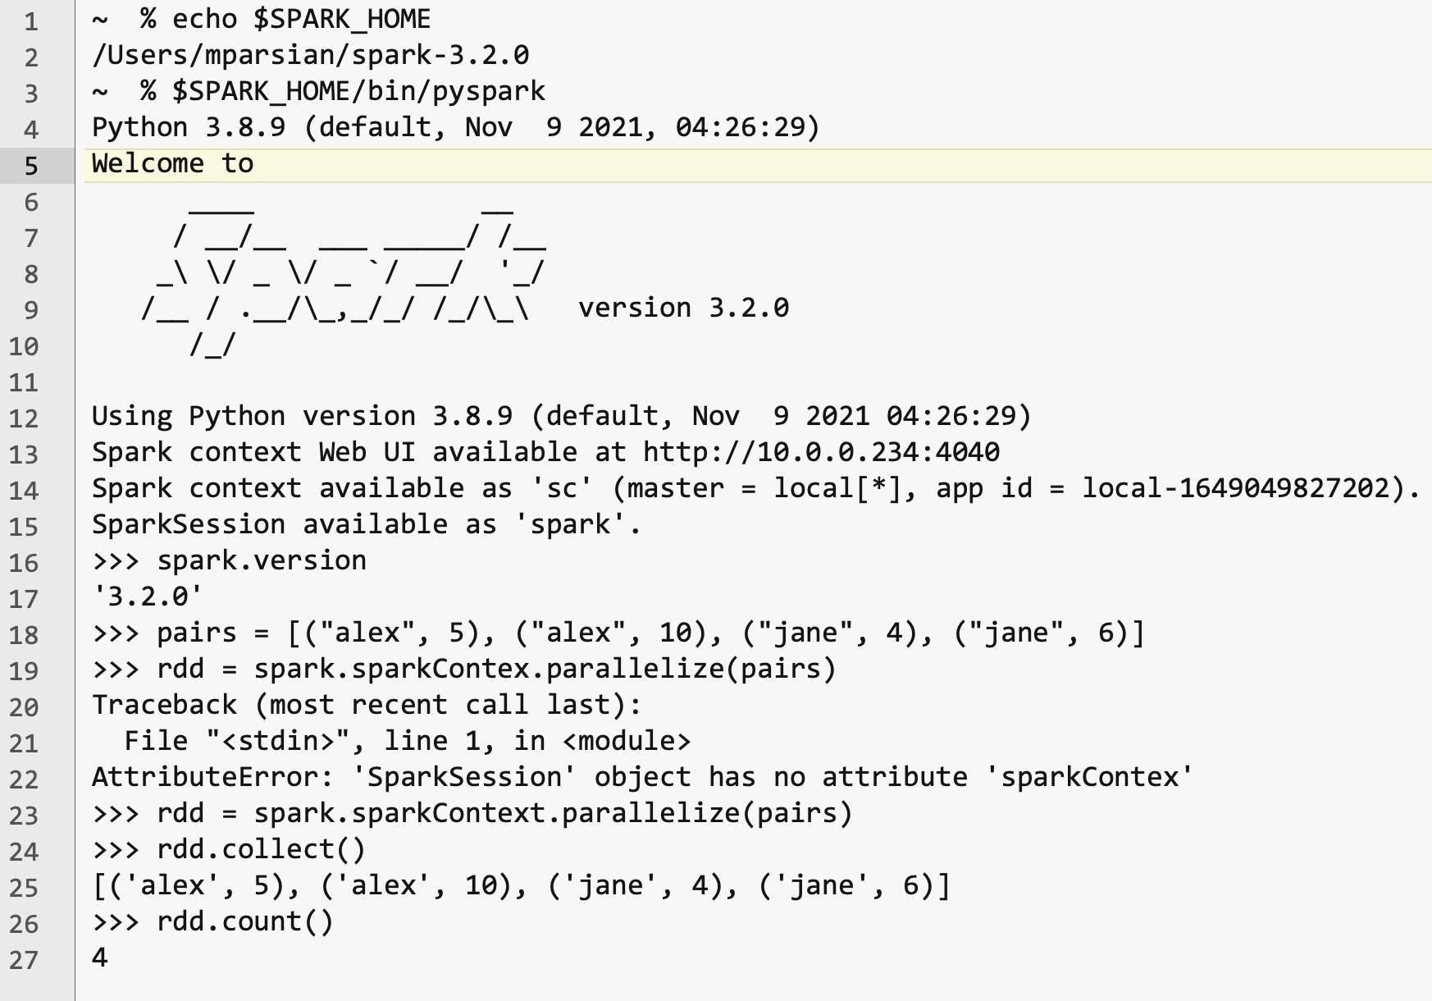
Interactive Shell

Slide 23
PySpark: interactive shell
Write Spark jobs in Python
Run interactive jobs in the shell
$ cat data.txt
fox jumped high
fox is crazy
crazy fox is here
fox is red
$SPARK_HOME/bin/pyspark
>>> # rdd : RDD[String]
>>> rdd = spark.sparkContext.textFile("data.txt")
>>> rdd.collect()
[
'fox jumped high’,
'fox is crazy’,
'crazy fox is here’,
'fox is red’
]

Slide 24
SparkContext (sc)
Main entry point to Spark functionality
Available in shell as variable sc
Use sc for RDDs
# spark : SparkSession
# sc : SparkContext
sc = spark.sparkContext

Slide 25
Creating RDDs
# Turn a Python collection into an RDD
rdd7 = sc.parallelize([1, 2, 3])
# Load text file from local FS, HDFS, or S3
sc.textFile(“file.txt”)
sc.textFile(“directory/*.txt”)
sc.textFile(“hdfs://namenode:9000/path/file”)
# Use existing Hadoop InputFormat (Java/Scala only)
sc.hadoopFile(keyClass, valClass, inputFmt, conf)

Slide 26
Basic Transformations
# nums : RDD[Integer]
nums = sc.parallelize([1, 2, 3])
# Pass each element through a function
# squares : RDD[Integer]
# x refers to an element of nums
squares = nums.map(lambda x: x*x) // {1, 4, 9}
# Keep elements passing a predicate
> # even : RDD[Integer]
even = squares.filter(lambda x: x % 2 == 0) // {4}
Notes:
All lazy

Slide 27
Basic Transformations
# nums : RDD[Integer]
nums = sc.parallelize([1, 2, 3])
# Pass each element through a function
squares = nums.map(lambda x: x*x) // {1, 4, 9}
# Keep elements passing a predicate
even = squares.filter(lambda x: x % 2 == 0) // {4}
# Map each element to zero or more others
nums.flatMap(lambda x: => range(x))
# => {0, 0, 1, 0, 1, 2}
Range object (sequence of numbers 0, 1, …, x-1)
Notes:
All lazy

Slide 28
Basic Actions
nums = sc.parallelize([1, 2, 3])
# Retrieve RDD contents as a local collection
nums.collect() # => [1, 2, 3]
# Return first K elements
nums.take(2) # => [1, 2]
# Count number of elements
nums.count() # => 3
# Merge elements with an associative function
nums.reduce(lambda x, y: x + y) # => 6
# Write elements to a text file
nums.saveAsTextFile(“hdfs://file.txt”)
Notes:
Launch computations

Slide 29
Working with Key-Value Pairs
Spark’s “distributed reduce” transformations operate on RDDs of key-value pairs
Python: pair = (a, b) pair[0] # => a pair[1] # => b
Scala: val pair = (a, b) pair._1 // => a pair._2 // => b
Java: Tuple2 pair = new Tuple2(a, b); pair._1 // => a pair._2 // => b

Slide 30
Some Key-Value Operations
pets = sc.parallelize( [(“cat”, 1), (“dog”, 1), (“cat”, 2)])
pets.reduceByKey(lambda x, y: x + y) # => {(cat, 3), (dog, 1)}
pets.groupByKey() # => {(cat, [1, 2]), (dog, [1])}
pets.sortByKey() # => {(cat, 1), (cat, 2), (dog, 1)}
reduceByKey also automatically implements combiners on the map side

Slide 31
Example: Word Count
lines = sc.textFile(“hamlet.txt”)
counts = lines.flatMap(lambda line: line.split(“ ”)) .map(lambda word => (word, 1)) .reduceByKey(lambda x, y: x + y)
“to” “be” “or”
(to, 1) (be, 1) (or, 1)
(be, 2) (not, 1)
“to be or”
“not” “to” “be”
(not, 1) (to, 1) (be, 1)
(or, 1)
(to, 2)
“not to be”

Slide 32
Word Count in JDK8
JavaSparkContext sc = new JavaSparkContext();
JavaRDD<String> rdd = sc.textFile(inputPath);
// counts = (word: K, frequencey: V)
JavaPairRDD<String, Integer> counts = rdd
.flatMap(x -> Arrays.asList(x.split(" ")))
.mapToPair(x -> new Tuple2<String, Integer>(x, 1))
.reduceByKey((x, y) -> x + y);
counts.saveAsTextFile(outputPath);

Slide 33
Other Key-Value Operations
visits = sc.parallelize([ (“index.html”, “1.2.3.4”), (“about.html”, “3.4.5.6”), (“index.html”, “1.3.3.1”) ])
pageNames = sc.parallelize([ (“index.html”, “Home”), (“about.html”, “About”) ])
visits.join(pageNames) # (“index.html”, (“1.2.3.4”, “Home”)) # (“index.html”, (“1.3.3.1”, “Home”)) # (“about.html”, (“3.4.5.6”, “About”))
visits.cogroup(pageNames) # (“index.html”, ([“1.2.3.4”, “1.3.3.1”], [“Home”])) # (“about.html”, ([“3.4.5.6”], [“About”]))

Slide 34
PageRank Performance
Notes:
54 GB Wikipedia dataset

Slide 35
Other Iterative Algorithms
Time per Iteration (s)
Notes:
100 GB datasets

Slide 36
Conclusion
Spark offers a rich API to make data analytics fast: both fast to write and fast to run
Achieves 100x speedups in real applications
Growing community with 25+ companies contributing

Slide 37
SUMMARY: What is Spark?
Fast and Expressive Cluster Computing System Compatible with Apache Hadoop
Up to 10× faster on disk, 100× in memory
2-5× less code
Efficient
Usable
General execution graphs
In-memory storage
Rich APIs in Java, Scala, Python
Interactive shell
Notes:
Generalize the map/reduce framework

Slide 38
Get Started on Spark
Up and Running in a Few Steps
Download
Unzip
Shell
Project Resources
Examples on the Project Site
Examples in the Distribution
Documentation
http://spark.apache.org

Slide 39
Demo of PySpark

